Slide 1
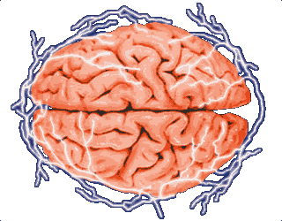
A Randomized, Controlled Trial of Surgery for Temporal-Lobe Epilepsy
Samuel Wiebe, M.D., Warren T. Blume, M.D., John P. Girvin, M.D., Ph.D., Michael Eliasziw, Ph.D., for the Effectiveness and Efficiency of Surgery for Temporal Lobe Epilepsy Study Group
Brian Toy
MS1, UCSF
May 3, 2008

Slide 2
Epilepsy
BACKGROUND
Statistics
Epilepsy and seizures affect over 3 million Americans of all ages (~1% of the population)
Approximately 200,000 new cases of seizures and epilepsy occur each year
Ten percent of the American population will experience a seizure in their lifetime.
Estimated annual price tag of $12.5 billion in direct and indirect costs
http://www.epilepsyfoundation.org/about/statistics.cfm

Slide 3
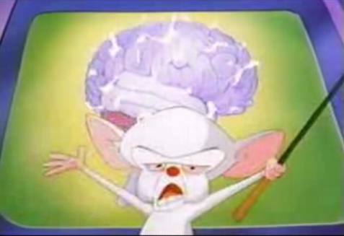
BACKGROUND

Slide 4
Epilepsy
BACKGROUND
Definitions
Epileptic seizure:
  an episode of neurologic dysfunction in which abnormal neuronal firing is manifest clinically by changes in motor control, sensory perception, behavior, and/or autonomic function.
Classification:
  Generalized epilepsy: generalized tonic-clonic seizures, generalized clonic seizures, tonic seizures, myoclonic seizures, atonic seizures
  Partial epilepsy: simple partial seizures, complex partial seizures, secondarily generalized seizures
Stafstrom C, Rho Jong. Pathophysiology of seizures and epilepsy. http://utdol.com/online/content/topic.do?topicKey=epil_eeg/8872

Slide 5

Generalized Epileptic Seizure
BACKGROUND

Slide 6
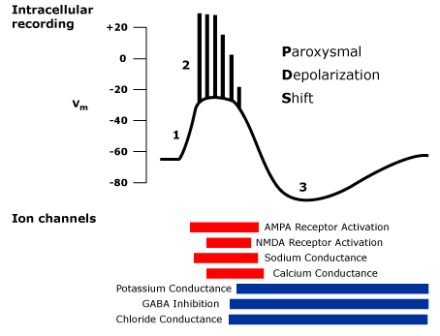
Epilepsy
BACKGROUND
Pathophysiology
Epileptiform bursts
  several million neurons in at least 6mm²
    increased glutamate-mediated currents
Ictal state
  exaggerated synchronization of firing
    gap junctions
    extracellular ion imbalance
    ephaptic effects
Stafstrom C, Rho Jong. Pathophysiology of seizures and epilepsy. http://utdol.com/online/content/topic.do?topicKey=epil_eeg/8872

Slide 7
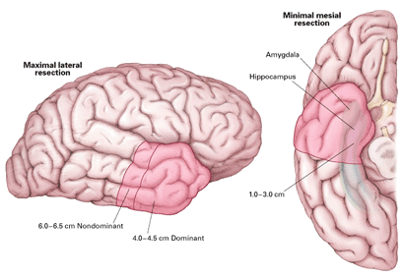
Epilepsy
BACKGROUND
Partial epilepsy
Localization: suggest temporal lobe
  Simple partial seizures
    awareness intact
    epigastric rising sensation
    auditory hallucinations
    anxiety
    déjà vu
  Complex partial seizures
    loss of awareness
    Repetitive, automatic motions (lip smacking, chewing, gesturing)
  Generalized convulsions
Notes:
Add number of patients in general seizure patient population in each categories

Slide 8
Epilepsy
BACKGROUND
Treatment options
Anticonvulsants
  voltage-gated Na⁺-channel blockers: phenytoin, carbamazepine
  modulators of GABA activity: barbiturates, benzodiazepines
Vagus nerve stimulation
  CNS “pacemaker”
Ketogenic diet
Surgical resection
Notes:
Include side effects of drugs, mechanism of action, relate to pathophys
Ablation analogy

Slide 9
Study Design
METHODS
80 patients with suspected MTL epilepsy
randomization*
Surgical Group: 40 patients
Medical Group: 40 patients
preoperative evaluation
2 patients not indicated for surgery
36 patients underwent surgery
2 patients declined surgery
1 yr waitlist with best medical therapy,
re-evaluation of medications q 3 mo
1 yr follow-up with medications,
re-evaluation of medications q 3 mo
preoperative evaluation
*included stratification according to the presence of generalized motor seizures

Slide 10
Preoperative Evaluation
METHODS
Outpatient EEG
MRI Brain
Video EEG
Intracranial EEG (if necessary, placement of subdural electrodes and/or depth electrodes)
Neuropsychological testing
Wada testing
Notes:
Add wada test diagram, explanation

Slide 11
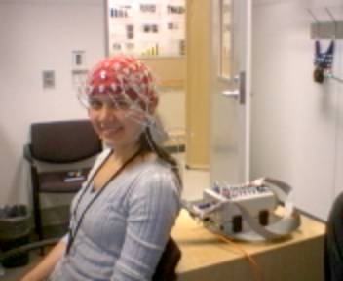
EEG
METHODS

Slide 12
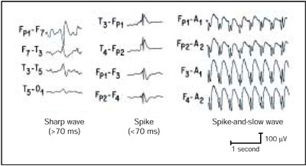
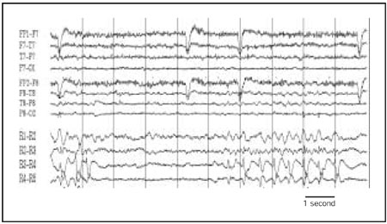
EEG
METHODS
EEG tracings of epileptiform sharp wave, spike, and spike-and-slow wave discharges.
R1-R5 are from a right middle temporal lobe depth electrode (intracranial recording). The depth electrode tracing shows the presence of a train of spike-and-slow wave discharges
Worrell G et al (2002). Mayo Clin Proc. 77:991-998

Slide 13
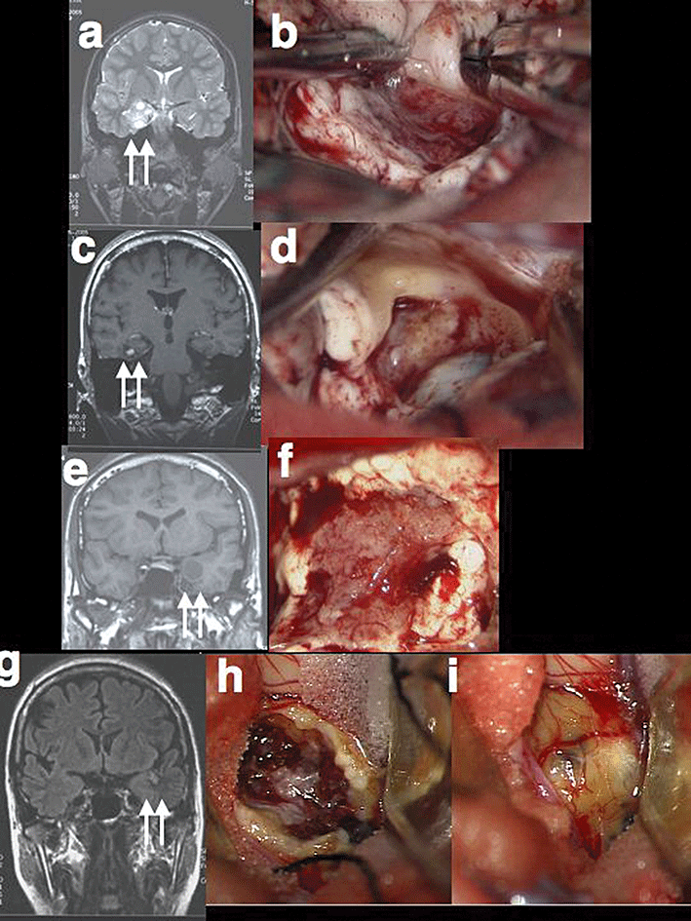
MRI
METHODS
Look for structural defects
  Mesial temporal sclerosis
  Mass lesion (low grade glioma, DNET, ganglioglioma, cavernous malformation)
  Cortical dysplasia
Guide stereotactic surgery
Maehara T (2007). Neuropathology 27(6), 585-593
Notes:
neuroepithelial tumor
ganglioglioma.
pilocytic astrocytoma
cavernous angioma

Slide 14
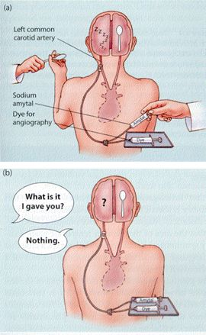
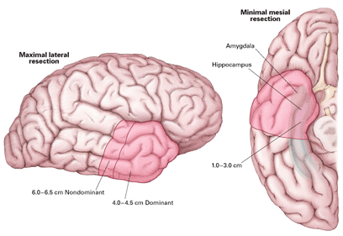
Wada Test
METHODS
Lateralize language and memory dominance
Gazzaniga M, Ivry B, and Mangun G. (2002). Cognitive Neuroscience.

Slide 15
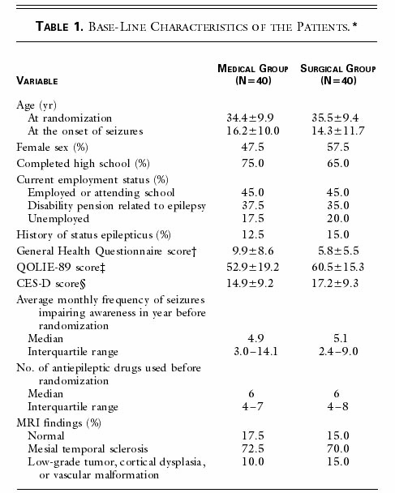
DATA

Slide 16
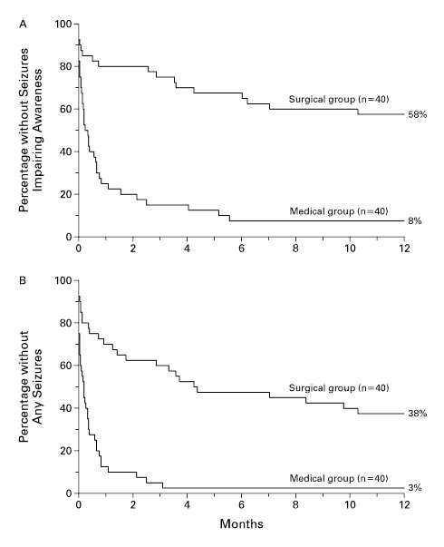
DATA
Kaplan–Meier Event-free Survival Curves
No seizures or simple partial seizures only
P < 0.001
No seizures
P < 0.001

Slide 17
RESULTS
Number Needed to Treat
Definition: number of patients who need to be treated in order to prevent one additional bad outcome
Endpoint: no seizures or only simple partial seizures for one year
  NNT =
  = 1 / (0.58-0.08) = 2
Endpoint = no seizures for one year
  NNT = 1 / (0.38-0.03) = 2.86 ≈ 3
Comparison to other therapies:
atorvastatin to prevent cardiovascular events for 3.3 years | 99.7
CABG to prevent recurrence of CVD for 4.9 years | 113
carotid endarterectomy to prevent disabling stroke or death for 5 years | 19
cataract surgery to prevent difficulty reading normal print for 6 months | 4
radioiodine and prednisone to prevent Graves’ ophthalmopathy for 1 year | 7
metformin to prevent death from diabetes for 10 years | 10
enoxaparin to prevent DVT or PE for 8 days | 7

Slide 18
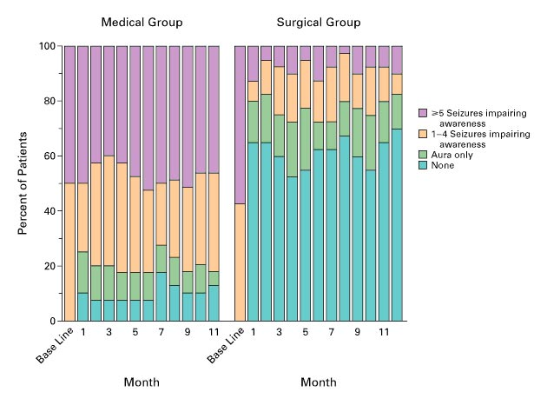
DATA
Monthly Rates of Seizures
P < 0.001 for median percentage improvement in monthly frequency of seizures

Slide 19
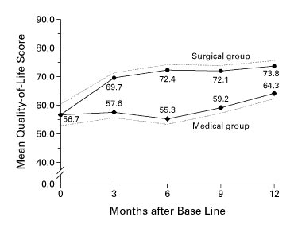
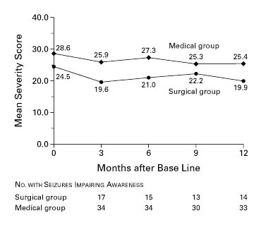
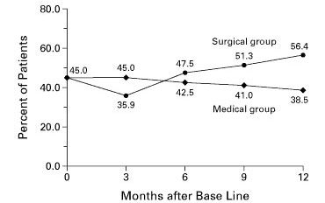
DATA
Mean Severity of Seizures Impairing Awareness
Mean Global Quality of Life Score
Difference between groups not significant
P < 0.001 between groups
P = 0.003 over time in both groups
Percentage of Patients Employed or Attending School
P = 0.11

Slide 20
Conclusions
DISCUSSION
In temporal lobe epilepsy, surgery is superior to prolonged medical therapy.
Randomized trials for epilepsy are feasible and appear to yield precise estimates of treatment effects.

Slide 21
Caveats / Future Directions
DISCUSSION
Surgical adverse events:
  substantial postoperative difficulties with memory: 5%
  hemiparesis: 0% (expected 2-5%)
Medical group adverse events:
  sudden, unexplained death (1/40): SUDEP?
Surgical timing
  early surgery vs. medical therapy/delayed surgery
  identification of medically refractory epilepsy (Kwan P and Brodie M. (2000). Early identification of refractory epilepsy, NEJM 342(5):314-319).
  30% of epilepsy patients do not respond to medical therapy (Mohanraj R and Brodie MJ. Diagnosing refractory epilepsy: response to sequential treatment schedules, Eur J Neurol 13 (2006), pp. 277–282)
  There is a 20-year delay between the diagnosis of epilepsy and surgical treatment. (Hakimi A et al. A survey of neurologists' views on epilepsy surgery and medically refractory epilepsy, Epilepsy & BehaviorIn Press, Available online 11 March 2008)

Slide 22
Thanks!
Professor Tina Shih, MD
Professor Andy Josephson, MD
Jenny Jin and Julie Wu

