Slide 1
Figure 1
72,362 articles
Excluding editorials, comments, letters, news, and retractions
55,085 articles
Pull authors from articles
261,572 authors
Algorithmic author sex determination
257,328 authors
Identify unique authors
71,345 unique authors
23,639 female authors
47,706 male authors

Slide 2
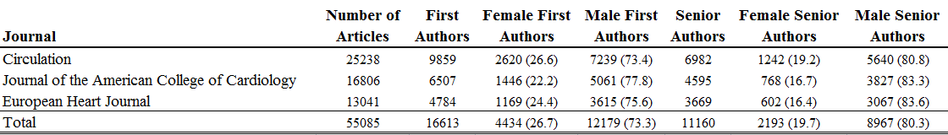
Table 1

Slide 3
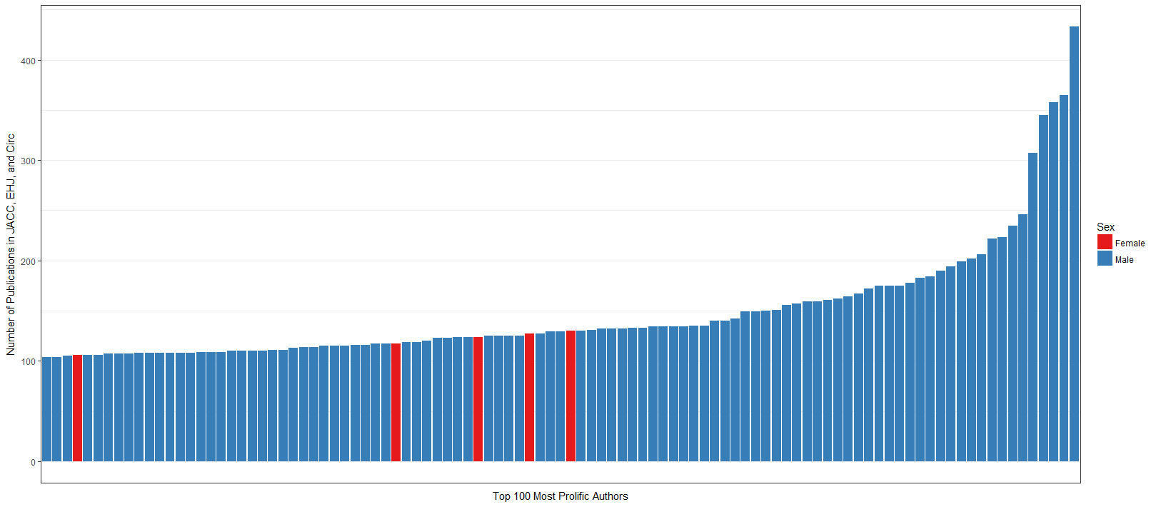
Figure 2

Slide 4
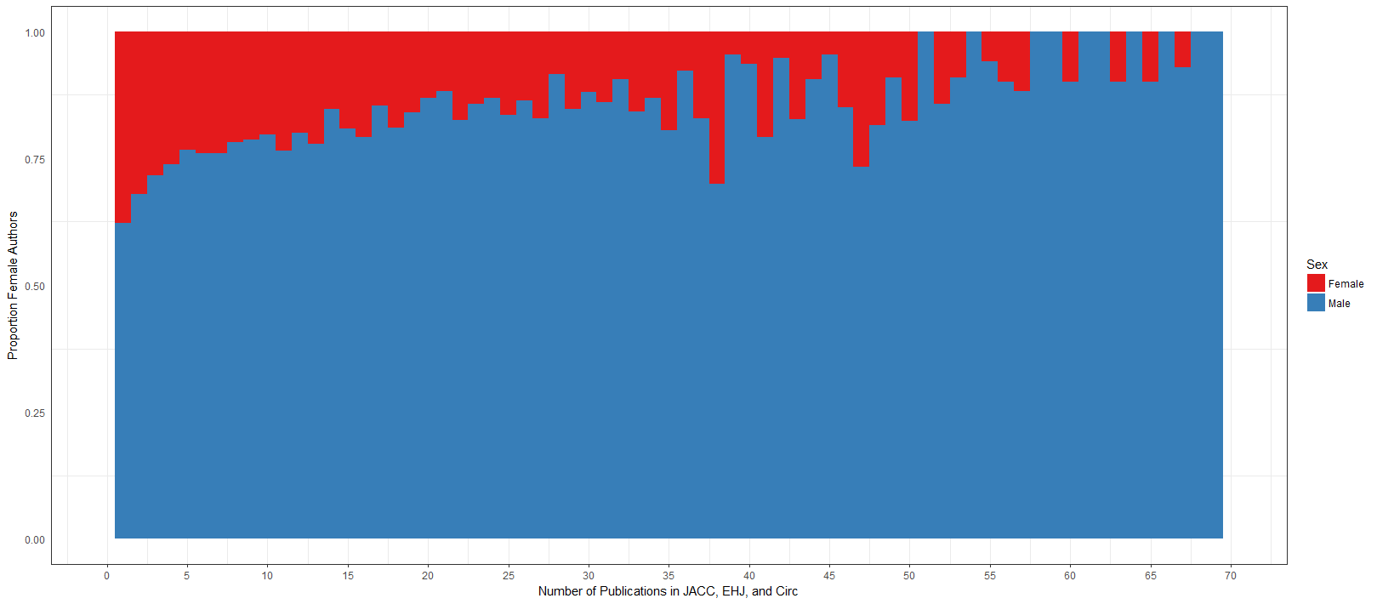
Figure 3

Slide 5
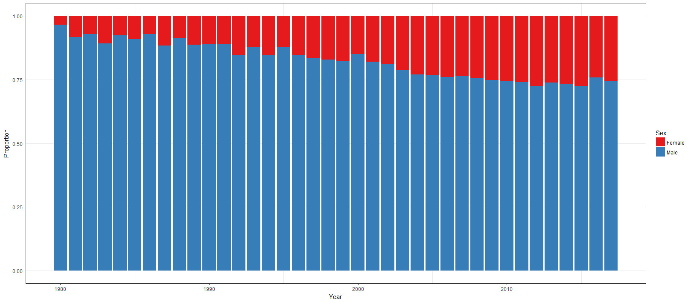
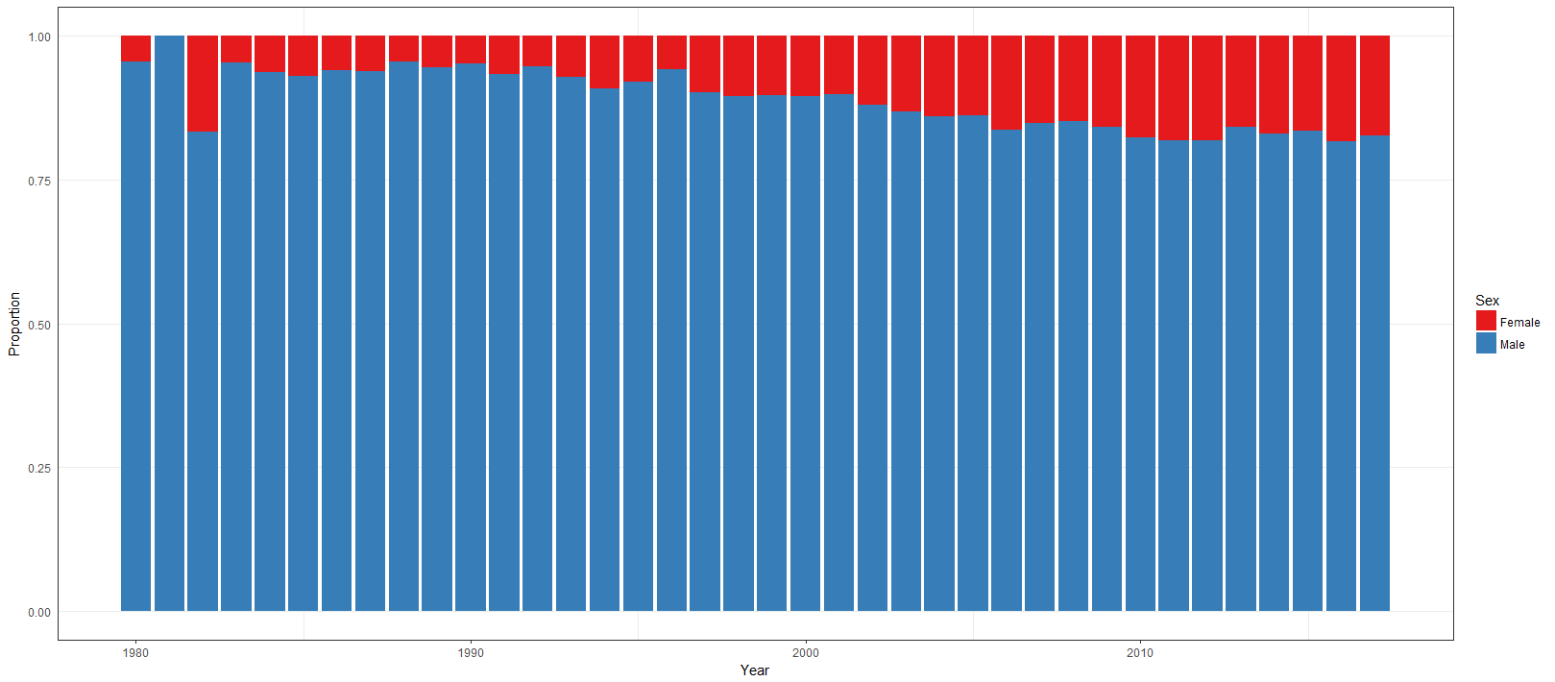
Figure 4
First Author
Senior Author

