Slide 1

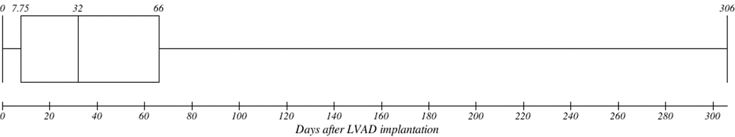
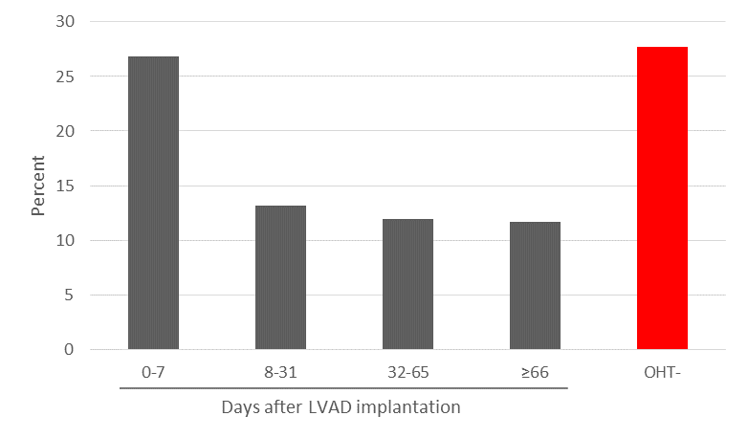
Impact of wait times for cardiac transplantation on outcomes after implantation of left ventricular assist devices
Impact of wait times for cardiac transplantation on outcomes after implantation of left ventricular assist devices
David Ouyang MD^{1,2,3}, Gunsagar Gulati^{1,2,3}, Dipanjan Banerjee MD MS¹
¹Stanford University Department of Medicine, Stanford, CA 94305, USA; ² VA Palo Alto Health Care System, Palo Alto, CA 94305 ³ These authors contributed equally to this work
David Ouyang MD^{1,2,3}, Gunsagar Gulati^{1,2,3}, Dipanjan Banerjee MD MS¹
¹Stanford University Department of Medicine, Stanford, CA 94305, USA; ² VA Palo Alto Health Care System, Palo Alto, CA 94305, ³These authors contributed equally to this work
Background
Baseline demographics
Timing of OHT after LVAD implantation
Conclusions
The optimal timing for orthotopic heart transplantation (OHT) after the implantation of left ventricular assist devices (LVAD) is unknown. In determining the optimal time for OHT after LVAD, the need for clinical stability and time to recover from major surgery is balanced by the risk of LVAD complications and the formation of adhesions and scarring. Some have argued that performing OHT early after LVAD placement poses an increased risk of morbidity and mortality to patients.
Table 1. Baseline demographics of all LVAD patients, LVAD patients who underwent invasive hemodynamic monitoring, and LVAD patients who received orthotopic heart transplant (OHT)
 | LVAD (n = 2200) | Swan-Ganz+ (n = 403) | OHT+ (n = 164)
Mortality, n (%) | 590 (26.5) | 86 (19.9) | 26 (15.9)
Length of stay, mean ± SD | 40.5 ± 38.9 | 45.4 ± 38.2 | 82.8 ± 59.3
Age, mean ± SD | 53.4 ± 13.7 | 53.4 ± 13.7 | 48.2 ± 13.5
Sex, n (%)
Male | 1659 (75.4) | 81 (20.1) | 134 (81.7)
Female | 541 (24.6) | 322 (79.9) | 30 (18.3)
Race, n (%)
White | 1274 (57.9) | 218 (54.1) | 89 (54.3)
Black | 352 (16.0) | 80 (19.9) | 22 (13.4)
Hispanic | 142 (6.5) | 33 (8.2) | 17 (10.4)
Asian/Pacific Islander | 51 (2.3) | 13 (3.2) | 7 (4.3)
Native American | 5 (0.2) | 0 (0.0) | 0 (0.0)
Otherǂ or unknown* | 376 (17.1) | 59 (14.6) | 29 (17.7)
Median household income, n (%)
$1-24,999 | 475 (21.6) | 98 (24.3) | 28 (17.1)
$25,000-34,999 | 491 (22.3) | 89 (22.1) | 37 (22.6)
$35,000-44,999 | 552 (25.1) | 90 (22.3) | 43 (26.2)
$45,000 or more | 631 (28.7) | 115 (28.5) | 52 (31.7)
Unknown* | 51 (2.3) | 11 (2.7) | 4 (2.4)
Comorbidities
Diabetes | 392 (17.8) | 65 (16.1) | 19 (11.6)
Hyperlipidemia | 310 (14.1) | 63 (15.6) | 13 (7.9)
Hypertension | 301 (13.7) | 44 (10.9) | 10 (6.1)
History of smoking | 144 (6.5) | 33 (8.2) | 7 (4.3)
BMI ≥ 30 kg/m² | 96 (4.4) | 17 (4.2) | 0 (0.0)
Number of comorbid diagnosis, mean ± SD | 12.7 ± 2.9 | 13.6 ± 2.5 | 12.3 ± 3.1
Year of hospitalization, n (%)
1998 | 18 (0.8) | 1 (0.2) | 5 (3.0)
1999 | 41 (1.9) | 10 (2.5) | 7 (4.3)
2000 | 71 (3.2) | 9 (2.2) | 9 (5.5)
2001 | 108 (4.9) | 14 (3.5) | 25 (15.2)
2002 | 93 (4.2) | 4 (1.0) | 16 (9.8)
2003 | 99 (4.5) | 13 (3.2) | 9 (5.5)
2004 | 80 (3.6) | 8 (2.0) | 13 (7.9)
2005 | 79 (3.6) | 14 (3.5) | 18 (11.0)
2006 | 131 (6.0) | 26 (6.5) | 9 (5.5)
2007 | 119 (5.4) | 19 (4.7) | 12 (7.3)
2008 | 209 (9.5) | 42 (10.4) | 14 (8.5)
2009 | 253 (11.5) | 55 (13.6) | 12 (7.3)
2010 | 427 (19.4) | 72 (17.9) | 8 (4.9)
2011 | 472 (21.5) | 116 (28.8) | 7 (4.3)
Location of hospital, n (%)
Rural | 17 (0.8) | 0 (0.0) | 0 (0.0)
Urban | 2181 (99.1) | 402 (99.8) | 164 (100.0)
Urban | 2 (0.1) | 1 (0.2) | 0 (0.0)
Bedsize of hospital, n (%)
Small | 38 (1.7) | 1 (0.2) | 6 (3.7)
Medium | 229 (10.4) | 49 (12.2) | 18 (11.0)
Large | 1931 (87.8) | 352 (87.3) | 140 (85.4)
Unknown* | 2 (0.1) | 1 (0.2) | 0 (0.0)
Teaching status of hospital, n (%)
Nonteaching | 165 (7.5) | 33 (8.2) | 5 (3.0)
Teaching | 2033 (92.4) | 369 (91.6) | 159 (97.0)
Unknown* | 2 (0.1) | 1 (0.2) | 0 (0.0)
Number of LVAD implantations have significantly increased from 1998 to 2011
Percent in-hospital mortality of LVAD patients significantly decreased from 2007 to 2011
In-hospital mortality is decreased for patients who undergo OHT greater than 8 days after LVAD implantation compared to both patients who do not receive OHT (12.2% vs 27.0%) and patients who undergo OHT within 1 week of LVAD implantation (12.2% vs 26.8%)
Acute renal failure, reoperation, postoperative bleeding, and acute respiratory failure are among the most frequent in-hospital complications in LVAD patients with or without OHT. Reoperation is more frequent in LVAD patients receiving OHT than in LVAD patients without OHT.
Patients with invasive hemodynamic monitoring have increased in-hospital survival (80.1% vs 71.9%) despite longer hospitalizations and longer time to LVAD implantation during the hospitalization (data not shown)
Figure 2: Box-and-Whisker plot of wait time for OHT after LVAD implantation. Of the 2200 patients who underwent LVAD implantation, 164 (7.5%) patients also underwent orthologous heart transplant during the same hospitalization (Table 1). OHT occurred a median of 32 days (IQR 7.75 to 66 days) after LVAD implantation
Methods
Data Source: The Nationwide Inpatient Sample (NIS), from the Healthcare Cost and Utilization Project, Agency for Healthcare Research and Quality, is the largest database of all-payer inpatient discharge information, sampling approximately 20% of all non-federal US hospitals and including approximately 9 million hospital admissions each year. It contains discharge data from over 5000 hospitals located across 45 states, of which approximately 1,200 hospitals are sampled each year to create a stratified sample of United States hospitals. Each NIS entry includes all diagnosis and procedure codes of activity during the patient’s hospitalization at the time of discharge, as well as patient demographics, hospital characteristics, and short-term complications of the hospitalization.
Study design and Cohorts: This was a retrospective cross-sectional study using the Nationwide Inpatient Sample (NIS) between 1988 and 2011. We identified all hospitalizations from 1988 to 2011 of patients 18 years of age or greater that underwent placement of a left ventricular assist device and for which the hospital day of each procedure was available. Procedures during the hospitalization in addition to LVAD placement, including orthologous heart transplant, extracorporeal membrane oxygenation, intubation, hemodialysis, invasive hemodynamic monitoring, and surgical revision were identified by associated ICD9 codes. Additionally, hospital mortality and perioperative morbidity such as post-operative infections, cardiopulmonary complications, and hemorrhagic complications requiring endoscopy were identified.
Future Directions
Figure 3. Comparison of percent mortality in hospitalized patients by wait time for OHT after LVAD implantation and no OHT after LVAD implantation. Of the 164 patients who underwent OHT, increased in-hospital mortality was identified in patients who underwent transplantation within 7 days of LVAD implantation compared to patients who underwent transplant after 8 days (26.8% vs. 12.2%, p = 0.0483). There was no statistically significant difference in patient demographics with regards to age, sex, race, household income, or number of comorbid diagnoses. Compared to patients who underwent LVAD implantation but did not undergo OHT, patients who underwent late OHT after LVAD had decreased mortality (12.2% vs. 27.0% p < 0.001). Patients who underwent early transplant after LVAD did not show a similar mortality benefit (26.8% vs. 27.0%, p = 0.946).
Our analysis of LVAD implantation, hemodynamic monitoring, and OHT can help inform decisions on the appropriate use and timing of these procedures. With significant variation in institutional best practices, use of national registries and databases can help clarify differences in outcomes based on various practice features. For outcomes of rare procedures or complicated clinical scenarios, such retrospective cohort studies are the only way to identify trends in practice.
Citations
In-hospital mortality of LVAD patients (1998-2011)
In-hospital complications of OHT after LVAD
Bui, Anh L., Tamara B. Horwich, and Gregg C. Fonarow. "Epidemiology and risk profile of heart failure." Nature Reviews Cardiology 8.1 (2011): 30-41.
Lloyd-Jones, Donald, et al. "Heart disease and stroke statistics—2010 update A report from the American Heart Association." Circulation 121.7 (2010): e46-e215.
Blecker, Saul, et al. "Heart failure–associated hospitalizations in the United States." Journal of the American College of Cardiology 61.12 (2013): 1259-1267.
Heidenreich, Paul A., et al. "Forecasting the impact of heart failure in the United States a policy statement from the American Heart Association."Circulation: Heart Failure 6.3 (2013): 606-619.
Friedrich, Erik B., and Michael Böhm. "Management of end stage heart failure."Heart 93.5 (2007): 626-631.
Fanaroff, Alexander C., et al. "Patient Selection for Advanced Heart Failure Therapy Referral." Critical pathways in cardiology 13.1 (2014): 1.
Carabello, Blase A. "Contemporary Reviews in Cardiovascular Medicine."Circulation 112 (2005): 432-437.
Taylor, David O., et al. "Registry of the International Society for Heart and Lung Transplantation: twenty-sixth official adult heart transplant report—2009." The Journal of Heart and Lung Transplantation 28.10 (2009): 1007-1022.
Rose, Eric A., et al. "Long-term use of a left ventricular assist device for end-stage heart failure." New England Journal of Medicine 345.20 (2001): 1435-1443.
Takeda, Koji, et al. "Outcome of cardiac transplantation in patients requiring prolonged continuous-flow left ventricular assist device support." The Journal of Heart and Lung Transplantation 34.1 (2015): 89-99.
McIlvennan, Colleen K., et al. "Clinical outcomes following continuous-flow left ventricular assist device: a systematic review." Circulation: Heart Failure(2014): CIRCHEARTFAILURE-114
Nativi, Jose N., et al. "Changing outcomes in patients bridged to heart transplantation with continuous-versus pulsatile-flow ventricular assist devices: an analysis of the registry of the International Society for Heart and Lung Transplantation." The Journal of Heart and Lung Transplantation 30.8 (2011): 854-861.
John, Ranjit, et al. "Improved survival and decreasing incidence of adverse events with the HeartMate II left ventricular assist device as bridge-to-transplant therapy." The Annals of thoracic surgery 86.4 (2008): 1227-1235.
Deo, Salil V., et al. "Cardiac transplantation after bridged therapy with continuous flow left ventricular assist devices." Heart, Lung and Circulation23.3 (2014): 224-228.
Lietz, Katherine, et al. "Outcomes of left ventricular assist device implantation as destination therapy in the post-rematch era implications for patient selection." Circulation 116.5 (2007): 497-505.
El-Hamamsy, Ismaïl, et al. "Successful explantation of a left ventricular assist device following acute fulminant myocarditis." Canadian Journal of Cardiology22.6 (2006): 507-508.
Chen, Jonathan M., et al. "Improved survival rates support left ventricular assist device implantation early after myocardial infarction." Journal of the American College of Cardiology 33.7 (1999): 1903-1908.
Complications in hospitalized patients with or without same-admission Orthostatic Heart Transplant (OHT) after Left Ventricular Assist Device (LVAD)
 | OHT+ (n = 164) | OHT- (n = 2036) | Total (n = 2200)
Acute renal failure | 88 (53.7) | 963 (47.3) | 1051 (47.8)
Reoperation | 115 (70.1) | 803 (39.4) | 918 (41.7)
Postoperative bleeding | 29 (17.7) | 570 (28.0) | 599 (27.2)
Acute respiratory failure | 45 (27.4) | 518 (25.4) | 563 (25.6)
Sepsis | 19 (11.6) | 233 (11.4) | 252 (11.5)
Postoperative cardiac complication | 20 (12.2) | 226 (11.1) | 246 (11.2)
Acute liver failure | 12 (7.3) | 223 (11.0) | 235 (10.7)
Device failure | 4 (2.4) | 62 (3.0) | 66 (3.0)
Stroke | 2 (1.2) | 53 (2.6) | 55 (2.5)
ICD-9 Codes
Diagnosis/Procedure | ICD9 Code(s)
Left ventricular assist device | 3766
Orthostatic heart transplant | 3751, 375
Swan-Ganz catheterization | 8964
Diabetes | 25000-25099
Disorders of lipoid metabolism | 2720-2729
Hypertension | 4010-4019
History of or current use of tobacco | V1582, 3051
BMI ≥ 30 kg/m² | 27800, 27801
Reoperation | 3403, 3764, 3479, 341, 3749
Sepsis | 99591, 99592
Acute respiratory failure | 51881
Postoperative cardiac complication | 9971, 4294
Acute renal failure | 5845-5849
Postoperative bleeding | 4513, 4523, 9904, 9905, 9907, 9909
Stroke | 43491
Acute liver failure | 570
Device failure | 99609
Figure 1. Trends in in-hospital mortality among LVAD patients from 1998 to 2011 Percent mortality for each year was calculated as number of deaths by total number of LVAD patients. Overall in-hospital mortality remained stable between 1998 and 2006 (r^ 2 = 0.1403, trend p-value = 0.9042) and linearly decreased between 2007 and 2011 (r^2 = 0.7648, trend p value = 0.033)
Table 4. Acute renal failure, reoperation, postoperative bleeding, and acute respiratory failure are among the most frequent in-hospital complications in LVAD patients with or without OHT. Reoperation is more frequent in LVAD patients receiving OHT than in LVAD patients without OHT. Repeat LVAD surgeries suggest significant surgical complications, with significant excess mortality in patients who received two LVADs (56.7%) and three LVADs (100.0%).
Disclosures
DO and GG has nothing to disclose. DB’s research is funded in part by grants from HeartWare and Thoratec.

