Slide 1
SKILLRADAR MY
LUMINA NUSANTARA
SDC 2026 · DOMAIN 1 — THE AIVERSECITY FUTURE-READY WORKFORCE DOMAIN
From who I am today
to where I can be in the AI era.
Explainable role matching · versioned labour-market signals · personalised reskilling pathways
TEAM LUMINA NUSANTARA
XIAMEN UNIVERSITY MALAYSIA
SDG 4 · TARGETS 4.4 / 8.5
Preliminary-round deck · Live demo on Streamlit Community Cloud

Slide 2
· SDC 2026 · SKILLRADAR MY
01
Problem
The training gap is widening
Contents
WHAT'S INSIDE
02
Who we build for
Four personas, one question
03
Our solution
Four steps to a new role
An AI-assisted reskilling navigator built on the UN Sustainable Development Goals — led by SDG 4, Quality Education.
04
Key features
The six must-haves, delivered
05
Explainable scoring
Five inputs, fully auditable
06
Technical design
Signals in, pathways out
07
SDG impact & demo
Intended contribution, live proof
SkillRadar MY · Lumina Nusantara · SDC 2026
02 / 12

Slide 3
01 · PROBLEM · BACKGROUND
AI is changing roles faster than training systems can update
56%
600k+
of Malaysian professionals already use AI tools at work
Malaysian workers are expected to need reskilling within the next 3–5 years
yet only
26%
— Ministry of Science, Technology & Innovation (MOSTI)
have received any formal AI training
The reskilling window is closing: skill frameworks haven't caught up, and job requirements have already moved.
A 30-point gap between tool adoption and capability — most people are improvising with AI, unguided.
Sources: Hays Asia Salary Guide 2025; MOSTI public statement (2025).
SkillRadar MY · Lumina Nusantara · SDC 2026
03 / 12

Slide 4
01 · PROBLEM · BACKGROUND
Three gaps keep people stuck in place
1
2
3
Workers can't see the way forward
Employers can't see the gap
Training providers ship stale maps
They don't know which AI skills are worth learning, or whether their own role is rising or declining.
HR can't translate AI headlines into a training plan — team reskilling lacks a data basis.
Learning pathways are static lists; by the time a course launches, demand has moved.
A one-off skills assessment is not enough — people need a system that keeps evolving as the market does.
SkillRadar MY · Lumina Nusantara · SDC 2026
04 / 12

Slide 5
02 · WHO WE BUILD FOR
Built for everyone the AI shift touches
Four personas, one shared question — “what should I learn next?” The live demo opens with this exact choice.
Jobseeker / worker at risk
Graduate & career switcher
“Will my role disappear? Where do I go next — and what do I learn to get there?”
“Show me the direction before I bet my career start on a shrinking track.”
WORKER FLOW: QUESTIONNAIRE + CV UPLOAD
GRADUATE STUDY-FIELD FILTERING
HR & talent development
TVET & career centres
“Give me a team-level skills-gap view I can actually plan training around.”
“Back career advice with live data, not an outdated handbook.”
HR FLOW: ROSTER → GAP HEATMAP & PLAN
CAREER-CENTRE FLOW: CURRICULUM COVERAGE
SkillRadar MY · Lumina Nusantara · SDC 2026
05 / 12

Slide 6
03 · OUR SOLUTION
One web app, four steps from here to your next role
01
02
03
04
Tell us who you are
See the market evidence
Get matched roles
Follow your pathway
→
→
→
Upload a CV or answer a 3-minute questionnaire — get a structured skills profile.
A versioned trend layer of dated, linked sources: job offerings, named-skill signals, global forecasts.
Future roles ranked by an explainable score, with your skill gaps spelled out.
An ordered learning plan with weekly steps, free or low-cost resources and SDG tags.
Design principles — every recommendation is explainable and source-traceable; forecasts come as scenarios and are labelled as estimates. The judgement stays with the person, not the algorithm.
SkillRadar MY · Lumina Nusantara · SDC 2026
06 / 12

Slide 7
04 · KEY FEATURES
The six must-haves — all running in the live demo
✓
Skills profile intake
✓
AI-trend signal layer
✓
Future-role matching
Questionnaire + synthetic CV parsing into a shared 54-skill taxonomy.
Dated, linked snapshots: DOSM job offerings, JobStreet–Randstad 2025, WEF 2025 — uploaded snapshots re-rank the current profile.
Explainable score decomposed into five auditable inputs.
✓
Personalised pathway
✓
SDG mapping
✓
Uncertainty handled
Ordered weekly steps toward free / low-cost courses; 60 course links covering all 54 skills.
Role-level SDG tags plus a skill-to-target crosswalk, labelled as the team's own reading.
Moderate vs fast disruption scenarios; every forecast marked as an estimate.
Beyond the checklist: HR team gap heatmap · evidence-source robustness check · trilingual EN / BM / 中文 · low-bandwidth friendly.
SkillRadar MY · Lumina Nusantara · SDC 2026
07 / 12

Slide 8
05 · EXPLAINABLE SCORING
One score, five inputs — auditable to the source
THE MODEL (AS SHIPPED IN THE DEMO)
BUSINESS OPERATIONS ASSOCIATE
64.0
score = 0.30 · skill coverage
+ 0.25 · role focus
+ 0.15 · transferability + 0.15 · demand trend
+ 0.15 · (1 − gap cost)
Actual demo output · synthetic profile
MATCH SCORE / 100
Skill coverage
84%
Role focus
50%
Fast-disruption scenario re-weights toward trend (0.35) and penalises flat or declining roles — the toggle is visible in the demo.
Transferability
50%
Every input opens in the UI
Each skill signal carries its source name, publish date and retrieval date. Scores are prototype estimates — never hiring probabilities.
Demand trend
70%
Gap cost · lower is better
45%
SkillRadar MY · Lumina Nusantara · SDC 2026
08 / 12

Slide 9
06 · TECHNICAL DESIGN
Signals in, pathways out — four honest layers
STREAMLIT WEB APP
Trilingual EN / BM / 中文 UI · worker, graduate, HR and career-centre flows · low-bandwidth friendly
DETERMINISTIC ENGINE
Pure-Python scoring, pathway & SDG modules — no external AI service on the request path · 52 automated tests
CURATED CATALOGUES
Role & skill catalogue · 60 linked course records · skill-to-SDG crosswalk, all versioned in JSON
TREND SIGNAL SNAPSHOTS
DOSM online job offerings 2026 Q1/Q2 · JobStreet–Randstad 2025 skill signals · WEF Future of Jobs 2025 · validated manual import, source + date shown · in-app reviewed snapshot re-ranks in-session
IN THE DEMO TODAY
ON THE ROADMAP
Rule-based explainable scoring · scenario toggle · evidence-source robustness check · HR heatmap · trilingual UI · tested data-import pipeline.
LLM / vector semantic CV parsing · automated trend scraping · verified course durations & fees · fairness audits across age, gender and background.
SkillRadar MY · Lumina Nusantara · SDC 2026
09 / 12

Slide 10
07 · SDG IMPACT · INTENDED CONTRIBUTION
Every pathway points at the Goals — led by SDG 4
Primary track: SDG 4 Quality Education (Target 4.4), with SDG 8.5 on decent work. Framed as intended contribution — impact indicators are still to be validated.
SDG 4 · Quality Education
SDG 8 · Decent Work & Growth
SDG 5 · Gender Equality
SDG 10 · Reduced Inequalities
Reskilling pathways built from free and low-cost resources — education that reaches working adults, not just students.
Helping workers transition into AI-era roles with their employability and dignity intact (intended outcome, to be measured).
Recommendations must not systematically differ by gender or age — fairness checks are on the roadmap.
Trilingual, low-bandwidth design so urban and rural learners use the same tool.
Honest mapping: the skill-to-target crosswalk is the team's own reading of the 2030 Agenda — it is shown in-app and labelled as such, not claimed as an official UN correspondence.
SkillRadar MY · Lumina Nusantara · SDC 2026
10 / 12

Slide 11
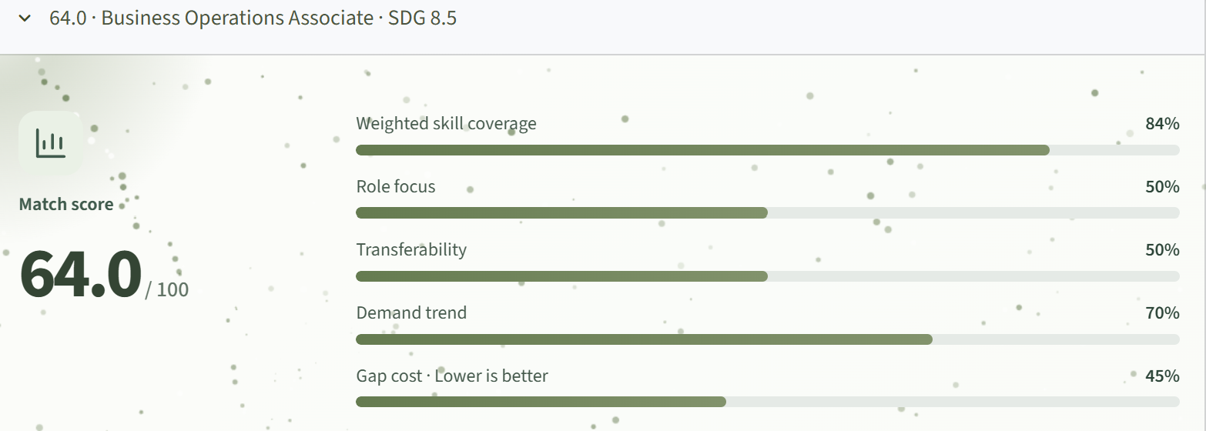
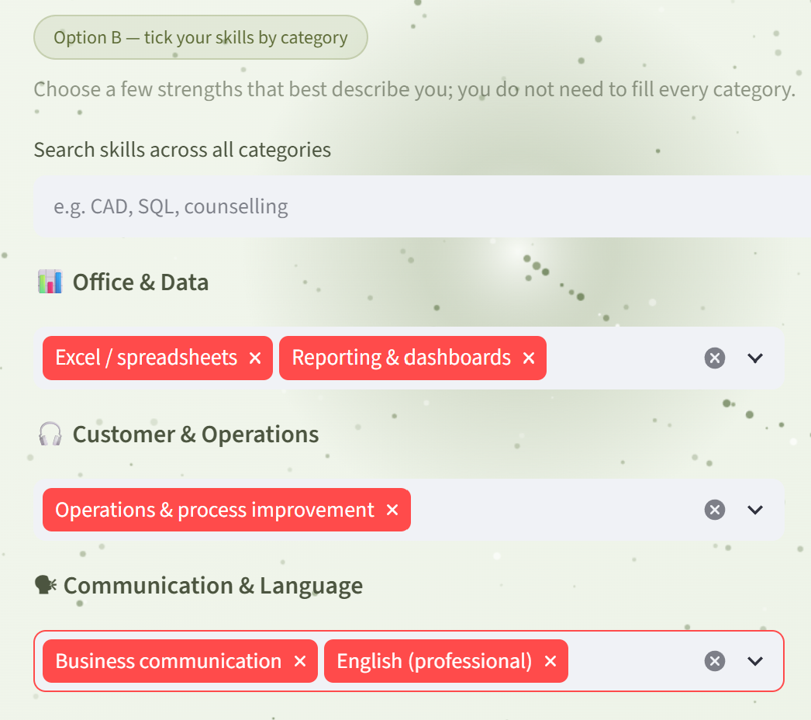
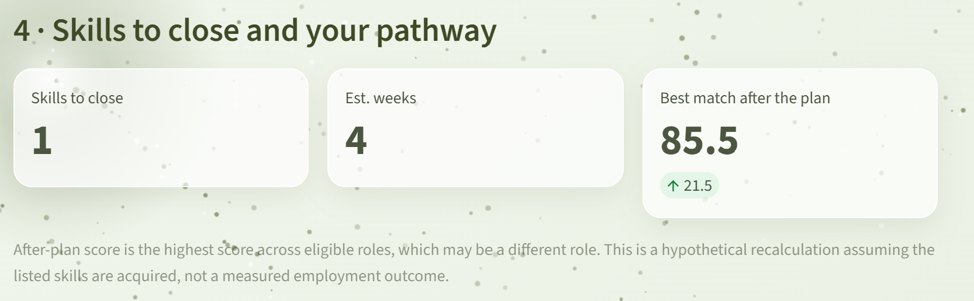
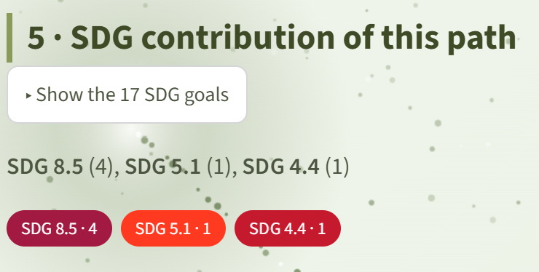
07 · PROTOTYPE · LIVE DEMO
Three screens from the running app
1
2
sdc2026-lumina-nusantara…streamlit.app
…streamlit.app · role matches
3
…streamlit.app · pathway & SDG
Screenshots captured from the live demo · synthetic sample data · free-tier instance may take 30–60 s to wake.
SkillRadar MY · Lumina Nusantara · SDC 2026
11 / 12

Slide 12
SKILLRADAR MY
Make AI everyone's partner —
not their replacement.
01
Pilot with TVET institutions and career centres
TRY IT YOURSELF
02
Verified course catalogue — real durations, links and fees
Live demo (Streamlit)
sdc2026-lumina-nusantara…streamlit.app
GitHub repository
github.com/douyinlin/sdc2026-lumina-nusantara
03
Fairness audits across age, gender and background
THANK YOU · Q&A
SkillRadar MY · Lumina Nusantara · SDC 2026
12 / 12

