Slide 1
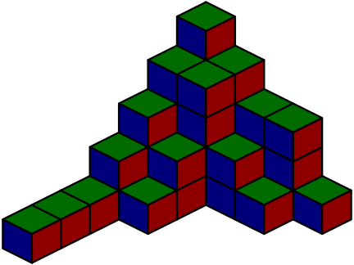
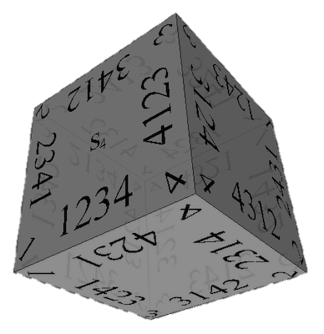
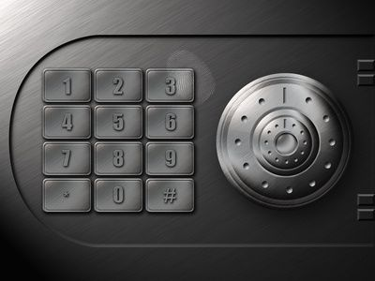
Combinatorics
Brief overview of combinations, permutations and binary vectors
Nikolay Kostov
Technical Trainer
Telerik Corporation
http://Nikolay.IT

Slide 2

Table of Contents
Definitions in Combinatorics
Permutations
Combinations
Pascal triangle
Binary Vectors
Resources
Test Questions

Slide 3
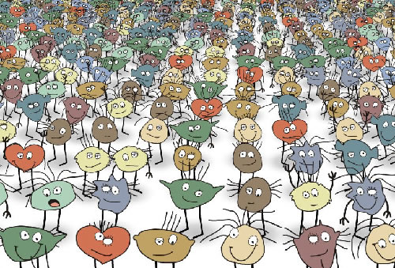
Definitions in Combinatorics

Slide 4
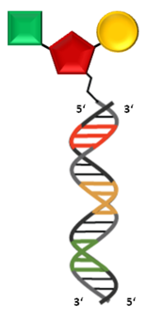
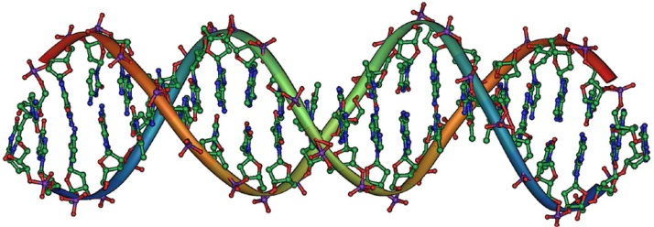
Combinatorics
Combinatorics is a branch of mathematics concerning the study of finite or countable discrete structures
Combinatorial problems arise in many areas of pure mathematics, notably in algebra, probability theory, topology, geometry, physics, chemistry, biology, etc.

Slide 5
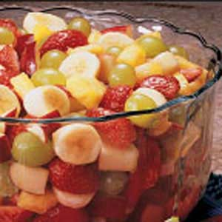
Combination
"My fruit salad is a combination of grapes, strawberries and bananas"
We don't care what order the fruits are in, they could also be "bananas, grapes and strawberries" or "grapes, bananas and strawberries" its the same salad
If the order doesn't matter, it is a Combination

Slide 6
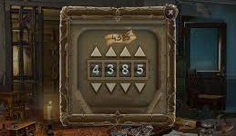
Permutation
"The combination to the safe was 4385".
Now we do care about the order
"8453" would not work, nor would "4538"
It has to be exactly 4-3-8-5
If the order does matter it is a Permutation
A Permutation is an ordered Combination.
To help you to remember, think "Permutation ... Position"

Slide 7


Factorial
The factorial function (!) just means to multiply a series of descending natural numbers
n! = n × (n-1)!
1! = 1, 0! = 1
4! = 4 × 3 × 2 × 1 = 24
7! = 7 × 6 × 5 × 4 × 3 × 2 × 1 = 5040

Slide 8
Factorial - Source code
Factorial – recursive
long long factorial(int n)
{
if (n == 0) return 1;
return factorial(n - 1) * n;
}
Factorial – iterative
long long factorial(int n)
{
long long result = 1;
for(int i = 2; i <= n; i++)
result = result * i;
return result;
}

Slide 9

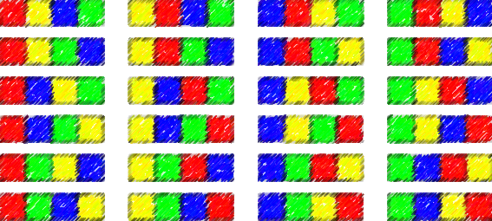

Permutations

Slide 10
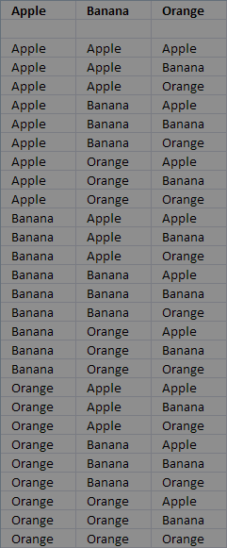
Permutations with Repetition
Easiest to calculate
When you have n things to choose from ... you have n choices each time!
When choosing k of them, the permutations are:
n × n × ... × n (k times)
n^{k}

Slide 11
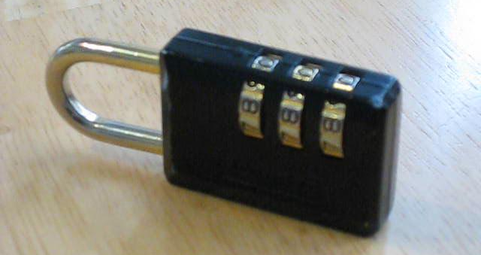
Permutations with Repetition
Example: in the lock below, there are 10 numbers to choose from (0, 1, … 9) and you choose 3 of them:
10 × 10 × 10 (3 times) = 10³ = 1,000 permutations
All permutations from (0, 0, 0) to (9, 9, 9)

Slide 12

Generating permutations
unsigned mp[100], n = 3;
void print(void)
{ unsigned i;
for (i = 0; i < n; i++) printf("%u ", mp[i] + 1);
printf("\n");
}
void permute(unsigned i)
{ unsigned k;
if (i >= n) { print(); return; }
for (k = 0; k < n; k++) {
mp[i] = k;
/* if */ permute(i+1);
}
}
int main () {
permute(0);
}

Slide 13
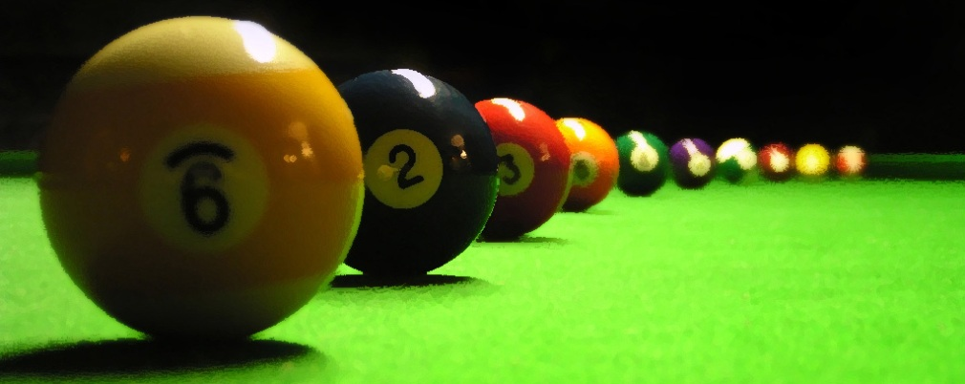
Permutations without Repetition
Less number of available choices each time
What order could 16 pool balls be in?
After choosing, ball 9 we can't choose the same ball again
First choice = 16 possibilities
Second choice = 15 possibilities, etc., etc.
Total permutations:
16 × 15 × 14 ×...× 2 × 1 = 16! = 20 922 789 888 000

Slide 14

Generating permutations
char used[100]; unsigned mp[100], n = 4;
void print(void)
{ unsigned i;
for (i = 0; i < n; i++) printf("%u ", mp[i] + 1);
printf("\n");
}
void permute(unsigned i)
{ unsigned k;
if (i >= n) { print(); return; }
for (k = 0; k < n; k++) {
if (!used[k]) {
used[k] = 1;
mp[i] = k;
/* if */ permute(i+1);
used[k] = 0;
}
}
}

Slide 15
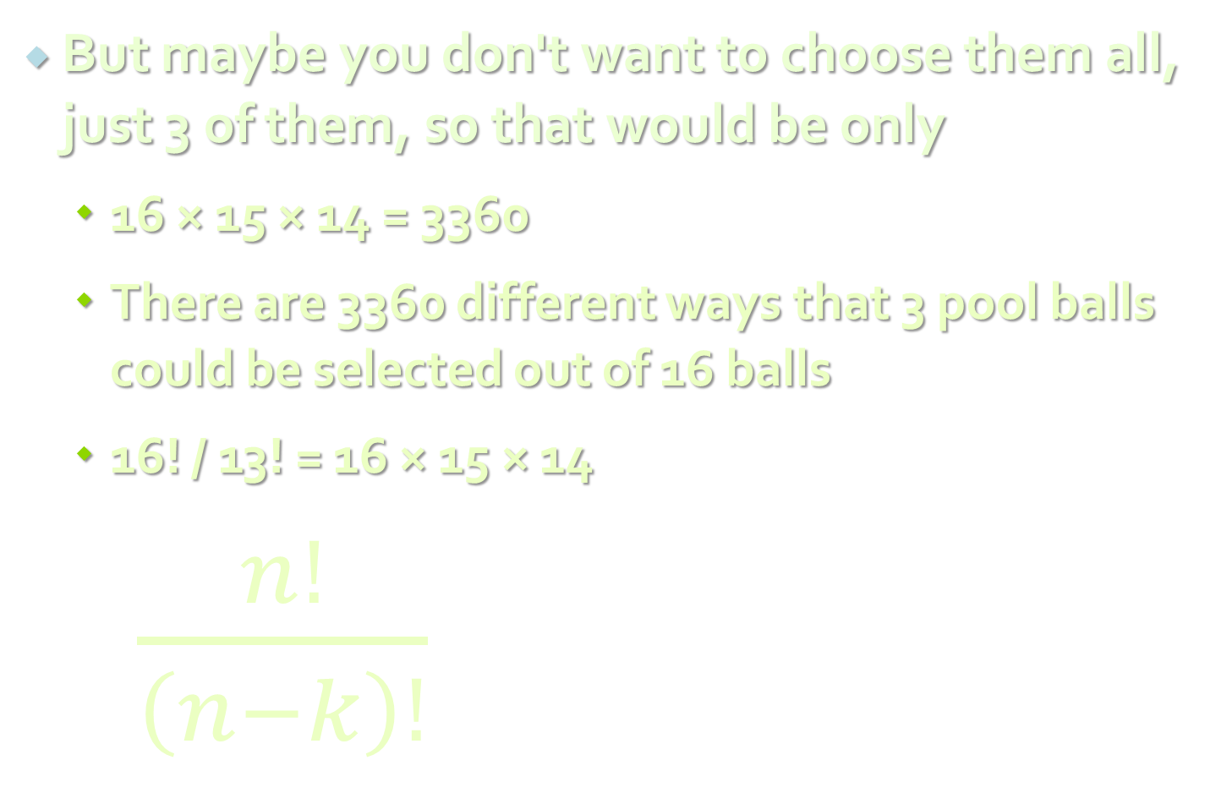
Permutations without Repetition
But maybe you don't want to choose them all, just 3 of them, so that would be only
16 × 15 × 14 = 3360
There are 3360 different ways that 3 pool balls could be selected out of 16 balls
16! / 13! = 16 × 15 × 14
$\frac{n!}{\left(n−k\right)!}$
16 × 15 × 14 × 13 × 12 ... | = 16 × 15 × 14 = 3360
13 × 12 ...
where n is the number of things to choose from, and you choose k of them (No repetition, order matters)

Slide 16

Permutations - Source code
Count of permutations with repetition
long long permurationsWithRepetition(int all, int toChoose)
{
long long result = 1;
for(int i = 1; i <= toChoose; i++)
result *= all;
return result;
}
n^{k}
Count of permutations without repetition
long long permurationsWithoutRepetition(int all, int toChoose)
{
long long result = 1;
for(int i = all; i > all - toChoose; i--)
result = result * i;
return result;
}
$\frac{n!}{\left(n−k\right)!}$

Slide 17
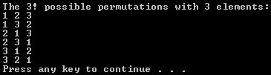
C++ - next_permutation
Rearranges the elements in the range [first, last) into the lexicographically next greater permutation of elements
#include <iostream>
#include <algorithm>
using namespace std;
int main () {
int ints[] = {1,2,3};
cout << "The 3! possible permutations with 3 elements:\n";
do {
cout << ints[0] <<" "<< ints[1] <<" "<< ints[2] << endl;
} while ( next_permutation (ints,ints+3) );
return 0;
}
http://goo.gl/W5vht

Slide 18
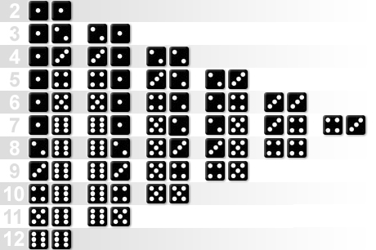
Combinations

Slide 19
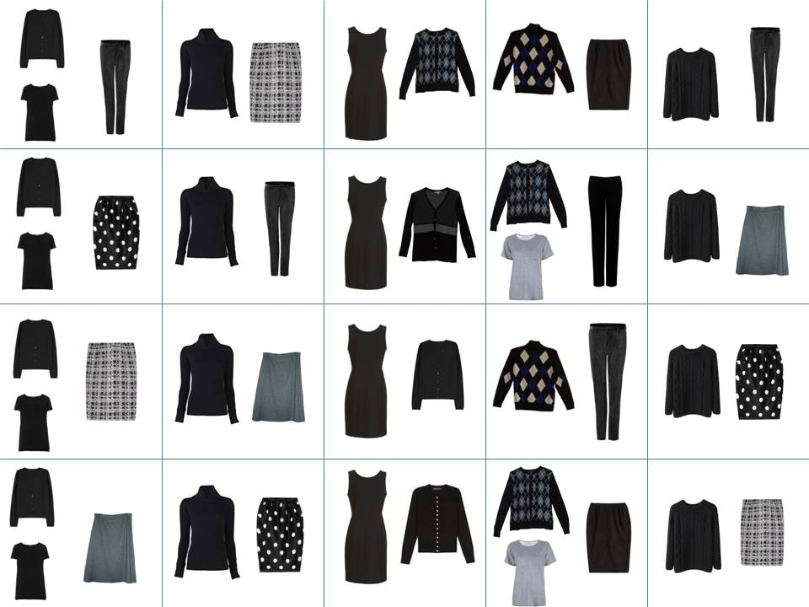
Combinations
Order does not matter!
Two types of combinations:
Repetition is Allowed
coins in your pocket
5,5,20,20,20,10,10
No Repetition
lottery numbers
TOTO 6/49, 6/42, 5/35
2,14,15,27,30,33

Slide 20
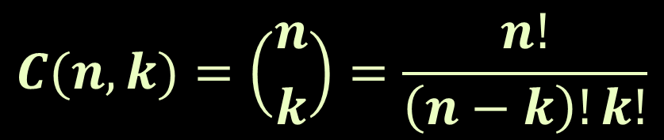
Combinations w/o Repetition
Back to the 3 of 16 billiard balls
Many comb. will be the same
We don't care about the order
Permutations w/o repetitions reduced by how many ways the objects could be in order:
This is how lotteries work (TOTO 6/49)
Often called "n choose k" (Google it!)
Order does matter | Order doesn't matter
1 2 3 1 3 2 2 1 3 2 3 1 3 1 2 3 2 1 | 1 2 3
$$C(n, k)=\left({n \atop k}\right)=\frac{n!}{\left(n−k\right)!k!}$$

Slide 21

Generate combinations w/o rep.
int n = 5, k = 3, mp[20];
void print(unsigned length)
{ for (int i = 0; i < length; i++) printf("%u ", mp[i]);
printf("\n");
}
void komb(unsigned i, unsigned after)
{ unsigned j;
if (i > k) return;
for (j = after + 1; j <= n; j++) {
mp[i - 1] = j;
if (i == k) print(i);
komb(i + 1, j);
}
}
int main(void) {
printf("C(%u,%u): \n", n, k);
komb(1, 0);
return 0;
}

Slide 22
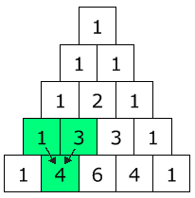

Pascal's Triangle
The triangle shows you how many combinations of objects without repetition are possible
Go down to row "n" (the top row is 0)
Move along "k" places
The value there is your answer
Build the triangle: start with "1" at the top, then continue placing numbers below it in a triangular pattern
$$\left({n \atop k}\right)=\frac{n!}{\left(n−k\right)!k!}$$

Slide 23
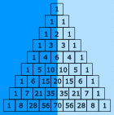
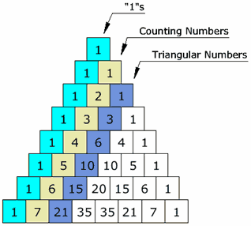
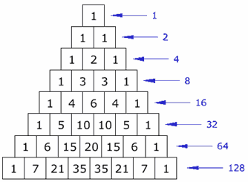
Pascal's Triangle's (2)
The triangle is symmetrical The numbers on the left side have identical matching numbers on the right side, like a mirror image
Diagonals:
First diagonal – only “1”s
Second diagonal – 1, 2, 3, etc.
Third diagonal – triangular numbers
Horizontal sums: powers of 2

Slide 24

Binomial coefficients
Calculate using recursion
$$\left({n \atop k}\right)=\left({n−1 \atop k−1}\right)+\left({n−1 \atop k}\right)$$
unsigned long binom(unsigned n, unsigned k)
{ if (k > n) return 0;
else if (0 == k || k == n) return 1;
else return binom(n-1, k-1) + binom(n-1, k);
}
Calculate using dynamic programming
unsigned long m[MAX], i, j;
for (i = 0; i <= n; i++) {
m[i] = 1;
if (i > 1) {
if (k < i - 1) j = k; else j = i - 1;
for (; j >= 1; j--) m[j] += m[j - 1];
}
} // The answer is in m[k]

Slide 25
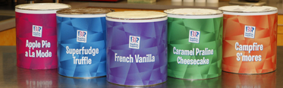
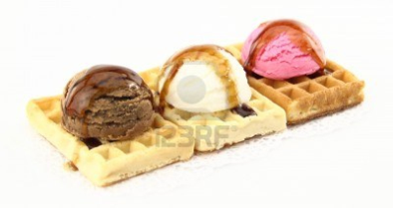
Combinations with Repetition
Ice-cream example
5 flavors of ice-cream: banana, chocolate, lemon, strawberry and vanilla
3 scoops
How many variations will there be?
Let's use letters for the flavors: {b, c, l, s, v}
{c, c, c} (3 scoops of chocolate)
{b, l, v} (one each of banana, lemon and vanilla)
{b, v, v} (one of banana, two of vanilla)

Slide 26

Combinations with Repetition
Ice-cream example
n=5 things to choose from, choose k=3 of them
Order does not matter, and we can repeat
Think about the ice cream being in boxes
arrow means move, circle means scoop
{c, c, c} (3 scoops of chocolate)
{b, l, v} (banana, lemon, vanilla)
{b, v, v} (banana, two of vanilla)

Slide 27
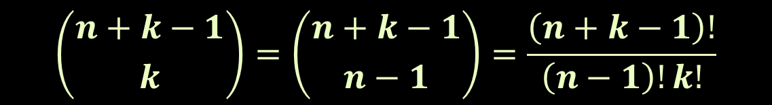
Combinations with Repetition
We have a simpler problem to solve
How many different ways can you arrange arrows and circles?
3 circles (3 scoops) and 4 arrows (we need to move 4 times to go from the 1st to 5th container)
There are k + (n-1) positions, and we want to choose k of them to have circles
$$\left({n+k−1 \atop k}\right)=\left({n+k−1 \atop n−1}\right)=\frac{\left(n+k−1\right)!}{\left(n−1\right)!k!}$$

Slide 28
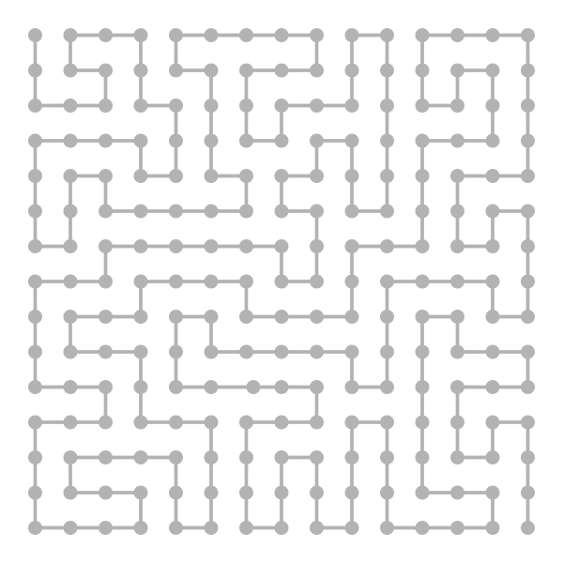
Binary Vectors

Slide 29
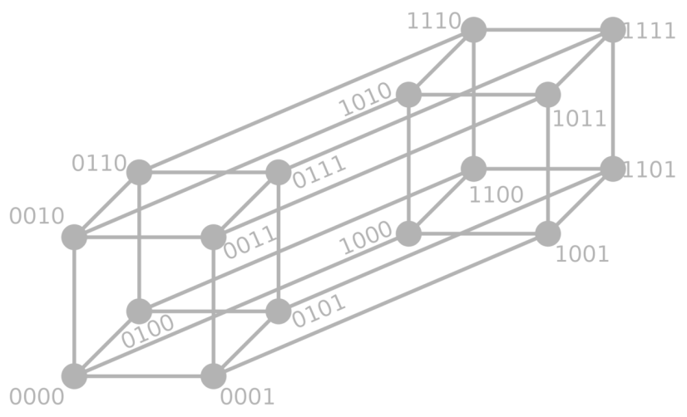
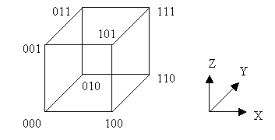
Binary Vectors
Some problems can be reformulated in terms of binary vectors – (1, 0, 1, 1, 1, 0, …)
Combinatorial properties of binary vectors:
Number of binary vectors of length n: 2^{n}.
Number of binary vectors of length n and with k `1` is C(n, k) (we choose k positions for n `1`)

Slide 30
Gray code
Gray code (a.k.a. reflected binary code) is a binary numeral system where two successive values differ in only one bit
Gray code by bit width
2-bit | 4-bit
00 01 11 10 | 0000 0001 0011 0010 0110 0111 0101 0100 1100 1101 1111 1110 1010 1011 1001 1000
3-bit
000 001 011 010 110 111 101 100
Decimal | Gray | Binary
0 | 000 | 000
1 | 001 | 001
2 | 011 | 010
3 | 010 | 011
4 | 110 | 100
5 | 111 | 101
6 | 101 | 110
7 | 100 | 111

Slide 31

Gray code – Source code
int n = 4, a[1000], i;
void print(void)
{ for (i = n; i >= 1; i--) printf("%d ", a[i]);
printf("\n");
}
void backgray(int k)
{ if (0 == k) { print(); return; }
a[k] = 1; forwgray(k - 1);
a[k] = 0; backgray(k - 1);
}
void forwgray(int k)
{ if (0 == k) { print(); return; }
a[k] = 0; forwgray(k - 1);
a[k] = 1; backgray(k - 1);
}
int main() { forwgray(n); return 0; }

Slide 32
Resources
Video lectures (in Bulgarian)
http://cs.maycamp.com/?page_id=685
http://cs.maycamp.com/?page_id=760
http://cs.maycamp.com/?page_id=764
TopCoder article: http://goo.gl/bN9RL
http://en.wikipedia.org/wiki/Permutation
http://en.wikipedia.org/wiki/Combination
Book: http://goo.gl/Z2Knl
Nakov’s book: Programming = ++Algorithms;

Slide 33
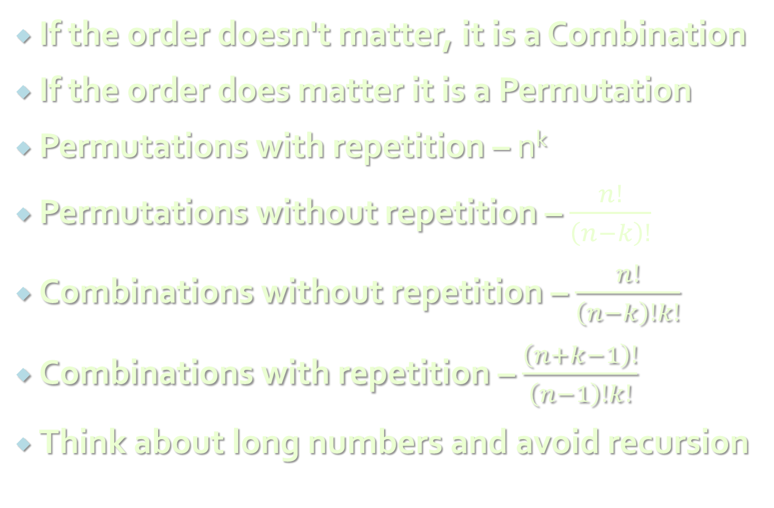
Summary
If the order doesn't matter, it is a Combination
If the order does matter it is a Permutation
Permutations with repetition – n^{k}
Permutations without repetition – $\frac{n!}{\left(n−k\right)!}$
Combinations without repetition – $\frac{n!}{\left(n−k\right)!k!}$
Combinations with repetition – $\frac{\left(n+k−1\right)!}{\left(n−1\right)!k!}$
Think about long numbers and avoid recursion

Slide 34
Combinatorics
http://algoacademy.telerik.com

Slide 35
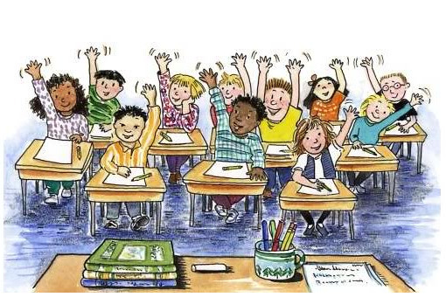
Test Questions

Slide 36
Test Question 1
How many permutations of 3 different digits are there, chosen from the ten digits 0 to 9 inclusive?
84
120
504
720
The number of permutations of 3 digits chosen from 10 is 10! / 7! = 10 × 9 × 8 = 720

Slide 37
Test Question 2
How many permutations of 4 different letters are there, chosen from the twenty six letters of the alphabet (repetition is not allowed)?
14950
23751
358800
456976
The number of permutations of 4 digits chosen from 26 is 26 × 25 × 24 × 23 = 358800

Slide 38
Test Question 3
How many different committees of 5 people can be chosen from 10 people?
252
2002
30240
100000
In choosing a committee, order doesn't matter so we need the number of combinations of 5 people chosen from 10. C(10, 5) = 10!/(5!)(5!) = 252

Slide 39
Test Question 4
Jones is a Chairman. In how many ways can a committee of 5 be chosen from 10 people given that Jones must be one of them?
126
252
495
3024
Jones is already chosen, so we need to choose another 4 from 9 (order doesn't matter). C(9, 4) = 9!/((5!)(4!)) = 126

Slide 40
Test Question 5
A password consists of four different letters of the alphabet. How many different possible passwords are there?
26⁴
456976
14950
358800
The number of permutations of 4 letters chosen from 26 is ²⁶P₄ = 26 × 25 × 24 × 23 = 358800

Slide 41
Test Question 6
A password consists of two letters of the alphabet followed by three digits (0 to 9). Repeats are allowed. How many different possible passwords are there?
492804
650000
676000
1757600
Ways of choosing the letters = 26 × 26 = 676 Ways of choosing the digits = 10 × 10 × 10 = 1000 Possible passwords = 676 × 10000 = 676000

Slide 42
Test Question 7
An encyclopedia has eight volumes. In how many ways can the eight volumes be replaced on the shelf?
8
5040
40320
8⁸
The 1st volume to be replaced could go in any one of the 8 spots. The 2nd could then go in any one of the 7 remaining spots, etc. Total number of ways = 8! = 40320

Slide 43
Test Question 8
Assuming that any arrangement of letters forms a 'word', how many 'words' of any length can be formed from the letters of the word SQUARE? (No repeating of letters)
82
720
1956
9331
Answer on the next slide…

Slide 44
Test Question 8 - Answer
The number of one letter 'words' = ⁶P₁ = 6 The number of two letter 'words' = ⁶P₂ = 6 × 5 = 30 The number of three letter 'words' = ⁶P₃ = 6 × 5 × 4 = 120 The number of four letter 'words' = ⁶P₄ = 6 × 5 × 4 × 3 = 360 The number of five letter 'words' = ⁶P₅ = 6 × 5 × 4 × 3 × 2 = 720 The number of six letter 'words' = ⁶P₆ = 6! = 720 So the total number of possible 'words' = 6 + 30 + 120 + 360 + 720 + 720 = 1956

