Slide 1
Scam Dataset - GASP
Shawn Ng
80s.h.a.w.n08@gmail.com

Slide 2
Scam Dataset
Consists of 17014 Normal Ads, 866 Fraudulent Ads
This is a classification problem, we want to train a model to classify an email as “Fraudulent” or “Normal” quickly.
For this we can consider training ML models which work well for classification:
Decision Trees
SVM
XGBoost
Neural Networks like Tabnet

Slide 3
Features
There are 18 features, including information on things like job description information, information on the company, and benefits.
Some features might not be impactful, while some might be huge tells, we have to pick the best features so our model doesn’t use multiple highly correlated features.
Hence we go through feature selection first – to preprocess our data for models that don’t handle this step well, and ensure no data leakages.

Slide 4
Dataset Preprocessing and Limitations
Fraudulent ads only represent 4.84% (866/17880) of the dataset, there is a huge class imbalance, so we need to choose a technique to account for the imbalance for each model
There are many duplicates in descriptions, 2785 rows of duplicates, which might result in model overfitting to duplicates
We simply drop duplicate rows.

Slide 5
Dataset Preprocessing and Limitations
We need to code our features into proper classifications so our models can use it for predictions
The final column (in_balanced_dataset) has to be removed because it has a 1:1 ratio of fraud to non-fraud ads - which is a non generalizable feature
We also don’t drop missing values in fraud detection, we simply label them as they might be tells.

Slide 6
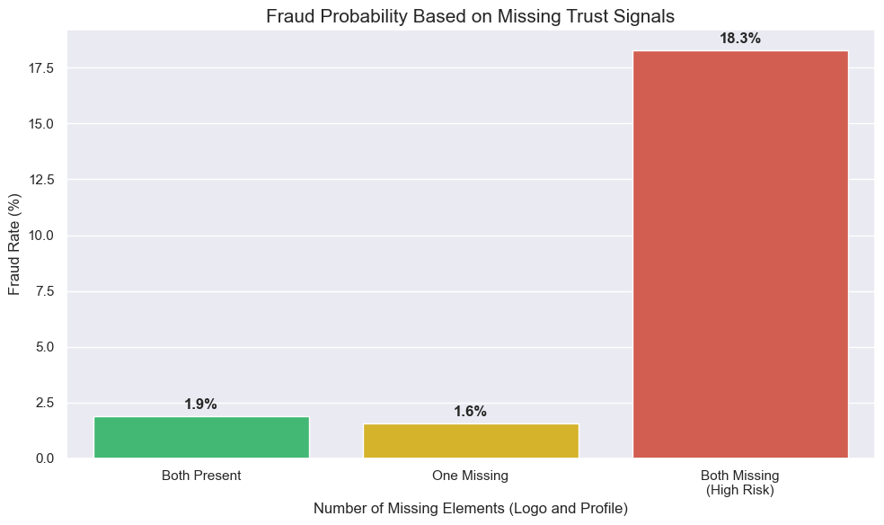
Most suspicious features
When both company logo and profile is absent, there is a high probability of fraud.
(18.3% vs 1.9%)

Slide 7
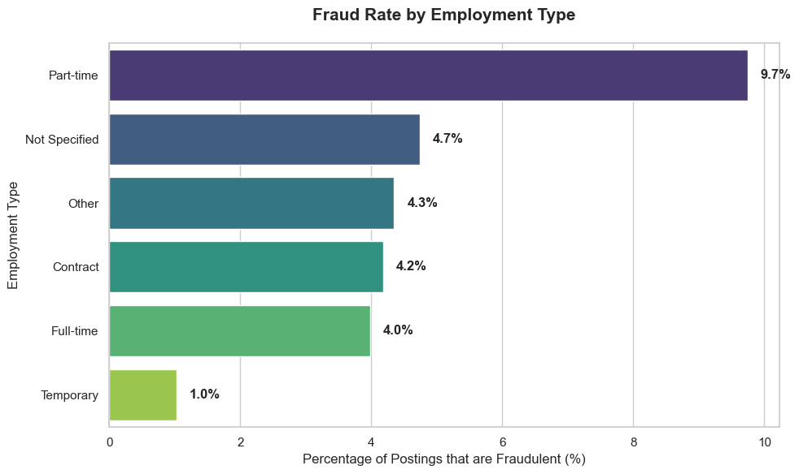
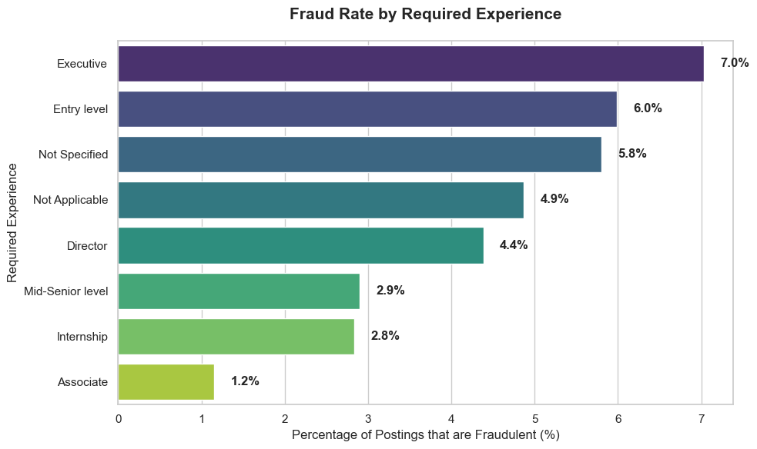
Type of Employment
Interestingly, part time jobs, and executive / entry level job ads are more likely to be scams. This might be to lure a larger base of people.

Slide 8
Descriptions
Personally reading through the descriptions, we find many real ads like this.
Our name is not in this ad to prevent us from showing up in Google indexing under our company name, which would then let our existing and potential clients know how much commission we all make. What a disaster that would be. Wouldn't you agree? But once we give you our name and you check us out you will see that we are the real deal.
<p>We help teachers get safe &amp; secure jobs abroad :)</p>
Many such cases of informal but real ads exist, but more professional ads actually might have a higher chance of being fake – because scammers are trying to act professionally.
We could check using sentiment analysis if we could use a “professionalism” score as a feature for our model.

Slide 9
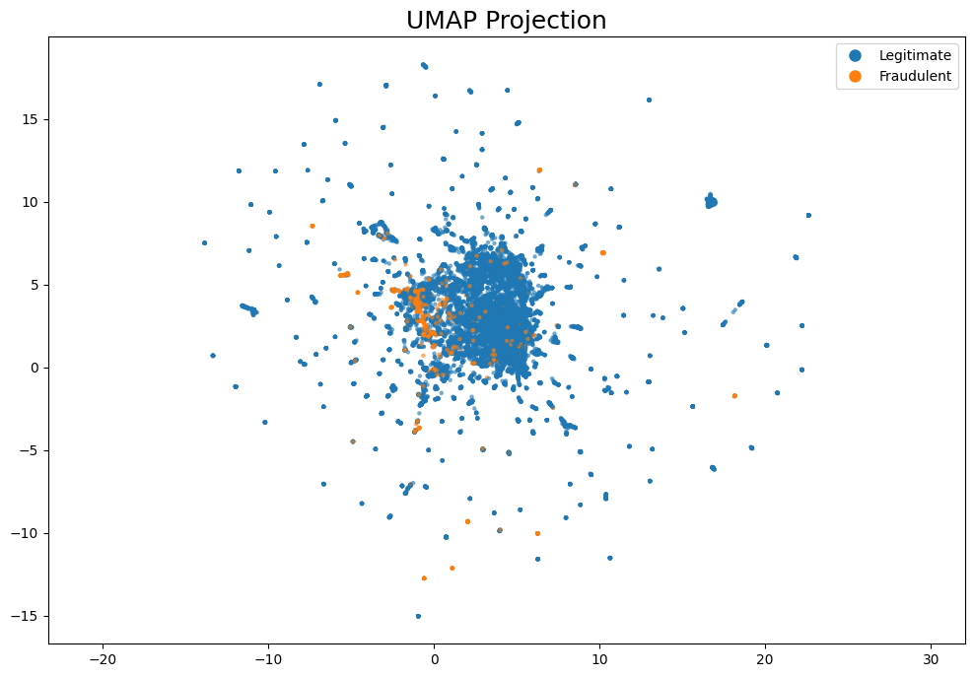
Visualization of Semantics
A quick UMAP projection of the ad descriptions, shows no clear boundaries for easy classification.
Scammers might already have robust understandings of what to write to blend in.

Slide 10
Criteria for Models
Our models should be robust and generalizable, and fulfill certain criteria.
Maximizing Recall (and possibly F1 Score if no human review)
We want to maximise the proportion of scams that the model is able to catch, and punish less for false positives, if we intend to use human review.
Maximizing Interpretability
In a real world model, that could produce false positives, we should be able to explain why the model flags it as scams, so human review is possible.
Minimizing Cost
We should choose a model which is easier to train if they produce similar results.

Slide 11
Proposal
We will do a comparative analysis of multiple types of models, and pick the best based on Recall, as well as interpretability.
We will only pick a less interpretable model if there is a statistically significant benefit to picking it.
Models will include Decision Trees, Linear SVM, XGBoost, and Tabnet
We will train all 4 models and pick the hyperparameters using Grid Search, testing using stratified K-fold-cross validation.
We also need to ensure class imbalances, and normalization / standardization is handled if required.

Slide 12
Example Pipelines
SVM (Linear)
Standardization of Data
Balance Classes using
class_weight = ”balanced”
Perform Grid Search to tune hyperparameters
Test for recall using Stratified K fold CV
XGBoost
No Standardization required
Balance Classes using SMOTE
Perform Grid Search to tune hyperparameters
Test for recall using Stratified K fold CV

Slide 13
Model Tradeoffs
Each model has their own strengths and weakness
Decision trees – easily interpretable, but decision boundaries are easily reverse engineered and boundaries are easily overfitted.
Linear SVM – easily interpretable, but struggles with non-linear relationships.
XGBoost – usually very high accuracy, but it does not handle class imbalances well, so we have to run SMOTE or some undersampling technique, which might not work well to create new samples of text.
Tabnet – Able to locate nonlinear trends, but highly uninterpretable, and expensive to train.

Slide 14
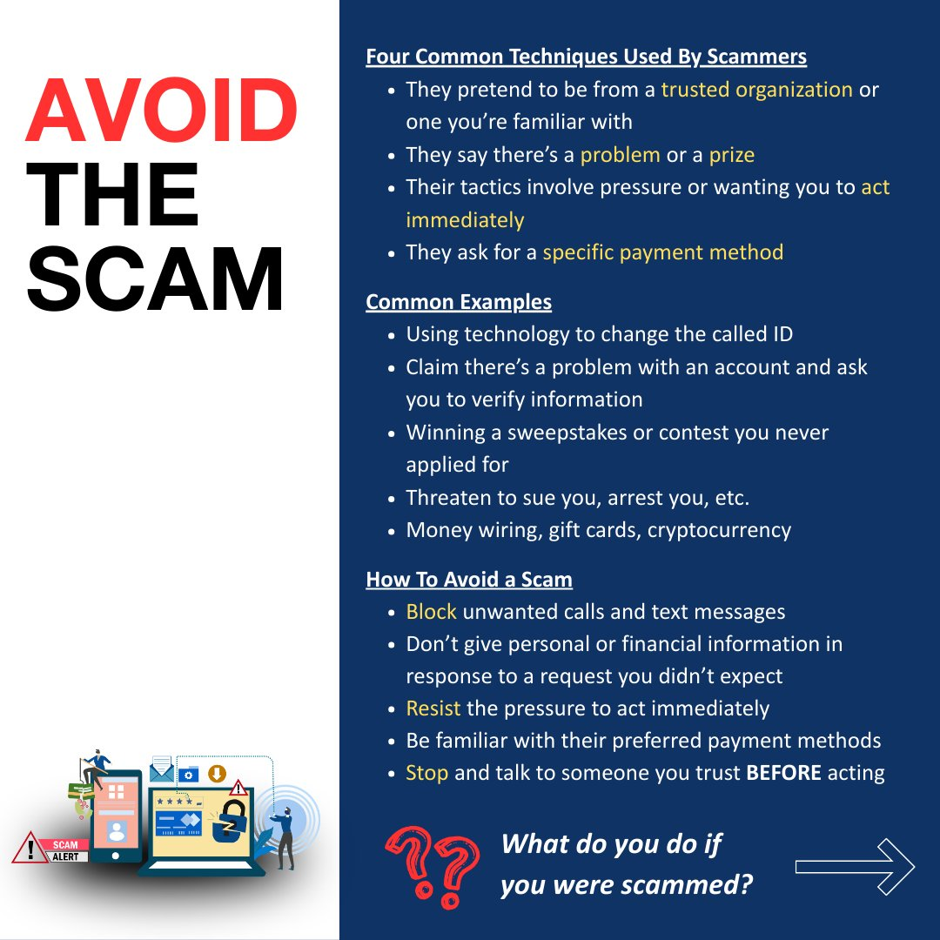
Structural Limitations
All our models have to be retrained if we want to update our model, because they cannot be updated.
Scammers can move quickly and change tactics quickly - old techniques are changed if they don’t work (even old social engineering techniques have improved)
Simple and interpretable models like decision trees can be quickly reverse engineered by scammers

Slide 15
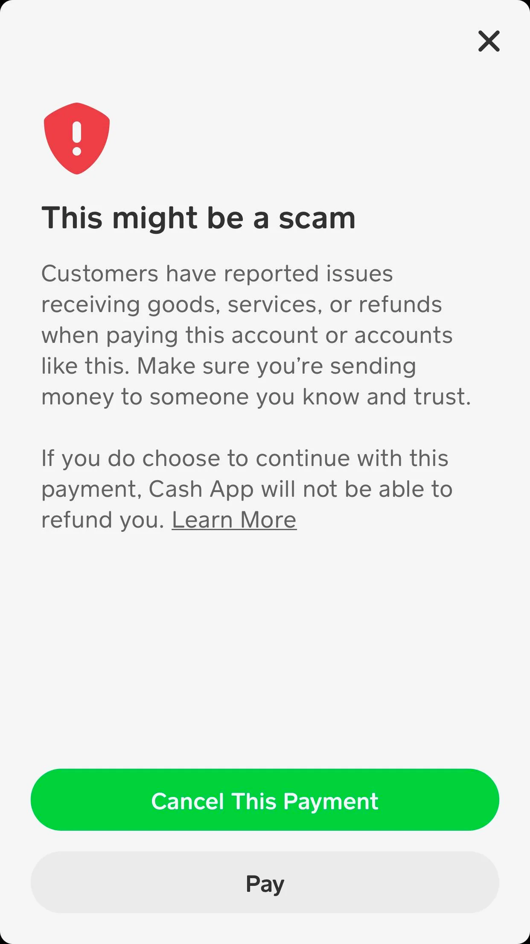
Structural Limitations
We are only able to flag fraudulent ads, but this still requires human verification
We cannot leave our model as an open box online, this allows scammers to reverse engineer our models – so we cannot directly flag it on site (like the image)
Hence we need to use some sort of review process, before we allow job ads onto platforms.

