Slide 1
Ideas for Final
Yuchen Li

Slide 2
Ideas
History Average Temperature of NYC
Teamfight Tactics Item & Champion Learning
League of Legends Item & Champion Learning

Slide 3
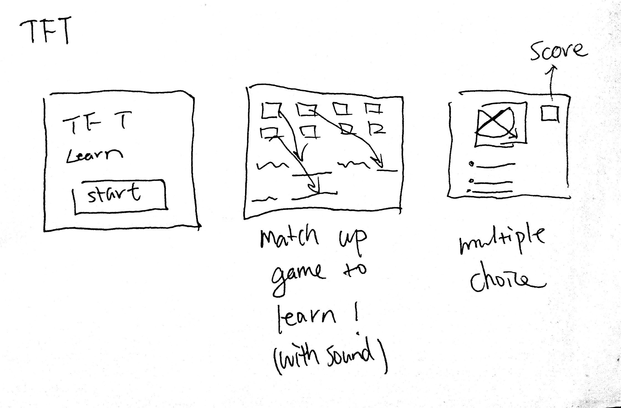
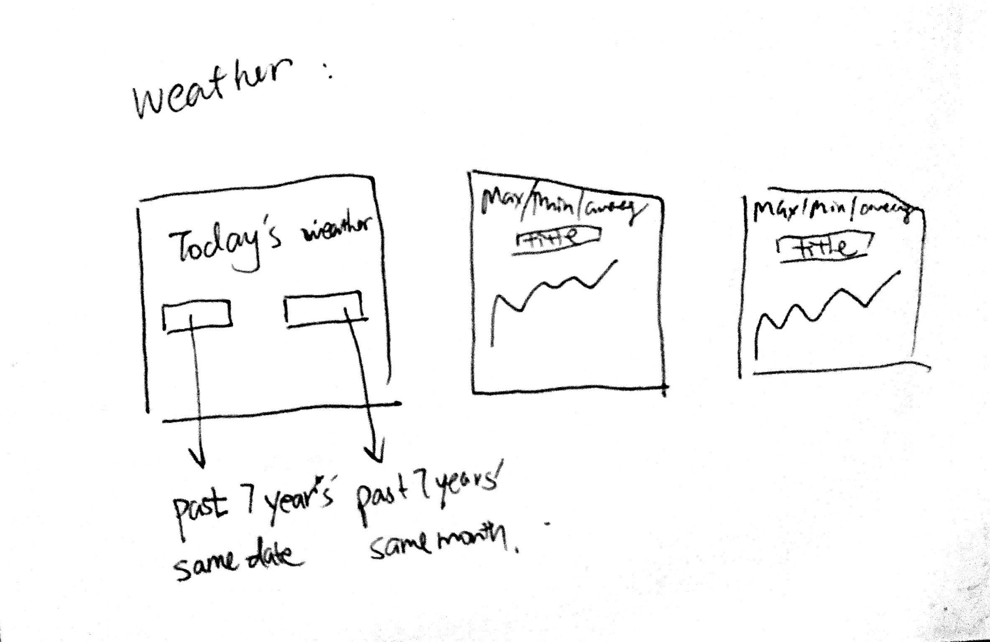
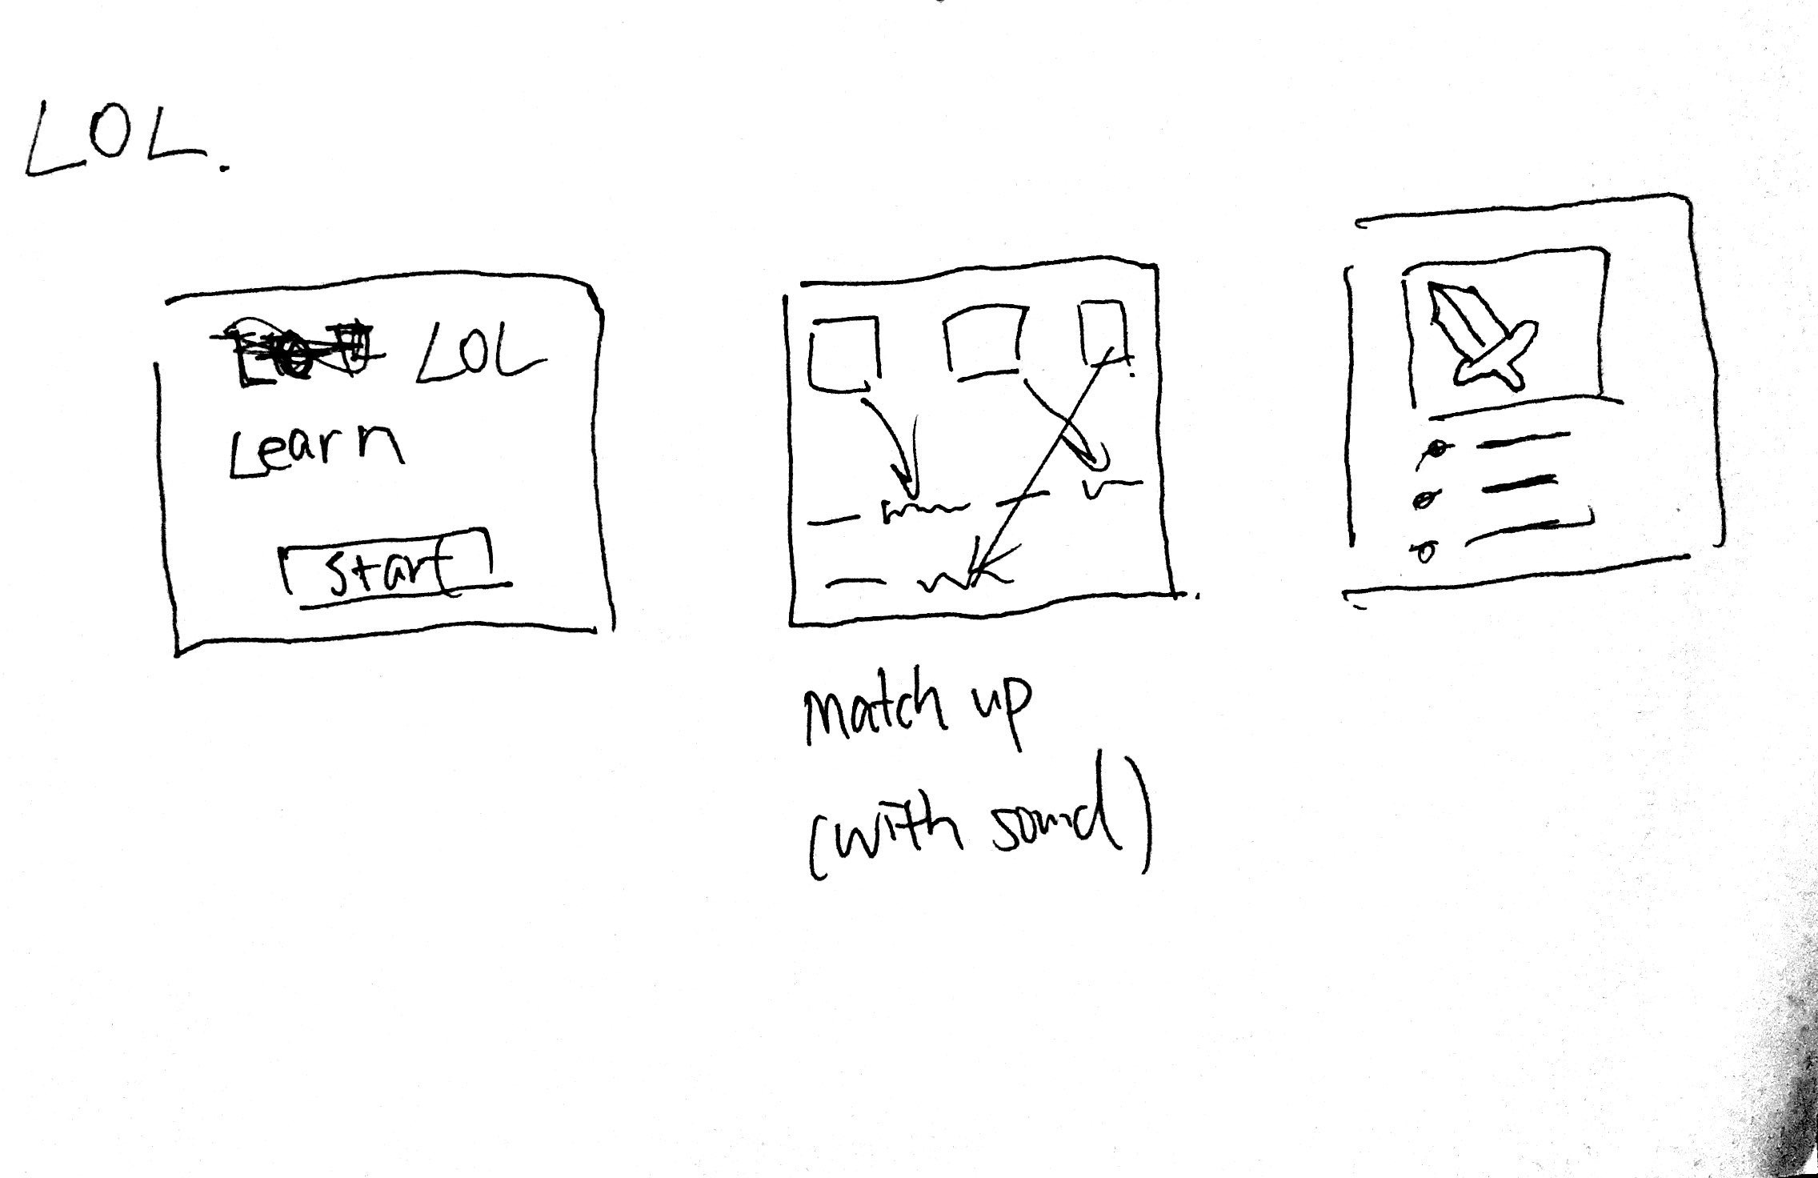

Slide 4
What would it look like through various stages ?
History Average Temperature of NYC: Have a choice of selecting month, and show the graph of average temperature change for last 7 years every month.
Teamfight Tactics Item & Champion Learning: have a game (quiz) to match up the combination of items, and champion category
League of Legends Item & Champion Learning: have a game to understand the item characteristics and classify the champion type.

Slide 5

Show the various stages on a macro-scale and micro-scale
History Average Temperature of NYC
Micro-scale: knowing the past 7 years’ temperature for a specific date.
Macro-scale: showing the graph of the max/min/average temperature change every month for 7 years.

Slide 6
Show the various stages on a macro-scale and micro-scale (cont)
Teamfight Tactics Item & Champion Learning
Understanding the game itself: it is an autochess game and characteristics of the game(Mode, winning condition)
Understanding the item power and champion ability to make a meaningful play

Slide 7
Show the various stages on a macro-scale and micro-scale (cont)
League of Legends Item & Champion Learning
Understanding the game itself: Multiplayer online battle arena (MOBA) game
Understanding the category of champions and characteristics of items and how these affect meaningful play.

Slide 8
System design: What does your software interact with?
USER!!!!!!!!!
History Average Temperature of NYC
Input and generated graph (maybe prediction)
Teamfight Tactics Item & Champion Learning
Learning and quizzing knowledge
League of Legends Item & Champion Learning
Learning and quizzing knowledge

Slide 9
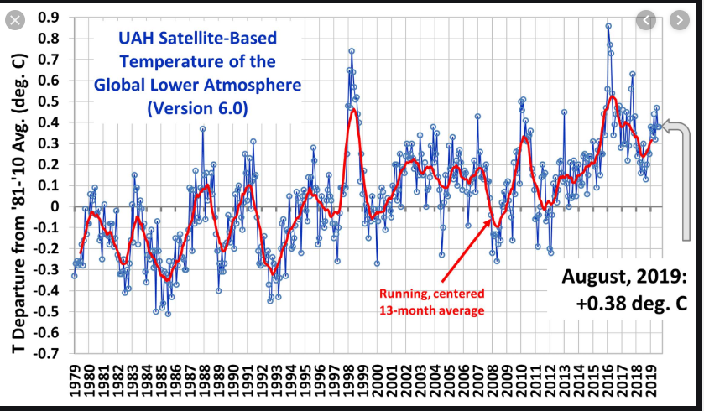
History Average Temperature of NYC
https://openweathermap.org/history-bulk
Importance of understanding Global Warming!

Slide 10

Teamfight Tactics & League of Legends Item & Champion Learning
Trivia Crack
Aimed for New Gamers!
https://developer.riotgames.com/docs/tft
https://developer.riotgames.com/docs/lol

Slide 11
Thank You!

