Slide 1
Ideas for Final
Yuchen Li

Slide 2
Ideas
History Average Temperature of NYC
Teamfight Tactics/ League of Legends Item & Champion Learning
New Tetris

Slide 3


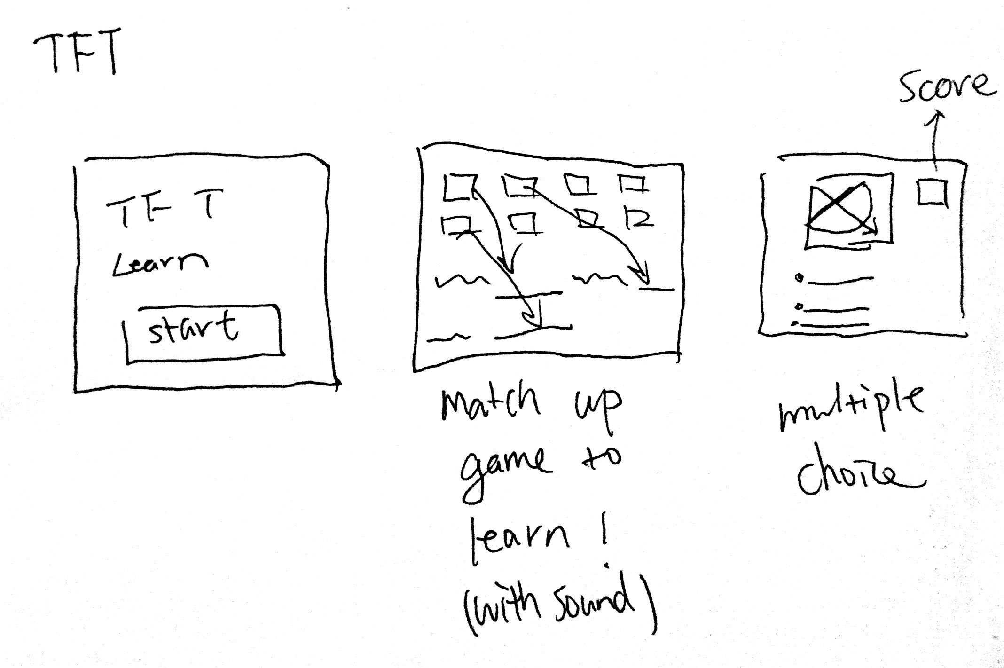
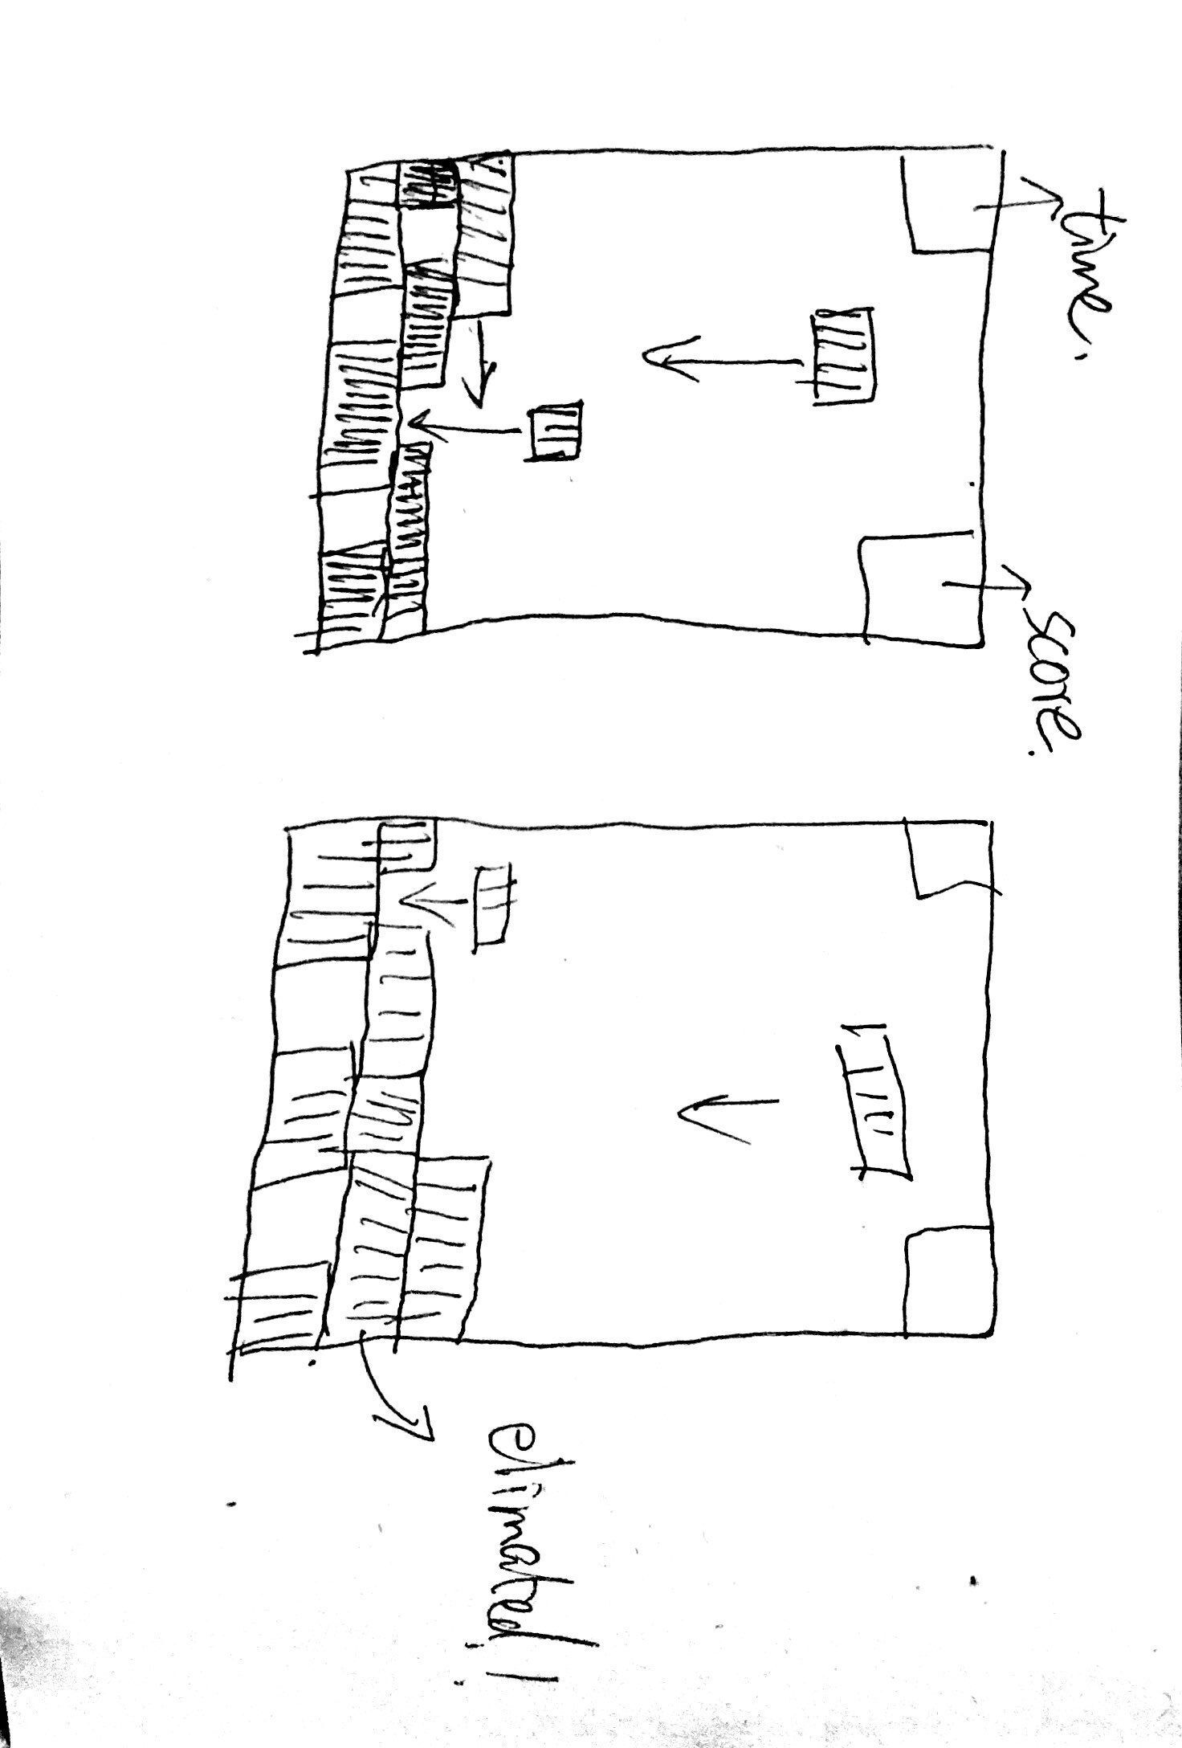
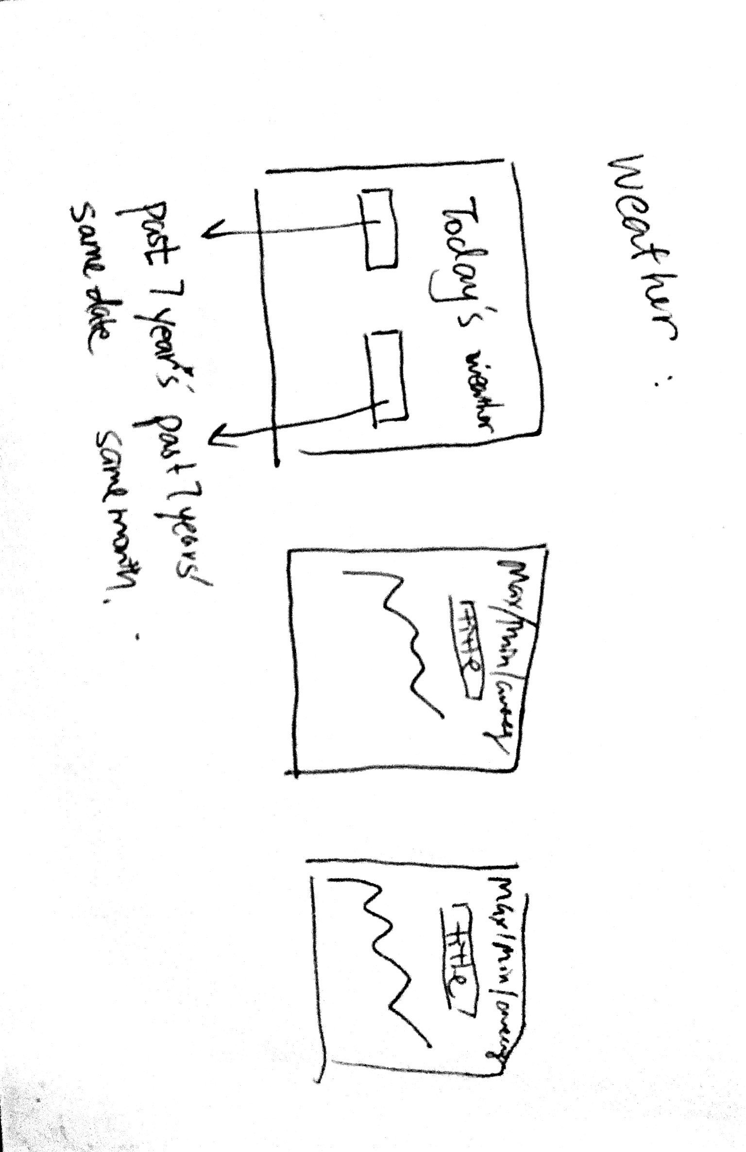
History Average Temperature of NYC: Have a choice of selecting month, and show the graph of average temperature change for last 7 years every month.
Teamfight Tactics/League of Legends Item & Champion Learning: have a game (quiz) to match up the combination of items, and champion category
New Tetris: Similar settings, but with more interactions

Slide 4
Show the various stages on a macro-scale and micro-scale
History Average Temperature of NYC
Micro-scale: knowing the past 7 years’ temperature for a specific date.
Macro-scale: showing the graph of the max/min/average temperature change every month for 7 years.

Slide 5
New Tetris
Meaningful Play instantaneously
Meaningful Play Potentially
Teamfight Tactics/ League of Legends Item & Champion Learning
Understanding the game itself: it is an auto-chess/ Multiplayer online battle arena (MOBA) game and characteristics of the game(Mode, winning condition)
Understanding the item power and champion ability to make a meaningful play

Slide 6
System design: What does your software interact with?
USER!!!!!!!!!
History Average Temperature of NYC
Input and generated graph (maybe prediction)
Teamfight Tactics/ League of Legends Item & Champion Learning
Learning and quizzing knowledge
New Tetris
Meaningful Play-How game interact with player’s action, short-term and long-term.

Slide 7
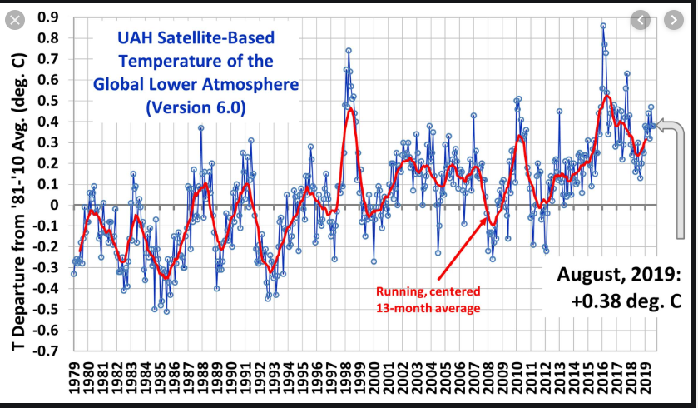
History Average Temperature of NYC
https://openweathermap.org/history-bulk
Importance of understanding Global Warming!

Slide 8

Teamfight Tactics & League of Legends Item & Champion Learning
Trivia Crack
Aimed for New Gamers!
https://developer.riotgames.com/docs/tft
https://developer.riotgames.com/docs/lol

Slide 9
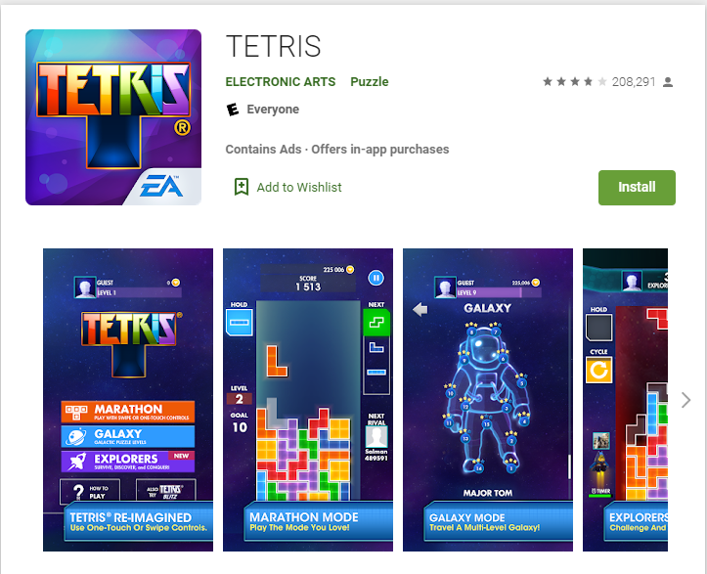
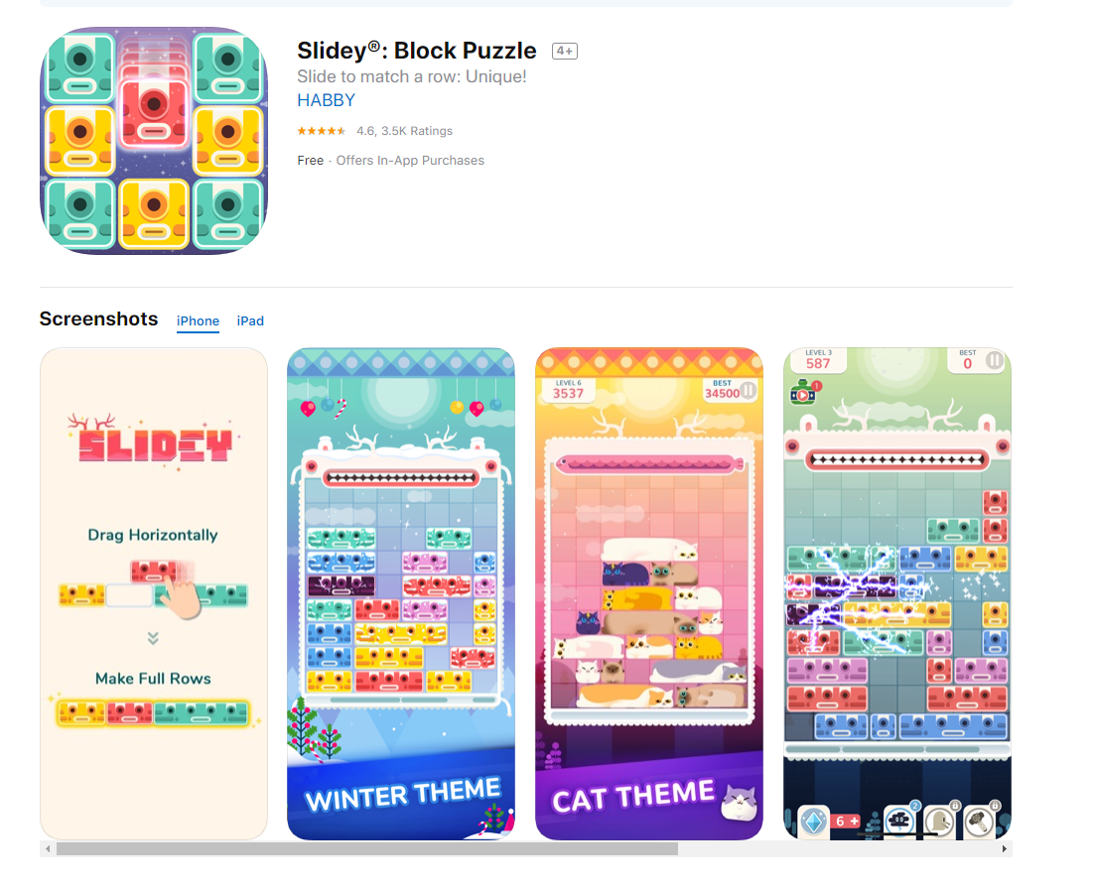
New Tetris
Horizontally Drag
Combination of both games
Theme
Difficulty increased with time

Slide 10
Thank You!

