Slide 1
How can we better secure our systems
Dovid Bender
https://github.com/dovi5988/cluecon/2021
ClueCon 2021 - How can we better secure our systems 1/16

Slide 2
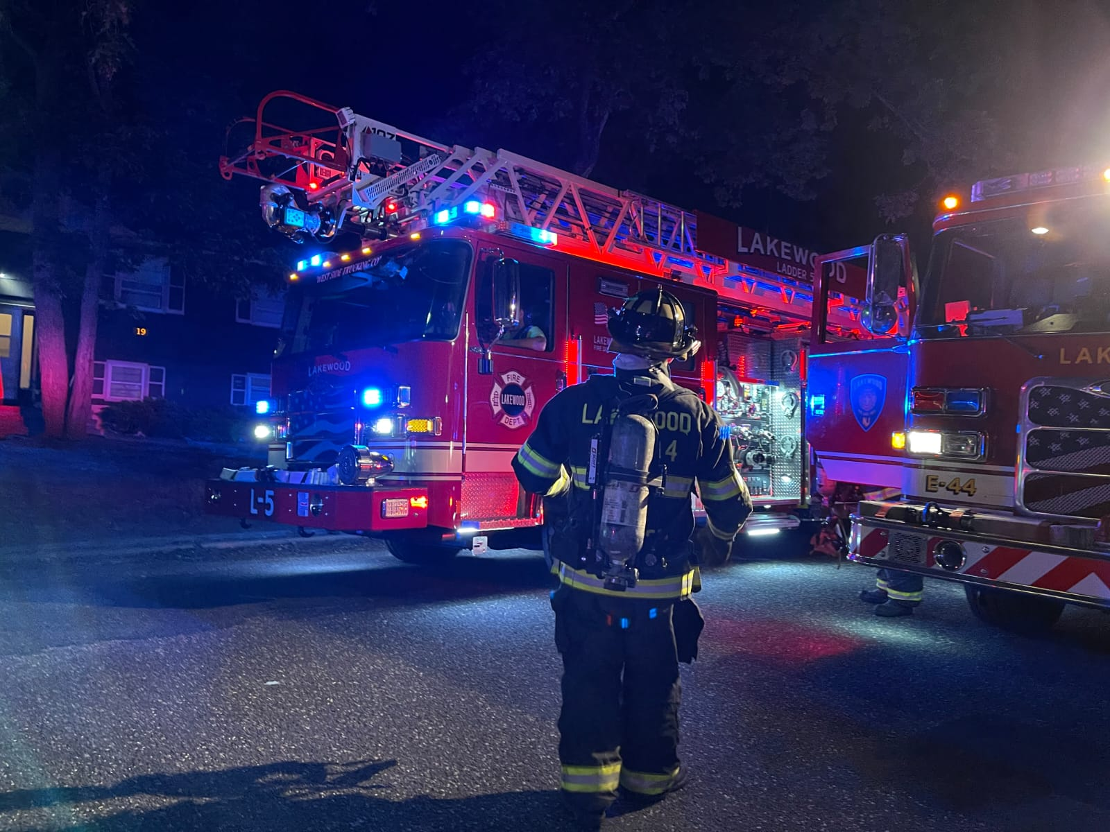
About me
Dovid Bender
Phone freak by day Firefighter by night.
ClueCon 2021 - How can we better secure our systems 2/16

Slide 3
Overview
Who is this for?
What has changed in the last few years?
What kind of attacks are we seeing?
What can we do about it?
ClueCon 2021 - How can we better secure our systems 3/16

Slide 4
Recent attacks
UK VOIP company
Not much known about attack(s)
ClueCon 2021 - How can we better secure our systems 4/16

Slide 5
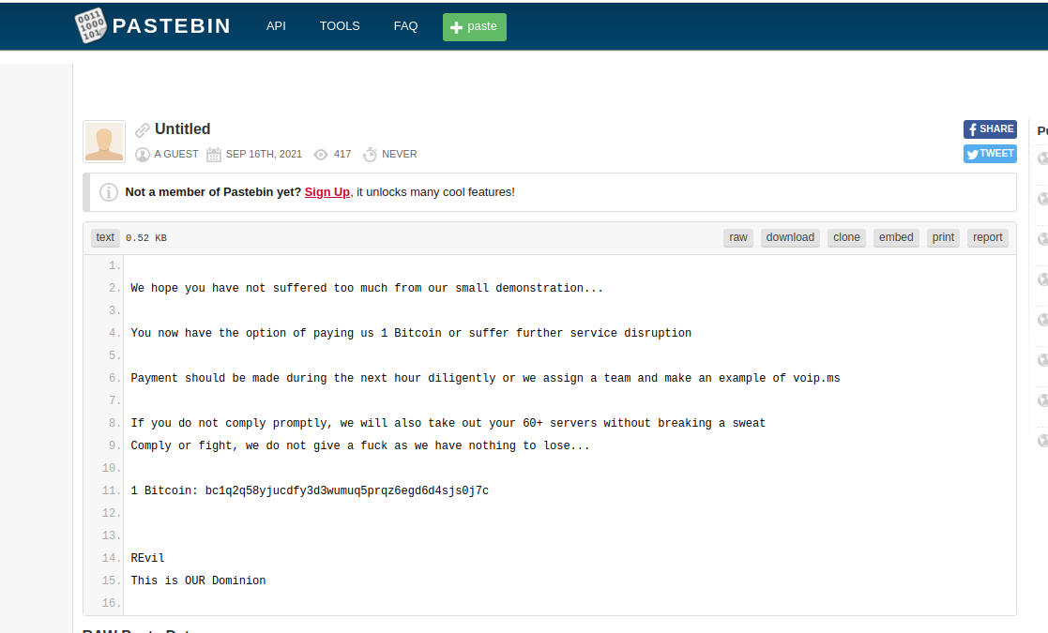
Recent attacks
VoIP.MS
- Was done for profit
- Started as an attack on their DNS servers.
- Pivoted to volumetric and I assume SIP as well
ClueCon 2021 - How can we better secure our systems 5/16

Slide 6
Recent attacks
Bandwidth
As with VoIP.MS was done for profit.
Started as volumetric attack.
Attacks seemed to have targeted the US 9-5 work day
BGP showed all routes dropped except ISP that does DDOS scrubbing.
A day or two later issues started again. I was told attackers pivoted to attacking with SIP packets.
BGP then showed all traffic going through cloudflare.
ClueCon 2021 - How can we better secure our systems 6/16

Slide 7
DDOS mitigation & protection
CloudFlare
Not cheap but is the gold standard.
They say they have 100TB of capacity.
Auto mitigation in 3 seconds.
At the very least SSH/WEB/DNS behind them. It won’t break the bank.
Many other services
ClueCon 2021 - How can we better secure our systems 7/16

Slide 8
DDOS mitigation & protection
Do it yourself. (AWS as an example).
AWS has a DDOS solution (not cheap).
Load Balancer (hashed based srcIP:port dstIP:port) so no issues with UDP.
Use OpenSIPS/Kamailio to scale out as needed. Let these instances take the brunt of the traffic.
Use the pike module to rate limit traffic, if there is too much ban the IP in iptables
Validate all packets to make sure they are valid SIP packets, if they aren’t ban them with iptables.
https://opensips.org/html/docs/modules/3.3.x/sipmsgops.html#func_sipmsg_validate
https://www.fredposner.com/2367/handling-sip-flood-attacks-using-kamailio/
https://www.fredposner.com/handling-non-sip-kamailio/
ClueCon 2021 - How can we better secure our systems 8/16

Slide 9
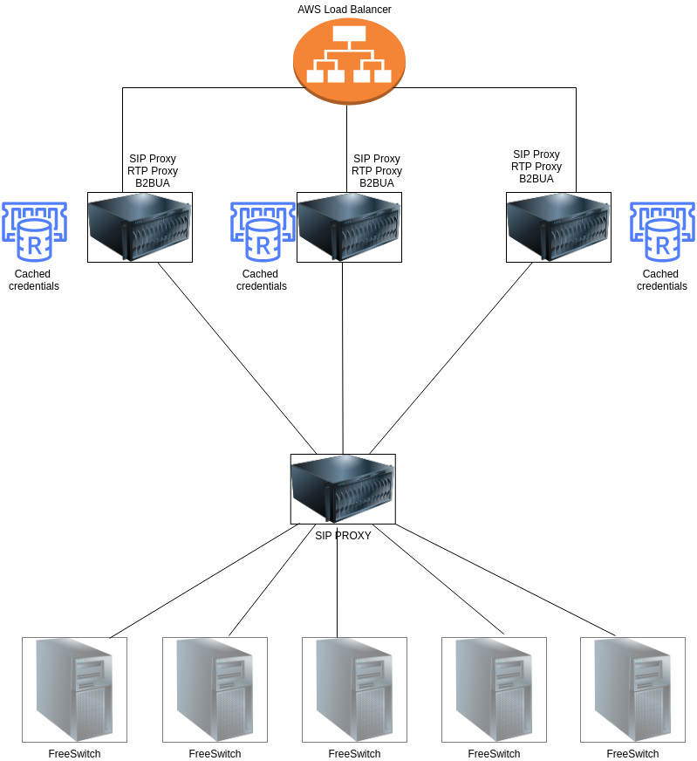
DDOS mitigation & protection
ClueCon 2021 - How can we better secure our systems 9/16

Slide 10
DDOS mitigation & protection
In addition
Lots of other DDOS mitigation providers out there. Do your homework.
Ban known bad IP’s for instance https://github.com/trick77/ipset-blacklist
TOR Exit nodes
Known bad/compromised hosts
API BAN - https://apiban.org/
Don’t forget about IPv6.
Hide from Shodan [1]
[1] https://www.kwancro.com/post/hide-from-shodan/
ClueCon 2021 - How can we better secure our systems 10/16

Slide 11
DDOS mitigation & protection
Whatever solution you go with TEST, TEST, TEST! DON’T ASSUME! A solution is worthless if not tested periodically.
Find a LEGITIMATE company that can stress test your system. [1] [2]
Many large telecom companies were shocked with their limits when stress testing their systems.
Self preserve. If your max is 50k CPS don’t let OpenSiPS/Kamailio take more. Drop the excess traffic rather than go down.
These are general rules. As you go through your dev cycle you should re-test and evaluate.
[1] https://www.enablesecurity.com/ - SIP, RTP, Web, XMPP and various others (volumetric coming)
[2] https://www.red-button.net/ - AWS Authorized DDOS test partner
ClueCon 2021 - How can we better secure our systems 11/16

Slide 12
Back to basics
Things to watch
Sign up with your vendors to find out about latest security issues. Most software vendors and lot’s of open source projects have a dedicated security email group for notifications.
Telegram can be a great resource. I follow
Hacker News https://t.me/hackernewslive
Cybersecurity & Privacy News - https://t.me/cibsecurity - Great for all CVE’s
The Hacker News - https://t.me/thehackernews
Cyber Security News - https://t.me/Cyber_Security_Channel
Podcasts
CyberWire-X
Security In Five Podcast
The Tripwire Cybersecurity Podcast
Defensive Security Podcast - Malware, Hacking, Cyber Security & Infosec
Beers with Talos Podcast
Twitter - The list is every long….
ClueCon 2021 - How can we better secure our systems 12/16

Slide 13
Back to basics
Just because you can’t do it all, it doesn’t mean you should not do any of it.
Have your system audited by a reputable organization.
Have a backup plan, and test it. Best if backups are:
Preferably stored off site, if on the cloud in a different account.
Stored with immutable storage.
If you have bare metal look at solutions like Veeam or N-Able.
Attackers like to linger.
Test periodically. You must validate your backups otherwise do you really have backups?
selinux/apparmor is there for a reason. Use it!
ClueCon 2021 - How can we better secure our systems 13/16

Slide 14
Back to basics
Principle of Least Privilege [1]
Does the SQL server need SSH access to the NFS server?
If using AWS or other cloud providers don’t use the same API keys for all systems.
Credentials should only have access to what they need to. (e.g. cdr’s collector should only have sql access to the cdrs table).
Segment your network. Put stops between systems. Don’t let an attacker move laterally.
SSH
Only leave open to known hosts or at the very least use a service like CloudFlare [2]
SSH KEYS ONLY with passphrases. Passwords should be for console access only.
2FA is a must and as much as we love SMS it can be less than secure.
[1] https://en.wikipedia.org/wiki/Principle_of_least_privilege
[2] https://www.cloudflare.com/products/cloudflare-spectrum/ssh/
ClueCon 2021 - How can we better secure our systems 14/16

Slide 15
Back to basics
Cycle through passwords regularly.
The only secure password is the one you don’t know, use password managers.
Have a schedule to update your systems periodically.
Provisioning
If you provision handsets, mutual TLS is a must.
Reduce the attack surface area (e.g. by customer or phone moel).
Don’t rely on one method (e.g. use Fail2Ban with mutual TLS)
Look at my talk from 2018 [1]
[1] https://www.youtube.com/watch?v=9Wzzlo1kfTQ
ClueCon 2021 - How can we better secure our systems 15/16

Slide 16
Thank you
Evan Mcgee from Signal Wire @startledmarmot
Fred Posner from LOD @fredposner
Sandro Gauci from Enable Security @sandrogauci
David Duffett from Let The Geek speak @dduffett
SignalWire crew!
Questions?
ClueCon 2021 - How can we better secure our systems 16/16

