Slide 1

Easy Asterisk Trouble-Shooting
Dovid Bender The Flat Planet Phone Company Inc.
dovid@flatplanetphone.com
https://github.com/dovi5988/asterisk-world
Asterisk World 2016 – Easy Asterisk Trouble-Shooting 1/25

Slide 2
About Us
The Flat Planet Phone Company Inc - Established in 2006 - Providing hosted PBX solutions - High quality SIP trunking
- Part of the NGN group Omega-Telecom (Cyprus), Hallo 015 (Israel), Newtel Systems (NY), Fone.Do (The Cloud)
Asterisk World 2016 – Easy Asterisk Trouble-Shooting 2/25
Notes:
Change Moshe notes

Slide 3
Outline
History and issues that we faced
What we monitor for and how we go about it
rSyslog
Customer input
VoipMonitor
Cacti/Nagios
24/7 NOC
Asterisk World 2016 – Easy Asterisk Trouble-Shooting 3/25

Slide 4
History
Started out in 2006 with two servers in one small data center.
Slowly grew to 100 pieces of hardware in five data centers across three continents.
Everything worked great until we had a problem. It took hours to track down.
Having an unmonitored network is like shooting blind folded in the wild west.
Asterisk World 2016 – Easy Asterisk Trouble-Shooting 4/25

Slide 5
History
MONITOR! MONITOR! MONITOR! If something does not look right investigate!
(You should always be checking anyways.)
Asterisk World 2016 – Easy Asterisk Trouble-Shooting 5/25

Slide 6
rSyslog
Single server environment: We can simply use the Asterisk logs - Multi server environment: We have all servers log to two local rSyslog servers. Options also include cloud solutions such as Papertrail and LogEntries.
On Asterisk Server /etc/asterisk/logger.conf syslog.local0 => notice,warning,error,debug,verbose,dtmf,fax
/etc/rsyslog.conf
local0.* @10.0.0.10
local0.* @10.0.0.11
local0.* @cloudprovider.example.org
On rSyslog server(s):
:fromhost-ip, isequal, "192.168.1.10" /var/log/asterisk/all_asterisk_servers.log
:fromhost-ip, isequal, "192.168.10.11" /var/log/asterisk/all_asterisk_servers.log
Asterisk World 2016 – Easy Asterisk Trouble-Shooting 6/25

Slide 7
rSyslog
[demo@logger asterisk]# tail -f /var/log/asterisk/all_asterisk.log | grep "dev asterisk.*18005551212"
Sep 7 19:56:30 dev asterisk[7630]: VERBOSE[26791]: pbx.c:4238 in pbx_extension_helper: -- Executing [18005551212@from-fpp:1] Goto("SIP/demo-opensips-000001c1", "voice_blast_main,s,1") in new stack
[demo@logger asterisk]#
tail -n 1000 all_asterisk_servers.log| grep '\[26791\]'
Sep 7 19:56:30 dev asterisk[7630]: VERBOSE[26791]: pbx.c:4238 in pbx_extension_helper: -- Executing [18005551212@from-fpp:1] Goto("SIP/demo-opensips-000001c1", "voice_blast_main,s,1") in new stack
Sep 7 19:56:30 dev asterisk[7630]: VERBOSE[26791]: pbx.c:9838 in pbx_builtin_goto: -- Goto (voice_blast_main,s,1)
Sep 7 19:56:30 dev asterisk[7630]: VERBOSE[26791]: pbx.c:4238 in pbx_extension_helper: -- Executing [s@voice_blast_main:1] Answer("SIP/demo-opensips-000001c1", "") in new stack
Sep 7 19:56:31 dev asterisk[7630]: VERBOSE[26791]: pbx.c:4238 in pbx_extension_helper: -- Executing [s@voice_blast_main:2] Set("SIP/demo-opensips-000001c1", "TIMEOUT(digit)=2") in new stack
Sep 7 19:56:31 dev asterisk[7630]: VERBOSE[26791]: func_timeout.c:183 in timeout_write: -- Digit timeout set to 2.000
Sep 7 19:56:31 dev asterisk[7630]: VERBOSE[26791]: pbx.c:4238 in pbx_extension_helper: -- Executing [s@voice_blast_main:3] Set("SIP/demo-opensips-000001c1", "TIMEOUT(response)=3") in new stack
Sep 7 19:56:31 dev asterisk[7630]: VERBOSE[26791]: func_timeout.c:175 in timeout_write: -- Response timeout set to 3.000
Sep 7 19:56:31 dev asterisk[7630]: VERBOSE[26791]: pbx.c:4238 in pbx_extension_helper: -- Executing [s@voice_blast_main:4] NoOp("SIP/demo-opensips-000001c1", "") in new stack
Sep 7 19:56:31 dev asterisk[7630]: VERBOSE[26791]: pbx.c:4238 in pbx_extension_helper: -- Executing [s@voice_blast_main:5] BackGround("SIP/demo-opensips-000001c1", "enter_phone_numberr") in new stack
Sep 7 19:56:40 dev asterisk[7630]: WARNING[26791]: file.c:663 in ast_openstream_full: File enter_phone_numberr does not exist in any format
Sep 7 19:56:40 dev asterisk[7630]: WARNING[26791]: file.c:958 in ast_streamfile: Unable to open enter_phone_numberr (format 0x4 (ulaw)): No such file or directory
Sep 7 19:56:40 dev asterisk[7630]: WARNING[26791]: pbx.c:9781 in pbx_builtin_background: ast_streamfile failed on SIP/demo-opensips-000001c1 for enter_phone_numberr
Asterisk World 2016 – Easy Asterisk Trouble-Shooting 7/25

Slide 8
rSyslog
Exten => _X.,10,GotoIf($["${DIALSTATUS}" = "NOANSWER"]?10)
[root@ollie asterisk]# cat /tmp/o | grep 'to-carrier-a_z,123456789,10' | wc -l
5239461
[root@ollie asterisk]#
Asterisk World 2016 – Easy Asterisk Trouble-Shooting 8/25

Slide 9
rSyslog
#!/bin/bash
MAILTO=dovid@flatplanetphone.com
tail -Fn0 /var/log/asterisk/full|\
while read LINE
do
if [[ $LINE =~ (.+Peer \'(.+)\' is now UNREACHABLE.+) ]] ; then
Q=mktemp
echo "Peer ${BASH_REMATCH[2]} just became unreachable. Below is a trace." > $Q
echo "" >> $Q
/usr/sbin/mtr -o "L SRD NBAW JMXI" --report --report-cycles 5 --no-dns `/usr/sbin/asterisk -rx'sip show peers' | grep ${BASH_REMATCH[2]} | awk '{print $2}'` >> $Q
mail -s "Connectivity issues to peer ${BASH_REMATCH[2]}" $MAILTO < $Q
rm -rf $Q
fi
done
Make sure to use the latest version of mtr!
Asterisk World 2016 – Easy Asterisk Trouble-Shooting 9/25

Slide 10
rSyslog
* * * * * /usr/sbin/asterisk -rx 'sip show peers' | grep UNREACHABLE | /root/log_unreachable.sh >/dev/null 2>&1
#! /bin/bash
while read INPUT
do
IFS=' ' read -ra INPUT <<< "$INPUT"
DIR=/var/log/traces/${INPUT[0]}/$(date +%Y-%m-%d)/$(date +"%H")/
DIR_FILE=$DIR$(date +"%M")
mkdir -p $DIR
/usr/sbin/mtr -o "L SRD NBAW JMXI" --report --report-cycles 5 --no-dns ${INPUT[1]} > $DIR_FILE
done
Asterisk World 2016 – Easy Asterisk Trouble-Shooting 10/25

Slide 11
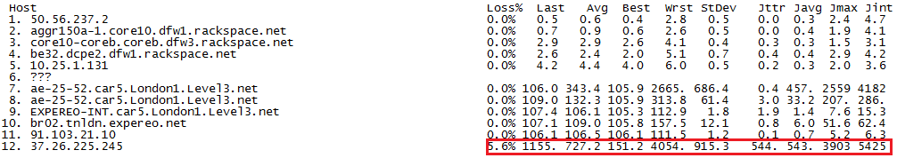
rSyslog
Asterisk World 2016 – Easy Asterisk Trouble-Shooting 11/25

Slide 12
Customer Input
Your customers can be a very helpful resource.
Let them know their input is valued.
Fast response time, even if it is a simple “we are investigating”.
Train them to accurately report issues.
Three scripts that we have set up to help customers report issues.
Looking glass (https://github.com/telephone/LookingGlass)
Trace activated by a call.
Reporting of bad call during call.
Asterisk World 2016 – Easy Asterisk Trouble-Shooting 12/25

Slide 13
Customer Input
run_mtr-aw.php
- If there is a quality issue, customer dials code that sends call details along with trace
-- Launched AGI Script /var/lib/asterisk/agi-bin/run_mtr-aw.php
-- AGI Script Executing Application: (PlayBack) Options: (one-moment-please)
-- <SIP/1200-00000019> Playing 'one-moment-please.gsm' (language 'en')
/var/lib/asterisk/agi-bin/run_mtr-aw.php: Hi there,
/var/lib/asterisk/agi-bin/run_mtr-aw.php:
/var/lib/asterisk/agi-bin/run_mtr-aw.php: The peer 1200 just dialed *222 to indicate that they may have a quality issue. Below is the details of the connection as well as a trace.
/var/lib/asterisk/agi-bin/run_mtr-aw.php: audioreadformat: ulaw
/var/lib/asterisk/agi-bin/run_mtr-aw.php: audionativeformat: ulaw
/var/lib/asterisk/agi-bin/run_mtr-aw.php: audiowriteformat: ulaw
/var/lib/asterisk/agi-bin/run_mtr-aw.php: peerip: 129.250.2.208
/var/lib/asterisk/agi-bin/run_mtr-aw.php: recvip: 129.250.2.208
/var/lib/asterisk/agi-bin/run_mtr-aw.php: from: sip:991200@sip.mydomain.org
/var/lib/asterisk/agi-bin/run_mtr-aw.php: uri: sip:991200@129.250.2.208:5063
/var/lib/asterisk/agi-bin/run_mtr-aw.php: useragent: Yealink SIP-T26P 6.60.18.4
/var/lib/asterisk/agi-bin/run_mtr-aw.php: peername: 1200
/var/lib/asterisk/agi-bin/run_mtr-aw.php: channeltype: SIP
/var/lib/asterisk/agi-bin/run_mtr-aw.php: rtpdest: 129.250.2.208 :11788
/var/lib/asterisk/agi-bin/run_mtr-aw.php:
/var/lib/asterisk/agi-bin/run_mtr-aw.php: HOST: sip.mydomain.org LOSS% Snt Rcv Drop Last Best Avg Wrst Jttr Javg Jmax Jint
/var/lib/asterisk/agi-bin/run_mtr-aw.php: 1. 50.56.237.2 0.0% 10 10 0 0.5 0.5 0.7 1.0 0.0 0.2 0.6 1.9
/var/lib/asterisk/agi-bin/run_mtr-aw.php: 2. 67.192.88.38 0.0% 10 10 0 0.9 0.7 1.0 1.8 0.0 0.4 1.1 3.1
/var/lib/asterisk/agi-bin/run_mtr-aw.php: 3. 74.205.108.48 0.0% 10 10 0 3.7 3.2 4.2 9.6 0.1 1.6 6.3 11.2
/var/lib/asterisk/agi-bin/run_mtr-aw.php: 4. 74.205.108.112 0.0% 10 10 0 5.8 3.2 4.0 5.8 2.6 1.0 2.6 8.7
/var/lib/asterisk/agi-bin/run_mtr-aw.php: 5. 10.25.1.103 0.0% 10 10 0 5.2 5.1 5.2 5.8 0.1 0.2 0.7 1.5
/var/lib/asterisk/agi-bin/run_mtr-aw.php: 6. 129.250.207.117 0.0% 10 10 0 5.2 5.1 5.6 6.7 0.7 0.6 1.5 5.2
/var/lib/asterisk/agi-bin/run_mtr-aw.php: 7. 129.250.2.208 0.0% 10 10 0 6.0 4.9 5.6 6.7 0.7 0.6 1.5 4.6
/var/lib/asterisk/agi-bin/run_mtr-aw.php:
-- AGI Script Executing Application: (PlayBack) Options: (privacy-thankyou)
-- <SIP/1200-00000019> Playing 'privacy-thankyou.gsm' (language 'en')
-- <SIP/1200-00000019>AGI Script /var/lib/asterisk/agi-bin/run_mtr-aw.php completed, returning 0
Asterisk World 2016 – Easy Asterisk Trouble-Shooting 13/25

Slide 14
Customer Input
log_bad_call.php
If there is a quality issue, customer dials code during the bad call to alert us.
Call sample is sent to support along with URL to PCAP of call.
[applicationmap]
testfeature => #9,peer,Playback,tt-monkeys
pauseMonitor => #1,self/callee,Pausemonitor
unpauseMonitor => #3,self/callee,UnPauseMonitor
caller_hangup => *0,caller,Hangup
callee_hangup => *0,callee,Hangup
log_call_caller => *#,self/caller,agi,/var/lib/asterisk/agi-bin/log_bad_call.php
log_call_callee => *#,self/callee,agi,/var/lib/asterisk/agi-bin/log_bad_call.php
[from-customers]
Exten => _X., 1, set(__DYNAMIC_FEATURES=log_call_caller#log_call_callee)
Exten => _X.,2, Agi(process_call.php)
Asterisk World 2016 – Easy Asterisk Trouble-Shooting 14/25

Slide 15
VoipMonitor
VoipMonitor (http://www.voipmonitor.org/)
- Single most widely used tool in our company.
- Sniffer is open source, gui is not
- GUI is worth every penny
- Possibilities are endless
Very scalable, largest deployment is 3 gb of traffic with 30, 000 simultaneous calls (SIP+RTP) and 120,000 simultaneous calls tracing SIP only (roughly 6000 CPS).
Some examples of data that we can get directly from the database:
Registration failures
cdrs
Asterisk World 2016 – Easy Asterisk Trouble-Shooting 15/24

Slide 16
VoipMonitor
Registration failures
mysql> select counter, created_at, INET_NTOA(sipcallerip) as src_ip, INET_NTOA(sipcalledip) as dst_ip, from_num, to_num, contact_num, contact_domain, digestusername, to_domain, (select ua from cdr_ua where id = ua_id) as ua from register_failed where id in(1756938, 1717326) \G
****************************** 1. row ******************************
counter: 930567
created_at: 2015-10-08 14:47:15
src_ip: 11.11.11.11
dst_ip: 103.102.77.32
from_num: 1010
to_num: 1010
contact_num: 1010
contact_domain: 192.168.100.103
digestusername: 1010
to_domain: sip1.example.org
ua: Yealink SIP-T20P 9.70.23.8 00:15:65:aa:bb:cc
****************************** 2. row ******************************
counter: 5
created_at: 2015-10-08 01:41:55
src_ip: 222.222.222.222
dst_ip: 103.102.77.32
from_num: 2749
to_num: 2749
contact_num: 2749
contact_domain: 192.168.1.106
digestusername: 2749
to_domain: sip-02.example.org
ua: PolycomVVX-VVX_400-UA/5.2.2.0501_0004f2aabbcc
Asterisk World 2016 – Easy Asterisk Trouble-Shooting 16/25

Slide 17
VoipMonitor
calldate: 2015-09-24 12:43:35
callend: 2015-09-24 12:43:41
duration: 6
connect_duration: 4
progress_time: 2
first_rtp_time: 2
caller: 1000
caller_domain: 103.102.77.32
caller_reverse: 0001
callername: Dovid
callername_reverse: divoD
called: 18005551212
called_domain: 103.102.77.32
called_reverse: 21215550081
caller_ip: 99.99.99.99
sipcallerport: 1030
called_ip: 103.102.77.60
sipcalledport: 5060
whohanged: caller
last_sip_response: 200 OK
sip_response_code: 200
source_addr: 99.99.99.99
dst_addr: 103.102.77.60
proxy_src: NULL
proxy_dst: 103.102.77.32
SIP_Call_ID: 6b45489a-69d7f6b0-a86bd93@192.168.2.14
src_lost_packets: 2
dst_lost_packets: 0
src_ua: PolycomSoundPointIP-SPIP_501-UA/3.1.6.0017
dst_ua:
a_maxjitter: 2
b_maxjitter: 7
a_sl1: 2
a_sl2: 0
a_sl9: 0
a_sl10: 0
b_sl1: 0
b_sl2: 0
b_sl9: 0
b_sl10: 0
a_last_rtp_from_end: 0
b_last_rtp_from_end: 2
calldate: 2015-09-24 12:43:36
callend: 2015-09-24 12:43:43
duration: 7
connect_duration: 6
progress_time: 1
first_rtp_time: 1
caller: 12129998888
caller_domain: 103.102.77.60
caller_reverse: 99998882121
callername: Dovid
callername_reverse: divoD
called: 554418005551212
called_domain: 70.10.217.10
called_reverse: 212155500817747
caller_ip: 103.102.77.60
sipcallerport: 5060
called_ip: 70.10.217.10
sipcalledport: 5061
whohanged: caller
last_sip_response: 200 OK
sip_response_code: 200
source_addr: 103.102.77.60
dst_addr: 206.23.67.28
proxy_src: NULL
proxy_dst: 103.102.77.32
SIP_Call_ID: 0142d0b01488961f3d92956a@103.102.77.60:5060
src_lost_packets: 1
dst_lost_packets: 0
src_ua: Asterisk
dst_ua:
a_maxjitter: 5
b_maxjitter: 3
a_sl1: 1
a_sl2: 0
a_sl9: 0
a_sl10: 0
b_sl1: 0
b_sl2: 0
b_sl9: 0
b_sl10: 0
a_last_rtp_from_end: 2
b_last_rtp_from_end: 0
Asterisk World 2016 – Easy Asterisk Trouble-Shooting 17/25

Slide 18
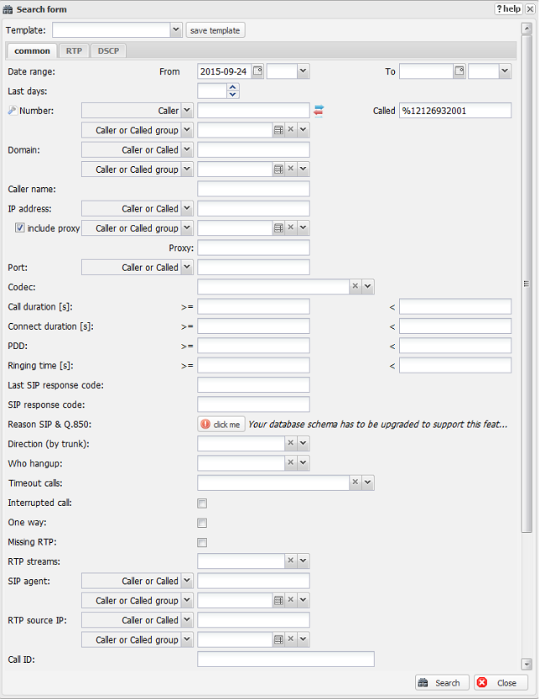
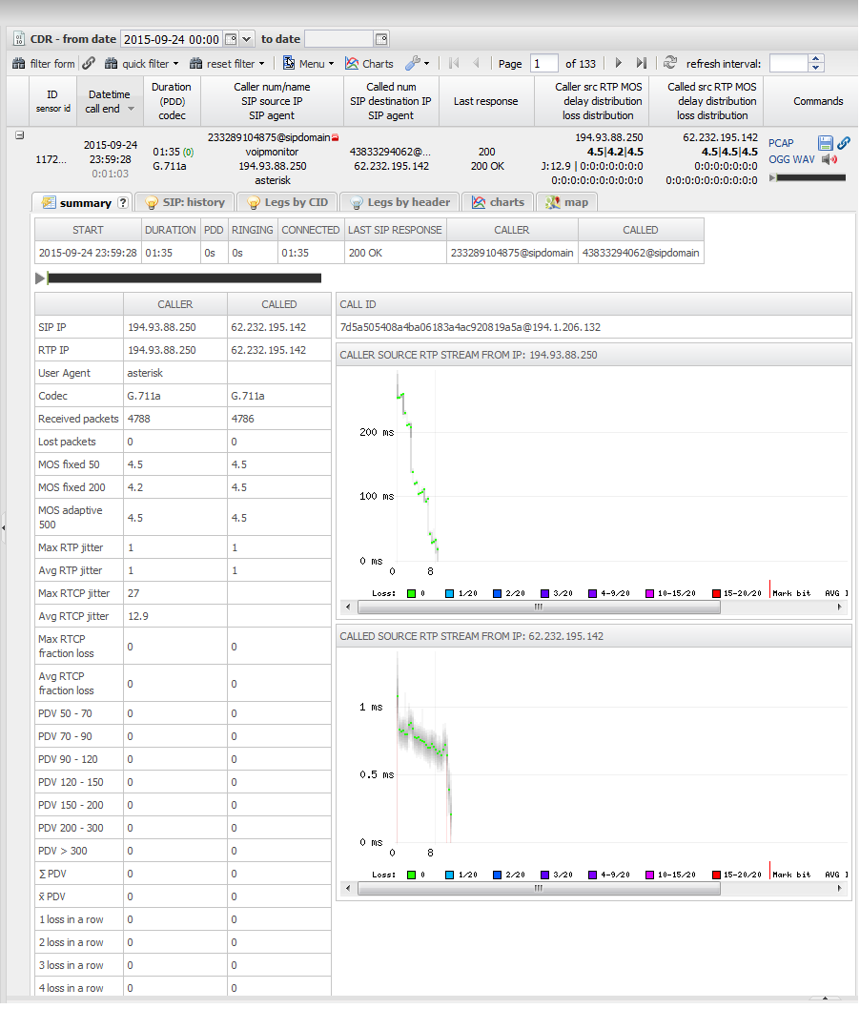
VoipMonitor
Asterisk World 2016 – Easy Asterisk Trouble-Shooting 18/25

Slide 19
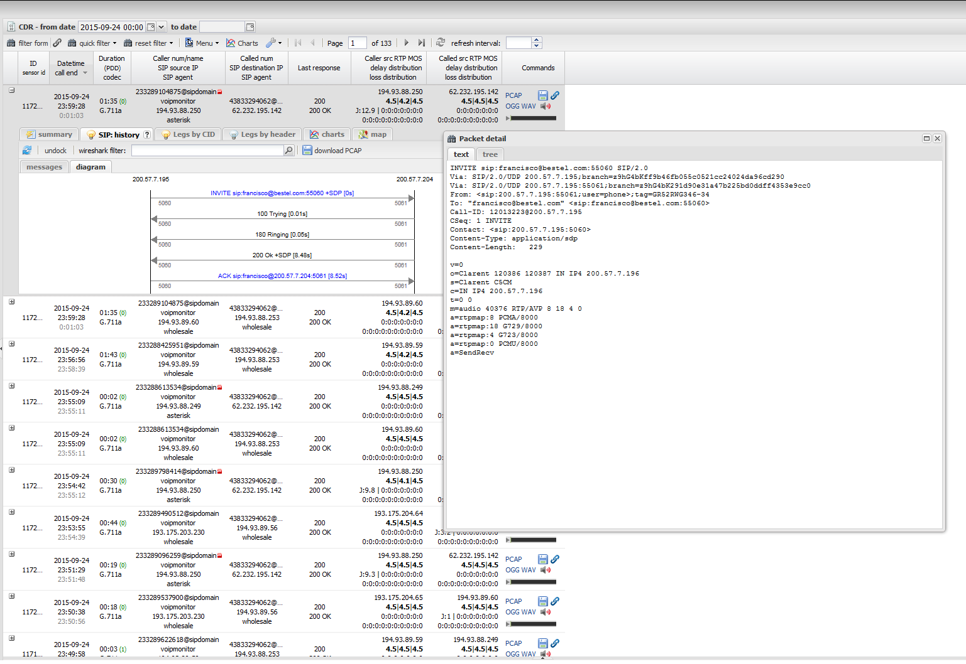
VoipMonitor
Asterisk World 2016 – Easy Asterisk Trouble-Shooting 19/25

Slide 20
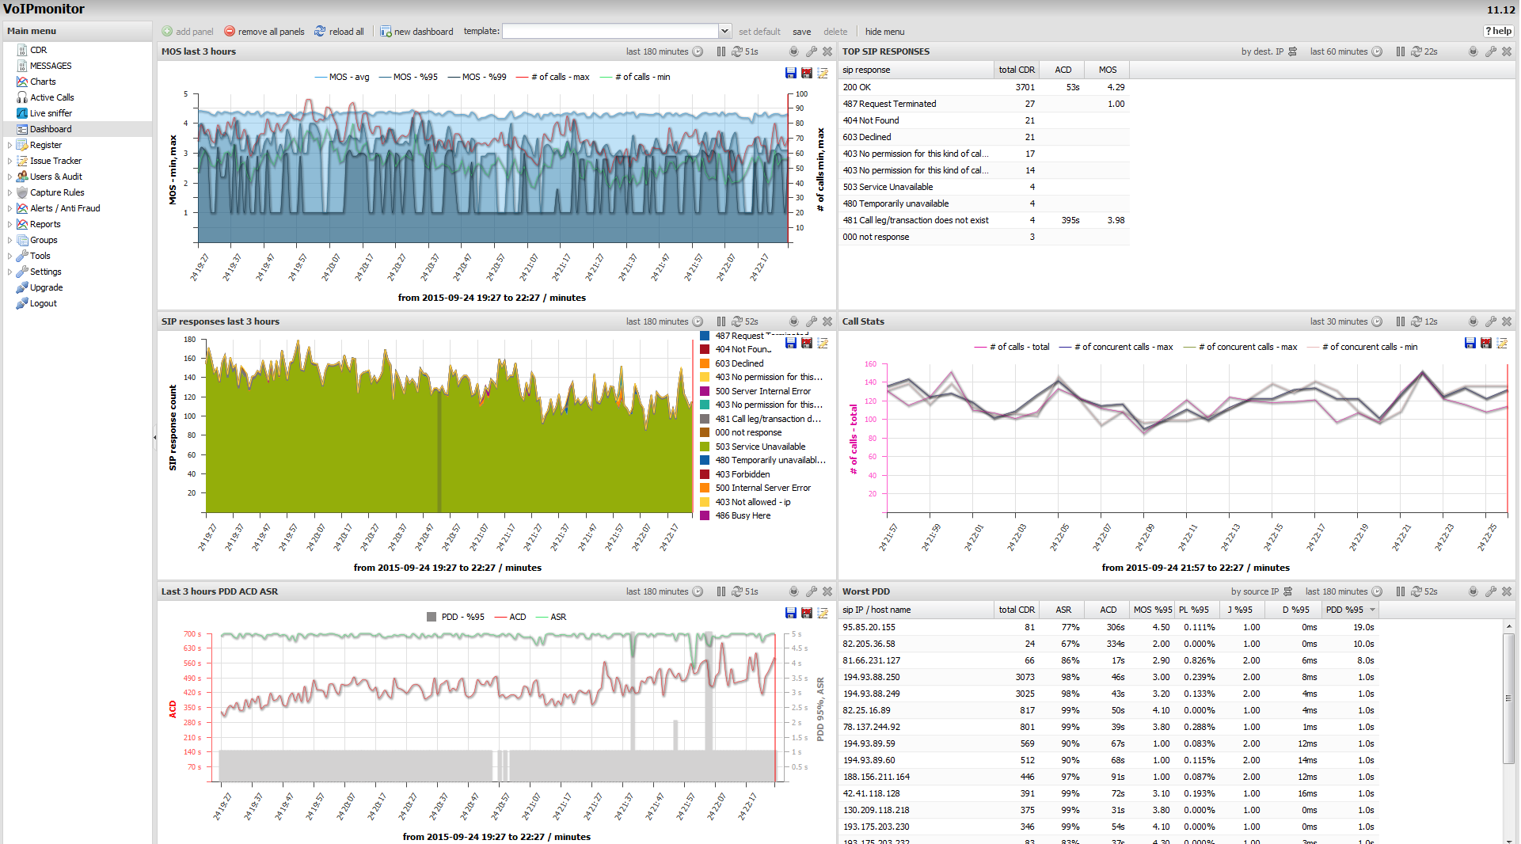
VoipMonitor
Asterisk World 2016 – Easy Asterisk Trouble-Shooting 20/25

Slide 21
Cacti/Nagios
Nagios is used more to alert of a current issue.
Cacti is used for monthly reviews and post mortem.
Should NOT be in the same physical location as the equipment you are monitoring
The more you watch the better!
Monitor anything and everything.
Make sure to review cacti and review it often.
What we watch in Cacti we also watch in Nagios
All Linux Operating systems have a basic list of items that can be monitored via SNMP such as:
CPU usage
Fan speeds
Load average
Bandwidth usage
Voltage
Disk usage
Uptime
Temperature
Memory (Physical memory, swap etc.)
Asterisk World 2016 – Easy Asterisk Trouble-Shooting 21/25

Slide 22
Cacti/Nagios
For all other items we have bash scripts that we connect via SNMP. Some of them are:
How many users are logged on to the server?
How many files are open on the system?
Ping time to the server. How fast is it responding?
CPU usage by Asterisk, Fail2Ban, Sendmail, MySQL, Apache etc.
IO Wait
Total calls
G729 licenses in use
Asterisk calls
Asterisk channels
How many users are registered?
Outgoing calls
Incoming calls
Internal calls
Asterisk threads
Asterisk SIP channels
Memory usage by process such as Asterisk, Fail2Ban, Sendmail, MySQL, Apache etc.
Logging if a process is up or down
How many connections are there to MySQL
Are there any slow queries?
Latency to VIP clients and carriers
What is considered a problem? What are we checking for?
There is no one size fits all. Everything depends on what is normal for you.
Asterisk World 2016 – Easy Asterisk Trouble-Shooting 22/25

Slide 23
24/7 NOC
A lot cheaper than you think
Sleep easier at night knowing your network is being watched 24/7
Great selling point for customers, it puts them at ease
Help with tasks from small “helper scripts” to large projects (depending on your agreement).
Extra eyes and ears on your network
Does NOT replace your core team it compliments them.
Experience with known issues and remedies to solve them.
Asterisk World 2016 – Easy Asterisk Trouble-Shooting 23/25

Slide 24
Questions?
Asterisk World 2016 – Easy Asterisk Trouble-Shooting 24/25

Slide 25
Thank you!
https://github.com/dovi5988/asterisk-world
Asterisk World 2016 – Easy Asterisk Trouble-Shooting 25/25

