Slide 1
GUI for OGRE3D Particle File Generation
By Dovydas Stankevicius and Sigurgrímur Unnar Ólafsson

Slide 2
Purpose and Motivation
To create a simple particle rendering engine
To make OGRE .particle files user friendly and easily accessible
To gain better understanding on how particle systems work
To get some basic experience in writing our own rendering engine
To create a lightweight system for quick .particle generation, where user is not required to download any software

Slide 3
Related and Existing work
Many particle editing engines
Quite few online particle editors exists
Nothing for OGRE (though exists a particle engine, however its not web based)
Couple examples
Particle editor for Cocos2dx (.json)
Online Flash editor for generating .pex files

Slide 4
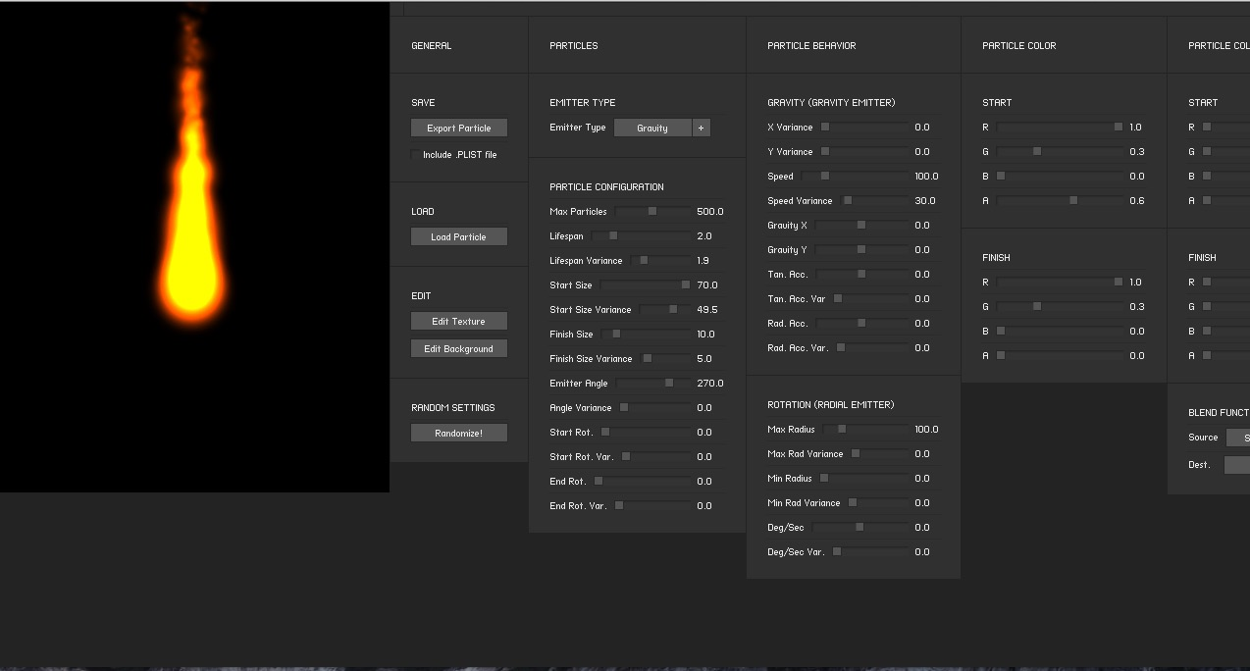
Flash Particle Editor
http://onebyonedesign.com/flash/particleeditor/

Slide 5
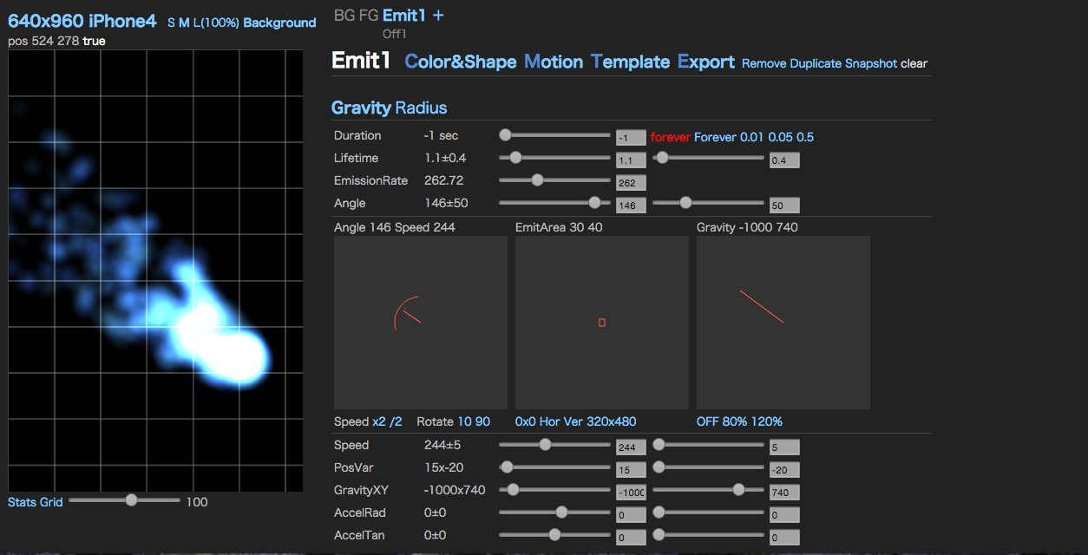
particle 2dx
http://particle2dx.com/

Slide 6
Our contribution
We designed simple web based particle editor for OGRE3D (from scratch)
The website structure allows possibility of taking this project even further by adding support for more file formats
The website is written using HTML5 canvas and AngularJS framework
SO Lets check out the results…

Slide 7
TEST IT YOURSELF! :D
http://guiopfg.freysteinn.com/#/create

