Slide 1
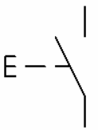
Barra de 110 sensores (10x11 nodos)
HMI 10”
Pantalla LED P10 32x16
123.4 cm²
RS232
2.2m
MCU STM32
IMPRESORA
MATRICIAL
RS485
RS485
USB
I1
Q1
ENCODER
M1
INICIAR

