Slide 1
Random numbers.
Strongly determined system:
1.Operation amplifier with feedback:
2R
R
A
2A
2.Classical Mechanics: moving of the point particle: 3 d moving point like object
F=M x a ∆t V=a x ∆t + V0 x= x0 + a²x ∆t /2
M, V0, x0,t0
Interaction or moving low
Final state
Initial state
S.Kuleshov UTFSM 06.05.2009

Slide 2


Slide 3
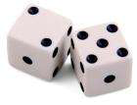
Random numbers
Deterministic world with more complicated systems:
You have huge number degrees of freedom system
with non fully determined initial state and parameters
(things we could know in principle but don’t
e.g. from limitations of cost, time, ...). Or we can't know in pinciple
Thermodynamic of ideal gas. T, P, V.
Game “Heads or Tails” . We will play later.
Casino. Lucky and Unlucky. I would not recommend.
Stock Market. Cleaver and Lucky. Be careful !
Example: Dice. Roll of the dice: 6x6= 36 combinations.
If there are not loaded dice , all combinations are equivalent. We are saying :”They have an equivalent PROBABILITY.”
Non deterministic world: non deterministic nature of micro cosmos.
Dealing with uncertainty
In particle physics there are various elements of uncertainty:
theory is not deterministic
quantum mechanics
random measurement errors
present even without quantum effects
Our aim is to consider how work with and how provide random numbers.
S.Kuleshov, UTFSM, 06.05.2009

Slide 4
Heads or Tails
Heads or Tails is a coin-tossing game. Most coins have a side where the imprint
of a person's head, such as a current or former head of state, is impressed — this
side is called the "heads" side. The other side is called the "tails" side, irrespective
of its design. Technically, the heads and tails sides are known as the obverse and reverse,
respectively.
In 1870 Brewer's Dictionary of Phrase and Fable describes heads in a similar way and
details tails as being the opposite and obvious reverse to heads. The expression
'can't make head nor tail of it' expresses this concept of opposites.
Generally, one person throws the coin up in the air, and the second person must predict
which side of the coin will lay face up after it rests back on the ground. A correct prediction
results in a win. Another variation has the person catch the coin in one hand and
slap it on the back of their other hand. Traditionally, the second person calls out
"heads" or "tails" while the coin is in the air.

Slide 5
Random numbers. A coin tossing.
Let’s consider a modification of “Heads or Tails “ game: an experiment with Chilean coin.
All of you should make 10 attempts (tosses) with a coin and write result in the table (see below, next slide).
Set “Head” is 1, “Tail” is 0.
My attempts (with 10 pesos coin): 1,0,0,1,0,0,1,0,1,1.
Each player made the experiment (10 attempts) with a coin and we suggest that the experiment result doesn’t depend from an experimentalist. It is very strong suggestion and there are special methods to check it (may be we will consider this later.)
If we could suppose that it is possible to provide “clean” experiment with coins, it means that there is “coin low”, or “coin statistics”. And each our experiment is an exposure of “coin statistics”. And every exposure is limited by attempts numbers, so you could provide only limited information about “coin low” (samples) in an experiment.
Let’s go to practice!

Slide 6
Random numbers. A coin tossing.
Toss # Player # | 1 | 2 | 3 | 4 | 5 | 6 | 7 | 8 | 9 | 10
1 | 1 | 0 | 0 | 1 | 0 | 0 | 1 | 0 | 1 | 1
2
3
4
5
6
7
8
9
10
11

Slide 7
Random numbers. Practice with ROOT.
If you work under Windows you should go to C:\root and make “my” folder and than “rannum” folder in “my”.
Copy my files to ~\my\runnum
Open ROOT
Print and enter: ‘.x C:\root\my\rannum\hello.txt ‘ and you will get answer “hello I have understood this !”
After lecture open file C:\root\my\rannum\hello.txt with Word, try to modify this and execute with ROOT
.x C:\root\my\rannum\pl1.txt is the simplest ROOT script !

Slide 8
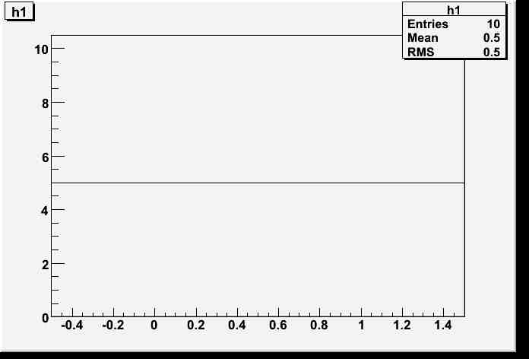
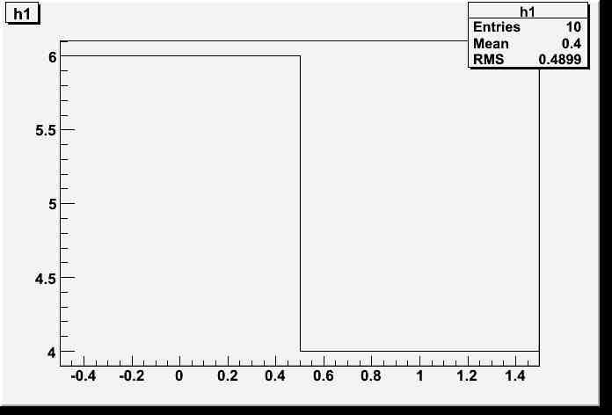
Random numbers. .x C:\root\my\rannum\pl1.txt
pl1.txt
set1.dat
Histograms:
void pl1()
{
TCanvas *MyC = new TCanvas("MyC","Test canvas",1);
MyC->Divide(1,1);
cout<<"pl1 open"<<"\n";
char s[50];
sprintf(s,"C:\\root\\my\\rannum\\set1.dat");
cout<<s<< "\n";
Int_t income[10];
h1 = new TH1F("h1","h1",2,-0.5,1.5);
ifstream fin;
fin.open(s);
Int_t b;
Float_t x;
for(int i=0;i<10;i++)
{
fin>>b;
income[i]=b;
//cout<<b<<"\n";
cout<<income[i]<<"\n";
x=income[i];
h1->Fill(x);
}
fin.close();
MyC->cd(1);
h1->Draw();
}
1
0
0
1
0
0
1
0
1
1
set2.dat
1
0
0
1
0
0
1
0
1
0

Slide 9
Distributions and Histograms.
Number attempts N=10 Entries =10
Sum of “heads”(X₁) and “tails”(X₂) 1+0+0+1+0+0+1+0+1+1=5 or ∑ = X_{i} Number attempts N= 10, so ∑/N=0.5 Mean=0.5
∑/N=0.5 is a sample mean of our “coin statistics”, let’s calculate this for all players:
Dispersion and RMS. Let’s calculate this.
What will be if we take 3, 5 attempts ? What will be if we take very large number (10⁶) attempts?
2
i=1

Slide 10
Probability.
Px₁ , Px₂ N->∞ Nx₁/N-> Px₁ =0.5 Nx₂/N-> Px₂ =0.5 Mean, D,
Uniform distribution
What will be if consider 10 attempts as 1 random number? Number players ->∞.

