Slide 1


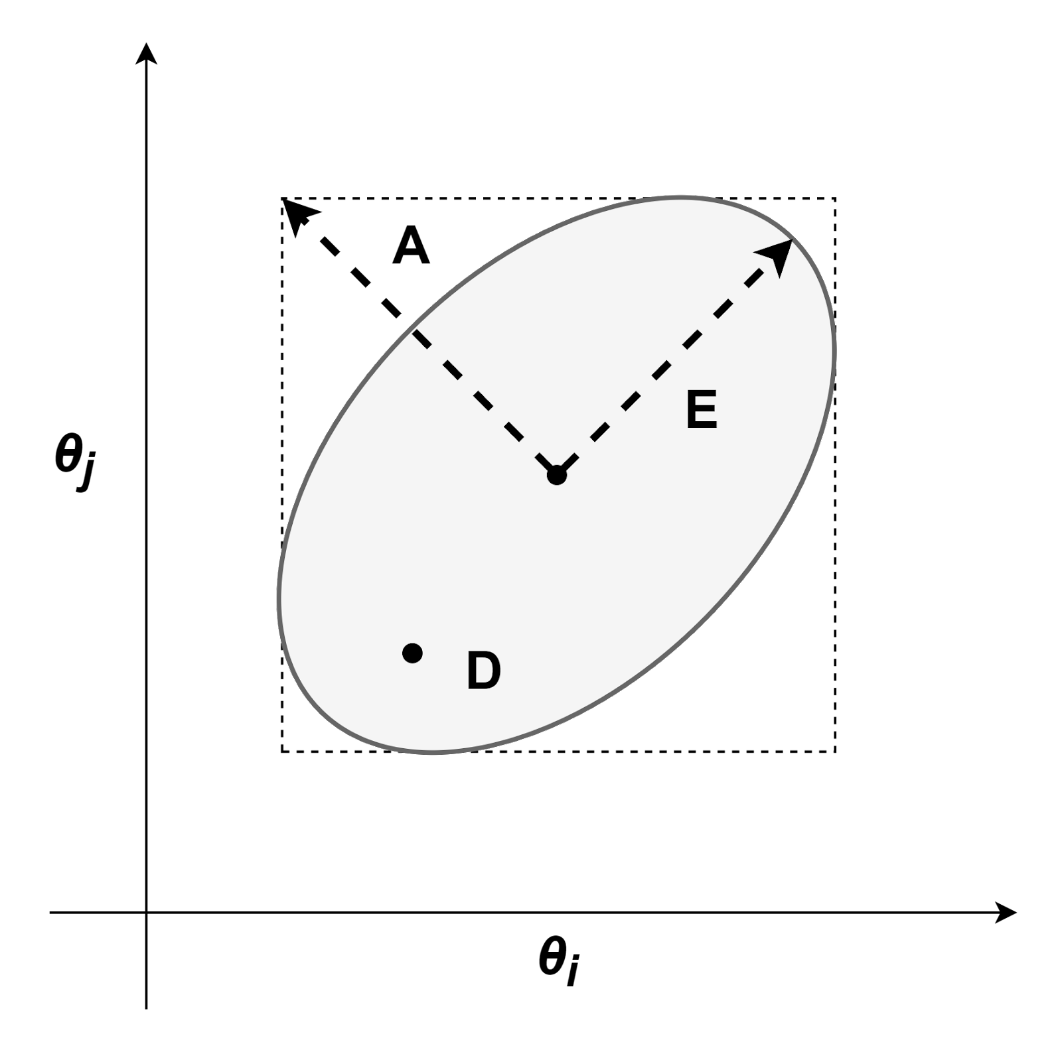
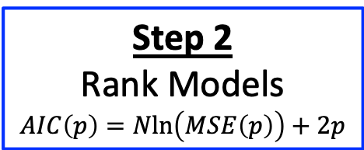
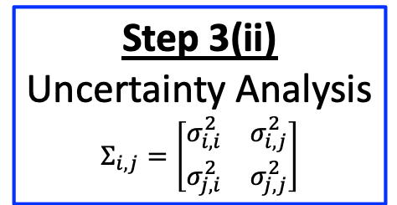
Step 1(i)
Visualize Fits
Step 3(i)
Identifiability Analysis
Step 0
Estimate Parameters
Step 3(ii)
Uncertainty Analysis
$$Σ_{i,j}=\left[\begin{matrix}σ_{i,i}^{2} & σ_{i,j}^{2} \\ σ_{j,i}^{2} & σ_{j,j}^{2}\end{matrix}\right]$$
Step 2
Rank Models
$$AIC\left(p\right)=Nln\left(MSE\left(p\right)\right)+2p$$
Step 1(ii)
Compare Model Fit Indices
Step 3(iii)
Optimality Analysis

Slide 2
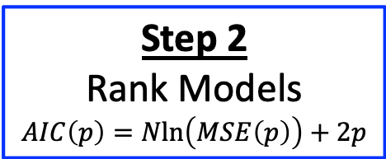
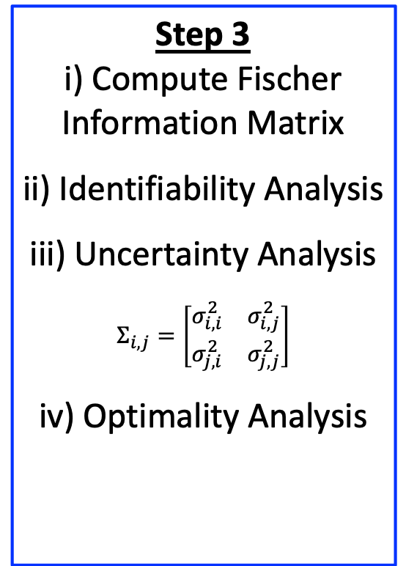

Step 3
i) Compute Fischer Information Matrix
ii) Identifiability Analysis
iii) Uncertainty Analysis
$$Σ_{i,j}=\left[\begin{matrix}σ_{i,i}^{2} & σ_{i,j}^{2} \\ σ_{j,i}^{2} & σ_{j,j}^{2}\end{matrix}\right]$$
iv) Optimality Analysis
Step 3
i) Compute Fischer Information Matrix
ii) Identifiability Analysis
iii) Uncertainty Analysis
$$Σ_{i,j}=\left[\begin{matrix}σ_{i,i}^{2} & σ_{i,j}^{2} \\ σ_{j,i}^{2} & σ_{j,j}^{2}\end{matrix}\right]$$
iv) Optimality Analysis
Step 1
i) Visualize Fits
ii) Compare Model Fit Metric
Step 1
i) Visualize Fits
ii) Compare Model Fit Metric
Step 0
Estimate Parameters
Step 0
Estimate Parameters
Step 2
Rank Models
$$AIC\left(p\right)=Nln\left(MSE\left(p\right)\right)+2p$$
Step 4
Model-Based Design of Experiments
Step 2
Rank Models
$$AIC\left(p\right)=Nln\left(MSE\left(p\right)\right)+2p$$

