Slide 1


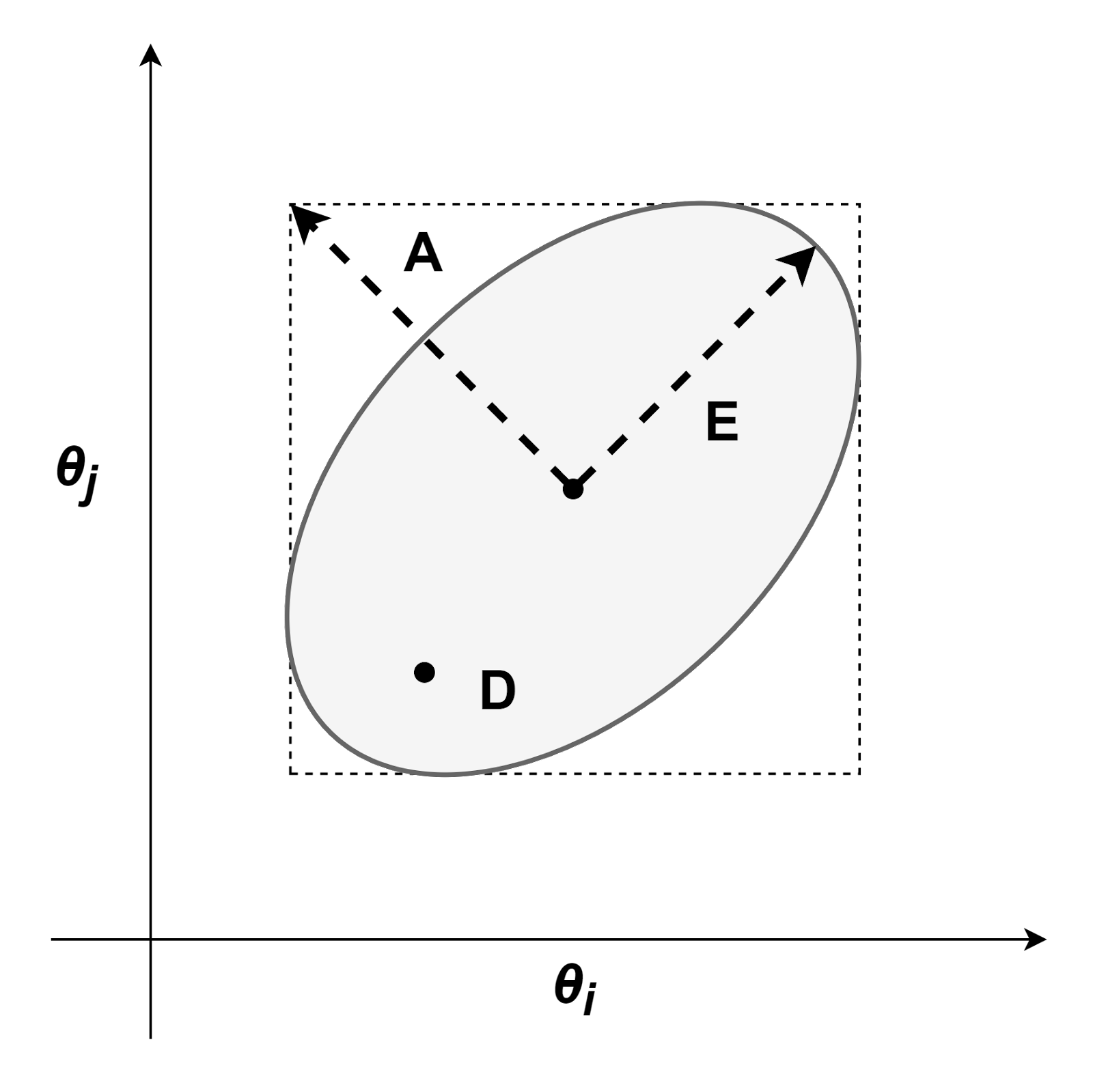
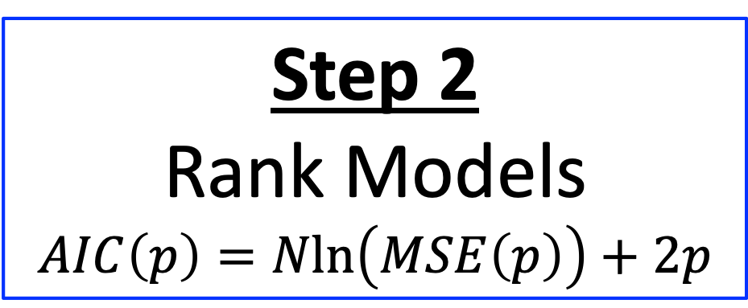
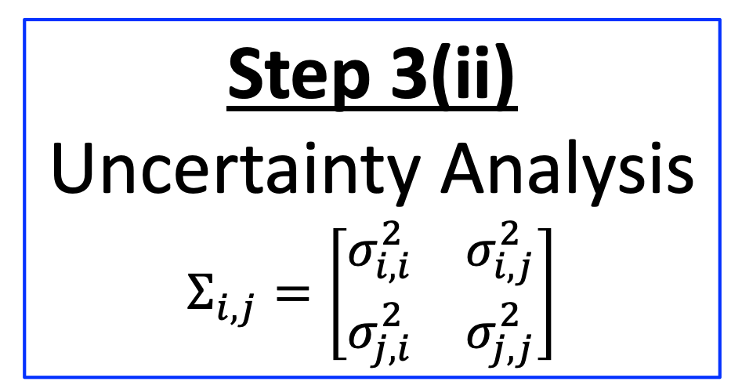
Step 1(i)
Visualize Fits
Step 3(i)
Identifiability Analysis
Step 0
Estimate Parameters
Step 2
Rank Models
$$AIC\left(p\right)=Nln\left(MSE\left(p\right)\right)+2p$$
Step 3(ii)
Uncertainty Analysis
$$Σ_{i,j}=\left[\begin{matrix}σ_{i,i}^{2} & σ_{i,j}^{2} \\ σ_{j,i}^{2} & σ_{j,j}^{2}\end{matrix}\right]$$
Step 1(ii)
Compare Model Fit Indices
Step 3(iii)
Optimality Analysis

Slide 2

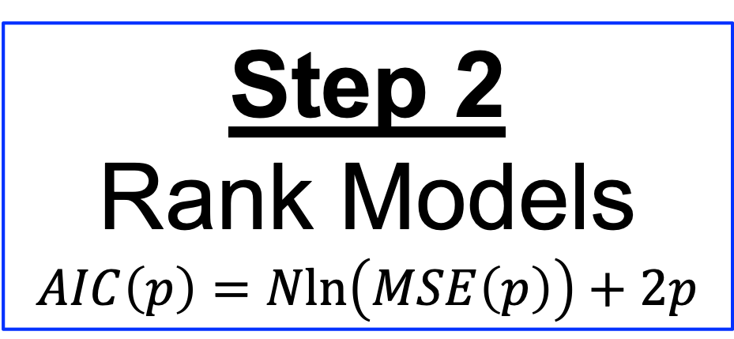
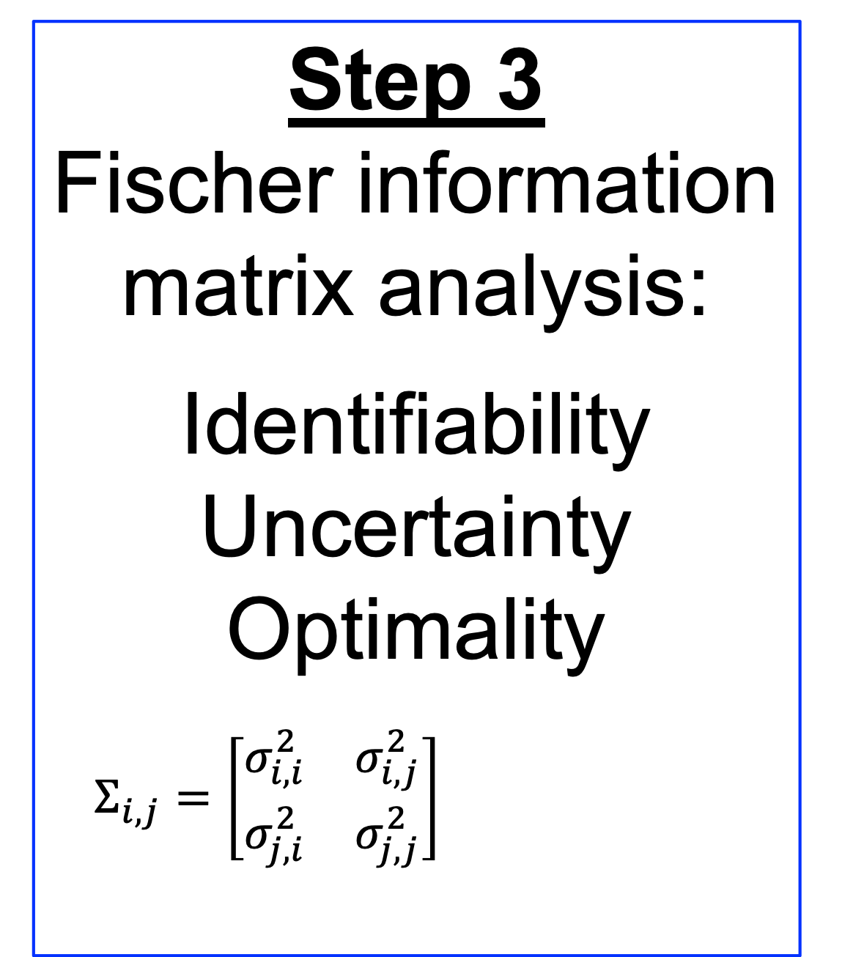
Library of Candidate Models
Step 3
Fischer information matrix analysis:
Identifiability
Uncertainty
Optimality
$Σ_{i,j}=\left[\begin{matrix}σ_{i,i}^{2} & σ_{i,j}^{2} \\ σ_{j,i}^{2} & σ_{j,j}^{2}\end{matrix}\right]$
Regressed Models
Step 1
Visualize and assess fit
Top Ranked Model
Model Errors
Step 2
Rank Models
$$AIC\left(p\right)=Nln\left(MSE\left(p\right)\right)+2p$$
Step 4
Model-Based Design of Experiments
Data
FIM
Suggested Measurements

Slide 3
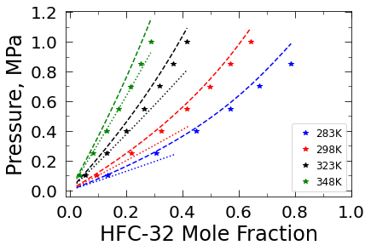

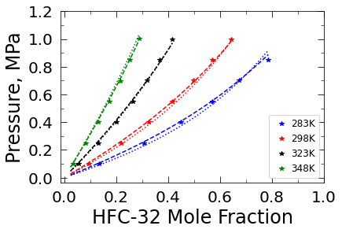

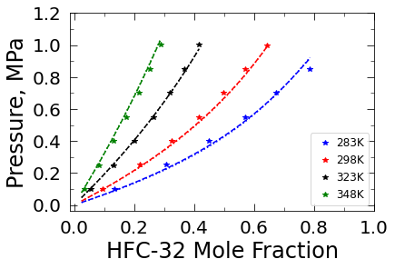


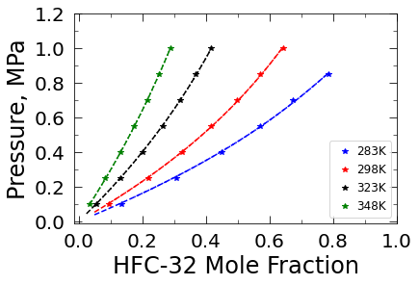
a
b
c
d
e
f
g
h
Notes:
A – PR 1 param
B – SRK 1 param
C – PR 3 params
D – SRK 3 params
E – no Tdep (2)
F – lin Tdep (4)
G – quadTdep (6)
H – polyTdep (8)

Slide 4
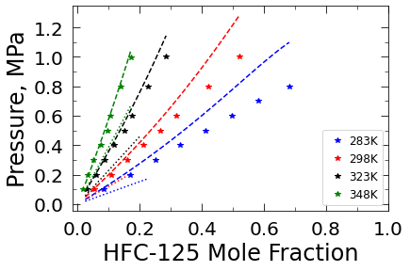

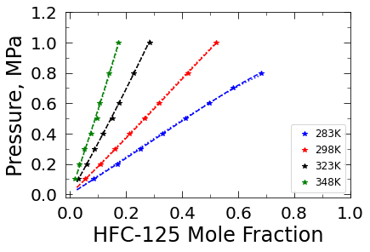
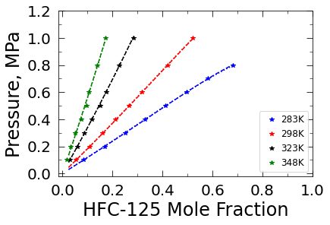




a
b
c
d
e
f
g
h
Notes:
A – PR 1 param
B – SRK 1 param
C – PR 3 params
D – SRK 3 params
E – no Tdep (2)
F – lin Tdep (4)
G – quadTdep (6)
H – polyTdep (8)

Slide 5
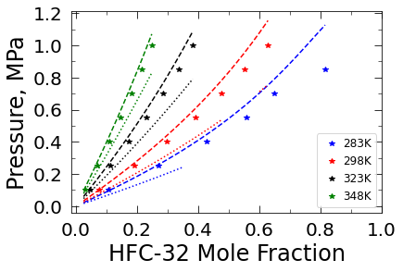
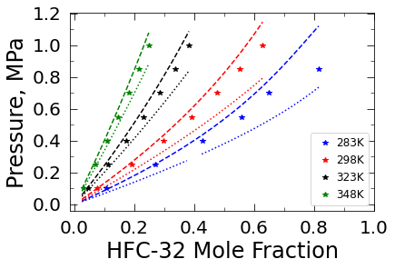
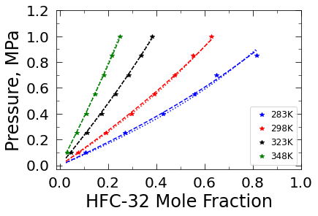
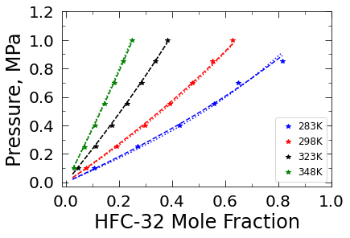




a
b
c
d
e
f
g
h
Notes:
A – PR 1 param
B – SRK 1 param
C – PR 3 params
D – SRK 3 params
E – no Tdep (2)
F – lin Tdep (4)
G – quadTdep (6)
H – polyTdep (8)

Slide 6
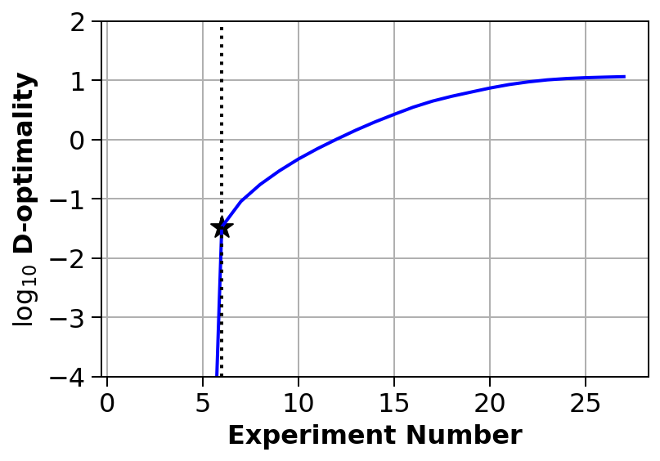
a
b

Slide 7
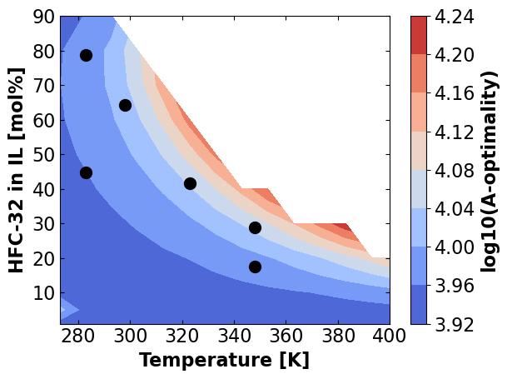
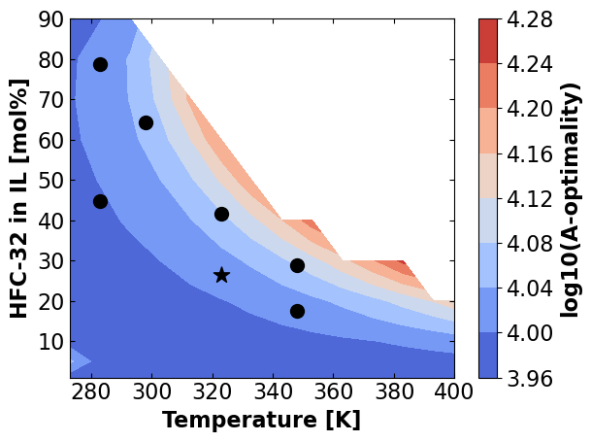
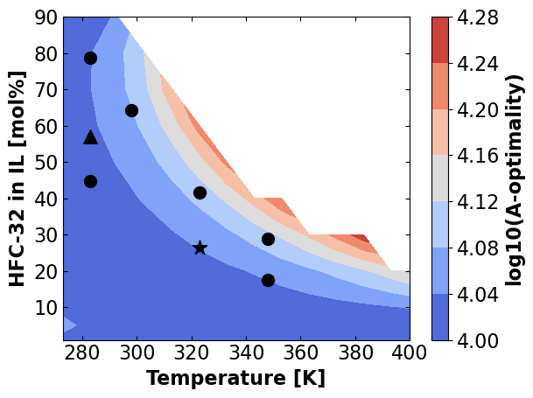
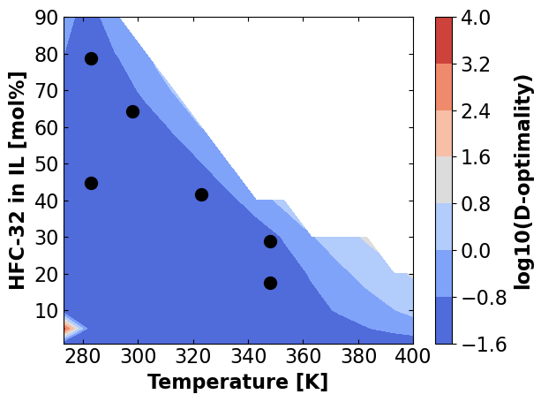
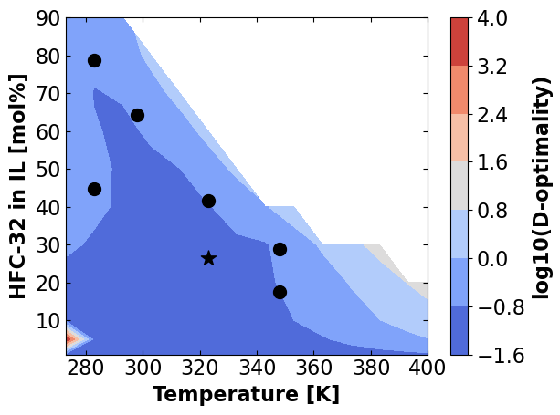
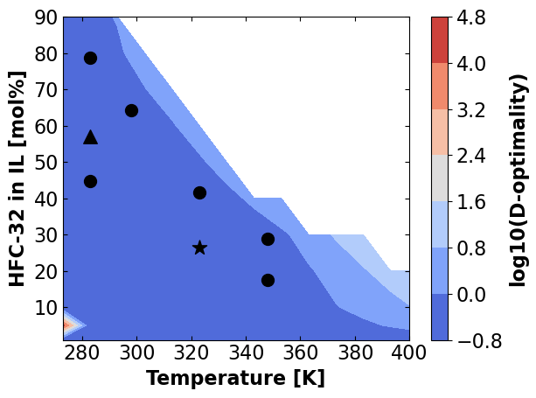
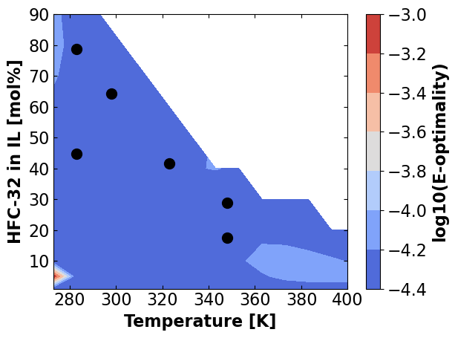
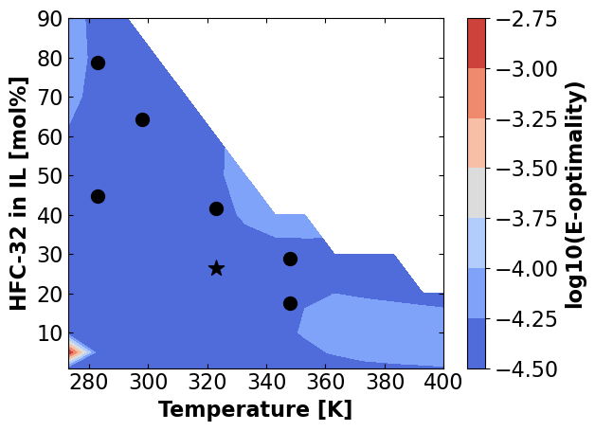

a
d
g
b
e
h
c
f
i

Slide 8
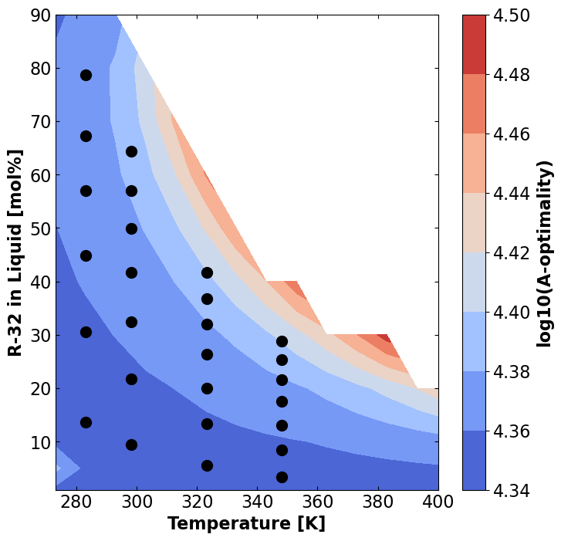
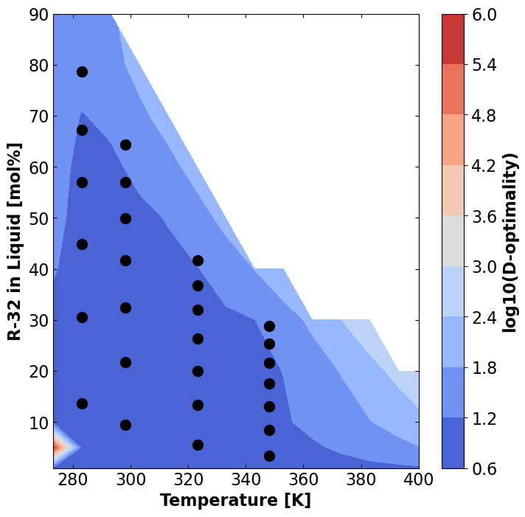
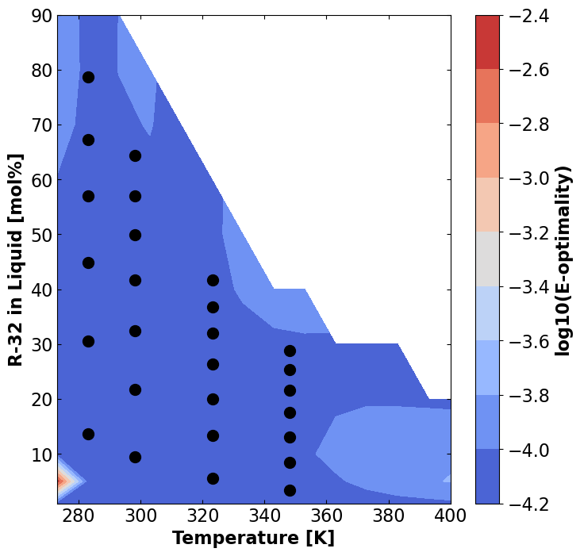
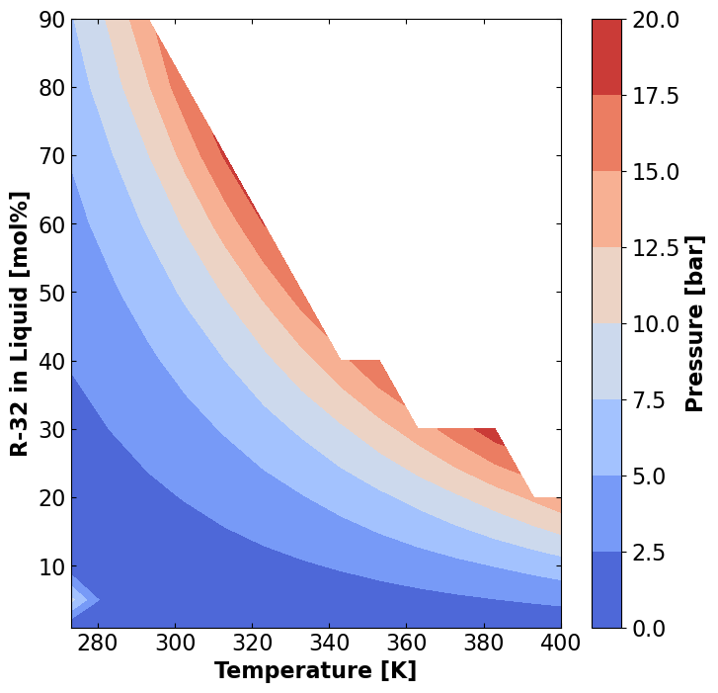
a
b
c
d

