Slide 1
A validated noise-trace simulator
for DELight's MMC readout
From the MMC noise budget to synthetic DAQ records — and what the model does not contain yet
Johnson
SQUID
TD
Er
Dowling Wong · KIT ETP · noise_module 0.3.1 · September 2026
noise_module 0.3.1 · DELight demo · 1

Slide 2
Why simulate the noise, and what the package does
Threshold = noise. Every reconstruction, trigger and ML study needs baselines with a known truth.
DELight's threshold goal (20 eV → < 10 eV) is a statement about the noise-weighted amplitude estimator on ~ms MMC pulses.
Measured baselines are scarce, drift, and carry no ground truth; a simulator gives unlimited records with the noise PSD, pulses, and every stressor known exactly.
The package turns a noise budget (four physical terms) into stationary Gaussian records with an exact discrete convention, then layers non-stationarity, artefacts and multichannel coupling — every stage validated by statistical gates, every run reproducible from a seed.
What it is: a validated trace synthesiser. What it is not yet: a full detector noise model (slide 13).
Reference budget
Johnson · SQUID · TD · Er (ASD, µΦ₀/√Hz, 1 Hz–30 MHz)
Parametric composite PSD
White + PowerLaw + RollOff + PowerLaw, fitted in log-PSD space
rFFT-grid PSD on the DAQ grid
band-limited resampling (readout bandwidth stated explicitly)
Stationary Gaussian records
E|X_k|² = f_s N P_k / 2 · circular complex Gaussian bins
Stressors
level / drift · lines · glitches · pile-up · non-Gaussian
Multichannel coupling
S(f) = L(f) L(f)ᴴ from low-rank factors
Validation gates + optimal filter
noise_module 0.3.1 · DELight demo · 2
power, PSD, Gaussianity, whitening, CSD, coherence · σ_A

Slide 3
The MMC noise budget, referred to flux at the SQUID
Paramagnetic Ag:Er sensor on a wafer absorber · meander pickup · dc-SQUID · T ≈ 15–20 mK
TD — thermodynamic energy fluctuations
Johnson — magnetic Johnson noise
Energy exchanged between spins, electrons and bath through the thermal links. Two-body model (Fleischmann–Enss–Seidel):
S_E(f) = k_B C_Z T² [ α₀·4τ₀/(1+ω²τ₀²) + α₁·4τ₁/(1+ω²τ₁²) ]
Sets the fundamental resolution:
ΔE_FWHM ≈ 2.35 √(4 k_B C_e T²) · (τ₀/τ₁)^¼ · [β(1−β)]^−¼
Budget used here: the τ₁ term only, τ₁ = 1 ms (f_c = 159 Hz).
Thermal currents in the metallic sensor/absorber couple flux into the pickup:
√S_Φ ≈ µ₀ √(C_m σ k_B T V)
White up to the skin-depth corner (well above the DAQ band). Small for a thin Ag:Er film at 15 mK; superconducting Al collectors do not contribute.
Er — spin 1/f noise
SQUID — readout flux noise
Slow fluctuations of the Er³⁺ moments, ≈ 0.1 µ_B²/Hz per ion, essentially temperature-independent.
S_Φ ∝ f^−ξ, ξ ≈ 0.9 in the budget (a 2023 direct measurement gives ≈ 1.0).
Scales with the number of Er ions, i.e. with sensor volume and concentration.
White floor + 1/f: S_Φ = S₀ + A/f, knee ≈ 100 Hz.
Budget: 0.30 µΦ₀/√Hz floor, 3.0 µΦ₀/√Hz at 1 Hz — the level of a two-stage dc-SQUID (ECHo-class).
Not in the budget: second-stage / room-temperature amplifier terms, FLL bandwidth, µMUX demodulation noise.
noise_module 0.3.1 · DELight demo · 3

Slide 4
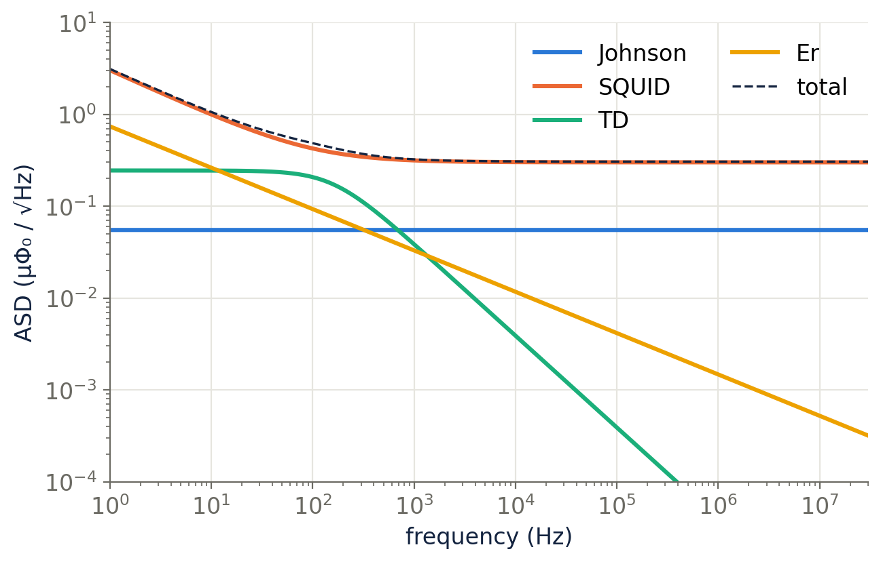
The reference budget and its parametric model
Six .dat files, 16 384 log-spaced points, 1 Hz – 30 MHz, one-sided ASD in µΦ₀/√Hz · fitted in log-PSD space
term | form (PSD) | fitted value
Johnson | white | 3.03×10⁻³ µΦ₀²/Hz (ASD 0.055)
SQUID | S₀ + A/f | S₀ = 0.090, A = 9.0 (knee 100 Hz)
TD | S₀ / [1+(f/f_c)²] | S₀ = 0.060, f_c = 159 Hz (τ = 1.0 ms)
Er | S₀ f^α | S₀ = 0.544, α = −0.90
signal | 2-pole pulse | τ_in = 5 µs, τ_t = 1 ms (A_n = A_t)
Fit quality: the composite reproduces total_noise.dat to a max fractional deviation of 2×10⁻¹⁶ — the file was generated from the same closed forms, so the model is exact, not approximate.
Provenance: the budget is the collaboration's ("the professor's plot"); the fit, synthesis and validation stack is the package's. The two live in separate directories on purpose.
noise_module 0.3.1 · DELight demo · 4

Slide 5
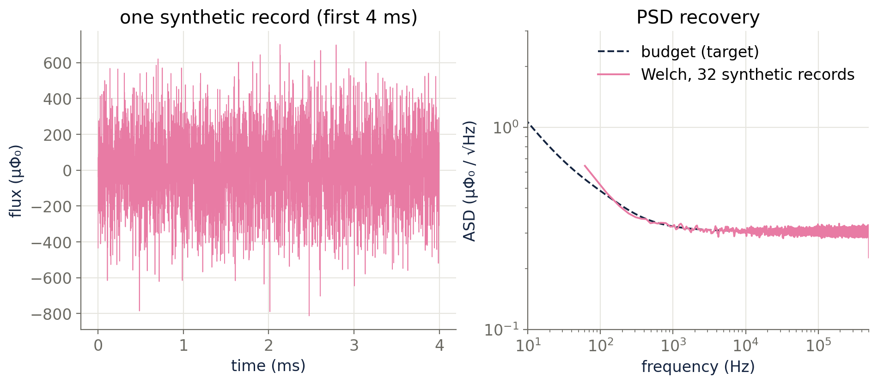
From PSD to time series: an exact discrete convention
PAPER_CONVENTION.md is the contract; the code is checked against it by statistical gates, not by inspection
One-sided density P_k at rFFT bin k, NumPy's unnormalised rfft/irfft:
E|X_k|² = ½ f_s N P_k (0 < k < N/2)
E|X_k|² = f_s N P_k (k = 0, N/2)
X_k = √(E|X_k|²) · (ξ₁ + iξ₂)/√2, ξ ~ N(0,1) interior
X_k = √(E|X_k|²) · ξ endpoints, real
⇒ Var[x_t] = Σ_k P_k Δf
Gaussian moduli, not constant-modulus random phases: the old sampler gave the right mean PSD but identical per-bin power in every record, so χ² and KS residual tests were degenerate.
The grid process is periodic (circulant covariance) with DC forced to zero: no sub-Δf content, no baseline offset or slope. Exact finite Toeplitz sampling is a separate API (circulant embedding, dense fallback).
0.9992
0.03 %
108
median ASD ratio, simulated / target
variance vs Σ P_k Δf (32 records)
tests passing (0.3.1)
noise_module 0.3.1 · DELight demo · 5

Slide 6
Validated, not plausible: the acceptance gates
validate_stationary_gaussian on the Al₂O₃ preset, 128 records × 8192 samples · tolerances widen with ensemble size
gate | what it checks | result
power | ensemble variance equals Σ P_k Δf within confidence allowance | pass
psd | mean periodogram matches target density (≤ 15 % mean relative error) | pass
fourier_real_normality | Re X_k / σ_k is N(0,1) (KS) | pass
fourier_imag_normality | Im X_k / σ_k is N(0,1) (KS) | pass
time_marginal_normality | one time sample per record is Gaussian (KS) | pass
periodogram_exponential | |X_k|² / E|X_k|² is Exponential(1) (KS) | pass
fourier_skewness | standardised Fourier parts: |skew| ≤ 0.10 | pass
fourier_excess_kurtosis | standardised Fourier parts: |excess kurtosis| ≤ 0.15 | pass
whitened_lag1 | whitened series: lag-1 autocorrelation ≈ 0 | pass
dc_real_constraint | DC coefficient is real | pass
nyquist_real_constraint | Nyquist coefficient is real | pass
dc_distribution | DC bin distribution (n/a: DC forced to zero) | n/a
nyquist_distribution | Nyquist bin is Gaussian with full endpoint power | pass
Why this matters for a collaboration tool
A generator that only matches the mean PSD can still feed wrong residual statistics into a χ² cut, an OF goodness-of-fit, or an ML training set.
These gates are the definition of "correct" for the synthesiser, and they run in CI (pytest, 108 tests).
Found while preparing this demo: the whitening step divided the zero-power DC bin by a 1e-30 floor; on a spectrum in absolute µΦ₀² units the round-off blew up and the lag-1 gate failed. Fixed in 0.3.1 — the gate now passes.
noise_module 0.3.1 · DELight demo · 6

Slide 7
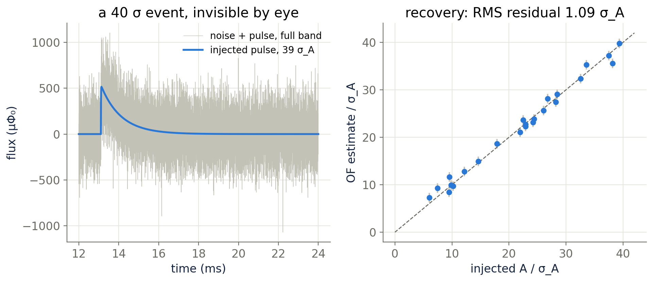
Pulse template and optimal filter
The estimator the threshold depends on, run on records where the truth is known
Template (Probst / Cait pulse_template_2):
p(t) = A_n(e^{−t/τ_n} − e^{−t/τ_in}) + A_t(e^{−t/τ_t} − e^{−t/τ_n})
Fitted from |signal.dat|: τ_in = 5 µs, τ_t = 1 ms. Magnitude only ⇒ t₀ and τ_n are unidentifiable and documented as such.
Gaussian-ML amplitude:
Â = Σ_k Re(S_k* X_k)/P_k ÷ Σ_k |S_k|²/P_k
Baseline resolution (new in 0.3.1, with the rFFT-power convention and interior bins counted twice):
σ_A⁻² = Σ_{all bins} |S_k|² / E|X_k|²
Empirical check: RMS residual over 24 injected pulses = 1.09 σ_A.
Units stay in flux; eV needs ∂Φ/∂E, which the budget does not contain.
σ_A = 6.73 template units, where a unit pulse peaks at 1.95 µΦ₀ — a 40 σ event is invisible in the 500 kHz raw record and cleanly recovered by the filter.
noise_module 0.3.1 · DELight demo · 7

Slide 8
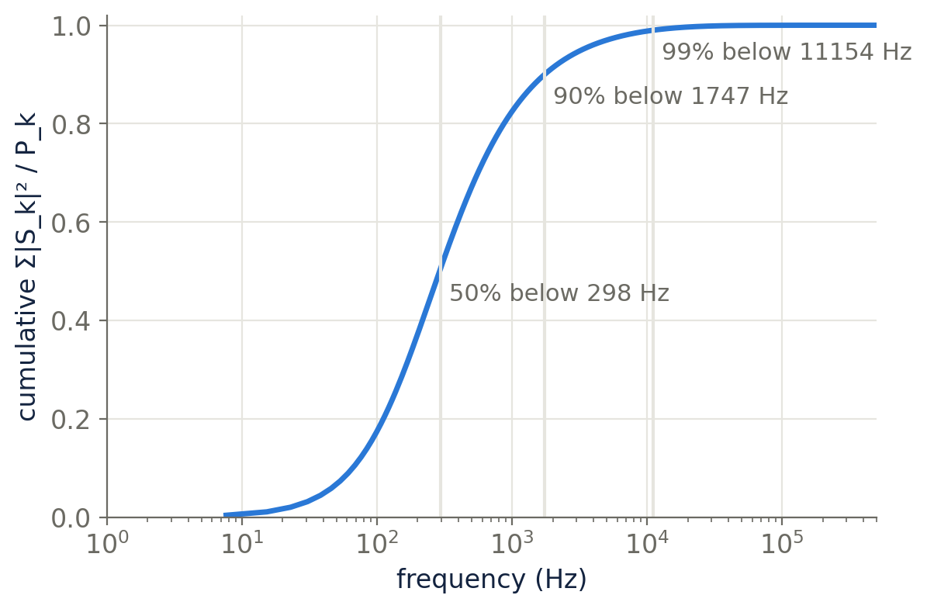
Where the resolution comes from — and which term limits it
Cumulative Σ|S_k|²/P_k is a map of the optimal filter's information
298 Hz
1.7 kHz
11 kHz
50 % of the information below
90 % below
99 % below
remove one term | σ_A / σ_A(all)
SQUID | 0.31
TD (thermodynamic) | 0.95
Johnson | 0.99
Er 1/f | 0.99
In this budget the detector is readout-limited: without the SQUID term σ_A improves ×3.3; without the thermodynamic term only 5 %. Everything above ~20 kHz matters only through aliasing — which is the next slide.
noise_module 0.3.1 · DELight demo · 8

Slide 9
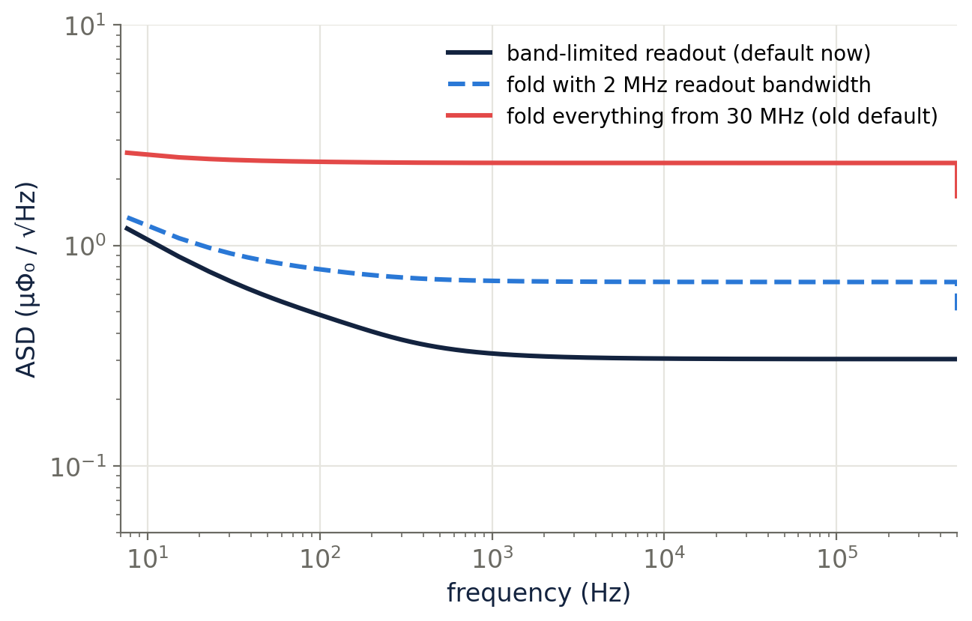
The readout-bandwidth decision (fixed in 0.3.1)
Bringing a 30 MHz budget onto a 1 MHz DAQ grid encodes a physical assumption about the readout chain
1.00
1.82
5.69
σ_A, band-limited readout
σ_A, 2 MHz readout bandwidth
σ_A, fold everything (old default)
The white SQUID+Johnson floor (≈ 0.093 µΦ₀²/Hz) extends to 30 MHz in the budget. Folding all of it into 0–500 kHz adds ≈ 60 aliases: in-band PSD ×60, baseline σ ×5.7.
Real MMC readouts are band-limited before sampling: a flux-locked-loop SQUID has a few MHz, fast digitisers decimate (DELight X-ray DAQ: 125 MHz → 256 ns bins), ECHo uses a ~100 kHz analogue anti-alias filter.
0.3.1: folding is opt-in (--alias-fold), the readout bandwidth is an explicit parameter (--anti-alias-cutoff-hz), and the artefact records the assumption it was built with.
First question for the DAQ group: what is the effective bandwidth before decimation?
noise_module 0.3.1 · DELight demo · 9

Slide 10
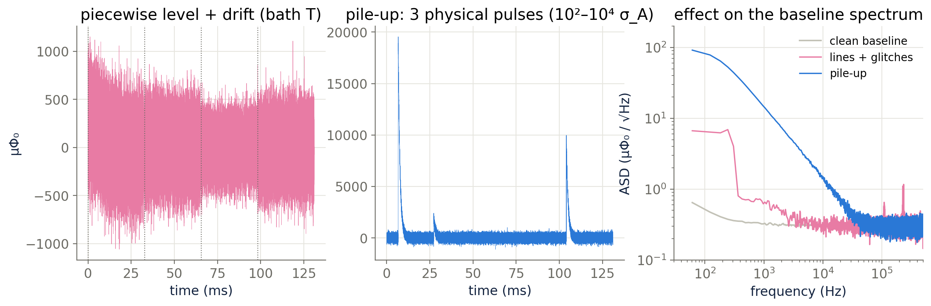
Beyond stationary: level drift, lines, glitches, pile-up
Real DELight records are not stationary — the prototype paper discarded 26 % of events for bath-temperature drift
Level & drift — TemporalNoiseWrapper: piecewise power ratios with crossfade, spline/low-pass/random-walk drift, variance envelopes; shared vs private across channels.
Lines & transients — ArtifactInjector: deterministic mains harmonics, Poisson/inhomogeneous/Hawkes transients with four templates, amplitude in raw / baseline-RMS / local-RMS units, exact component bookkeeping.
Fixed in 0.3.1: the level wrapper scaled noise_power, which absolute-unit spectra ignore, while reporting the scaled value. It now scales the correct knob (psd_scale) and reports level_scale — the plot above is real, not metadata.
noise_module 0.3.1 · DELight demo · 10

Slide 11
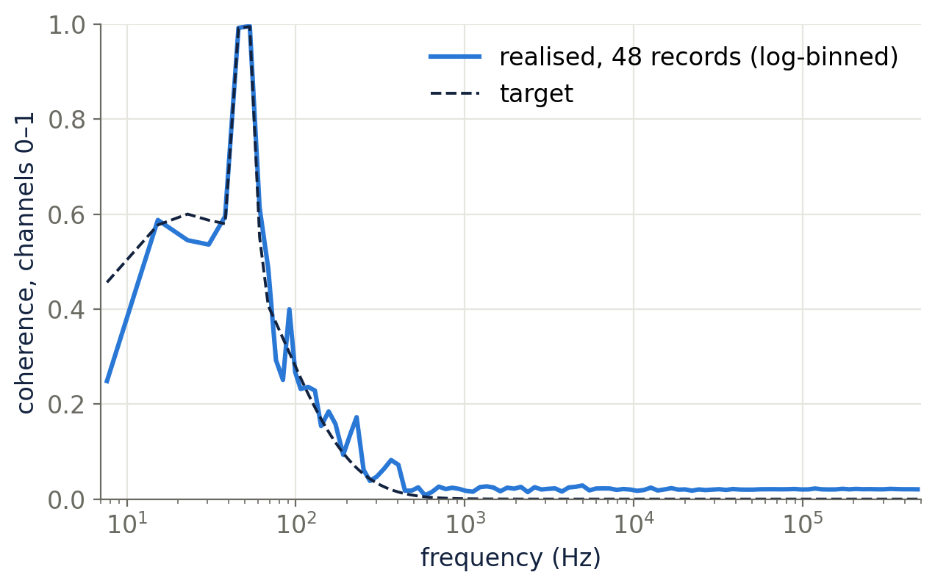
Multichannel synthesis with a physical cross-spectrum
Correlated noise between MMC channels is low-frequency and line-like, not white
Private to each sensor: SQUID, Johnson, Er, TD.
Common to all: bath temperature (≪ 1 Hz), pulse-tube microphonics (1.4 Hz + harmonics), mains, shared readout electronics (µMUX crosstalk < 1 %).
The right object is a frequency-dependent CSD
S(f) = L(f) L(f)ᴴ
synthesised directly from low-rank factors — never materialising the dense (F × C × C) matrix. DC/Nyquist factors are forced real; PSD-cone-preserving interpolation when the CSD is on another grid.
Shown: 4 channels, private four-term budget + one shared Lorentzian (bath/microphonics stand-in) + a shared 50 Hz line, per-channel coupling gains. Realised coherence follows the target; broadband time-domain correlation is 0.03, the < 100 Hz band is 0.97.
The generic shared_private / lowrank presets give flat coherence — fine for stress tests, not a detector model. A DELight coupling preset is an afternoon's work.
noise_module 0.3.1 · DELight demo · 11

Slide 12
Implementation: what makes it a tool rather than a script
and the four defects closed in 0.3.1 while preparing this demo
Engineering
Closed in 0.3.1
Strict, versioned configuration schema (v3) with migrations; unknown fields are errors, not surprises.
One documented unit convention (PAPER_CONVENTION.md + machine-readable JSON); PSD density, rFFT power and covariance kept distinct.
Reproducibility: seed/rng are mutually exclusive, every wrapper spawns child streams; identical inputs give identical records.
Metadata records what was actually applied — level scale, component powers, readout-bandwidth assumption, regularisation of CSDs.
Confidence-aware validation gates (power, PSD, Gaussianity, whitening, CSD magnitude/phase/coherence, artefact bookkeeping).
Immutable reference preset + adjustable layers; input budget (collaboration) and synthesis stack (package) in separate directories.
108 tests; standalone installable package; NumPy + SciPy only.
build_optimal_filter() crashed on the default grid because the generated PSD artefact is git-ignored and was absent → analytic fallback with a warning; artefact regenerated; tested on the default grid.
Alias-folding of the 30 MHz budget was the script default (σ ×5.7) → opt-in, explicit readout-bandwidth parameter, assumption recorded in metadata.
noise_power was a silent no-op for absolute-unit spectra while wrappers reported the scaled value → rejected at config time; psd_scale is the level knob; wrappers scale and report the right one.
Validation whitening divided the zero-power DC bin by a 1e-30 floor → whitening restricted to supported bins; the lag-1 gate passes.
Plus: OptimalFilter.amplitude_resolution — σ_A in physical units, verified against empirical scatter.
noise_module 0.3.1 · DELight demo · 12

Slide 13
Not in the model yet — questions for the collaboration
Ranked by expected impact on DELight's large-area wafer detectors
1
Bath-temperature fluctuations as a physical process
2
Pile-up as a first-class injector template
Coupled to gain (∂Φ/∂E), correlated across channels, calibrated to ΔT/T ≈ 6×10⁻⁴ and the 0.04 % gain drift of the prototype. Today: a generic level/drift model.
Real event rate and energy spectrum (muons through 40 cm² × 300 µm Si ≈ 0.7 Hz at ~100 keV, calibration sources); He-atom adsorption heat load on the above-liquid wafers.
3
Readout chain
4
The τ₀ (spin–electron) thermodynamic term
FLL bandwidth, second-stage/array SQUID and room-temperature amplifier terms; µMUX flux-ramp demodulation noise (0.7 → 1.4 µΦ₀/√Hz) and its aliasing; crosstalk.
The budget has one Lorentzian; the two-body model has two. Legitimately negligible for large β — but it should be a stated assumption. Who produced the .dat files?
5
Digitiser and calibration constants
6
Athermal / position-dependent pulse shapes
16-bit quantisation, decimation-filter response; µΦ₀ → ADC → eV is not carried in any config.
Phonon-collector wafers give a two-component, position-dependent pulse (Si/Ge + film MMCs: τ_a ≈ 0.16 ms). A signal-model issue, invisible to a single signal.dat.
None of these is a flaw in the synthesiser: they are inputs the collaboration has and the simulator does not yet carry.
noise_module 0.3.1 · DELight demo · 13

Slide 14
References
A. Fleischmann, C. Enss, G. M. Seidel, Metallic magnetic calorimeters, in Cryogenic Particle Detection (C. Enss, ed.), Springer 2005, doi:10.1007/10933596_4 — two-body thermodynamic noise model, resolution formula.
S. Kempf, A. Fleischmann, L. Gastaldo, C. Enss, Physics and applications of metallic magnetic calorimeters, J. Low Temp. Phys. 193, 365 (2018), doi:10.1007/s10909-018-1891-6.
D. McCammon, Thermal equilibrium calorimeters — an introduction, in Cryogenic Particle Detection, Springer 2005, doi:10.1007/10933596_1.
B. von Krosigk et al., DELight: a direct search experiment for light dark matter with superfluid helium, SciPost Phys. Proc. 12, 016 (2023), doi:10.21468/SciPostPhysProc.12.016.
DELight collaboration, MMC-based detector with 1.25 eV FWHM at 5.9 keV, arXiv:2310.08512; bath-temperature drift and event selection, arXiv:2310.08698; status and LAMCAL design, arXiv:2209.10950, arXiv:2512.15278.
Er spin 1/f noise: direct measurement with a noise-o-meter, arXiv:2303.15257. Lausberg, KIP Heidelberg thesis (magnetic Johnson noise, readout noise terms).
ECHo two-stage SQUID readout and DAQ (100 kHz anti-alias filter), arXiv:2102.11100. µMUX readout noise and crosstalk, arXiv:2509.07671, arXiv:2211.07127.
Si/Ge wafer + Au-film MMC light detectors, athermal/thermal pulse components, J. Low Temp. Phys. 2023, doi:10.1007/s10909-023-02962-6. Pulse-tube and microseismic lines in mK calorimeters, Eur. Phys. J. C 84 (2024), doi:10.1140/epjc/s10052-024-13065-1.
F. Probst et al., two-exponential pulse model (1995), as implemented in Cait, arXiv:2207.02187; QETpy optimal-filter convention, github.com/spice-herald/QETpy.
Package documents: PAPER_CONVENTION.md, CONFIGURATION.md, AL2O3_AL_ATHERMAL_PLAN.md, CHANGELOG.md (0.3.1); demo notebook notebooks/noise_module_tutorial.ipynb.
noise_module 0.3.1 · DELight demo · 14

