Slide 1

BI Analyst Capstone Project
Jody Upright

Slide 2

Table of Contents
Introduction
Methodology
Results
Discussion
Conclusion
Appendix
Stock ID: 47857043

Slide 3

Introduction

Slide 4

Introduction
This Turkish retail company is a leading chain that operates globally.
This company is committed to customer satisfaction and offers a diverse range of products.
This company is seeking to leverage data-driven insights to maintain its competitive edge, and enhance sales strategies and operational efficiency.

Slide 5

Methodology

Slide 6
Data Details
This data coming from a Turkish retail company was originally published on Kaggle
The original data spans the years 2017-2019
Data was provided across six spreadsheets in normalized format spanning the following categories:
Sales – delineated by date, product, and store
Product Hierarchy – details product dimensions and categories
Product Names – organized by product id
Store names – organized by store id
Store cities – organized by store id
City Names – organized by city id

Slide 7
Module 1: Data Cleaning and Preparation Using Excel
Part 1: Data Cleaning
The Sales data was limited to 50000 rows to accommodate limitations of Excel for the Web
Six spreadsheets were combined into a single .xlsx file
710 rows missing price data were filtered out of the data
Adjusted number formatting for consistency, including date format
Looked for duplicates on City and Product spreadsheets
Part 2: Pivot Tables
The Sales data was further limited to 30000 rows
VLOOKUPs were used to combine the six spreadsheets into a single spreadsheet
Pivot tables were created to examine different sales scenarios
Pivot tables were given filters to allow for additional drilling down

Slide 8
Module 2: Data Querying and Analysis Using PostgreSQL
Part 1: Data Querying
A database with six tables was created
SELECT statements were used to confirm correct table creation
Sales performance was grouped by store and city for analysis
Part 2: Data Analysis
Sales performance by store and month was analyzed with a rollup
Sales performance by product hierarchy was analyzed with a rollup
Sales performance by city and month was analyzed with a cube

Slide 9
Module 3: Data Visualization and Statistical Analysis
Part 1: Data Visualization
Consolidated spreadsheets into a single sheet with VLOOKUPS
Created a bar chart, line chart, and sunburst chart for various aspects of sales analysis
Due to Excel limitations for scatter plots, unique points comparing stock and sales data were used to create a scatter plot and trendline
Part 2: Statistical Analysis
XLMiner Analysis ToolPak was used for regression analysis
Due to Excel limitations, 20,000 rows were used
Analysis performed to determined significance of the linear regression model

Slide 10
Module 4: Data Visualization and Dashboards Using Tableau
Relationships across six spreadsheets created within Tableau Public
Calculated fields created for Sales Growth Percentage and Average Stock Levels
Converted date from dd/MM/yy to MM/dd/yy format for future time-based analysis
Created various charts for sales analysis
Compiled charts onto a single dashboard for side-by-side visual analysis

Slide 11

Results

Slide 12
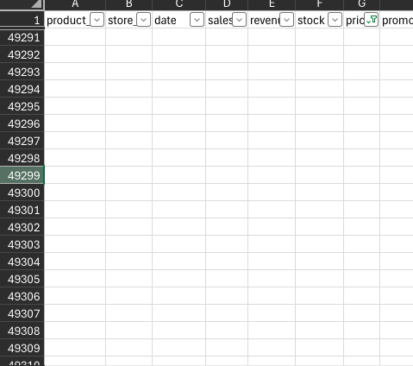
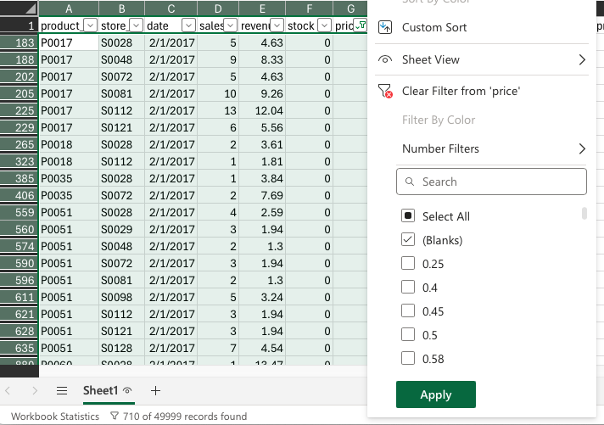
Module 1, Lesson 1: Data Cleaning and Preparation
Dropping rows with missing price values ensures missing data does not skew final results.

Slide 13
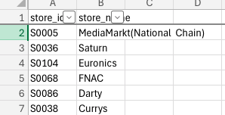
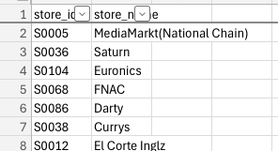
Module 1, Lesson 1: Data Cleaning and Preparation
Extra spaces were removed from the data to ensure consistent formatting

Slide 14
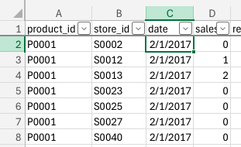
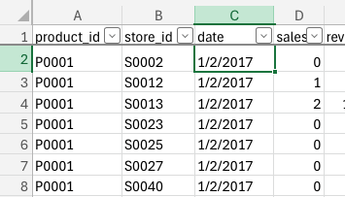
Module 1, Lesson 1: Data Cleaning and Preparation
Dates were converted from dd/MM/yyyy format to MM/dd/yyyy format
This step was taken because Excel was reading 2/1/2017 as February 1 when the original source had this as January 2
Dates will be used to analyze sales through the passage of time

Slide 15
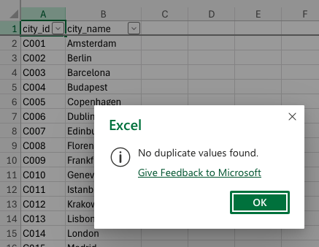
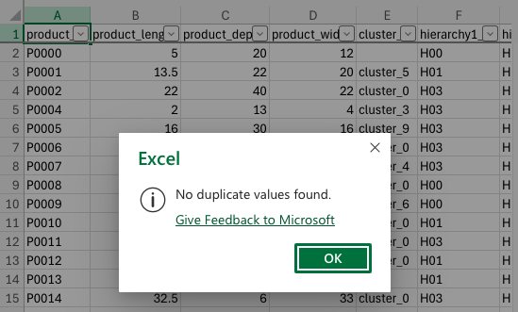
Module 1, Lesson 1: Data Cleaning and Preparation
The data was examined for duplicate values as duplicate values could impact regression analysis
No duplicate values were found

Slide 16
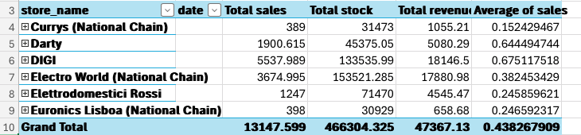
Module 1, Lesson 2: Data Analysis Using Pivot Tables
Sales by Store Analysis
Jan. 2-18, 2017
DIGI and Electro World are the most profitable based on total ​sales and total revenue
DIGI and Darty have the highest average of sales
DIGI, Electro World, and Darty would be good candidates for future store expansion
Currys and Euronics Lisboa have the lowest values in all categories and would be the candidates for targeted intervention to improve store performance

Slide 17
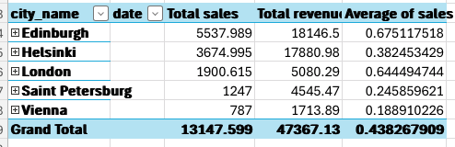
Module 1, Lesson 2: Data Analysis Using Pivot Tables
Sales by City Analysis
Jan. 2-18, 2017
Sales figures for the top four cities align with sales figures for the four highest performing stores.
Edinburgh and Helsinki have the highest total sales and revenue figure, while Edinburgh and London have the highest average sales.
Edinburgh, Helsinki, and London would be good candidates for store expansion.
Vienna has the lowest values in all three categories, combining sales figures from the two lowest-performing stores.

Slide 18
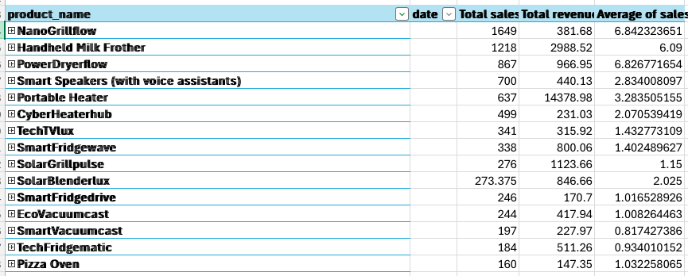
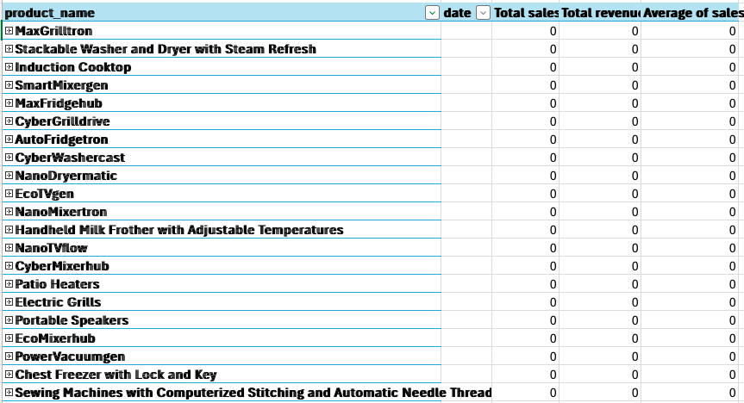
Module 1, Lesson 2: Data Analysis Using Pivot Tables
Product Performance Analysis
Jan. 2-18, 2017
The top 15 products by total sales provided are items to continue stocking
The bottom list of products that had no sales in the 17 day window are items to consider discontinuing sales, particularly if sales performance for these items has not shown improvement across later data

Slide 19
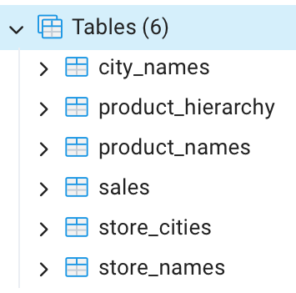
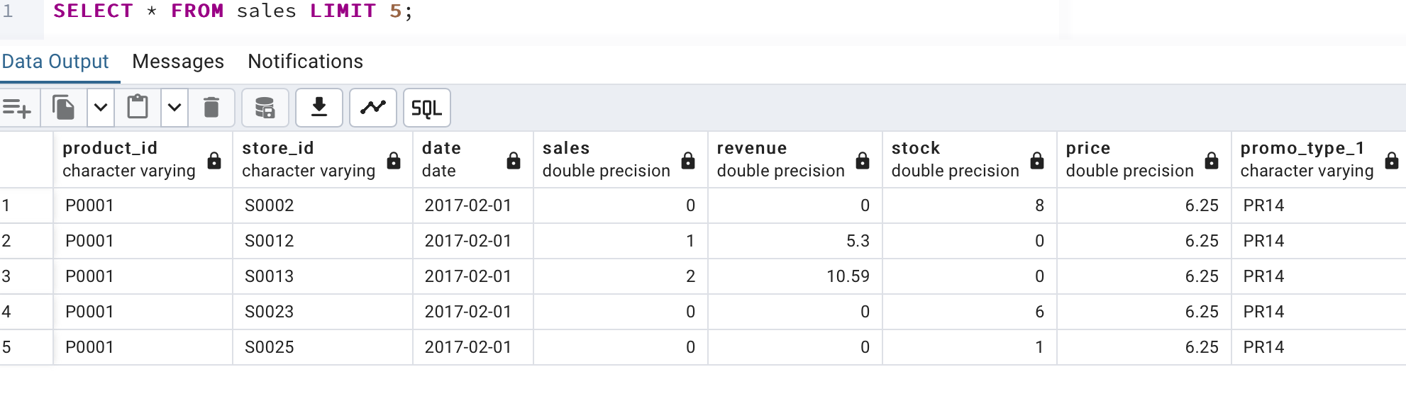
Module 2, Lesson 1: Data Querying Using PostgreSQL
A database with six tables was created using a dump file
SELECT statements like the one below were used to verify the data was correctly imported.

Slide 20
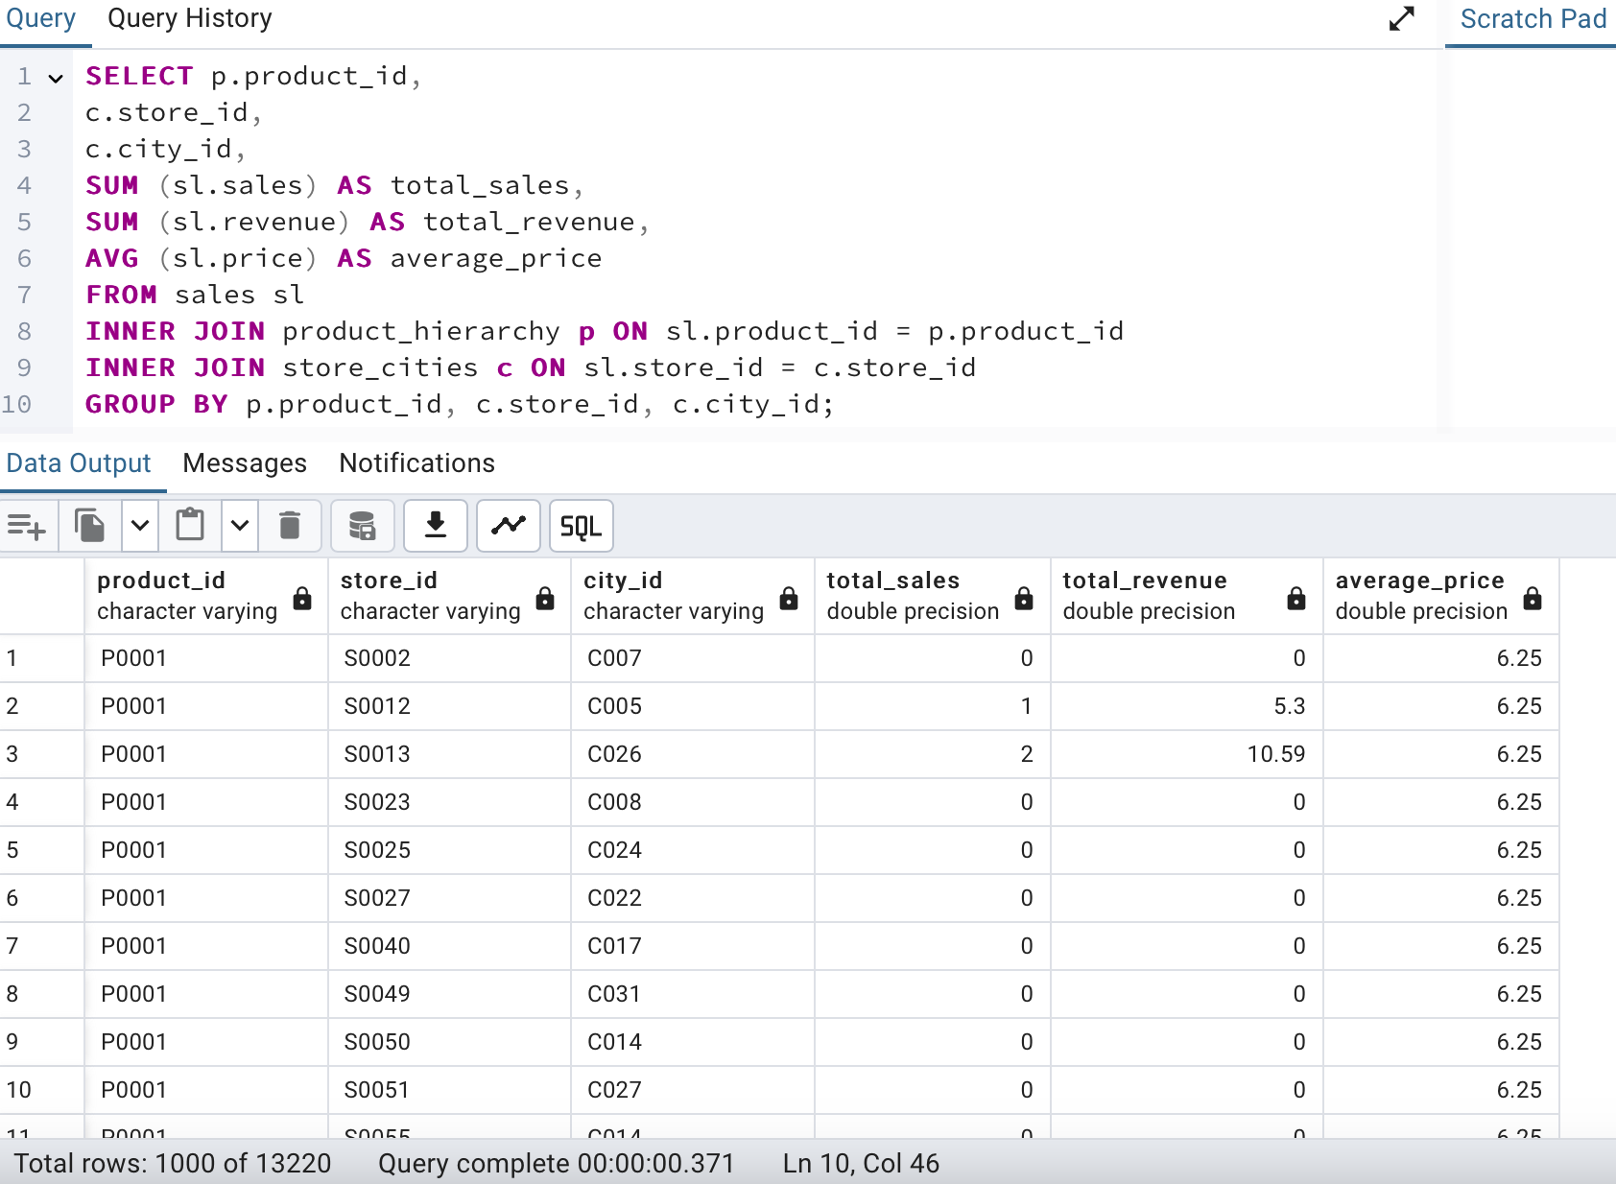
Module 2, Lesson 1: Data Querying Using PostgreSQL
Sales performance totals by product, store, and city id were found using the SQL query to the right
Setting up the database allows for analysis of larger, more complete datasets than what Excel is able to handle

Slide 21
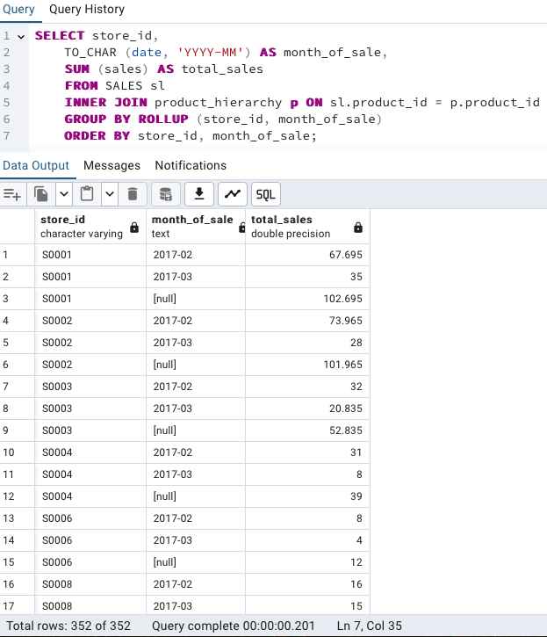
Module 2, Lesson 2: Data Analysis Using PostgreSQL
Sales by Store over time
[null] values indicate grand totals for each store
Stores generally saw a decrease in sales between February and March, in many cases 50% or more
Maintaining stock levels equivalent to February sales would be ideal as some stores not show a substantial drop in sales
i.e. S0008 and S0029

Slide 22
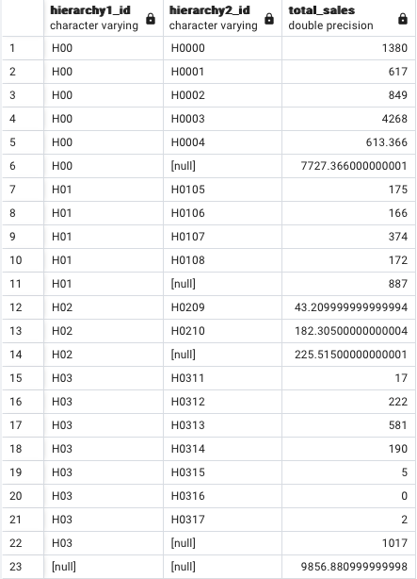
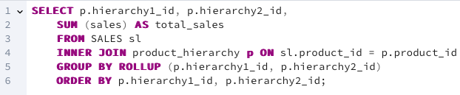
Module 2, Lesson 2: Data Analysis Using PostgreSQL
Sales by Product Hierarchy
The five highest-performing sub-hierarchies are all in hierarchy H00
Three subhierarchies in H03 had five or fewer sales; these would be candidates for either a sales promotion or for having their sales discontinued

Slide 23
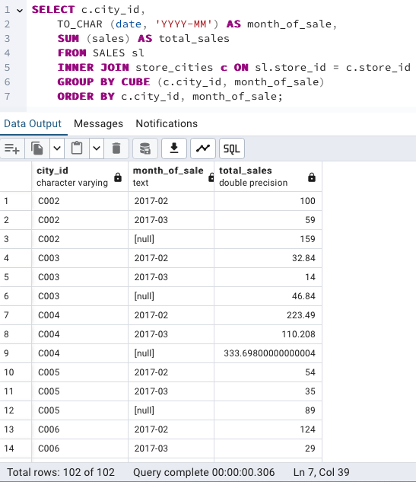
Module 2, Lesson 2: Data Analysis Using PostgreSQL
Sales by City
Most cities saw a 30-50% decrease in sales from February to March
City C033 saw a 15% decrease in sales, the smallest percentage change of any city

Slide 24
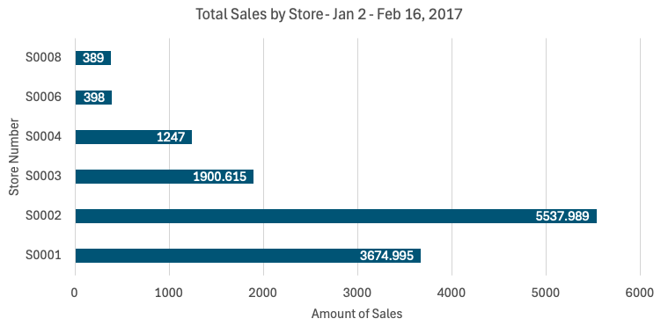
Module 3, Lesson 1: Data Visualization Using Excel

Slide 25
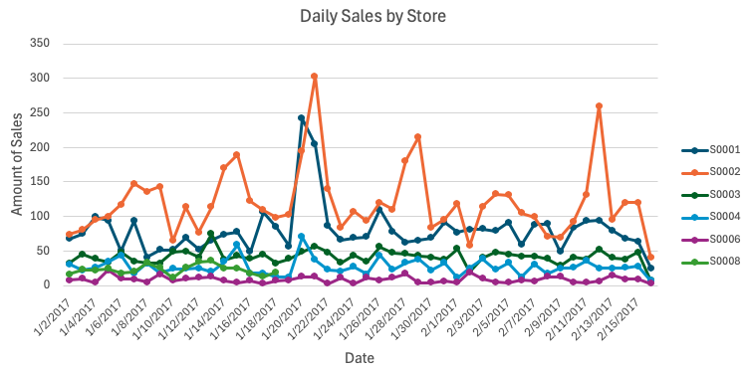
Module 3, Lesson 1: Data Visualization Using Excel

Slide 26
Module 3, Lesson 1: Data Visualization Using Excel
The bar chart shows S0008 and S0006 ​having the lowest total sales figures
The line chart shows S0006 having the lowest daily sales figures each day
The line chart shows that S0008 has no sales data after January 18, 2017
This indicates either sales data got cut off abruptly, or a possible store closure
S0002 had the highest total sales figure, and held the highest daily sales most days
S0001 had the did outperform S0002 four days in the time frame
A dataset with more dates would reveal monthly or seasonal sales trends

Slide 27
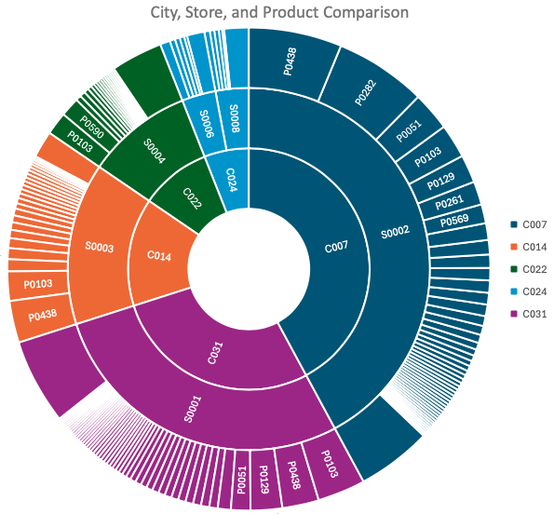
Module 3, Lesson 1: Data Visualization Using Excel
City 024 was the only city with two stores but had the lowest overall sales figures.
P0438 was one of the top 2 highest performing products in each of the three highest-performing cities
P0103 was one of the highest performing products in each of the four highest-performing cities

Slide 28
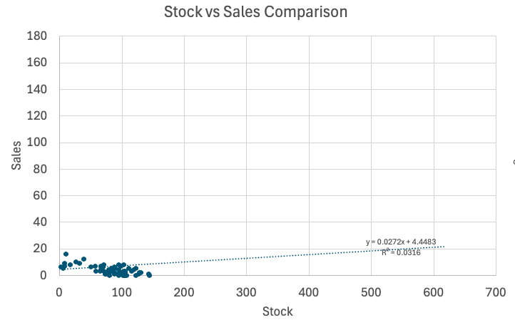
Module 3, Lesson 1: Data Visualization Using Excel
The scatter plot shows a very weak positive correlation between daily stock levels and sales figures.

Slide 29
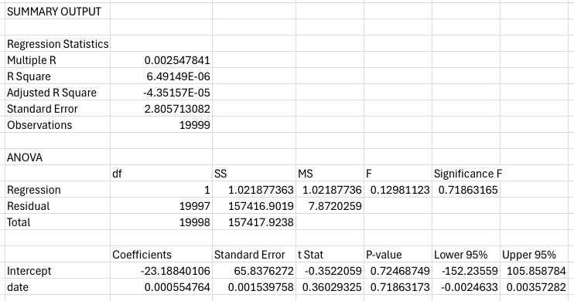
Module 3, Lesson 2: Statistical Analysis
The R-squared value of 6.49E-06 shows that 0.000649% of variance is explained by the model.
The Significance F of 0.7186 is the p-value of the model. Since it is greater than 0.05, the model is not statistically significant.

Slide 30
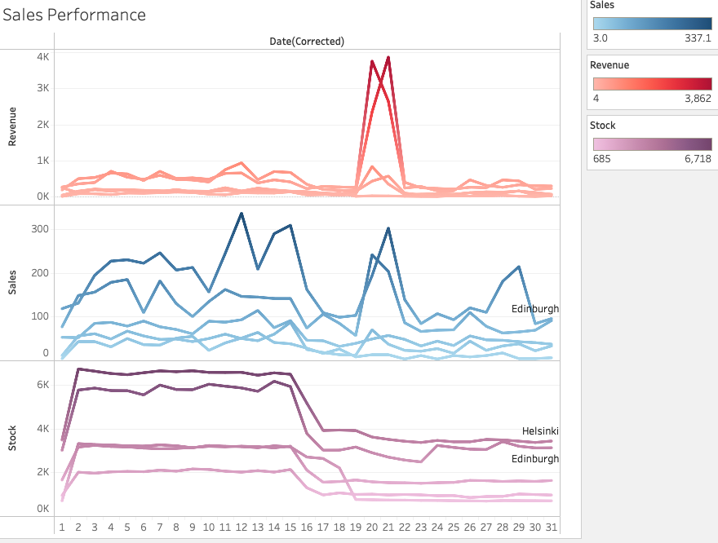
Module 4, Lesson 1: Basic Tableau Visualizations
The line charts allow for a comparison of sales and revenue performance against stock level based on the day of the month.
Individual lines represent individual cities.
Hovering over the lines in Tableau reveal the city, sales growth percentage from the previous day, and applicable totals.

Slide 31
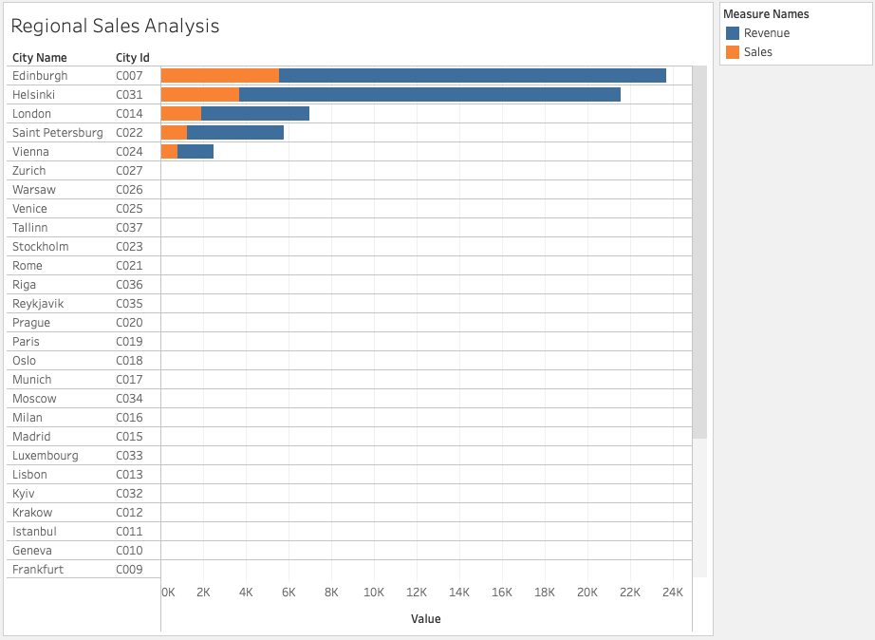
Module 4, Lesson 1: Basic Tableau Visualizations
The bar chart shows Edinburgh and Helsinki have the highest sales and revenue figures
Hovering over each bar reveals exact sales and revenue figures, and the change in sales growth as you move through each city

Slide 32
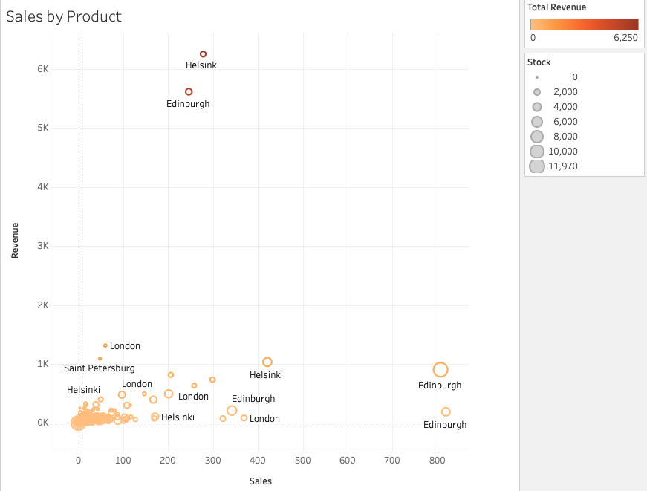
Module 4, Lesson 1: Basic Tableau Visualizations
The scatter plot shows a comparison of sales and revenue split by product, city, and store.
Hovering over points on the plot reveals information about the product's performance at each location

Slide 33
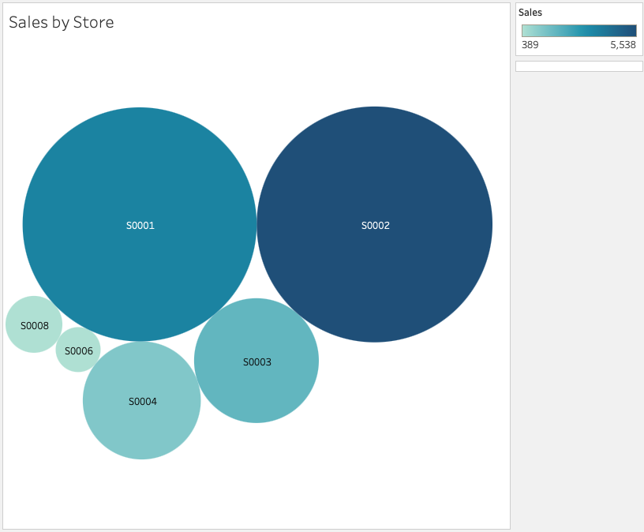
Module 4, Lesson 1: Basic Tableau Visualizations
The bubble chart shows the relative performance each store.
Hovering over a bubble reveals the store location and performance figures.

Slide 34
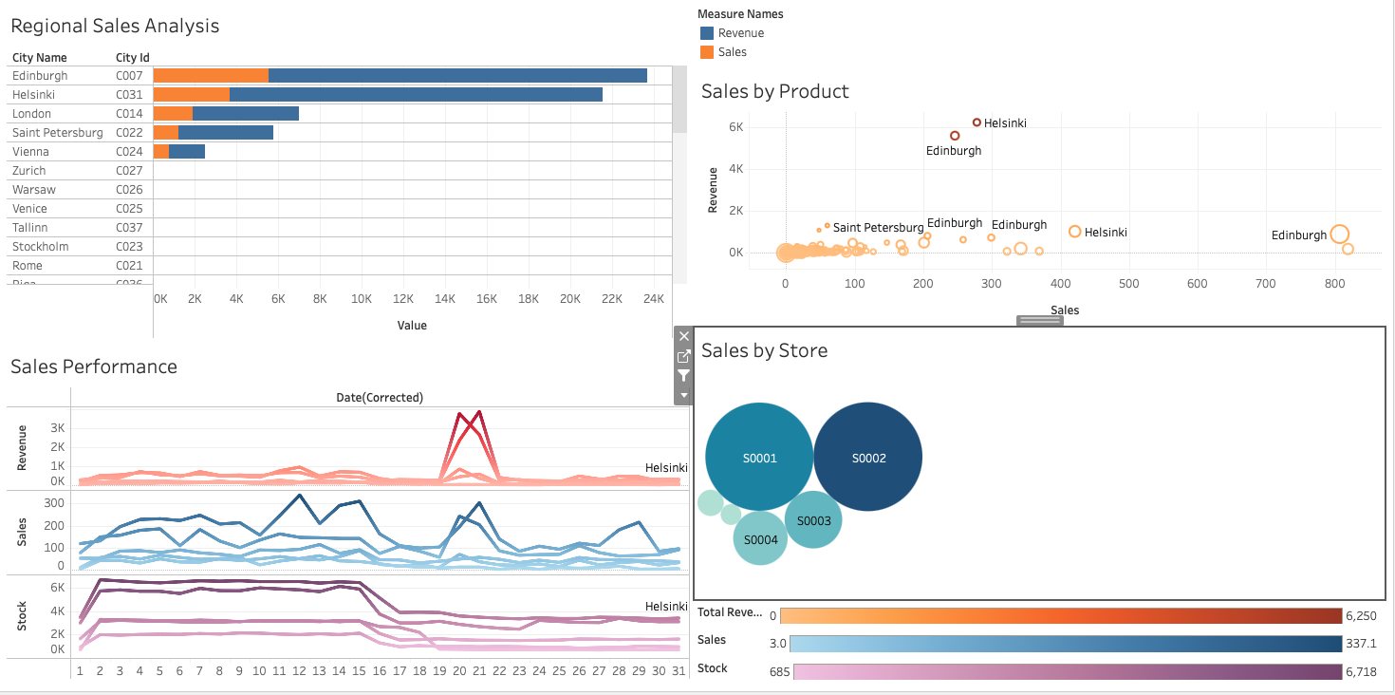
Module 4, Lesson 2: Advanced Visualizations Using Tableau

Slide 35
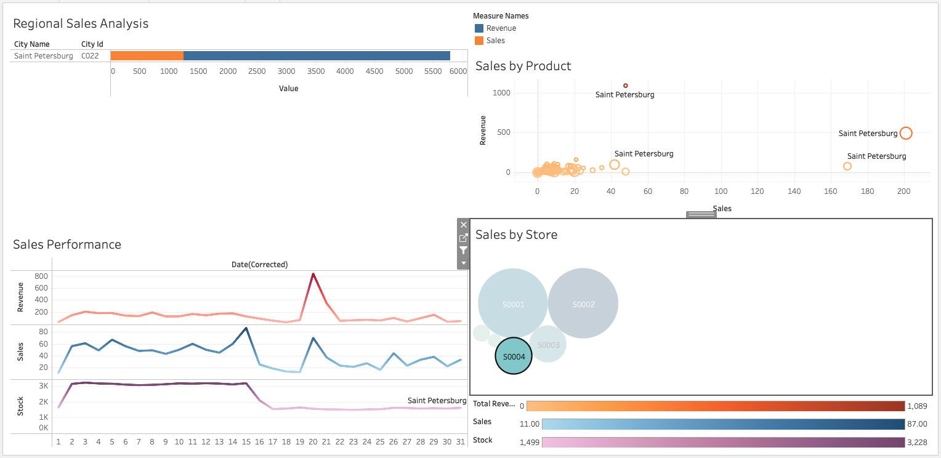
Module 4, Lesson 2: Advanced Visualizations Using Tableau

Slide 36
Module 4, Lesson 2: Advanced Visualizations Using Tableau
The dashboard allows for viewing multiple visualizations at the same time to allow for comparisons and analysis.
Filtering by clicking on a bubble allows for drilling down by store to look for trends that would indicate why certain locations are achieving their level of success, and analyse performance trends across the passage of time.

Slide 37

Discussion

Slide 38
Insights and Recommendations
Edinburgh and Helsinki were shown to have the highest sales and revenue figures
These two cities would be good candidates for store expansion
Identify strategies these stores are using that other stores could implement
Vienna was shown to have the lowest sales figures, though two stores were located in Vienna
Consider analysis of pricing or offering promotions to help these stores improve their performance
If these stores continue to show low performance, closing one of the stores may need to be considered
Most stores saw a decrease in sales from February to March, 2017
Consideration should be made for any promotions or events that may have influenced customer behavior

Slide 39
Insights and Recommendations
Several products were shown to have no or few sales during the time frame
Consider if promotions should be offered to encourage customers to purchase these items, or discontinuing sales of these items to make room for other products
Several products were shown to have high sales performance
Monitor stock levels to make sure these items do not sell out to ensure continued success

Slide 40
Insights and Recommendations
Pivot charts allow for quickly summarizing data and creating charts.
Pivot Charts can be set up with filters to allow for drilling down with data
Excel does limit the amount of data that can be used for certain charts, which limited the analysis that could be performed across several stores and dates
PostgreSQL allows for quickly summarized and sorting larger data sets
This analysis can be exported for creating visualizations in other programs
Tableau allows for the creation of interactive visualizations
Tableau Public requires that visualizations be publically available for all to view
If using Tableau for company-specific visualizations, consider a paid version of Tableau

Slide 41

Conclusion

Slide 42
Summary
Edinburgh and Helsinki were shown to have the highest sales and revenue figures
Vienna's two stores were shown to have the lowest sales performance
Most stores saw a decrease in sales from February to March, 2017
Several products were shown to have no or few sales during the time period

Slide 43

Appendix

Slide 44
Appendix #
Tableau public workbook: https://public.tableau.com/views/Upright_Workbook/PerformanceAnalysis?:language=en-US&:sid=&:display_count=n&:origin=viz_share_link

Slide 45
Acknowledgements
Alan, Berkay. “Retail Sales Data.” Kaggle, 12 Apr. 2021, www.kaggle.com/datasets/berkayalan/retail-sales-data/data.

