Slide 1

DACANAY | RAMILO
PREDICTING CUSTOMER CHURN
WITH REGRESSION-BASED
AND TREE-BASED METHODS
CAPSTONE PROJECT
20 May 2025

Slide 2
INTRODUCTION

Slide 3
EXPLORED TELECOM CUSTOMER CHURN USING EDA AND MACHINE LEARNING.
GoAL: PREDICT CHURN BASED ON USAGE METRICS AND CUSTOMER BEHAVIOR.
EVALUATED MODEL PERFORMANCE ON BOTH TRAINING AND TEST SETS.
INTRODUCTION

Slide 4
METHODOLOGY

Slide 5
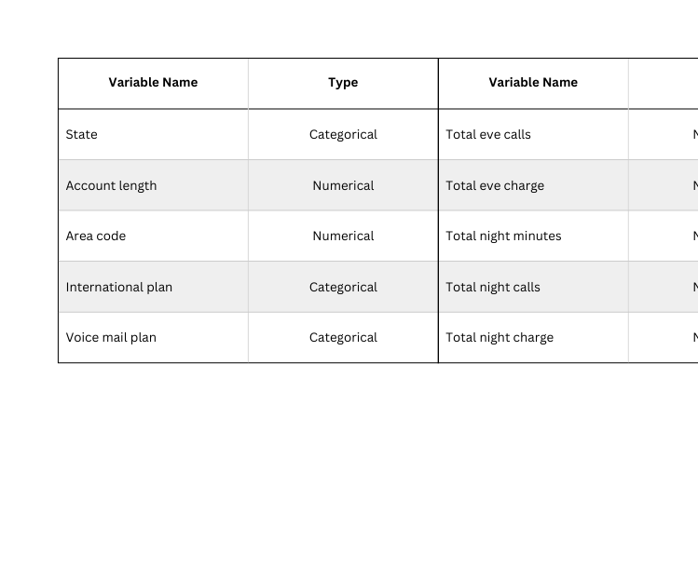
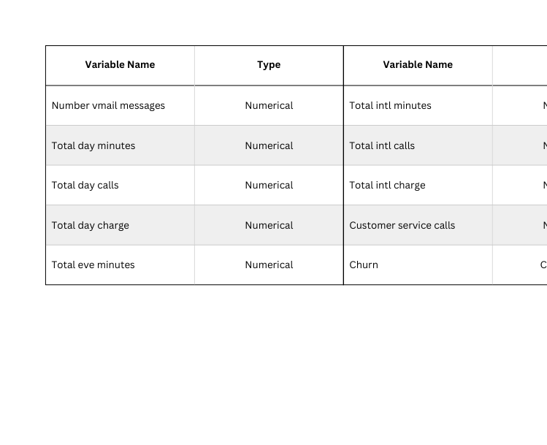
DATA
ORANGE TELECOM’S CHURN DATASET
Two datasets are provided: churn-80 and churn-20.
Data split: churn_80 (training), churn_20 (testing).
METHODOLOGY

Slide 6
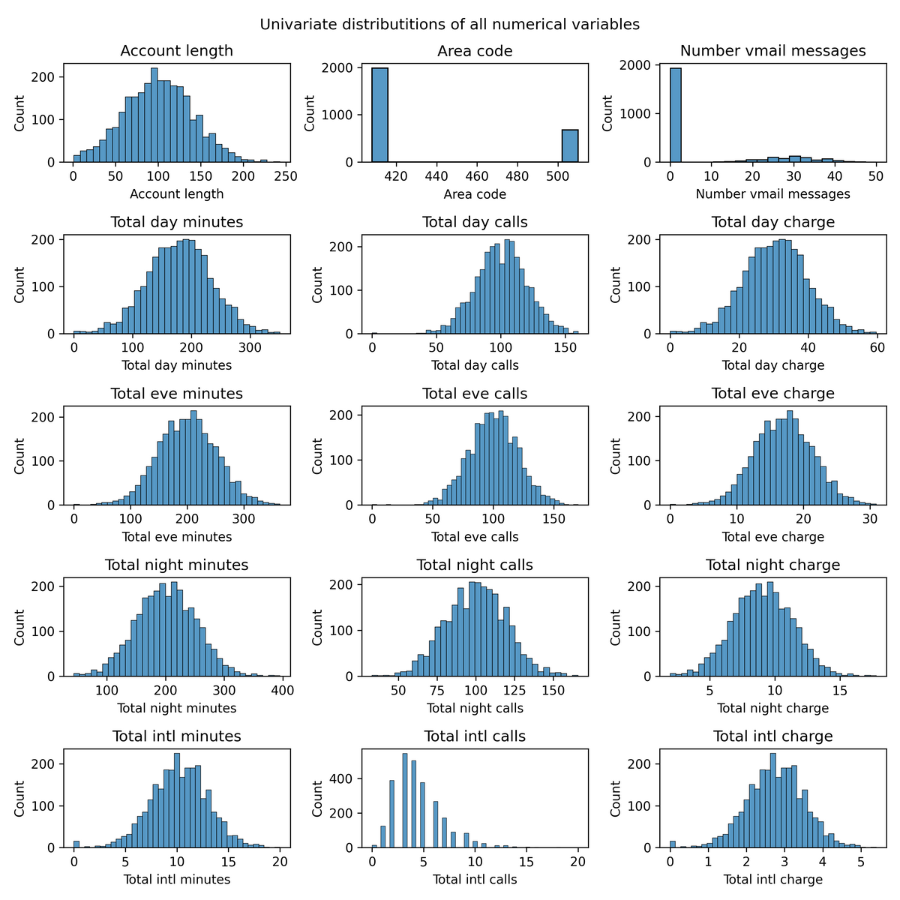
EXPLORATORY DATA ANALYSIS
UNIVARIATE ANALYSIS
Does not exhibit severe outliers or anomalies.
Most variables demonstrate distributional properties that are favorable for modeling.
Skewed variables like voicemail usage and international calls may benefit from transformation or stratification to enhance model performance.
Overall, the distributions suggest that the data is well-behaved and suitable for statistical modeling and machine learning applications.
METHODOLOGY

Slide 7
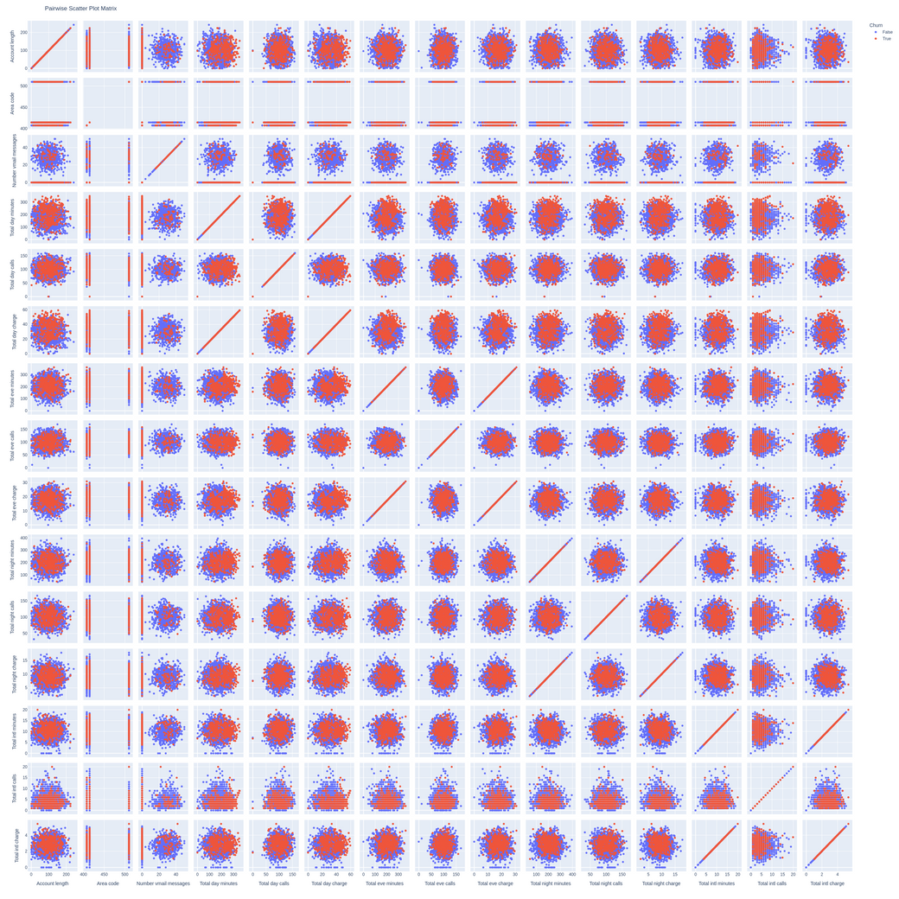
EXPLORATORY DATA ANALYSIS
BIVARIATE ANALYSIS
The scatter matrix confirms the presence of highly correlated redundant variables, limited linear separability between churn classes, and the necessity for nonlinear classification models and feature engineering to improve churn prediction.
METHODOLOGY

Slide 8
PREPROCESSING STEPS
TYPE CONVERSION & ENCODING
ONE-HOT ENCODING & YEO-JOHNSON TRANSFORMATION
STANDARDIZATION
ADDRESSED IMBALANCE WITH RANDOM UNDER-SAMPLING + SMOTE.
METHODOLOGY

Slide 9
MODEL TRAINING
MODELS USED
DECISION TREE
RANDOM FOREST
GRADIENT BOOSTING
LOGISTIC REGRESSION (WITH GRID SEARCH TUNING)
EVALUATED USING ACCURACY, PRECISION, RECALL, F1-SCORE, ROC AUC.
METHODOLOGY

Slide 10
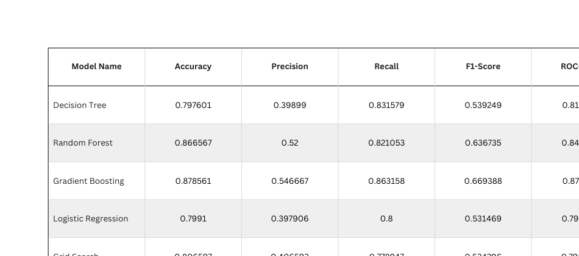
RESULTS
Gradient Boosting: Best overall metrics (Recall, F1-Score, ROC AUC).
Random Forest: Strong generalization.
Decision Tree: High recall, low precision → overpredicts churn.
Logistic Regression: Lower scores, but interpretable.

Slide 11
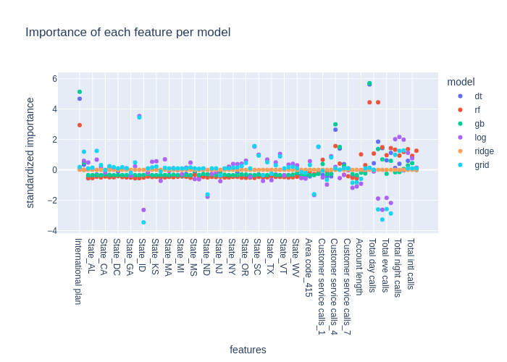
FEATURE IMPORTANCE
Top features: Customer service calls, usage minutes, intl calls.
Tree-based models emphasize sharp splits.
Linear models spread importance more evenly.
Feature patterns are consistent across models.

Slide 12
CONCLUSION
Gradient Boosting offers optimal balance of performance.
Behavioral metrics are key churn predictors.
Logistic Regression remains valuable for interpretation.
Proper preprocessing and resampling are crucial.

