Slide 1

Data Cleaning Project with College Admission Data
By: Vicki Blevins, Eric Brown, Mary Ann Walton
(Team 1)

Slide 2

Project Objective
Do colleges need to go back to requiring SAT and ACT scores for college acceptances?
Should colleges raise the SAT and ACT acceptance criteria to increase graduation rates?
Are students’ potential earnings affected if colleges go back to requiring standardized test scores?

Slide 3

Data Collected for Project Study
Data gathered from the U.S. Department of Education government website, from the year 2010 to 2022
Each year will have its own corresponding admission data information regarding institutional characteristics, enrollment, student aid, costs, and student outcomes
Website link: https://collegescorecard.ed.gov/data/

Slide 4
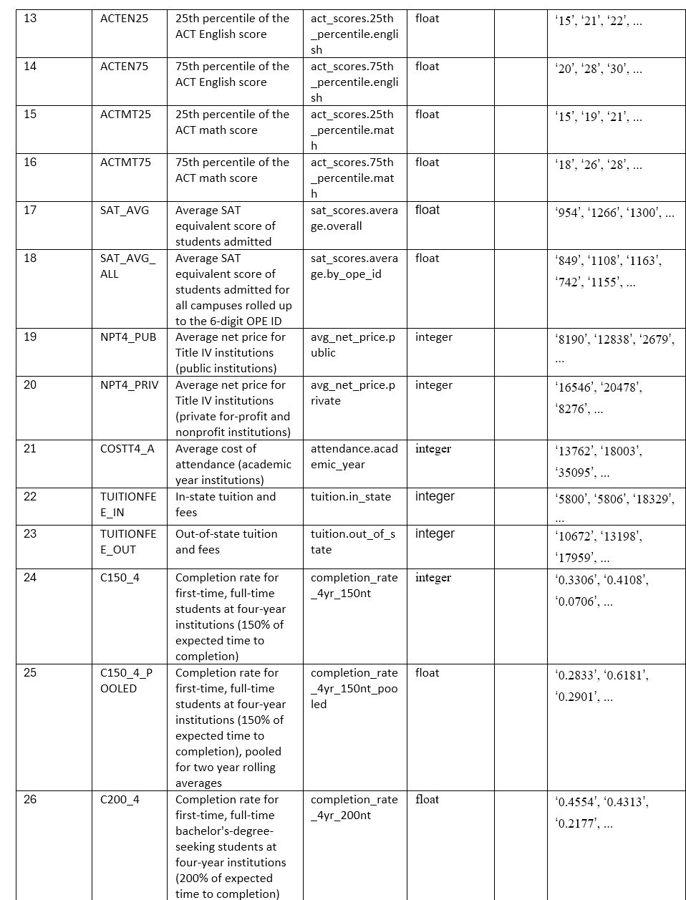
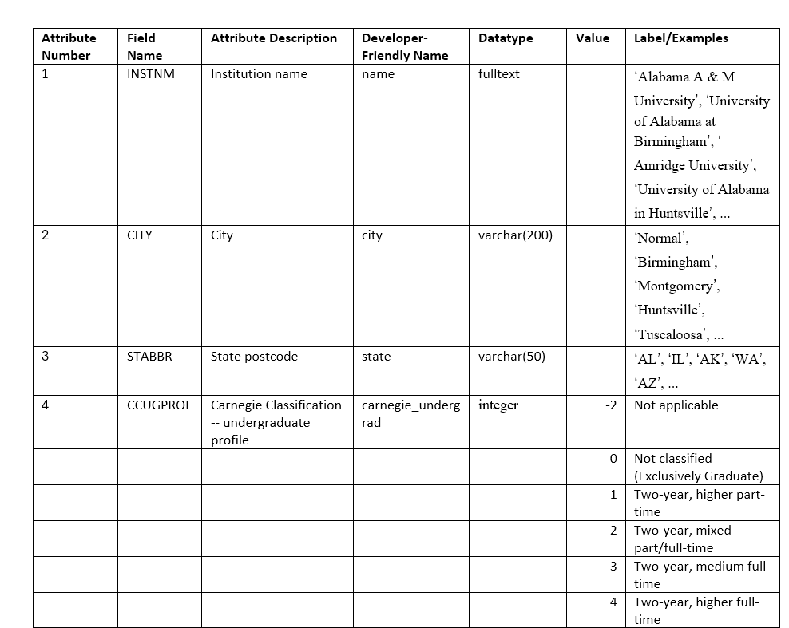
Admission Data Characteristics
Number of Instances (rows): 87,454
Number of Attributes (columns): 38

Slide 5
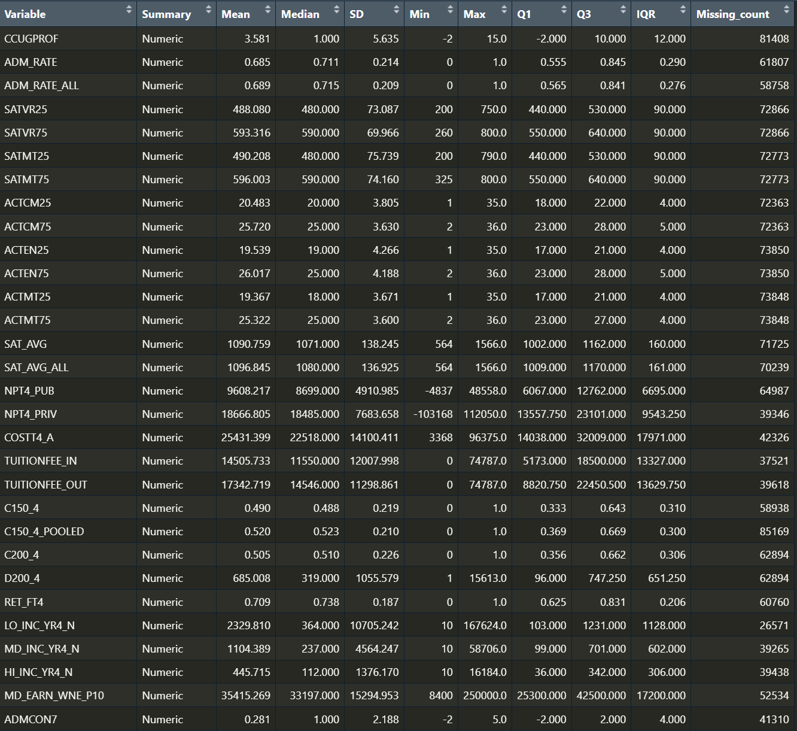
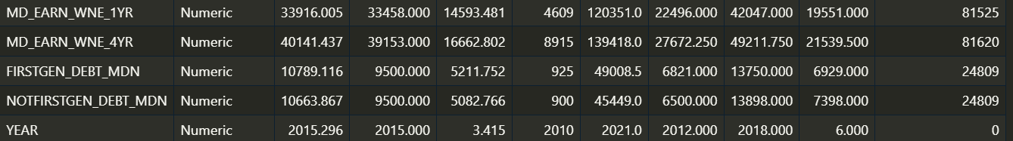
Additional Admission Data Characteristics
Most variables had more than 92% of missing values
Some variables had strange numeric categorical values

Slide 6
Data Storage Method
Used AWS S3 bucket for our data lake to store all our original college admission csv data files
Inside the AWS S3 bucket we stored our combined dataset (all 12 institutional level admission data merged together)
Our final cleaned datasets used for future analysis of the institutional data was included in the S3 bucket

Slide 7
Why Use AWS for data storage?
Amazon S3 provides an optimal foundation for a data lake because of its virtually unlimited scalability and high durability
You can seamlessly and non-disruptively increase storage from gigabytes to petabytes of content, paying only for what you use
Amazon S3 is secure by default. Amazon S3 supports user authentication to control access to data through bucket policies and access-control lists

Slide 8
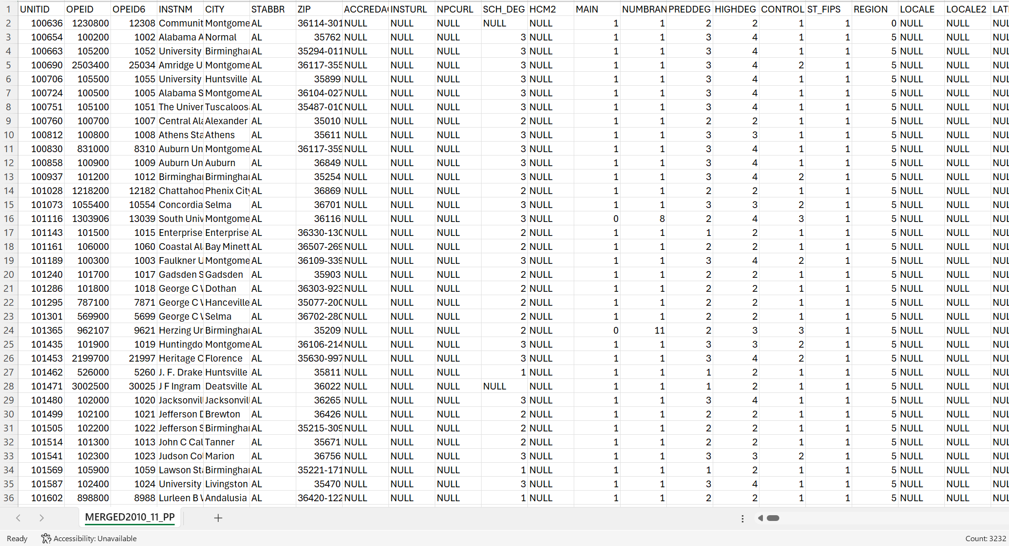

Why we Used AWS for storage
Our data files originally had a lot of rows and columns
Most files were over 200 MB

Slide 9

How we Combined our Datasets – AWS Steps
First create a user group for our team in AWS with proper user credentials to access S3 bucket
Then create a IAM permission for this user group to control the about of access they have on AWS (only allowing access to one specific S3 bucket used for this course)
Create the S3 bucket and create access keys for this bucket to have programable access through different software APIs
Upload all 12 institutional admission date files from the years of 2010 to 2022 to the S3 bucket

Slide 10

How we Combined our Datasets – Python Steps
Use access keys created for S3 bucket in conjunction with python API called boto3 to create a session to link with AWS S3 server
Then grabble each of the 12 college admission data files and put them in an object variable to iterate through and manipulate
Specify 37 out of 3232 attributes we would like to keep from the original data files
Make sure each attribute is displayed under the correct data type used for future analysis
Create a year variable to attach to each original data file to differentiate each dataset
Combine each data file with the correct 38 attributes selected and upload the final combined dataset back into the S3 bucket

