Slide 1
Conditionals
IMED 2351
JavaScript

Slide 2
The if Statement
if statement: a control structure that executes a block of statements only if a certain condition is true
General syntax:
  if (<test>) {
  <statement(s)> ;
  }
Example:
  var gpa = 3.25;
  if (gpa >= 3.0) {
  alert("Good job! Have a cookie.");
  }

Slide 3

if Statement Flow Chart

Slide 4
The if/else Statement
if/else statement: A control structure that executes one block of statements if a certain condition is true, and a second block of statements if it is false. We refer to each block as a branch.
General syntax:
  if (<test>) {
  <statement(s)> ;
  } else {
  <statement(s)> ;
  }
Example:
  var gpa = 3.25;
  if (gpa >= 3.0) {
  alert("Good job! Have a cookie.");
  } else {
  alert("No cookie for you!");
  }

Slide 5
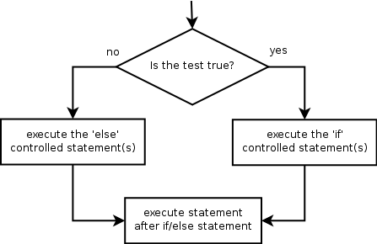
if/else Statement Flow Chart

Slide 6
Comparison Expressions
The <test> used in an if or if/else statement must evaluate to a Boolean value (true or false).
Relational expressions evaluate to Boolean values and use the following relational operators:
Operator | Meaning | Example | Value
== | equals | 1 + 1 == 2 | true
=== | identity | 1.5 === 1.5 | true
!= | does not equal | 3.2 != 2.5 | true
< | less than | 10 < 5 | false
> | greater than | 10 > 5 | true
<= | less than or equal to | 126 <= 100 | false
>= | greater than or equal to | 5.0 >= 5.0 | true

Slide 7
Evaluating Comparison Expressions
Relational operators have lower precedence than math operators.
    5 * 7 >= 3 + 5 * (7 - 1)
    5 * 7 >= 3 + 5 * 6
    35 >= 3 + 30
    35 >= 33
    true
Relational operators should not be "chained" as they can in algebra. WARNING! JavaScript will NOT complain if you do so and you may get unexpected results.
    2 <= 1 <= 10
    false <= 10
    true
???

Slide 8
Errors In Coding
Many students new to if/else write code like this:
  var percent = 85;
  if (percent >= 90) {
  alert("You got an A!");
  }
  if (percent >= 80) {
  alert("You got a B!");
  }
  if (percent >= 70) {
  alert("You got a C!");
  }
  if (percent >= 60) {
  alert("You got a D!");
  } else {
  alert("You got an F!");
  }
What will happen? What’s the problem?
  You may get too many popup boxes. Try it out!

Slide 9
Nested if/else Statements
Nested if/else statement: A chain of if/else that can select between many different outcomes based on several tests.
General syntax:
  if (<test>) {
  <statement(s)> ;
  } else if (<test>) {
  <statement(s)> ;
  } else {
  <statement(s)> ;
  }
Example:
  if (number > 0) {
  alert("Positive");
  } else if (number < 0) {
  alert("Negative");
  } else {
  alert("Zero");
  }

Slide 10
Nested if/else Variations
A nested if/else can end with an if or an else.
  If it ends with else, one of the branches must be taken.
  If it ends with if, the program might not execute any branch.
if (<test>) {
<statement(s)>;
} else if (<test>) {
<statement(s)>;
} else {
<statement(s)>;
}
if (<test>) {
<statement(s)>;
} else if (<test>) {
<statement(s)>;
} else if (<test>) {
<statement(s)>;
}

Slide 11

Nested if/else Flow Chart
if (<test>) {
<statement(s)>;
} else if (<test>) {
<statement(s)>;
} else {
<statement(s)>;
}

Slide 12
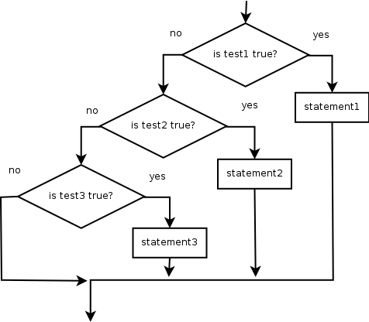
Nested if/else if Flow Chart
if (<test>) {
<statement(s)>;
} else if (<test>) {
<statement(s)>;
} else if (<test>) {
<statement(s)>;
}

Slide 13
Nested if/else Variations
  if (place == 1) {
  alert("You win the gold medal!");
  } else if (place == 2) {
  alert("You win a silver medal!");
  } else if (place == 3) {
  alert("You earned a bronze medal.");
  }
Are there any cases where this code will not print a message?
  Yes, if the place variable is not 1, 2, or 3.
How could we modify it to print a message to non-medalists?
  Add an else clause.

Slide 14
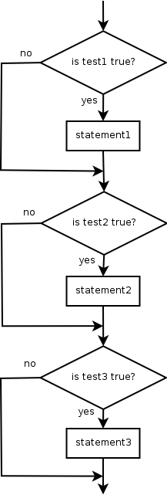
Sequential if Flow Chart
if (<test>) {
<statement(s)>;
}
if (<test>) {
<statement(s)>;
}
if (<test>) {
<statement(s)>;
}

Slide 15
Summary: if/else Structures
Choose exactly 1 set of statements if (<test>) { <statement(s)>; } else if (<test>) { <statement(s)>; } else { <statement(s)>; } | Choose 0, 1, or more set of statements if (<test>) { <statement(s)>; } if (<test>) { <statement(s)>; } if (<test>) { <statement(s)>; }
Choose 0 or 1 set of statements if (<test>) { <statement(s)>; } else if (<test>) { <statement(s)>; } else if (<test>) { <statement(s)>; }

Slide 16
Which if/else Construct To Use?
Reading the user's GPA and printing whether the student is on the dean's list (3.8 to 4.0) or honor roll (3.5 to 3.7)
Printing whether a number is even or odd
Printing whether a user is lower-class, middle-class, or upper-class based on their income
Determining whether a number is divisible by 2, 3, and/or 5
Printing a user's grade of A, B, C, D, or F based on their percentage in the course

Slide 17
Which if/else Construct To Use?
Reading the user's GPA and printing whether the student is on the dean's list (3.8 to 4.0) or honor roll (3.5 to 3.7)
  if / else if
Printing whether a number is even or odd
  if / else
Printing whether a user is lower-class, middle-class, or upper-class based on their income
  if / else if / else
Determining whether a number is divisible by 2, 3, and/or 5
  if / if / if
Printing a user's grade of A, B, C, D, or F based on their percentage in the course
  if / else if / else if / else if / else

