Slide 1
Loops/Iteration
IMED 2351
JavaScript

Slide 2
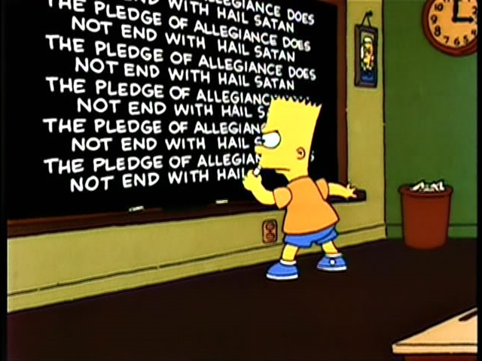
Iteration = Repetition

Slide 3
Looping Via The for Loop
for loop: A block of code that executes a group of statements repeatedly until a given test fails.
General syntax:
  for (<initialization>; <test>; <update>) {
  <statement>;
  <statement>;
  ...
  <statement>;
  }
Example:
  for (var i = 1; i <= 6; i = i + 1) {
  alert("The Pledge of Allegiance...");
  }

Slide 4
Shortcut: Adding One
Can shorten
i = i + 1 to i++
Example:
  for (var i = 1; i <= 6; i++) {
  alert("The Pledge of Allegiance...");
  }

Slide 5
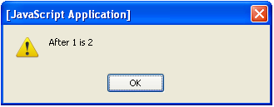


for Loop Over Range Of Numbers
We'll write for loops over integers in a given range.
  The <initialization> declares a loop counter variable that is used in the test, update, and body of the loop.
  for (var <name> = 1; <name> <= <value>; <name>++) {
Example:
for (var i = 1; i <= 3; i++) {
alert("After " + i + " is " + (i + 1));
}
"For each i from 1 through 3, ..."

Slide 6
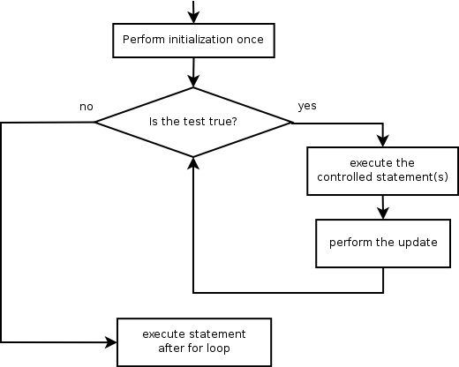
for Loop Flow Diagram
  for (<init>; <test>; <update>) {
  <statement>;
  <statement>;
  ...
  <statement>;
  }

Slide 7
Loop Walkthrough
Code:
  for (var i = 1; i <= 3; i++) {
  alert("After " + i + " is " + (i + 1));
  }
Result:
i:

Slide 8


Exercise
Create a web page that looks as follows:
When the user clicks "Generate Song", the phrase "round and round" will be repeated the specified number of times after "The wheels on the bus go".

Slide 9
The Wheels On The Bus Go…
<div>
Times: <input type="text" id="times" /><br />
<input type="button" value="Generate Song"
onclick="generate();" />
<p id="output">
</p>
</div>
HTML
function generate() {
var times = document.getElementById("times").value;
var text = "The wheels on the bus go ";
for (var i = 1; i <= times; i++) {
text = text + "round and round ";
}
document.getElementById("output").innerHTML = text;
}
JavaScript

Slide 10
The Wheels On The Bus Go…
Can shorten
text = text + ... to text += ...
function generate() {
var times = document.getElementById("times").value;
var text = "The wheels on the bus go ";
for (var i = 1; i <= times; i++) {
text += "round and round ";
}
document.getElementById("output").innerHTML = text;
}
JavaScript

Slide 11

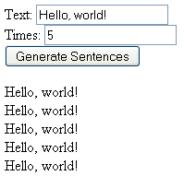
Exercise
Create a web page that looks as follows (example values filled in):
When the user clicks "Generate Sentences", the text will be repeated the specified number of times.

Slide 12
Solution
<div>
Text: <input type="text" id="text" /><br />
Times: <input type="text" id="times" /><br />
<input type="button" value="Generate Sentences"
onclick="generate();" />
<p id="output">
</p>
</div>
HTML
function generate() {
var times = document.getElementById("times").value;
var sentence = document.getElementById("text").value;
var text = "";
for (var i = 1; i <= times; i++) {
text += sentence + "<br />";
}
document.getElementById("output").innerHTML = text;
}
JavaScript

