Slide 1
Debugging

Slide 2
What's The Proper Indentation?
function max(x,y)
{
if (x<y)
{
return y;}
else
{
return x;}
}
alert(max(10,12));

Slide 3
When To Indent?
Everything between a opening and closing curly brace should be indented in.
The closing curly brace should be on its own line and should line up with the start of the code block.
if (age < 21) {
alert("Intruder alert!");
alert("Unauthorized attempt to drink alcohol!");
}
if (age < 21) {
alert("Intruder alert!");
alert("Unauthorized attempt to drink alcohol!");
}

Slide 4
When To Indent?
Notice that the indentation rules are the same as the HTML indentation rules. Nothing new to learn!
if (age < 21) {
alert("Intruder alert!");
alert("Unauthorized attempt to drink alcohol!");
}
JavaScript
<ol>
<li>First!</li>
<li>If you're not first, you're last.</li>
</ol>
HTML

Slide 5
Opening Curly Brace
There are two standard ways to open a code block.
Pick whichever you prefer and stick with it.
if (age < 21) {
...
}
if (age < 21)
{
...
}

Slide 6
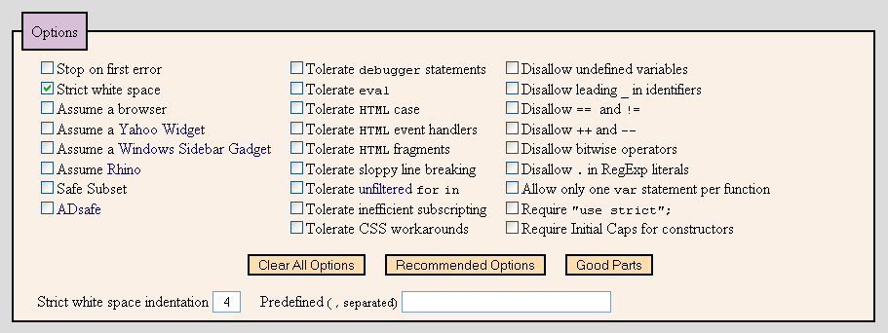
JSLint (http://jslint.com)
Make sure the option "Strict white space" is checked.
Change the number for "Strict white space indentation" to whatever number of spaces you like.

Slide 7
Using JSLint
Ignore error messages that do not pertain to indentation.

Slide 8
Proper Indentation
function max(x, y)
{
if (x < y)
{
return y;
}
else
{
return x;
}
}
alert(max(10, 12));
function max(x, y) {
if (x < y) {
return y;
} else {
return x;
}
}
alert(max(10, 12));
Remember: Don't mix spaces and tabs when indenting!

Slide 9
Debuggers

Slide 10
How To Debug
Find out what values are stored in the variables at different points in time. Never assume anything.
  Don't just say that a variable contains a certain value. Prove it!
    Use popup boxes to display the variable or watch the variable in the debugger.
Narrow down the location of the problematic code.
  Delete code until you get it in a working state, and then add in the broken code in phases.

Slide 11
How To Debug
Simulate the computer on paper. Go line by line.
  Can also use the debugger go line by line.
Make sure you understand what every single line does.
  Computers are neither magical nor mysterious. Everything can be explained!

Slide 12
Get Firebug
Firebug:
  https://addons.mozilla.org/en-US/firefox/addon/1843
Firefox:
  http://www.mozilla.com/en-US/firefox/
While you're at it, consider getting Ad Block Plus.
  https://addons.mozilla.org/en-US/firefox/addon/1865

Slide 13
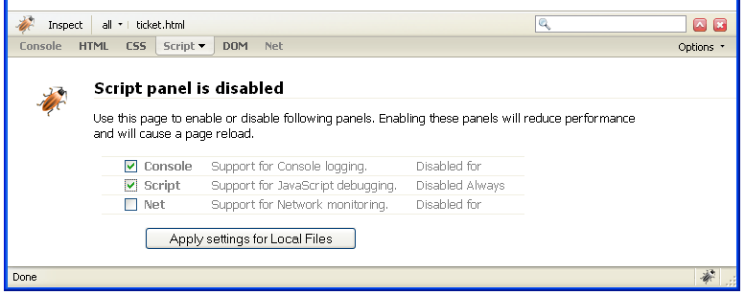
Setting Up Firebug
After installation, load one of your HTML pages into Firefox.
Click the picture of the grey bug on the bottom right of the window.
Firebug will open up. Click on the "Script" tab and then select the "Console" and "Script" checkboxes in the window. Apply the settings.

Slide 14
Understanding Error Messages
document.getElementById("<ID>") is null
  The given identifier, <ID>, does not exist. Typo perhaps?
<name> is not a function
  Most likely cause is spelling or capitalization error.
<name> is not defined
  Most likely cause is spelling or capitalization error or copying from example code without changing the names.

Slide 15
Understanding Error Messages
As the computer is not omniscient, not all error messages are exact.
What's wrong here? Adding semi-colons before the statement does not fix the problem.
  if is misspelled.
Firebug can miss some errors.
  A debugger should be only used as an aid, not a panacea.

Slide 16
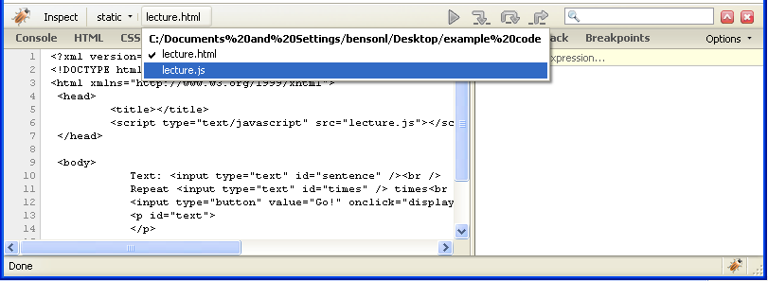
Breakpoint
breakpoint: intentional stopping or pausing place in a program, put in place for debugging purposes
To add a breakpoint, click on the filename on the top bar in Firebug and select the JavaScript file.

Slide 17
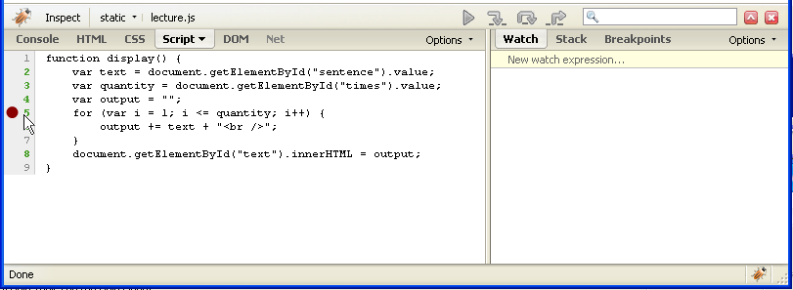
Adding Breakpoints
Clicking on a number on the left-hand side toggles the appearance of a red circle (a breakpoint).

Slide 18
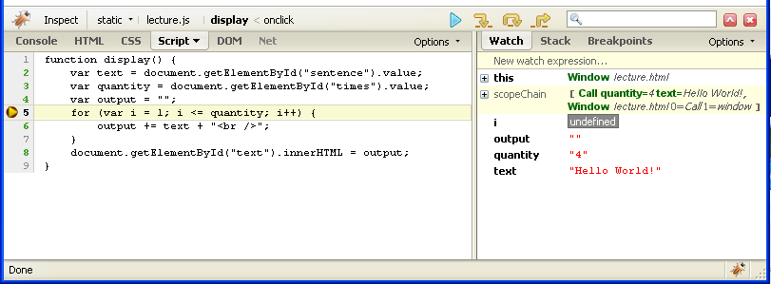
Breakpoints
When the program is running, it will stop on any line that has a red circle.
All variables that the computer "knows" at that point in time before the line is executed will appear on the right-hand side.

Slide 19
Debugging
Continue executing program until next red circle or end of program
Execute this line and stop at start of next line

Slide 20
Exercise
How old are you? <input type="text" id="age" /><br />
<input type="button" value="Can I Enter The Club?"
onclick="checkAge();" />
HTML
function checkAge() {
var guestAge = document.getElementById("age").value;
if (guestAge >= 21) {
alert("Welcome. Rock on!");
} else if (guestAge = 20) {
alert("Close enough; we'll sneak you in.");
} else {
alert("I'm sorry, you can't party with us. Scram!");
}
}
JavaScript

Slide 21
Solution
How old are you? <input type="text" id="age" /><br />
<input type="button" value="Can I Enter The Club?"
onclick="checkAge();" />
HTML
function checkAge() {
var guestAge = document.getElementById("age").value;
if (guestAge >= 21) {
alert("Welcome. Rock on!");
} else if (guestAge == 20) {
alert("Close enough; we'll sneak you in.");
} else {
alert("I'm sorry, you can't party with us. Scram!");
}
}
JavaScript

Slide 22
Exercise
Text: <input type="text" id="sentence" /><br />
Repeat <input type="text" id="times" /> times<br />
<input type="button" value="Go!" onclick="display" />
<p id="text">
</p>
HTML
function display() {
var text = document.getElementById("text").value;
var quantity = document.getElementById("time").value;
for (var i = 1; i <= times; i++) {
output = sentence + "<br />";
}
document.getElementById("text").innerHTML = output;
}
JavaScript

Slide 23
Solution
Text: <input type="text" id="sentence" /><br />
Repeat <input type="text" id="times" /> times<br />
<input type="button" value="Go!" onclick="display();" />
<p id="text">
</p>
HTML
function display() {
var text = document.getElementById("sentence").value;
var quantity = document.getElementById("times").value;
var output = "";
for (var i = 1; i <= times; i++) {
output += text + "<br />";
}
document.getElementById("text").innerHTML = output;
}
JavaScript

