Slide 1
JavaScript
Tools of the Trade

Slide 2
Objectives
Understand what the key features are of development software
Describe the pros and cons of text editors vs. Integrated Development Environments (IDEs)
Know what to look for in a browser as a development tool

Slide 3
More Objectives
Name the five most popular browsers
Recall the common debugging tools available to the most popular browsers
Write and test JavaScript code using online services
Identify the general types of JavaScript errors

Slide 4
More Objectives
Name many common causes of errors
Utilize a wealth of debugging steps and tools
Use JavaScript code to debug problems
Use Firebug for advanced debugging

Slide 5
Development Software
Coding
Executing
Debugging
Notes:
For coding, you’ll either use a text editor or IDE.
For executing, you’ll use multiple browsers.
For debugging, you’ll use tools built into the browser, built into the IDE, or you’ll use specific code.

Slide 6
Choosing Software
Operating System
Language(s) supported
Specific Features

Slide 7
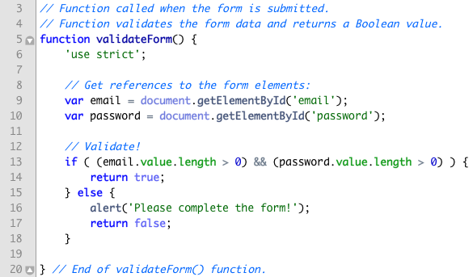
Syntax Highlighting
Notes:
Syntax highlighting can be useful for debugging as it implicitly validates the syntax.
Notice how the keyword Document with a capital D is not colored in the second image.

Slide 8
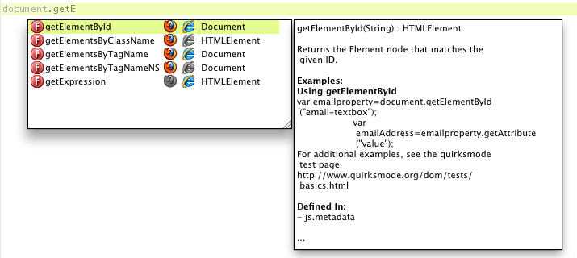
Code Intelligence
Auto-balancing of characters and tags
Code completion
Tracking of variables and functions
Notes:
Also minimizes possible errors.
The ability to track user defined or library variables and functions may also apply to refactoring.

Slide 9
Other Features
Inline execution of code
Page templates
FTP support
Built-in debugger
Network monitor
WYSIWYG
Help system, manual, and documentation
Notes:
FTP support is useful with JavaScript, as it’s primarily used for Web development and you’ll want to be able to move the finished or edited work online.
WYSIWYG is also helpful with Web development in particular.
Debuggers and network monitors are also available in browsers.

Slide 10
Coding Software
Text Editors
IDEs
Cheaper
Simpler
Easier to master
Faster to begin using
Less demanding of the computer
Can be used for many tasks
More expensive
More complicated
Requires more computer resources
Tend to be more specific
Better code intelligence
Better debugging
Faster development once mastered

Slide 11
Coding Software
Text Editors
IDEs
Komodo Edit
UltraEdit
Notepad++
EditPlus
TextMate
TextWrangler
BBEdit
Emacs
Vim
Adobe Dreamweaver
Komodo IDE
Aptana Studio
Eclipse
NetBeans
WebStorm

Slide 12
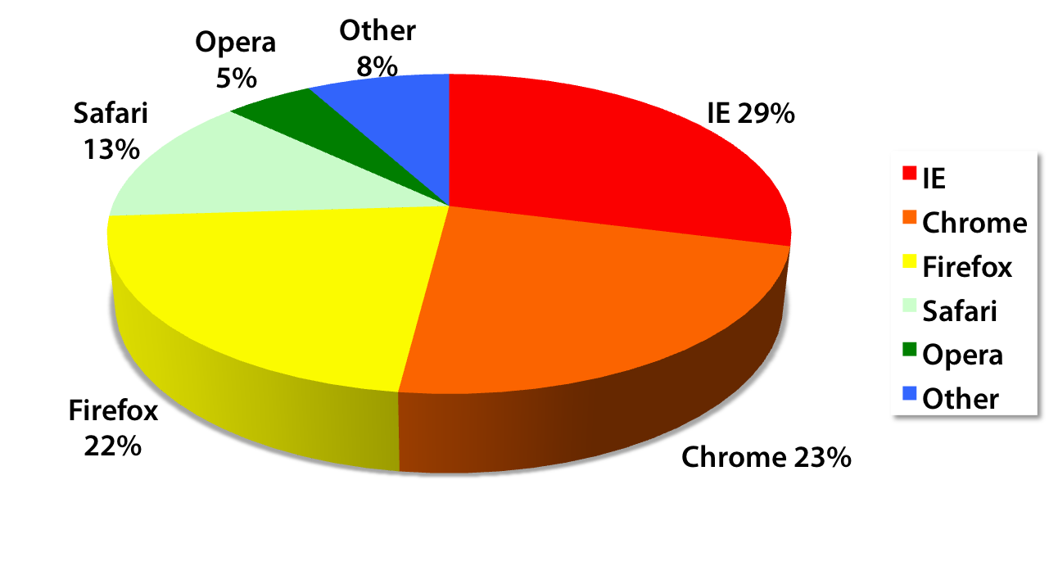
Executing Software
Notes:
These are usage stats as of February 2012.
But the focus here is on the best browser as a development tool, not the best browser overall or the most used browser.
The quality of browsers as development software comes down to the built-in tools and the availability of extensions.

Slide 13
What to Look For
DOM Inspector
JavaScript source viewer
Advanced JavaScript debugger
Network monitor
Error console
Notes:
Because JavaScript often does DOM manipulation, the ability to view the active DOM, not the initial DOM, is valuable.
Ability to execute JavaScript inline
Ability to set breakpoints, watch the values of variables and the flow of code.
Network monitor is key to debugging Ajax transactions

Slide 14
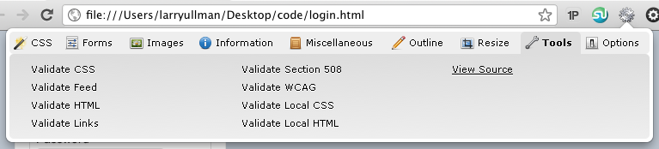
Chrome
Web Developer
Pendule
Firebug Lite
JavaScript Tester
Validity
Notes:
Web developer: HTML, CSS, JavaScript and more (see image)
Pendule: similar to Web developer
Firebug Lite: watered down version of the excellent debugger
Validity: for validating HTML

Slide 15
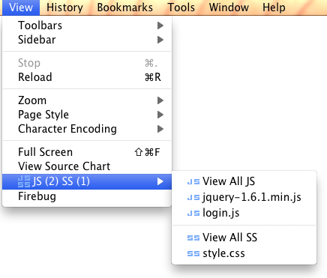
Firefox
Firebug
Web Developer
YSlow!
Greasemonkey
View Source Chart
JS View
Notes:
Firebug is one of the first and is still one of the best Web developer extensions
Yslow! For checking a page’s performance (from Yahoo!)
Greasemonkey: for executing additional JavaScript
JS View, for viewing JavaScript source on the page

Slide 16
Internet Explorer
IE Developer Toolbar
Web Accessibility Toolbar
Notes:
IE is not as extendible.
IE Developer Tool bar is pretty good, let’s you test running as different versions of IE.
Best for testing final version to make sure it’s compatible.

Slide 17
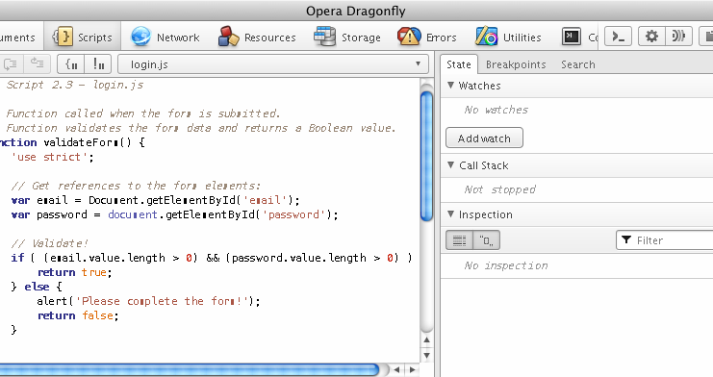
Opera
Notes:
Opera is extendible but it’s built-in Dragonfly is really good. Has all the necessary features.

Slide 18
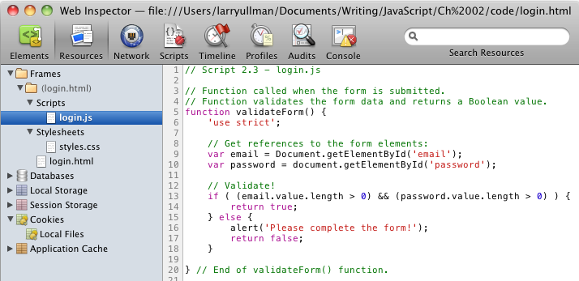
Safari
Notes:
Safari has some extensions but its Web Inspector is sufficient, similar to Opera’s Dragonfly

Slide 19
Complete Testing
Browsershots
Adobe BrowserLab
Virtualization Software
Spoon
Commercial Online Services
CrossBrowserTesting
BrowserCam
Sauce Labs
Notes:
Browsershots and BrowserLab are appearance only (unless you’re using DW with BrowserLab).
Virtualization software is good, but limited to specific versions of each browser
Spoon is great, but does not support IE.

Slide 20
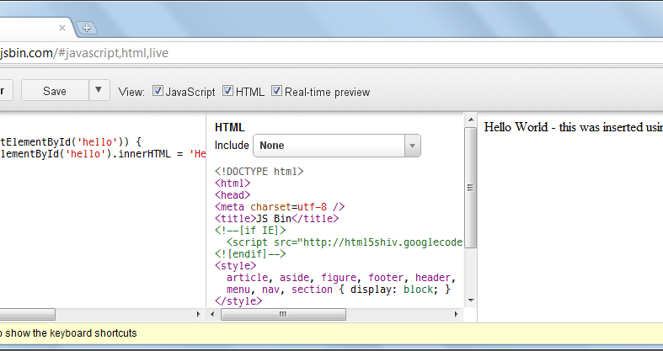
JS Bin
Notes:
JS Bin (jsbin.com) allows you to write and test JavaScript online, without creating an entire Web page.
JS Bin even works with variables frameworks.
A more complex alternative is jsFiddle.

Slide 21
General Error Types
Syntax
Run-time
Logical
Notes:
Syntactical errors prevent JavaScript from running. Caused by improper syntax. Very common for beginners. Relatively easy to find and fix.
Run-time errors occur during execution of JavaScript. Can be caused by referencing objects or methods that don’t exist. Can be browser-specific.
Logical errors are bugs. No actual error reported, just an unexpected result. Hardest to find and fix.

Slide 22
Common Causes
Case Sensitivity
Improper Syntax
Misuse of = and ==
Referencing objects that don’t yet exist
Treating objects as the wrong type
Misspelling
Notes:
Case sensitivity applies to almost everything: variables, functions, objects, etc.
Syntax problems include an imbalance of quotation marks, parentheses, brackets, etc.
The assignment and equality operators are frequently misused, which causes bugs.
In the browser, it’s easy to reference an object that doesn’t yet exist. You’ll need to understand the program flow to fix this.
You’ll sometimes see errors when you treat, for example, an object that’s not a string as if it were a string.

Slide 23

Debugging Techniques
Get a good text editor or IDE.
Get a good development browser.
Keep the error console open!
Validate your JavaScript code.
Rubber duck debugging.
Notes:
Good development tools do a better job of minimizing and highlighting problems.
Validation can be done at jslint.com or jshint.com
Rubber duck debugging is an EXCELLENT approach.

Slide 24
Debugging Techniques
Use external JavaScript files
Save the file and refresh the browser.
Try a different browser.
Take a break!
Notes:
External JavaScript files are easier to edit and read, and line numbers can be more useful.
Never forget to save your work and refresh the browser!
Many problems are browser-specific. Use a different browser to confirm if it’s a general problem or a browser-specific one.
Take a break to clear your head!

Slide 25
Bad Debugging Techniques
Panicking!
Ignoring error messages
Trying random solutions
Sending emails to teachers out of frustration*
Notes:
*It is a good idea to email the teacher if you are stuck and need a different perspective.

Slide 26
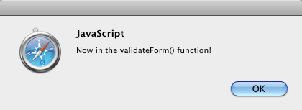
Debugging with alert()
alert('Now in the XXX function!');
Notes:
Alert() is simple to use and works on all browsers.
Can become tedious and isn’t great for reporting a lot of information.

Slide 27
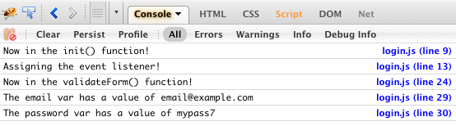
Debugging with console.log()
console.log('Now in the XXX function!');
console.log('myVar is ' + myVar);

Slide 28
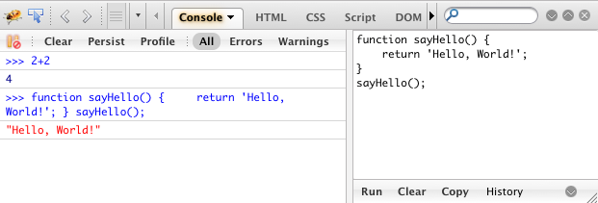
Debugging with Firebug
Notes:
Execute code. Can be random bits or code related to the current page. Can even execute multiple lines of code.

Slide 29



Debugging with Firebug
Notes:
Set breakpoints and watch expressions.

Slide 30
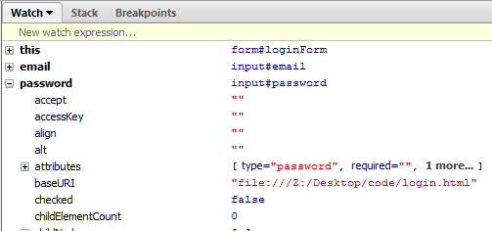
Debugging with Firebug
Notes:
Check the values of variables at specific places.
Firebug is great, but a bit hard for beginner’s to use. Perhaps recommend watching an online tutorial or screencast.

Slide 31
Other Tools
jsFiddle.net
jsBin.com
jsbeautifier.org
jQuery.com
jQueryUI.com

