Slide 1
HTML Basics

Slide 2
LEARNING OUTCOMES
In this chapter, you will learn how to ...
  Describe HTML, XHTML, and HTML5
  Identify the markup language in a web page document
  Use the html, head, body, title, and meta elements to code a template for a web page
  Configure the body of a web page with headings, paragraphs, line breaks, divs, lists, and blockquotes
  Configure text with phrase elements
  Configure special characters
  Use the anchor element to link from page to page
  Create absolute, relative, and e-mail hyperlinks
  Code, save, and display a web page document
  Test a web page document for valid syntax

Slide 3
WHAT IS HTML?
HTML:
The set of markup symbols or codes placed in a file intended for display on a Web browser page.
The World Wide Web Consortium (http://w3c.org) sets the standards for HTML and its related languages.

Slide 4
HTML ELEMENTS
Each markup code represents an HTML element .
Each element has a purpose.
Most elements are coded as a pair of tags:
an opening tag and a closing tag.
Tags are enclosed in angle brackets, "<" and ">" symbols.

Slide 5
WHAT IS XHTML?
The most recent standard version of HTML
eXtensible HyperText Markup Language.
XHTML uses:
  the elements and attributes of HTML
  the syntax of XML (eXtensible Markup Language).

Slide 6
XML SYNTAX
An XML document must be well-formed.
  Use lowercase
  Use opening and closing tags
  <body> </body>
  Close stand-alone tag with special syntax
  <hr />

Slide 7

WHAT IS HTML5 ?
Newest draft version of HTML/XHTML
Supported by modern browsers
  Safari, Google Chrome, Firefox, Internet Explorer 9
Intended to be backwards compatible
Adds new elements
Adds new functionality
  Edit form data
  Native video and audio
  And more!

Slide 8
DOCUMENT TYPE DEFINITION
Document Type Definition (DTD)
  doctype statement
  identifies the version of HTML contained in your document.
  placed at the top of a web page document

Slide 9
DTD EXAMPLES
XHTML 1.0 Transitional DTD
<!DOCTYPE html PUBLIC "-//W3C//DTD XHTML 1.0 Transitional//EN"
http://www.w3.org/TR/xhtml1/DTD/xhtml1-transitional.dtd>
HTML5 DTD
<!DOCTYPE html>

Slide 10
EXAMPLE XHTML WEB PAGE
<!DOCTYPE html PUBLIC "-//W3C//DTD XHTML 1.0 Transitional//EN"
"http://www.w3.org/TR/xhtml1/DTD/xhtml1-transitional.dtd">
<html xmlns="http://www.w3.org/1999/xhtml" lang="en" xml:lang="en">
<head>
<title>Page Title Goes Here</title>
<meta http-equiv="Content-Type" content="text/html; charset=utf-8" />
</head>
<body>
... body text and more XHTML tags go here ...
</body>
</html>

Slide 11
EXAMPLE HTML5 WEB PAGE
<!DOCTYPE html>
<html lang="en">
<head>
<title>Page Title Goes Here</title>
<meta charset="utf-8">
</head>
<body>
... body text and more HTML5 tags go here ...
</body>
</html>

Slide 12
HEAD & BODY SECTIONS
Head Section
Contains information that describes the Web page document
  <head>
  …head section info goes here
  </head>
Body Section
Contains text and elements that display in the Web page document
<body>
  …body section info goes here
  </body>

Slide 13
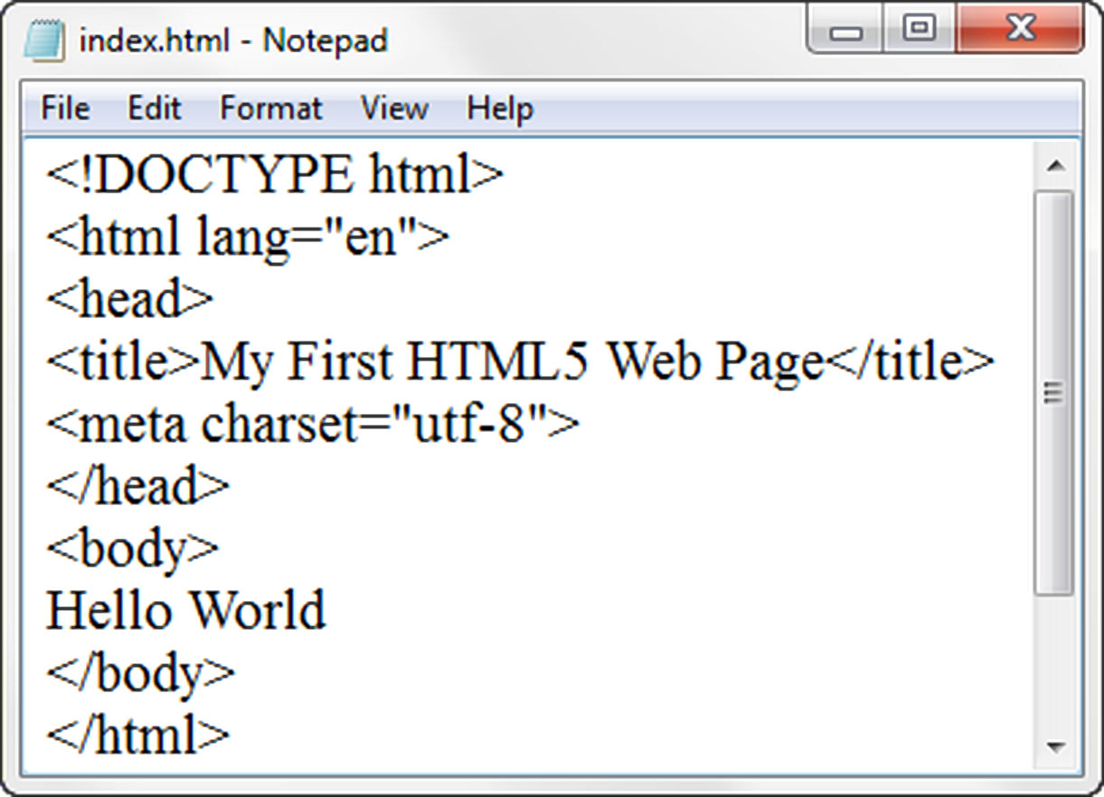
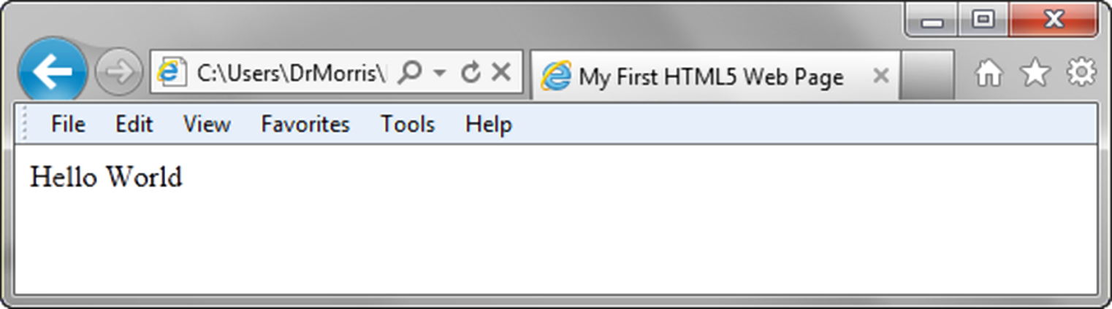
TITLE ELEMENT
META ELEMENT

Slide 14
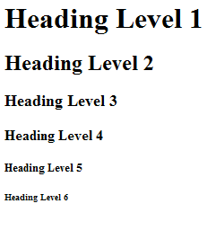
THE HEADING ELEMENT
<h1>Heading Level 1</h1>
<h2>Heading Level 2</h2>
<h3>Heading Level 3</h3>
<h4>Heading Level 4</h4>
<h5>Heading Level 5</h5>
<h6>Heading Level 6</h6>

Slide 15
PARAGRAPH ELEMENT
Paragraph element
<p> …paragraph goes here… </p>
  Groups sentences and sections of text together.
  Configures a blank line above and below the paragraph

Slide 16
LINE BREAK ELEMENT
Line Break element
  Stand-alone, or void tag
    XHTML syntax: <br />
    HTML syntax: <br>
  …text goes here <br>
  This starts on a new line….
  Causes the next element or text to display on a new line

Slide 17
BLOCKQUOTE ELEMENT
Blockquote element
  Indents a block of text for special emphasis
  <blockquote>
  …text goes here…
  </blockquote>

Slide 18
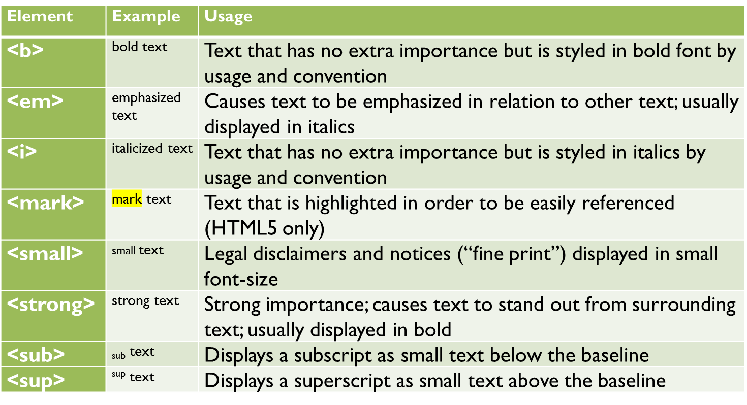
PHRASE ELEMENTS
Indicate the context and meaning of the text

Slide 19
HTML LISTS
Unordered List
Ordered List
Description List
formerly called a definition list

Slide 20
UNORDERED LIST
Displays a bullet, or list marker, before each entry in the list.
<ul>
Contains the unordered list
  type attribute determines the type of bullet point
  default type is disc (but depends on the browser)
<li>
Contains an item in the list

Slide 21
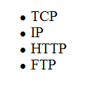
UNORDERED LIST EXAMPLE
<ul>
<li>TCP</li>
<li>IP</li>
<li>HTTP</li>
<li>FTP</li>
</ul>

Slide 22
ORDERED LIST
Displays a numbering or lettering system to itemize the information contained in the list
<ol>
Contains the ordered list
  type attribute determines numbering scheme of list, default is numerals
<li>
Contains an item in the list

Slide 23
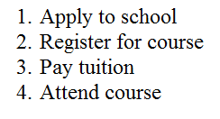
ORDERED LIST EXAMPLE
<ol>
<li>Apply to school</li>
<li>Register for course</li>
<li>Pay tuition</li>
<li>Attend course</li>
</ol>

Slide 24
DESCRIPTION LIST
Useful to display a list of terms and descriptions or a list of FAQ and answers
  <dl>
  Contains the description list
  <dt>
  Contains a term/phrase/sentence
  Configures empty space above and below the text
  <dd>
  Contains a description of the term/phrase/sentence
    Indents the text
    Configures empty space above and below the text

Slide 25
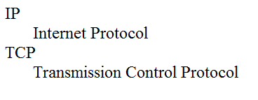
DESCRIPTION LIST EXAMPLE
<dl>
<dt>IP</dt>
<dd>Internet Protocol</dd>
<dt>TCP</dt>
<dd>Transmission Control Protocol</dd>
</dl>

Slide 26
CHECKPOINT
Describe the features of a heading element and how it configures the text.
Describe the difference between ordered lists and unordered lists.
Describe the purpose of the blockquote tag.

Slide 27
SPECIAL CHARACTERS
Display special characters such as quotes, copyright symbol, etc.
Character Code
© &copy;
< &lt;
> &gt;
& &amp;
&nbsp;

Slide 28
DIV ELEMENT
Configures a structural block area or “division” on a web page with empty space above and below.
Can contain other block display elements, including other div elements
<div>Home Services Contact</div>

Slide 29
ANCHOR ELEMENT
Specifies a hyperlink reference (href) to a file
Text between the <a> and </a> is displayed on the web page.
<a href="contact.html">Contact Us</a>
href Attribute
  Indicates the file name or URL

Slide 30
ABSOLUTE & RELATIVE HYPERLINKS
Absolute link
  Link to other websites
<a href="http://yahoo.com">Yahoo</a>
Relative link
  Link to pages on your own site
<a href="index.htm">Home</a>

Slide 31
E-MAIL HYPERLINK
Automatically launch the default mail program configured for the browser
If no browser default is configured, a message is displayed
<a href=“mailto:me@hotmail.com”>me@hotmail.com</a>

Slide 32
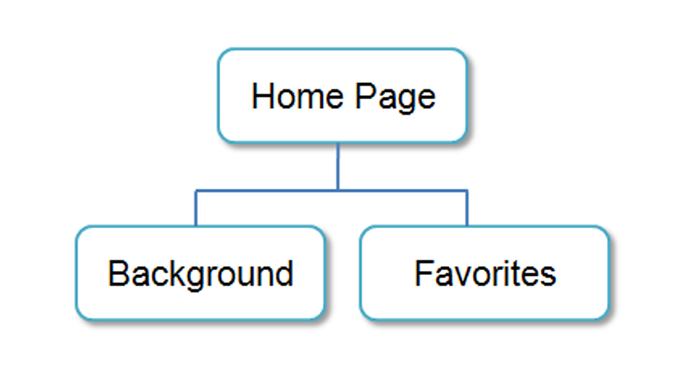
HYPERLINKS
Hands-On Practice

Slide 33
CHECKPOINT
Describe the purpose of special characters.
Describe when to use an absolute link.
Is the http protocol used in the href value?
Describe when to use a relative link. Is the http protocol used in the href value?

Slide 34
WRITING VALID XHTML
Check your code for syntax errors
  Benefit:
    Valid code →
    more consistent browser display
W3C XHTML Validation Tool
  http://validator.w3.org

Slide 35
SUMMARY
This chapter provided an introduction to HTML.
You will use these skills over and over again as you create web pages.

