Slide 1
Objects
IMED 2351
JavaScript

Slide 2
What is an Object?
Objects are things.
Objects are a data type that let’s us store a collection of properties and methods.
Objects can contain data and methods.
Anything that has properties and a function (or functions) is an object.
Every object is a little database.

Slide 3
Properties and Methods
Properties are qualities, traits, or attributes common to a specific thing – or object.
Properties (also called attributes) describe the object.
A function (or method) is a process or operation executed by or to the object.
Methods (or functions) are the things the object can do or have done to it.

Slide 4
Objects Have Properties
A property is a characteristic of an object
Cats have fur
Bicycles have wheels
The browser window has a title
A form has fields and a submit button
You can use properties to modify objects
Properties are objects in their own right

Slide 5
Objects Have Methods
Methods are the things that objects can do -- actions
In the real world
Cats purr
Computers calculate
In the JavaScript world
Buttons click()
Windows open()
Text can be selected()

Slide 6
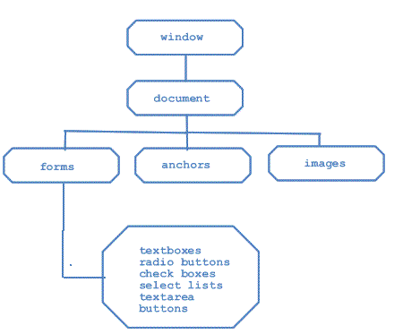
The Document Object
An HTML document is an object.
It uses the Document Object Model (DOM)

Slide 7
Dot Notation
You instruct the browser where to place content by using dot notation.
The object is accessed, then a dot, and then any further instructions (methods or properties) are appended.
document.write("Hello World!");
The document object is accessed.
The dot says to use the write() method on the document object.

Slide 8
The getElementById() Method
Each part of a web page is called an element
To access an element use the getElementById() method
Allows access a particular container within a document
Each container must be marked with an identifier
Add an id attribute to the HTML tag

Slide 9
The innerHTML Property
The innerHTML property sets or returns the inner HTML of an element.
1. var dog = document.getElementById("puppy");
document.write(dog.innerHTML);
<h1 id="puppy">Poodle</h1>
The id of the <h1> tag is “puppy” (line 3).
Line 1 gets the object of the element with the id “puppy”.
Line 2 uses that value in the output

Slide 10
Declaring an Object
var theCat = {
age: 18,
furColor: ‘black’,
meow: function() {
alert(‘meowww’);
}
};

Slide 11
Call the object using dot notation:
theCat.meow();
document.write(theCat.age); // 18
document.write(theCat.furColor); // black

Slide 12
Object Literals
Object literals are wrapped in { }
Names can be names or strings
Values can be expressions
Separate names and values with :
Separate pairs with ;
Object literals can be used anywhere a value can appear

Slide 13
Objects – Properties
var objectName = {
propertyName: propertyValue,
propertyName: propertyValue,
…
};

Slide 14
Example:
var aboutMe = {
hometown: “Houston, TX”,
hair: “red”
};

Slide 15
Object Access
Access property using “dot notation”
var aboutMe = {
hometown: “Houston, TX”,
hair: “red”
};
Var myHometown = aboutMe.hometown;
Or use “bracket notation”:
var myHair = aboutMe[“hair”];

Slide 16
Changing Objects
Changing existing properties:
var aboutMe = {
hometown: “Houston, TX”,
hair: “red”
};
aboutMe.hair = “brown”;
Or add a new property:
aboutMe.gender = “male”;
Or delete a property:
delete aboutMe.hometown;

Slide 17
Object Methods
var theCat = {
age: 18,
furColor: ‘grey’,
meow: function() {
alert(‘meowww’);
},
eat: function(food) {
alert(‘Yum, I love ‘ + food);
},
sleep: function(numMinutes) {
for (var i = 0; i < numMinutes; i++) {
alert(‘z’);
}
}
};
Call the object method:
theCat.meow();
theCat.eat(‘brown mushy stuff’);

Slide 18
Arrays of Objects
var myCats = [
{name: "Lizzie", age: 18},
{name: "Daemon", age: 1}
];
for (var i = 0; i < myCats.length; i++) {
var myCat = myCats[i];
document.write(myCat.name + ' is ' + myCat.age + ' years old.');
}

