Slide 1
JavaScript

Slide 2
What is it?
A Real Language
Small, but Sophisticated
Not Java
Load and Go Delivery
Loosely Typed
Objects as Containers
Prototypical Inheritance

Slide 3
What is it?
Commonly used by web browsers
User Interaction
Controls the web browser
Asynchronous
Lightweight Interpreted Language
Aimed @ non-professional programmers
It is FREE

Slide 4
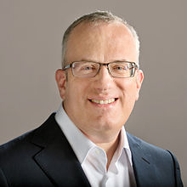

History
Created by Brendan Eich @ Netscape
Web sites were “static”
Needed more Dynamic interaction
May 1995 – JS was written in 10 days

Slide 5
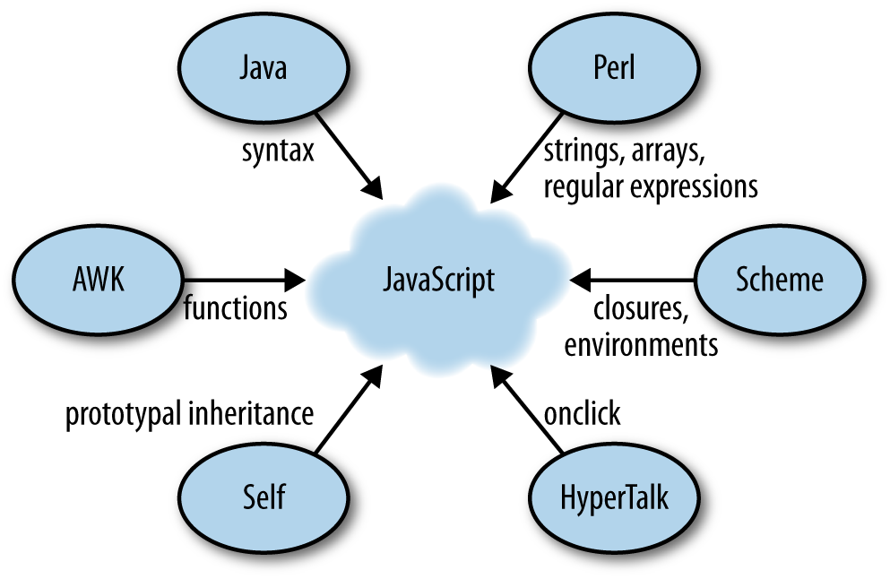
History
First called “Mocha”
Then called “LiveScript”

Slide 6


History
December 1995 – Renamed to JavaScript
Via license between Sun & Netscape
Because of “Java” momentum
Java => for “high-priced” programmers
JavaScript => for web page designers
or “glue programmers”

Slide 7


History
August 1996 – Microsoft implements Jscript with Internet Explorer 3.0

Slide 8

History
November 1996
Netscape standardizes JavaScript
ECMA – European Computer Manufacturers Association
ECMAScript – official language
Keeps track of versions – ECMA-262

Slide 9


History
ECMAScript Members
Microsoft
Mozilla
Google

Slide 10
History
Purpose
Reach a consensus on standards
How it works on devices
How it is written
Compatibility
Current version – ECMAScript 5.1 (June 2011)

Slide 11
What can it do?
Form validation
Special effects – Animation, events
Content manipulation
Client functionality
Calculations
Concurrency
Do more than one task at a time

Slide 12
What can it do?
Create / Read / Delete cookies
Fix layout issues
Enhance HTML interface

Slide 13
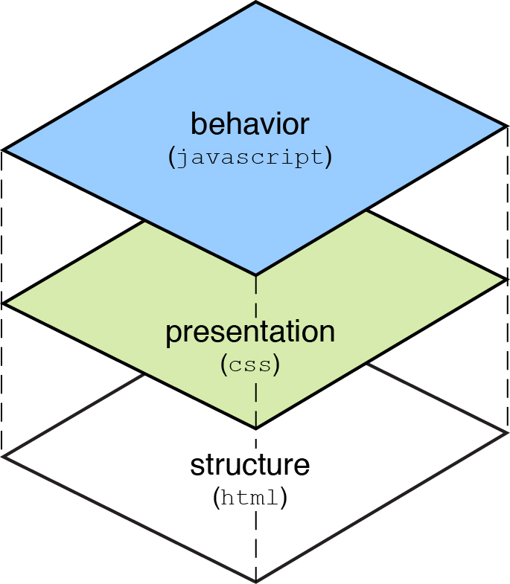
What can it do?

Slide 14
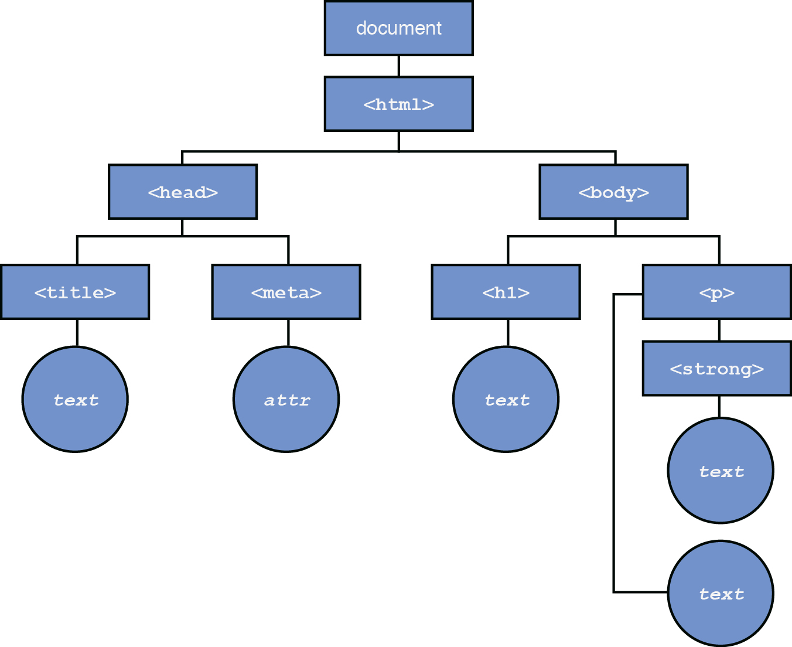
What can it do?

Slide 15
How can I use it?
Requires text editor
Need browser / device / app that can interpret Javascript code
Can be placed within HTML
Source code is easily accessible
JavaScript cannot write to hard disk*
JavaScript programs run on client-side*

Slide 16
Can I Learn it?
Like a Natural Language
Has Active and Passive Vocabulary
Active
Keywords you use daily & understand fluently
Passive
Keywords you recognize but don’t think of immediately

Slide 17
Can I Learn it?
Know HTML
Active Vocabulary 20 – 30 elements
<body> <p> <div> <ul>, etc
Start learning attributes (Passive)

Slide 18
Can I Learn it?
Know CSS
Active Vocabulary
Learn properties and values
Selectors carry over from HTML
Passive Vocabulary
Backgrounds, borders, CSS3 effects
JavaScript * HTML * CSS have Direct Relationship

Slide 19
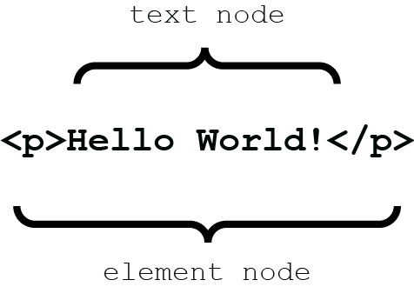
Can I Learn it?

Slide 20
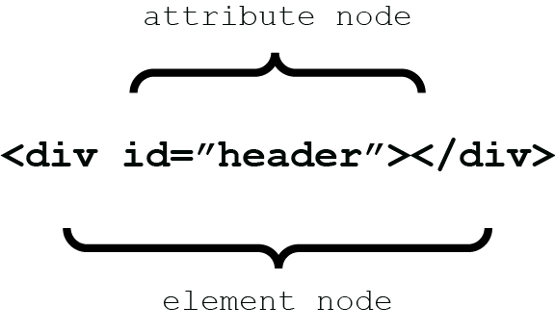
Can I Learn it?

Slide 21
Where does JavaScript Live?

Slide 22
jQuery

Slide 23
Why care about jQuery?
Write less, do more.
Deal with actions and results
Overcome browser differences
Unobtrusive JavaScript
Accomplish Complex Tasks with Ease

Slide 24
What is jQuery?
It is a Library
What is a Library?
A collection of implementations of behavior
Huh?
A bunch of functions you can use in your own programs
Ok

Slide 25
What is jQuery?
To make full use of jQuery you must learn certain JavaScript concepts:
Object creation
Properties of objects
Object literals
Functions as methods
Anonymous functions
Closures
Callbacks

Slide 26
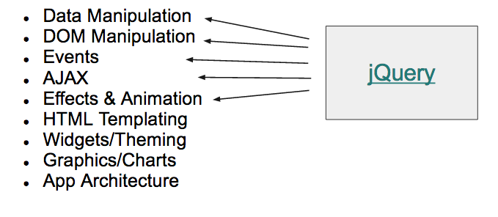
jQuery: Why?
The most popular library
Write less code for common tasks
Abstract on top of cross-browser differences

Slide 27
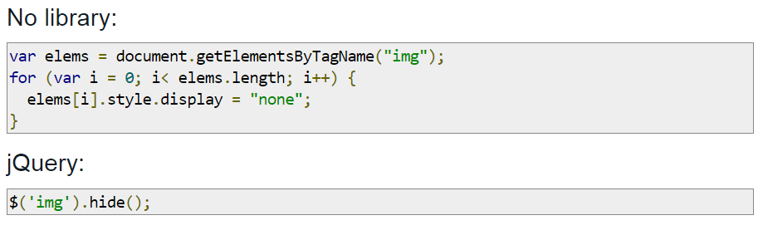
jQuery: Why?

Slide 28
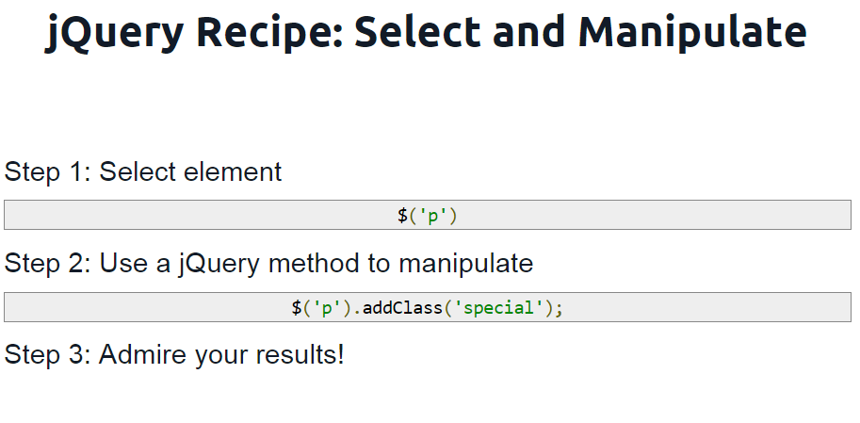
jQuery: Why?

Slide 29
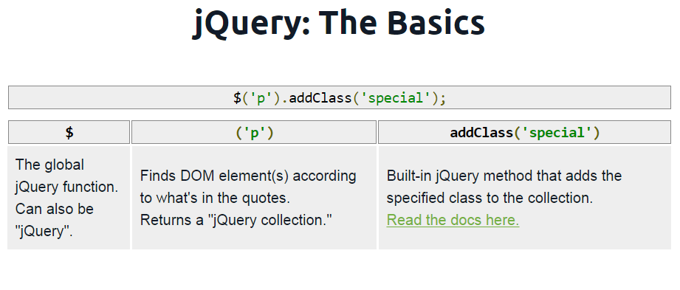
jQuery: Why?

Slide 30
Where does jQuery Live?

