Slide 1
JavaScript
Using in a web page

Slide 2
The <script></script> Tag Pair The <noscript></noscript> Tag Pair
<script></script>:
Used to define a client-side script like JavaScript
<noscript></noscript>:
Used to provide alternate content for users who have disabled scripts in their browsers
Used to provide alternate content for browsers that don’t support client-side scripting – rare today
<noscript>
Sorry, your browser doesn't support JavaScript.
</noscript>

Slide 3

JavaScript in a Web Page <body>
Using inline JavaScript with a button:
Code to add a button to a web page:
<input type="button" id="myButton" value="Hi there!" onclick="alert('Well, hello my friend.');" />
Creates a button that looks like this:
When clicked, you get an alert that says:
Well, hello, my friend.

Slide 4
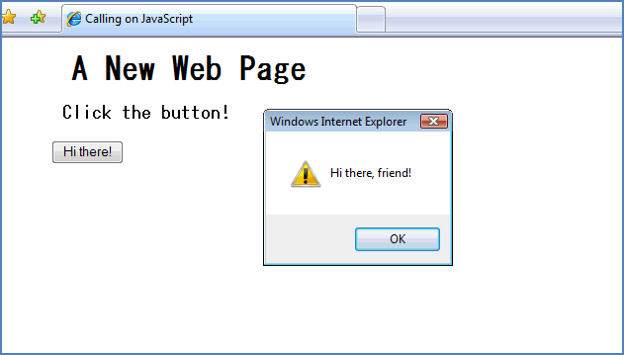
JavaScript in the Document <head> Section Most JavaScript we will write will be in <head> section JavaScript executes when user does something in web page
<html> <head> <title>Example</title> <script> function welcome() { alert("Hi there, friend!"); } </script> </<head>> <body> <h1>A New Web Page</h1> <h3>Click the button! </h3> <p><input type="button“
id="myButton" value="Hi
there!" onclick =
"welcome();" /></p>
</body> </html>

Slide 5
The <body> onload Event
Loads JavaScript before user views the page, as it is loading
<html> <head> <title>Example</title> <script> function welcome() { alert("Hi there, friend!"); } </script> </<head>> <body onload = “welcome()”> <h1>A New Web Page</h1> <h3> This site is nothing but fun!</h3>
</body> </html>

Slide 6
Introduction to Objects

Slide 7
What is an Object? Properties and Methods
Anything that has properties and a function (or functions) is an object.
Properties are qualities, traits, or attributes common to a specific thing—or object.
Properties (also called attributes) describe the object
A function, in this context, is a process or operation executed by or to the object.
Methods (also called functions) are the things the object can do or have done to it.

Slide 8
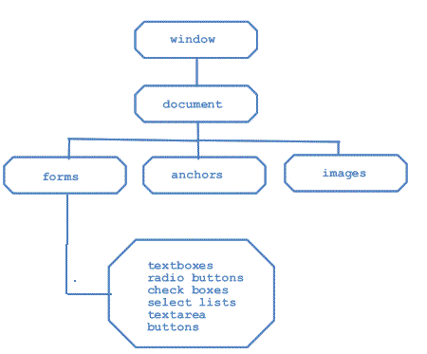
The Document Object
An HTML document is an object.
It uses the Document Object Model (DOM)

Slide 9
Dot Notation
You instruct the browser where to place content by using dot notation.
The object is accessed, then a dot, and then any further instructions (methods or attributes) are appended.
document.write("Welcome to my first JavaScript page!");
The document object is accessed. The dot says to use the write() method on the document object.

Slide 10
The getElementById() Method
Each part of a web page is called an element
To access an element use the getElementById() method
Allows access a particular container within a document
Each container must be marked with an identifier
Add an id attribute to the HTML tag

Slide 11
The innerHTML Property
The innerHTML property sets or returns the inner HTML of an element.
1. <html> 2. <head> 3. <title>Example</title> 4. <script type="text/javascript"> 5. function getValue() 6. { 7. var dog = document.getElementById("puppy"); 8. document.write("Your dog is not a terrier <br />"); 9. document.write("It is a ");
10. document.write(dog.innerHTML); 11.} 12.</script> 13.</head> 14.<body> 15. <h1 id = "puppy" onclick="getValue()">Poodle</h1> 16.</body> 17.</html>
The id of the <h1> tag is “puppy” (line 15).
Line 6 gets the value of the contents of the element with the id “puppy”.
Line 10 uses that value in the output

