Slide 1
Performance Engineering
Basics using Java

Slide 2
Content
Scalability and Performance for:
1. CPU Bound Task
2. File IO Tasks

Slide 3
Preparation of Demo
Preparation of demo
Puzzle demo
CPU bound task demo
File I/O task demo
git@github.com:dowonderatwill/performanceengineering.git
A machine with 8 core, and memory around up to 24GB, and storage 16GB.
Maven
Perf

Slide 4
CPU Bound Task – Know Your Task
Thread1
Task W
Exec. Time = 10
W=W1 + W2
W1
W2
Thread1
Exec. Time = 8
Thread2
Exec. Time = 2

Slide 5
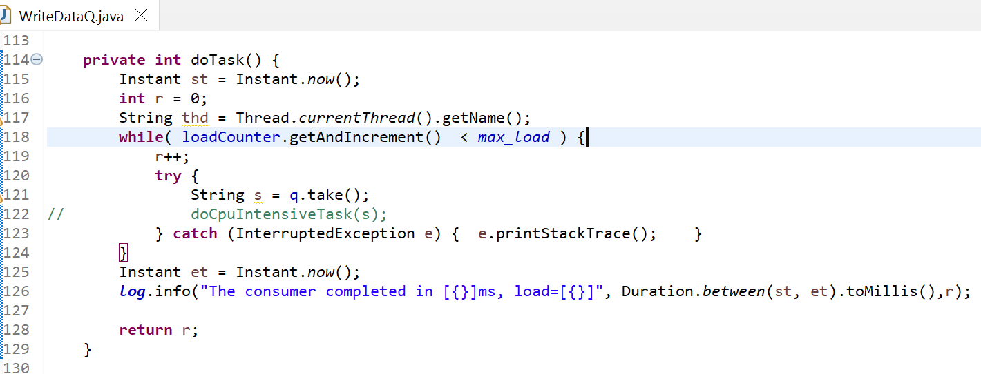
CPU Bound Task – Demo
Preparation of demo
Puzzle demo
CPU bound task demo
File I/O task demo

Slide 6
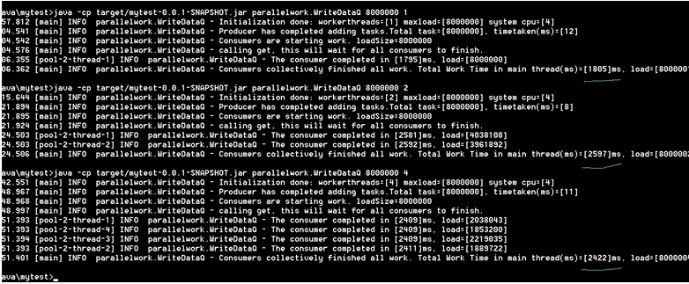
CPU Bound Task – Demo
Preparation of demo
Puzzle demo
CPU bound task demo
File I/O task demo

Slide 7
CPU Bound Task – Demo
Preparation of demo
Puzzle demo
CPU bound task demo
File I/O task demo
WriteDataQ.java
Case | Load | Threads | CPU | Time
A | Constant | 1
B | Constant | 2
C | Constant | 4
D | Constant | 8
E | Constant | 16
AtomicInteger:loadCounter
Consumer Thread 1
Consumer Thread 2

Slide 8
CPU Bound Task – Demo
Preparation of demo
Puzzle demo
CPU bound task demo
File I/O task demo
Case | Load | Threads | Chunk | Buffer | CPU | I/O
A | Constant | Constant | Constant | Change
B | Constant | Constant | Change | Constant
C | Constant | Change | Constant | Constant
Command line: WriteDataFile <load> <threads> <chunk> 1 <buffersize>
WriteDataFile.java

