Slide 1
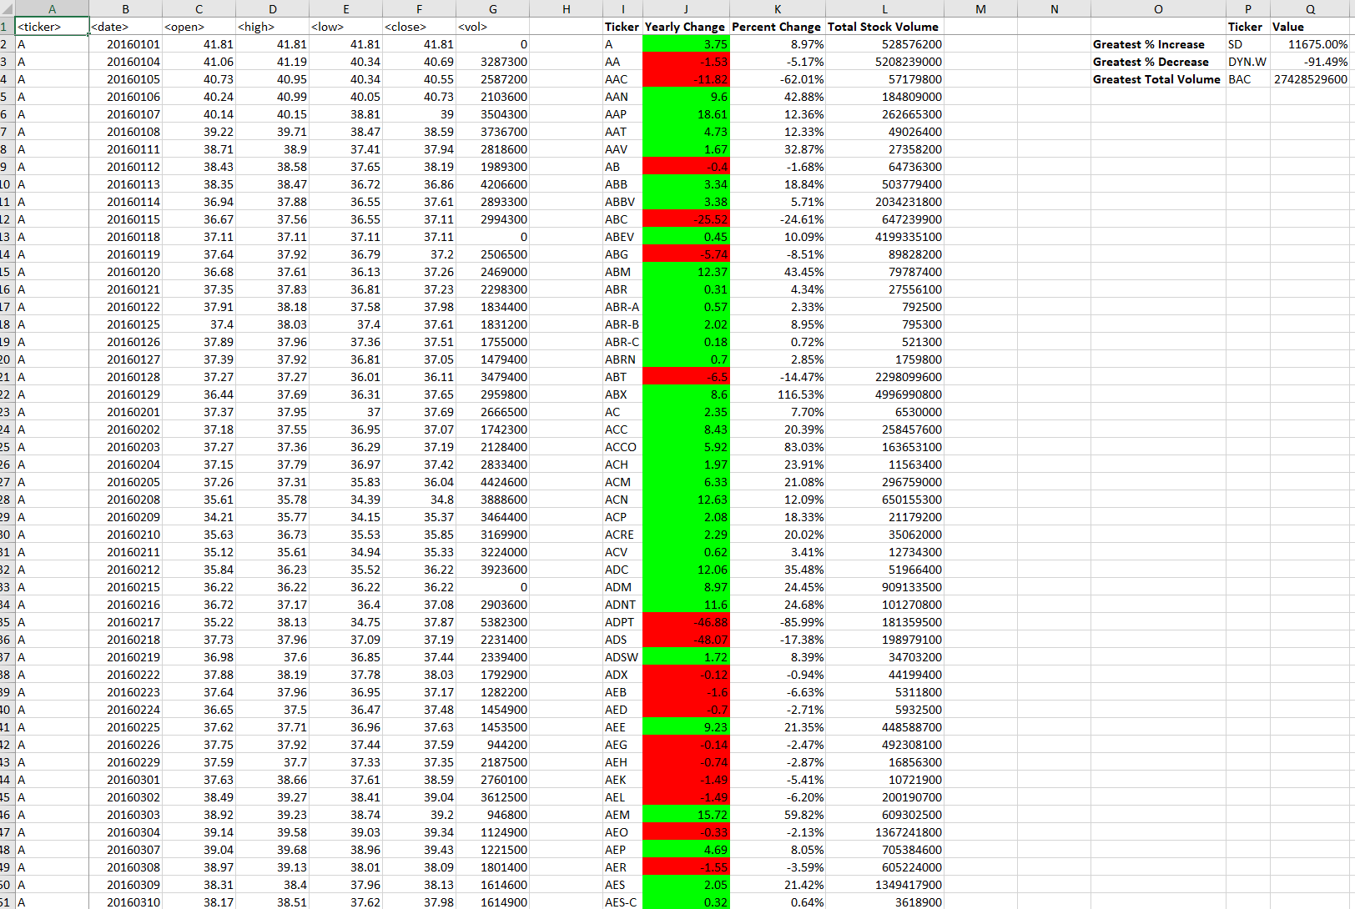
2016 Screenshot

Slide 2
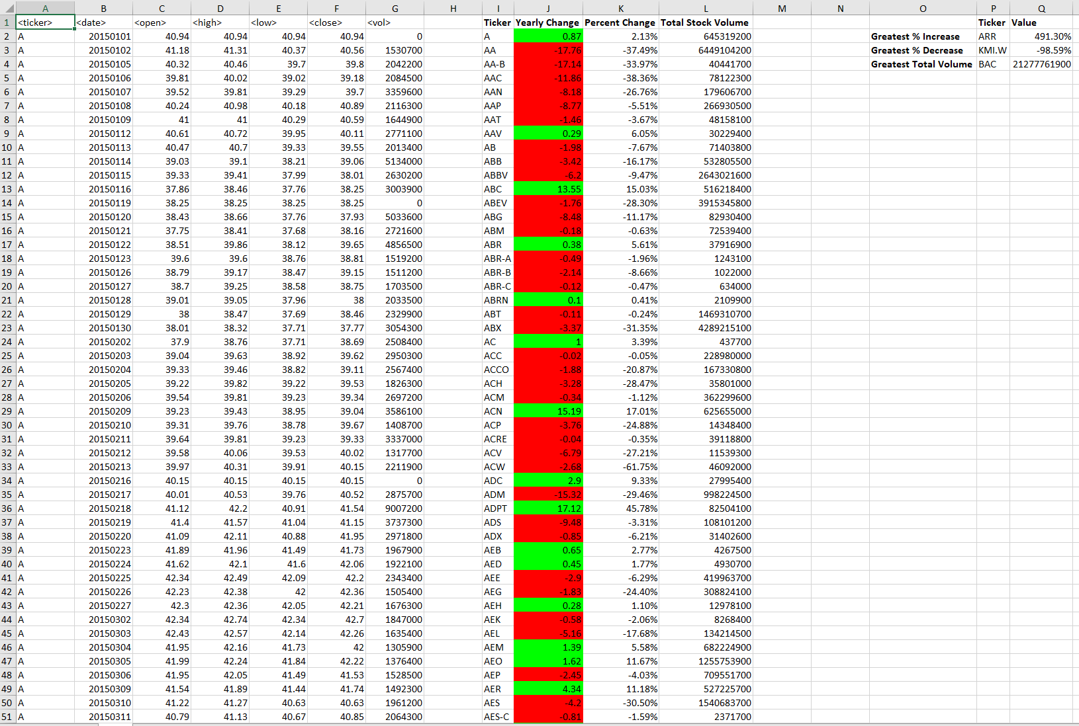
2015 Screenshot

Slide 3
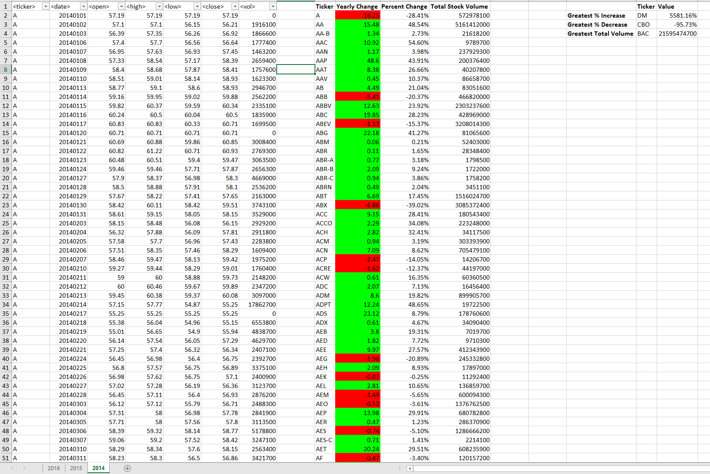
2014 Screenshot

