Slide 1


Voluntary. Global. Receiving.
PARTNERSHIP

Slide 2
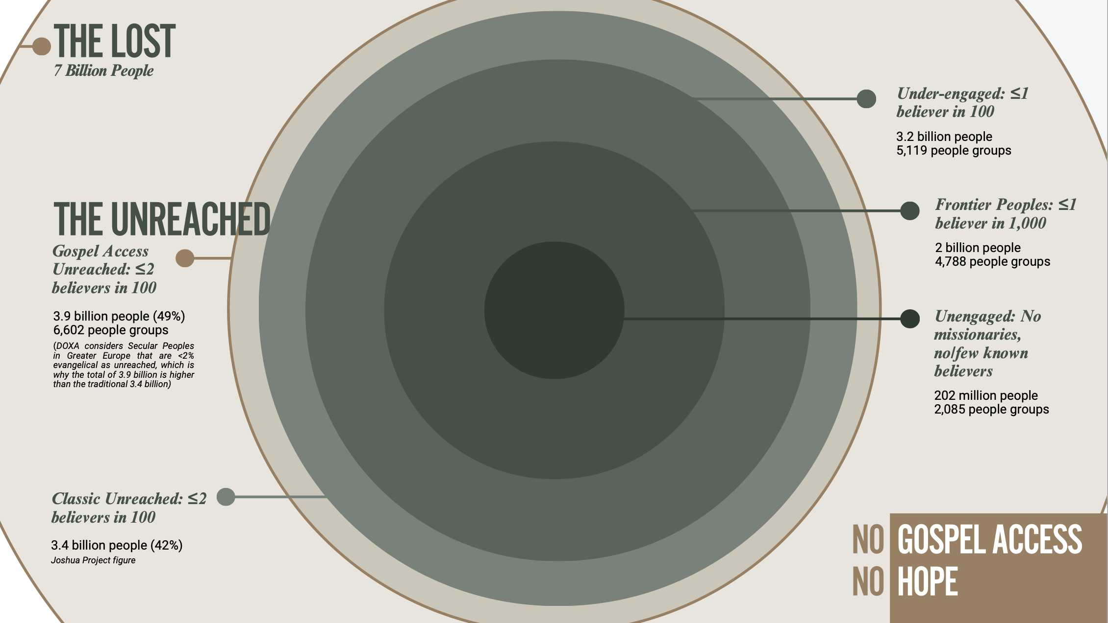
2,085

Slide 3
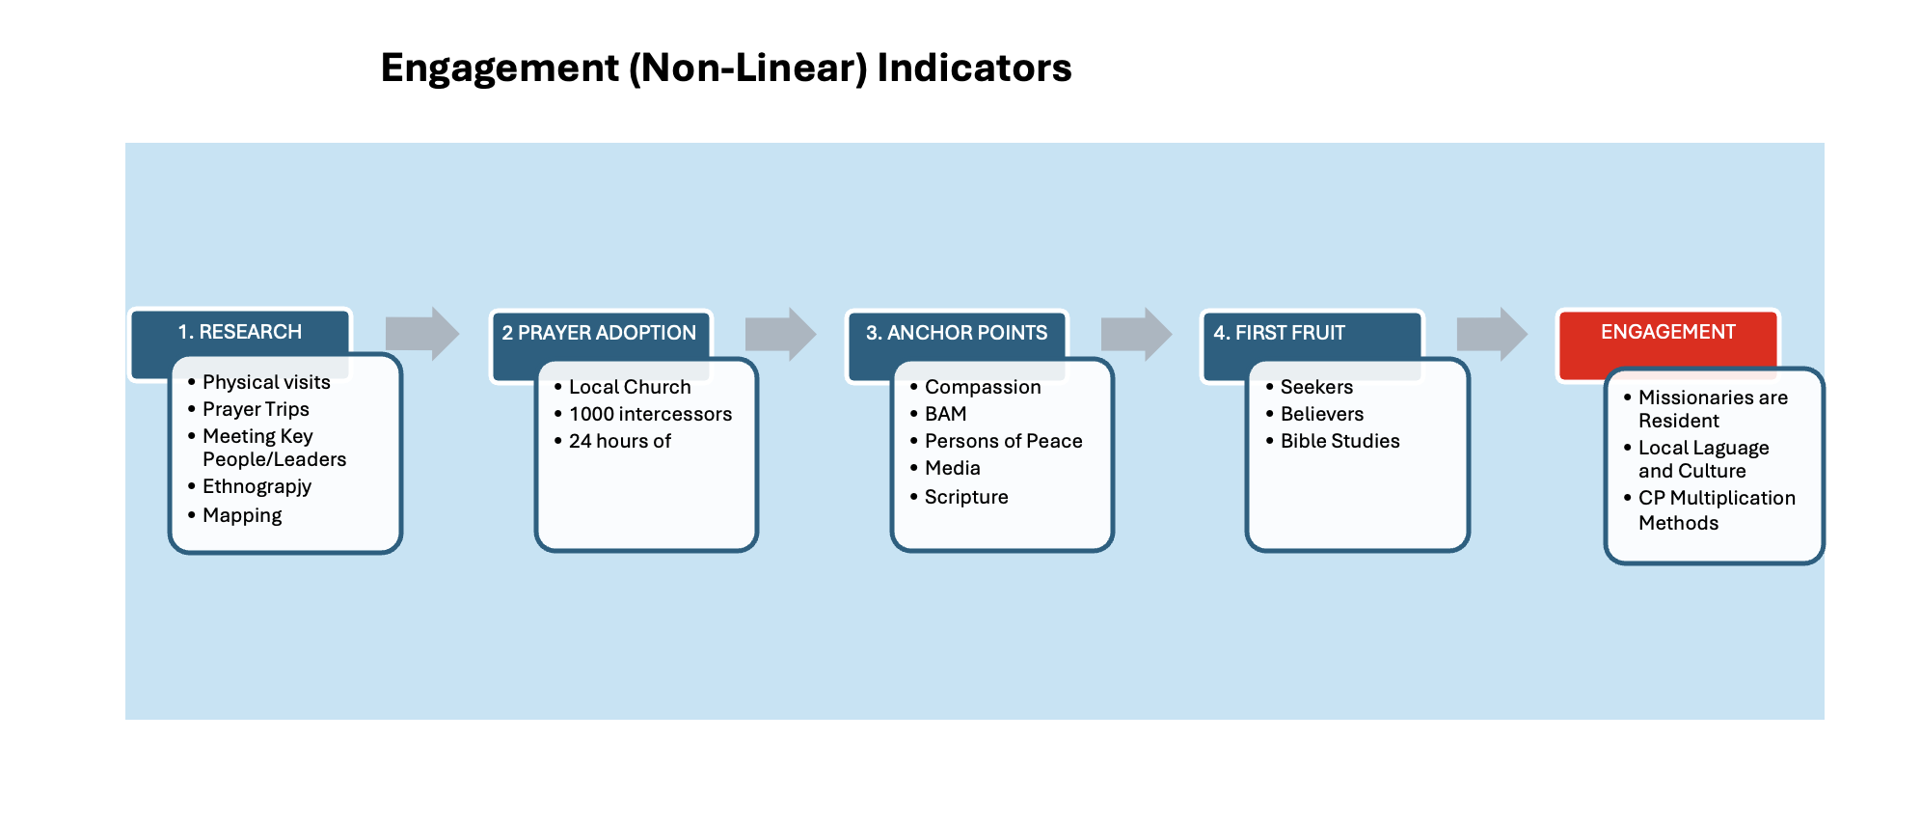
* Residential engagement can be by foreign missionaries, local church teams or personnel, near neighbor workers, proximate cross-cultural workers, etc.
2,085 Unengaged peoples engaged by 2033
GRAPH OF PROCESS

Slide 4
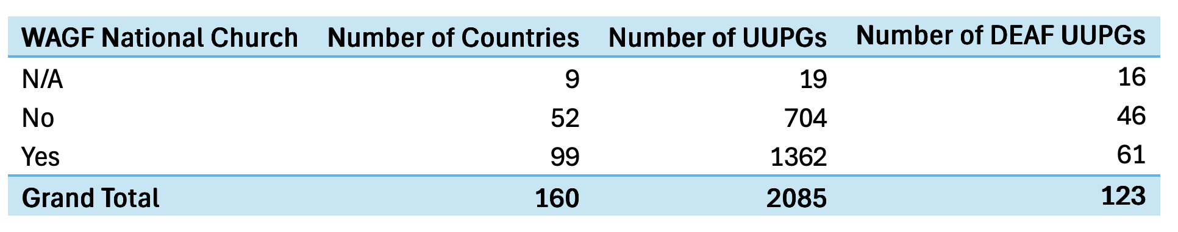
65% OF UN-ENGAGED PEOPLES ARE IN COUNTRIES WHERE WE HAVE WAGF NATIONAL CHURCHES! (1362 of 2088)
UUPGs are in 160 countries of which 99 have WAGF member Churches (62%)

Slide 5
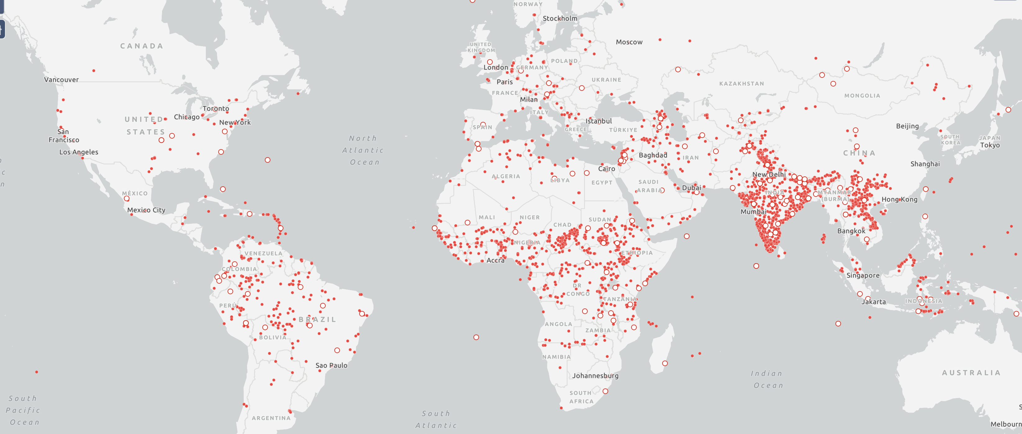
APPROXIMATE LOCATIONS OF UNENGAGED PEOPLES AROUND THE WORLD
2,085

Slide 6
THE PARTNERSHIP VISION
We, the World Assemblies of God Fellowship, desire to collaborate, coordinate, and partner more closely together to address Gospel Access globally.
TOGETHER we could engage all 2,085 Unengaged peoples by 2033.
This is the first priority of DOXA, even as DOXA will work beyond engagement to indigenous churches being planted among all unreached peoples.

Slide 7
DOXA: Started and Stewarded by World Assemblies of God Fellowship (WAGF) Mission Commission
Reports to WAGF Missions Commission Lead Team
Led by Global Coordinator
“Lead team” comprised of 7 WAGF Regional Coordinators
(Regional Coordinators work with Country Coordinators)
Global Coordinator has an “Action Team” that serves all of DOXA in spheres of Prayer, Training, Foundation, Admin., etc.

Slide 8
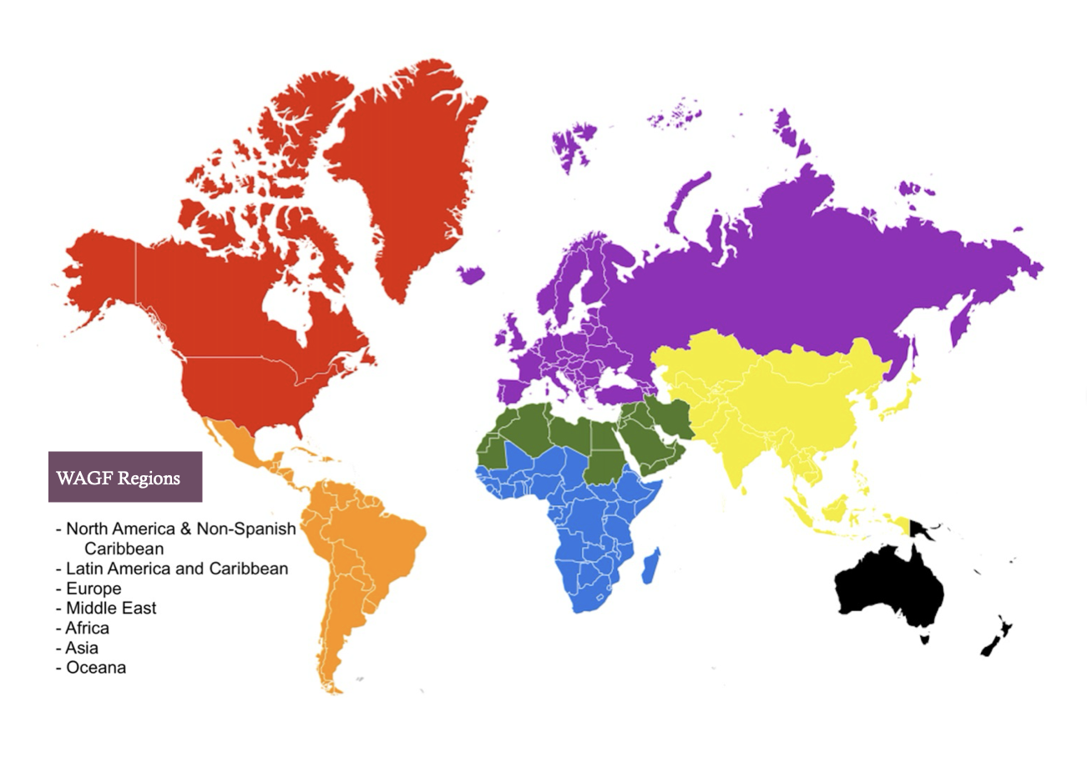
WAGF Missions Commission
Lead Team
Global Coordinator
Leadership Team
(Regional Coordinators)
Action Team
(Cross Region Services)

Slide 9
VOLUNTARY: Any WAGF related Missions Department may participate in DOXA to the level they desire.
GLOBAL: DOXA will operate all over the world, wherever there are Unreached, Unengaged Peoples.
RECEIVING: DOXA is NOT a sending agency. It receives missionaries in the field at the request of their sending agency and coordinates their training, team placement, and church planting strategy.
PARTNERSHIP: DOXA does one thing - make disciples and plant churches among the unreached, prioritizing engaging the unengaged by 2033

Slide 10
HOW DOXA WILL WORK ON THE FIELD:
Missionary sent by their WAGF member country t missions department. DOXA can help coordinate field training on arrival as needed through a launch team.
Option 1
Missionary can join a field team of the sending missions department OR a team of another missions department (that is also a DOXA partner).
Option 2
Bi-vocational missionary can go right to their tentmaking job and DOXA helps organize them into a team with others nearby.
Option 3
DOXA can coordinate a team with members from several different sending mission departments who are DOXA partners.

Slide 11
THE DOXA DECLARATION September 25th, 2025
Recognizing that Jesus has called us to partnership we commit ourselves to God and to one another to partner together globally for the greatest disciple making and church planting movement among the unreached that the World Assemblies of God Fellowship has ever seen. Our commitment includes the following:
That we will remain reliant on the Holy Spirit and the Holy Scripture always and for everything; That we will humbly consider others better than ourselves and will not compete with each other or other agencies, but will respect and honor all God’s people in His mission;

Slide 12
That we will form a Voluntary, Global, Receiving Partnership committed to working with existing National Churches and Assemblies of God General Councils wherever that is possible; That this partnership will not be a sending agency nor is it replacing the work or role of current sending agencies or their national churches;
That sending agencies may collaborate with the partnership to the level they desire. They may choose to send some or all or none of their missionaries through the partnership; That sending agencies will retain final authority over their missionaries, support them, and train them before they are sent to the field; That the partnership – at the invitation of the sending agency – can receive missionaries, train them on the field, coordinate team placement and coach them strategically in the field;

Slide 13
That the partnership will prioritize the fruitful, long term, residential, engagement of the world’s unengaged peoples who currently do not have church planting teams among them with the long term goal of planting indigenous churches that lead to national churches or integration into existing national churches; That the partnership will also empower missionaries for the fruitful, long term, residential engagement of frontier peoples (less than 1 believer in 1000), under-engaged peoples (less than 1 believer in 100), and the generally unreached (less than 2 believers in 100);
That the partnership will be stewarded by the Missions Commission of the World Assemblies of God Fellowship who will appoint and oversee the partnership leaders – who may come from any country or agency in the partnership; That the partnership will be called “Doxa” which is the Greek word for “glory” and this name will remind us that Jesus is worthy of glory from every tribe, tongue, people, and nation; That we will partner with all of God’s church to take all of God’s gospel to all of God’s world;

Slide 14
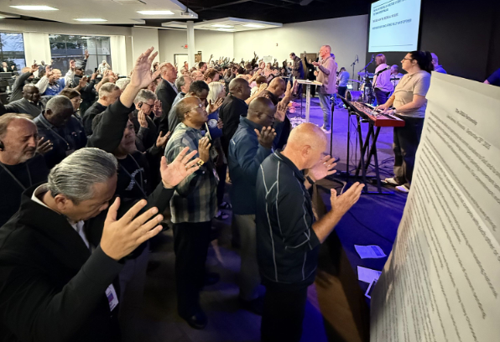
That one day there will be a multitude of every people around the throne worshipping God.
That Jesus alone will receive all the glory.
In faith and by God’s grace, agreed to this 25th day of September, 2025.

Slide 15
CONTACT INFORMATION
DOXA GLOBAL COORDINATOR – DICK BROGDEN
doxacoordinator@gmail.com
DOXA PARTNERSHIP ADMIN
thedoxapartnership@gmail.com
WEB SITE
Doxa.life

