Slide 1




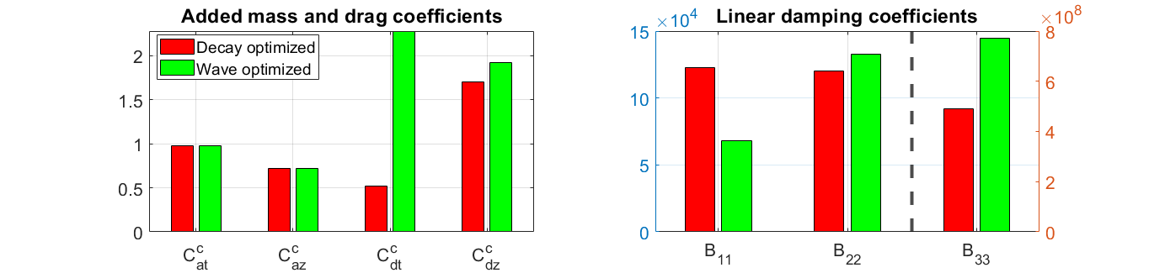
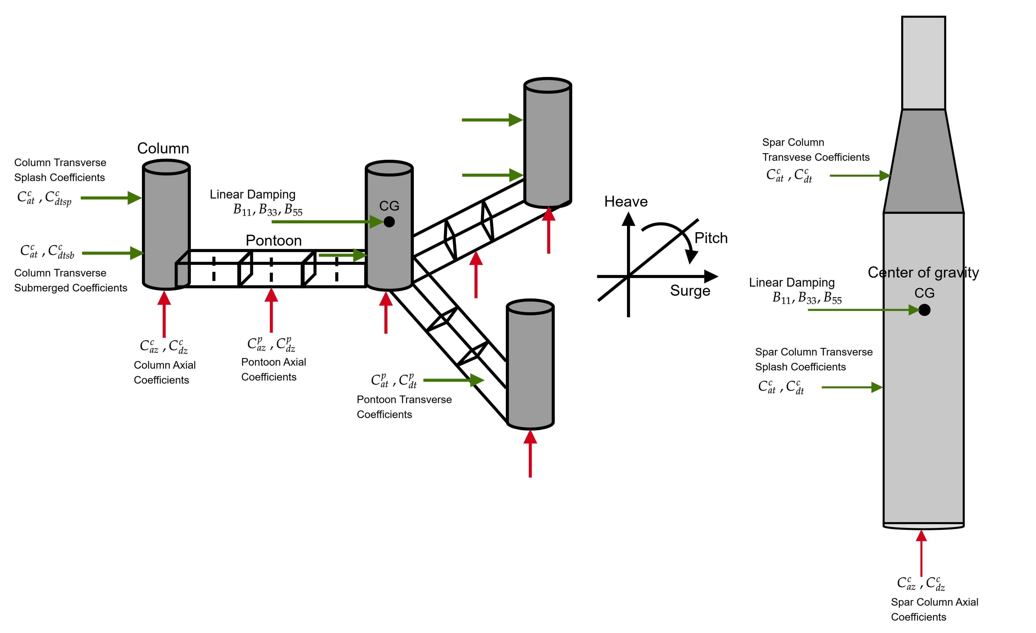
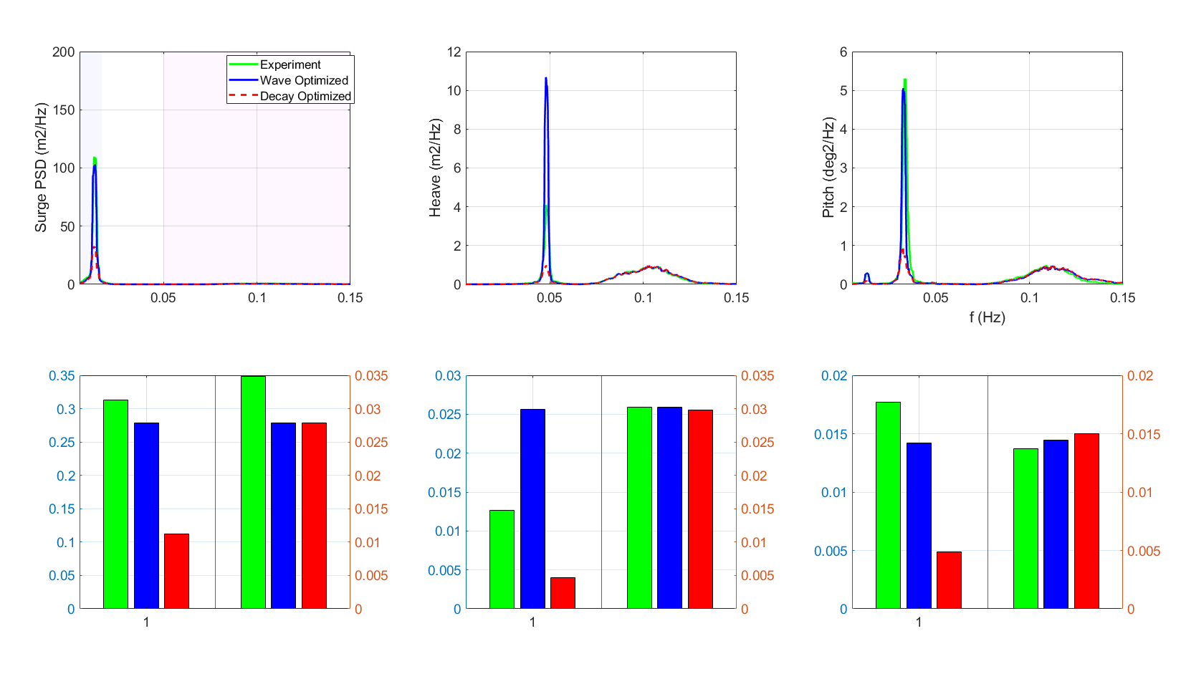
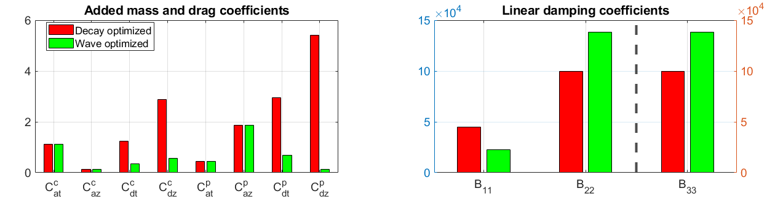
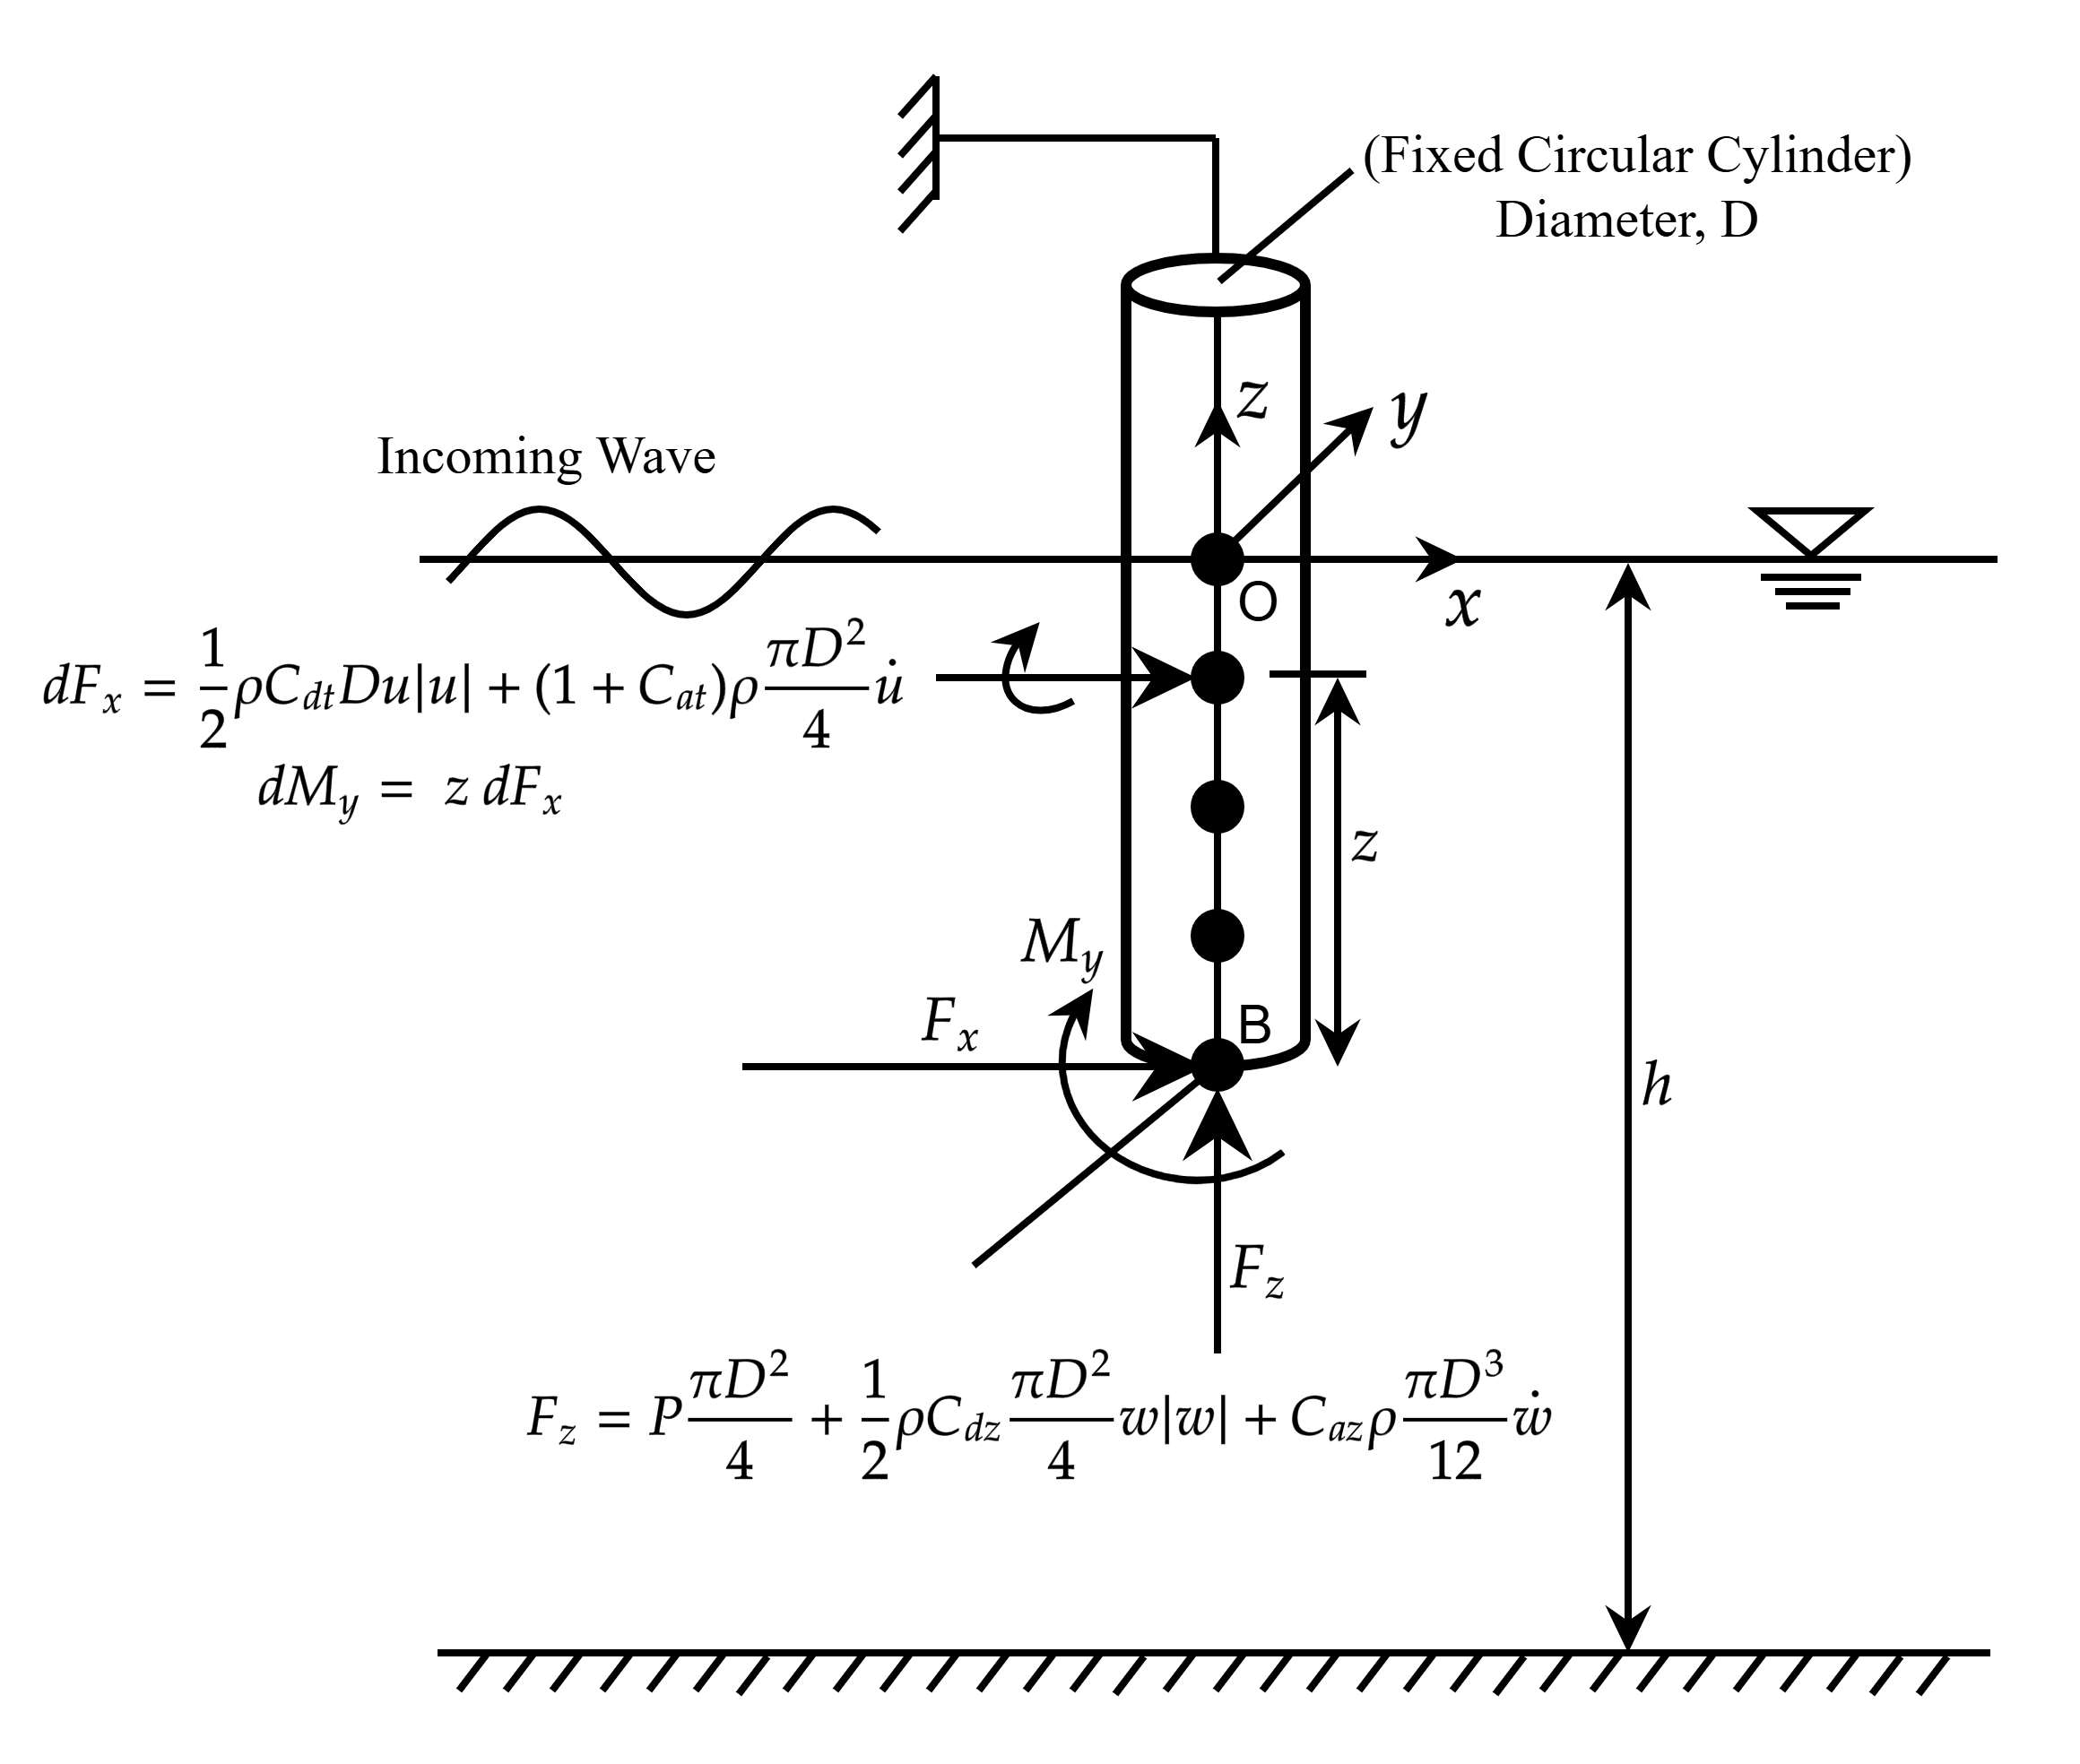
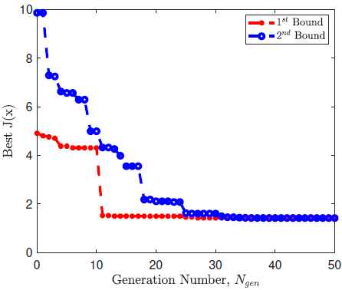
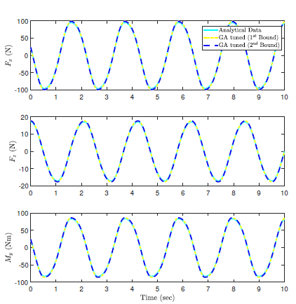
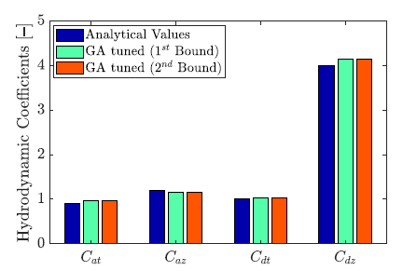
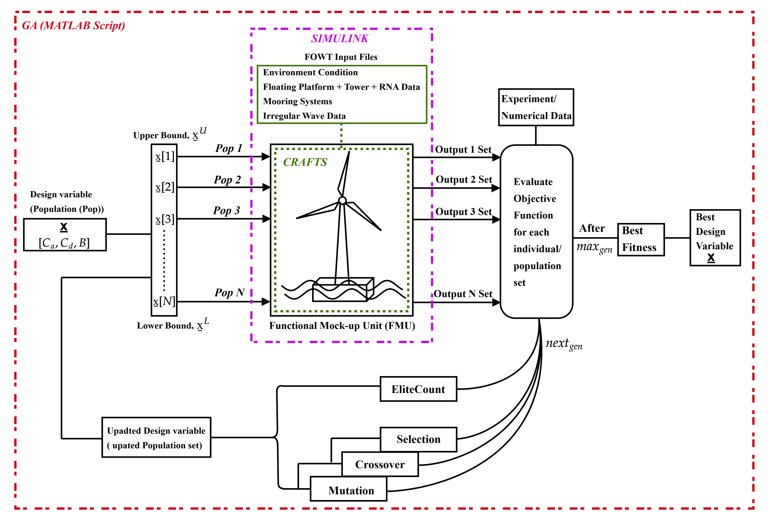
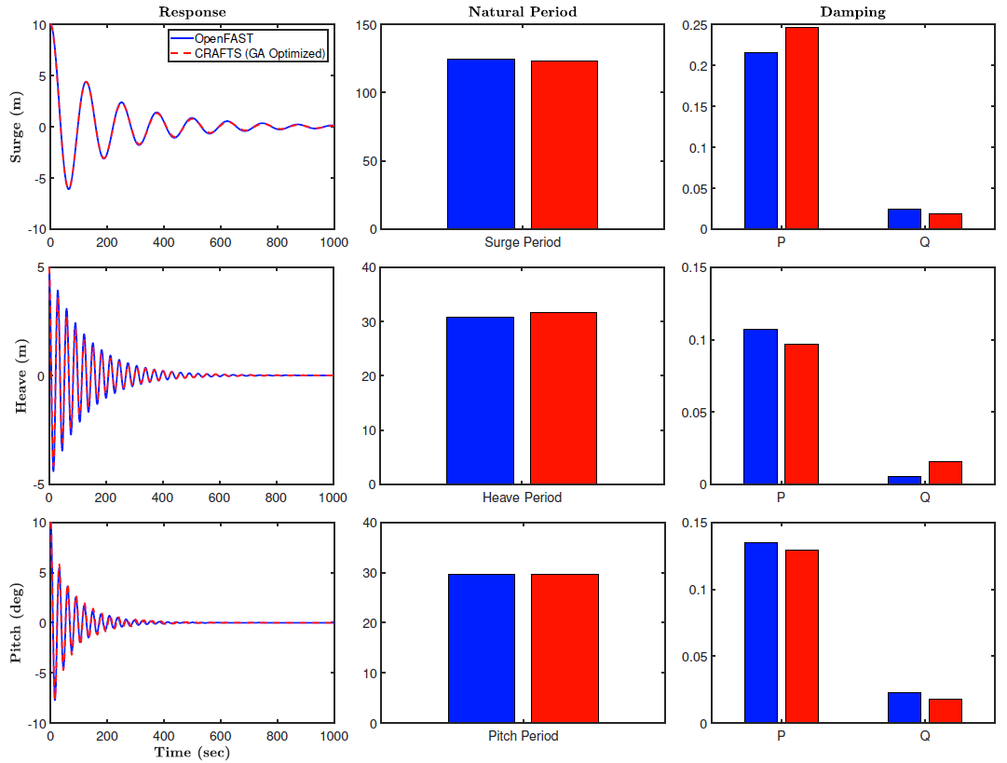
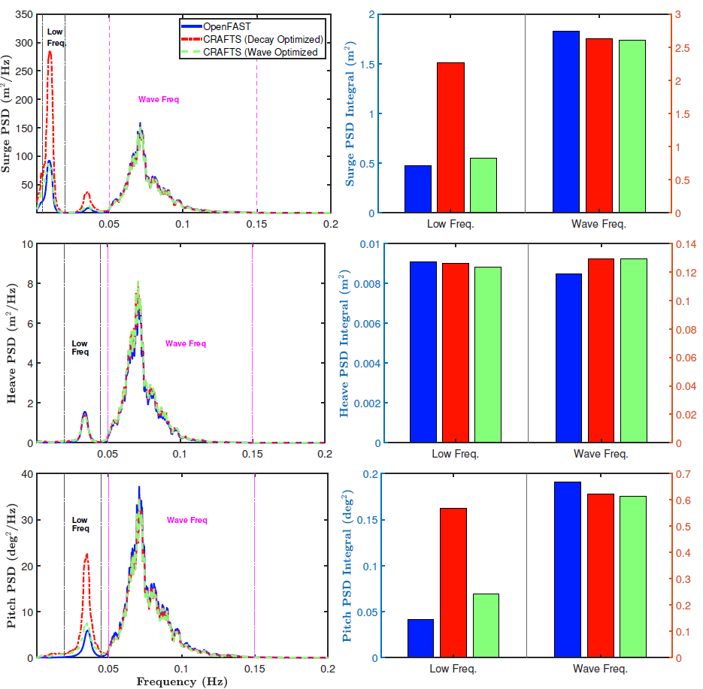
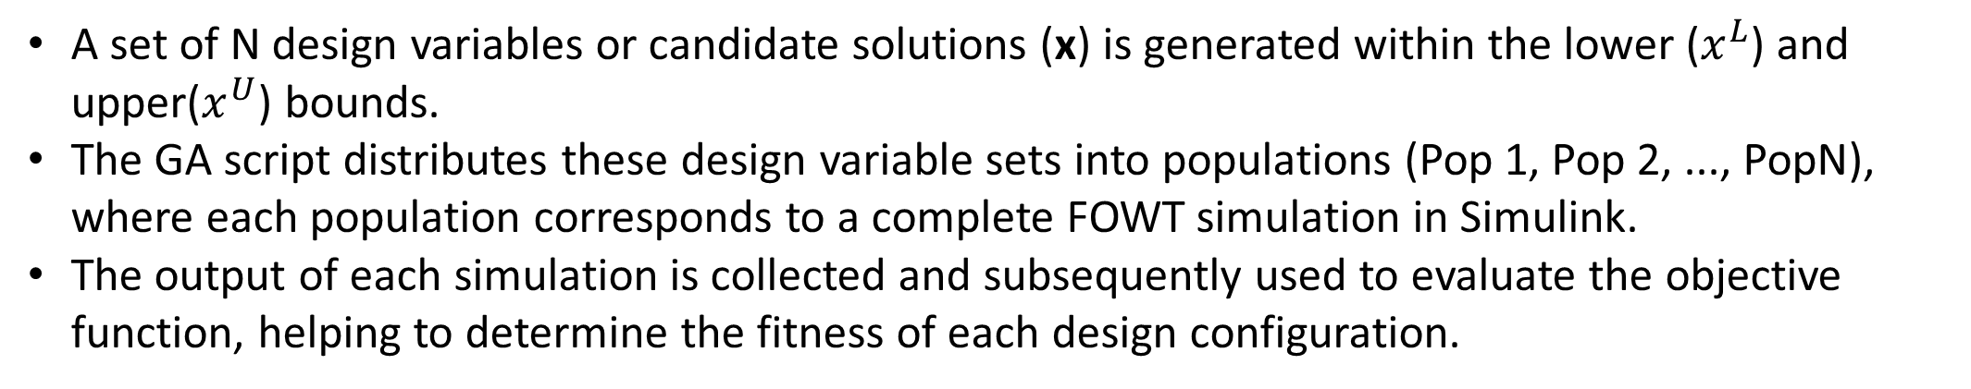
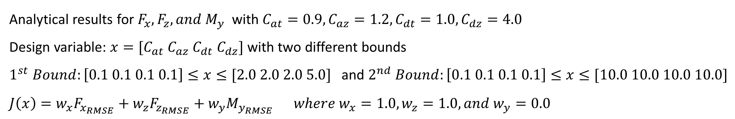
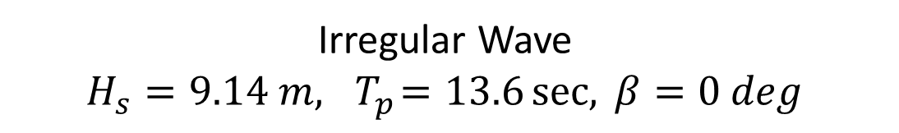
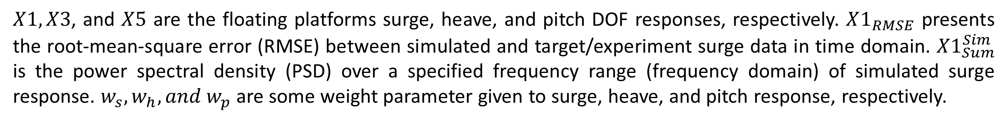
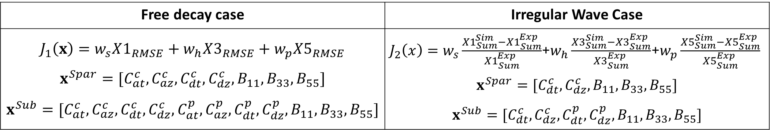
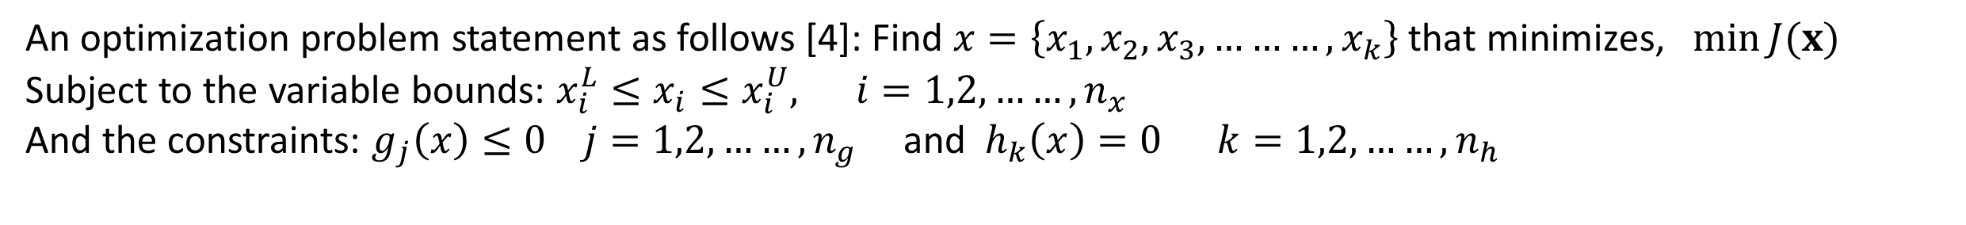
Development of an AI-Enabled Predictive Hydrodynamics Model
For Floating Offshore Wind Turbines (FOWT)
Doyal Sarker, Tri Ngo, Tuhin Das
University of Central Florida, Orlando, FL 32816, USA
Introduction
Objective Function and Design Variables
Direct optimization of hydrodynamic damping using irregular wave data significantly improve the low frequency response with a minor effect on wave frequency response. This automatic tuning using GA perform better tuning the quadratic and linear damping, simultaneously.
Floating offshore wind turbines (FOWTs) are pivotal in providing resilient and self-sufficient renewable energy, accessing oceanic wind resources.
Challenge in stability maintain and deployment necessitating the accurate loads modeling
Accurate hydrodynamic modeling is crucial for predicting FOWT dynamic responses.
Hydrodynamic coefficients (added mass, damping, and drag) significantly influence platform behavior and are highly sensitive to design, fluid flow and environmental conditions
A case-by-case comparable wave simulation against experiment requires different set of hydrodynamic coefficients, hence, manual tuning needs be performed.
A Genetic Algorithm (GA) optimizes these hydrodynamic coefficients automatically using experimental data (decay tests and wave conditions).
An optimization problem statement as follows [4]: Find $x=\left\{x_{1},x_{2},x_{3},………,x_{k}\right\}$ that minimizes, $\min{J(x)}$
Subject to the variable bounds: $x_{i}^{L}≤x_{i}≤x_{i}^{U}, i=1,2,……,n_{x}$
And the constraints: $g_{j}\left(x\right)≤0 j=1,2,……,n_{g}$ and $h_{k}\left(x\right)=0 k=1,2,……,n_{h}$
Free decay case | Irregular Wave Case
$$J_{1}\left(x\right)=w_{s}X1_{RMSE}+w_{h}X3_{RMSE}+w_{p}X5_{RMSE}$$ $$x^{Spar}=[C_{at}^{c},C_{az}^{c},C_{dt}^{c},C_{dz}^{c},B_{11},B_{33},B_{55}]$$ $$x^{Sub}=[C_{at}^{c},C_{az}^{c},C_{dt}^{c},C_{dz}^{c},C_{at}^{p},C_{az}^{p},C_{dt}^{p},C_{dz}^{p},B_{11},B_{33},B_{55}]$$ | $J_{2}\left(x\right)=w_{s}\frac{{X1}_{Sum}^{Sim}−{X1}_{Sum}^{Exp}}{{X1}_{Sum}^{Exp}}$+$w_{h}\frac{{X3}_{Sum}^{Sim}−{X3}_{Sum}^{Exp}}{{X3}_{Sum}^{Exp}}$+$w_{p}\frac{{X5}_{Sum}^{Sim}−{X5}_{Sum}^{Exp}}{{X5}_{Sum}^{Exp}}$ $$x^{Spar}=[C_{dt}^{c},C_{dz}^{c},B_{11},B_{33},B_{55}]$$ $$x^{Sub}=[C_{dt}^{c},C_{dz}^{c}, C_{dt}^{p},C_{dz}^{p},B_{11},B_{33},B_{55}]$$
Case Study 2: Semi-Submersible Platform
In contrast to spar platform, semi-submersible requires multiple component specific $C_{a}$ and $C_{d}$in addition to the global linear damping. $B$.
$X1, X3$, and $X5$ are the floating platforms surge, heave, and pitch DOF responses, respectively. $X1_{RMSE}$ presents the root-mean-square error (RMSE) between simulated and target/experiment surge data in time domain. ${X1}_{Sum}^{Sim}$ is the power spectral density (PSD) over a specified frequency range (frequency domain) of simulated surge response. $w_{s}, w_{h}, and w_{p}$ are some weight parameter given to surge, heave, and pitch response, respectively.
Direct optimization using irregular wave significantly improve low frequency response of surge and heave. However, a significant deviation resulted in heave response, indicating, single objective optimization potentially compromise with one response while prioritizing other response. As the single objective, combine all the error into a single value to be minimized.
GA Hyperparameter setting
Population size = 30, Max generation = 50, Crossover Fraction = 0.7;
Elite Count = 0.1xPoputation Size, Mutation rate = 0.01
A Demonstrative Example: Morison Equation-Fixed Cylinder
Semi-submersible [1] (left) and Spar-buoy [2] (right) platforms
Analytical results for $F_{x},F_{z}, and M_{y}$ with $C_{at}=0.9, C_{az}=1.2, C_{dt}=1.0, C_{dz}=4.0$
Design variable: $x=[C_{at} C_{az} C_{dt} C_{dz}]$ with two different bounds
$1^{st} Bound:\left[0.1 0.1 0.1 0.1\right]≤x≤[2.0 2.0 2.0 5.0]$ and $2^{nd} Bound:\left[0.1 0.1 0.1 0.1\right]≤x≤[10.0 10.0 10.0 10.0]$
$$J\left(x\right)=w_{x}F_{x_{RMSE}}+w_{z}F_{z_{RMSE}}+w_{y}M_{y_{RMSE}} where w_{x}=1.0, w_{z}=1.0, and w_{y}=0.0$$
Methodology
Hydrodynamics Modeling
The hydrodynamics loads modeled in CRAFTS (Control oriented, Reconfigurable and Acausal Floating Turbine Simulator) include the radiation induced added mass, wave excitation and non-linear viscous drag using Morison equation in relative form [3].
$dF_{i}\left(t,z\right)=−C_{a}ρ\ddot{r_{i}}\left(\frac{πD^{2}}{4}\right)dz+\left(1+C_{a}\right)ρ{\dot{u}}_{i}\left(\frac{πD^{2}}{4}\right)dz+\frac{1}{2}C_{d}ρ(u_{i}−{\dot{r}}_{i})\left|u_{i}−{\dot{r}}_{i}\right|(Ddz)$
CRAFTS Feature:
Acausal plug and play, Modelica language
Library-based, modular, and hierarchical architecture
Reusability of existing model without extensive re-modeling
Integrable with causal platform like MATLAB
CRAFTS Hydrodynamics Feature:
Component level and distributed loadings
First and Second order wave modeling
Wave stretching
Mac-Camy Fuchs (MCF) diffraction correction
Kinematics Spatial effect for large structure
Conclusions and Future works
This study demonstrated a predictive hydrodynamics modeling for FOWTs focusing on the automation of hydrodynamics coefficients applying GA optimization. Accurate hydrodynamic modeling is critical for the modeling and analysis of FOWTs, as hydrodynamic coefficients—including added mass, damping, and drag coefficients—govern the platform’s dynamic responses. The study showed, applying the hydrodynamic coefficients from free decay test, can lead to inaccurate low frequency response in the irregular wave case. To improve accuracy, recalibrating these coefficients was necessary, and GA-based automatic tuning provided better agreement. Selecting appropriate bounds helped achieve optimal solutions with faster convergence. However, as shown in a fixed-cylinder example, GA can still perform well even without prior knowledge of the solutions.
This study was limited to the single objective optimization for calibrating all the coefficients simultaneously. Future study will focus on Mult objective optimization for the specific coefficients sets for the respective dynamic response. Furthermore, this study assumed same coefficients for all column/pontoon in semi-submersible, however, due the spatial wave-kinematics, the same geometric structure might need different values.
Automatic tuning via GA reducing manual tedious tuning
Fast convergence (1st bound)
Global search and constrained search based on pre-study
More generic structure, easily can be adapted for other configurations.
GA Optimization Framework (Interface between CRAFTS and MATLAB)
The design optimization framework is implemented by integrating the CRAFTS library with the MATLAB-SIMULINK graphical programming environment.
Results (Floating Platforms)
Case Study 1: Spar-Buoy Platform
Irregular Wave
$$H_{s}=9.14 m, { T}_{p}=13.6\sec{, }β=0 deg$$
Acknowledgements
This work is supported by the U.S. Department of Energy Advanced Research Projects Agency for Energy (ARPA-E) under the grant DE-AR0001187[5].
References
[1] Allen, C., Viscelli, A., Dagher, H., Goupee, A., Gaertner, E., Abbas, N., ... & Barter, G. (2020). Definition of the UMaine VolturnUS-S reference platform developed for the IEA wind 15-megawatt offshore reference wind turbine (No. NREL/TP-5000-76773). National Renewable Energy Lab.(NREL), Golden, CO (United States); Univ. of Maine, Orono, ME (United States).
[2] Jonkman, J. (2010). Definition of the Floating System for Phase IV of OC3 (No. NREL/TP-500-47535). National Renewable Energy Lab.(NREL), Golden, CO (United States).
[3] Sarker, D., Hasan, T., Ngo, T., & Das, T. (2024). Causality-Free Modeling and Validation of a Semisubmersible Floating Offshore Wind Turbine Platform With Tuned Mass Dampers. IEEE Journal of Oceanic Engineering, 49(4), 1430-1454.
[4] Martins, J. R., & Ning, A. (2021). Engineering design optimization. Cambridge University Press.
[5] Program description “Aerodynamic Turbines Lighter and Afloat with Nautical Technologies and Integrated Servo-control”, url: https://arpa-e.energy.gov/programs-and-initiatives/view-all-programs/atlantis
A set of N design variables or candidate solutions (x) is generated within the lower ($x^{L}$) and upper($x^{U}$) bounds.
The GA script distributes these design variable sets into populations (Pop 1, Pop 2, ..., PopN), where each population corresponds to a complete FOWT simulation in Simulink.
The output of each simulation is collected and subsequently used to evaluate the objective function, helping to determine the fitness of each design configuration.
Minimizing the error between reference (OpenFAST) and iterative simulation data, GA optimize the hydrodynamic coefficient leading the excellent agreement in natural model and with a small discrepancy in linear and quadratic damping contribution.

