Slide 1


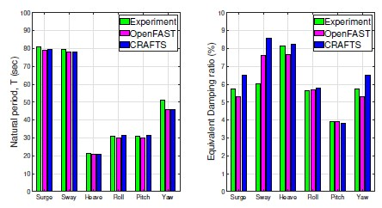
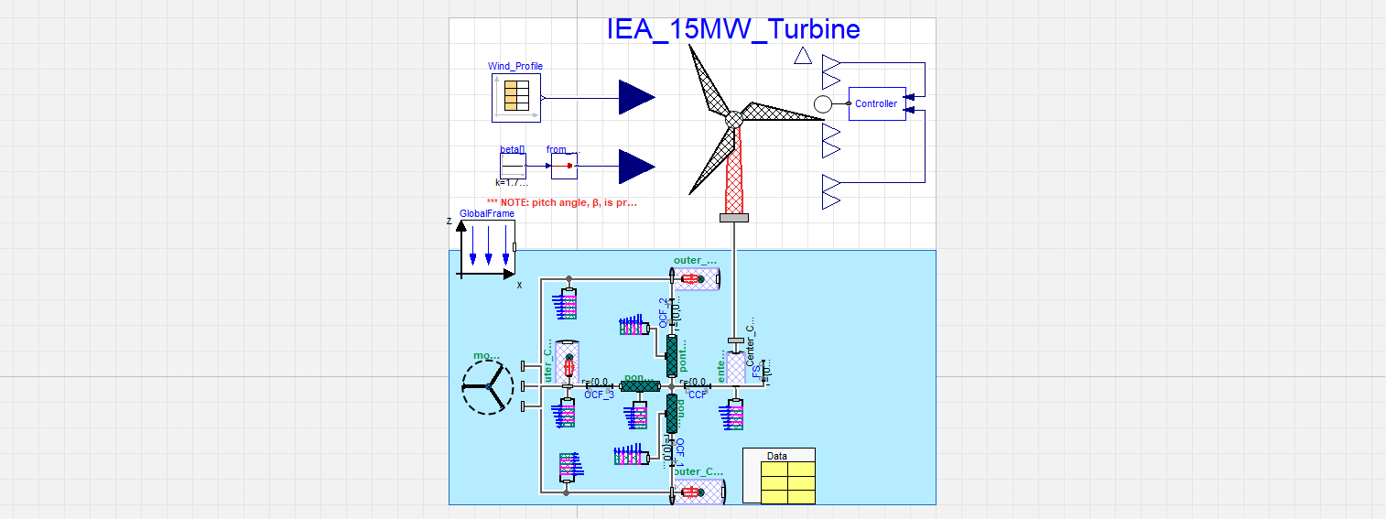
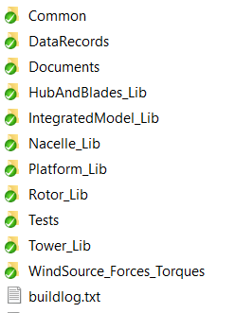
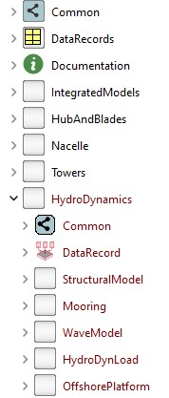
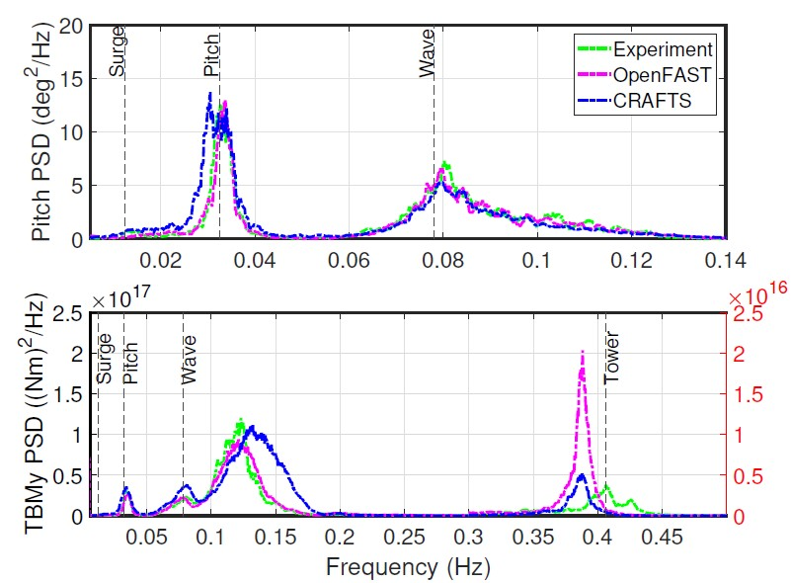
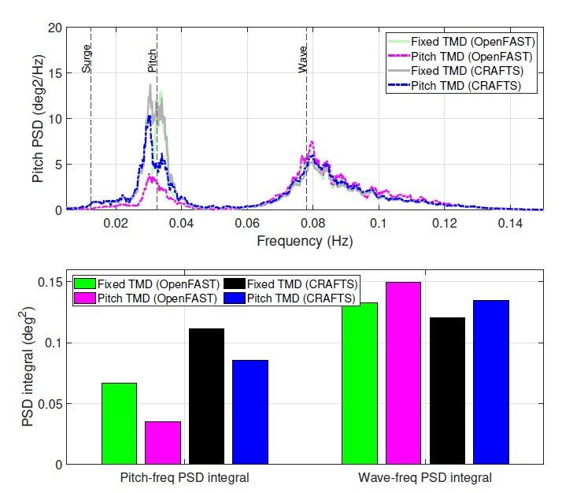

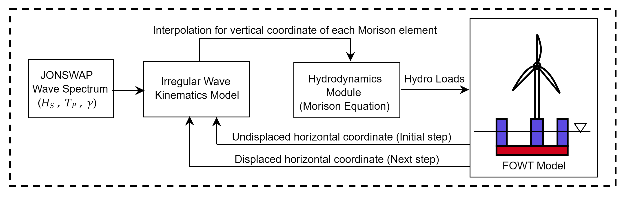
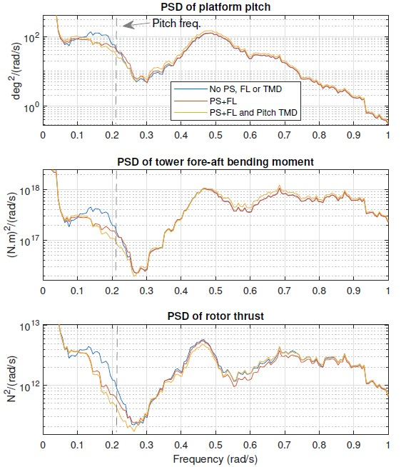
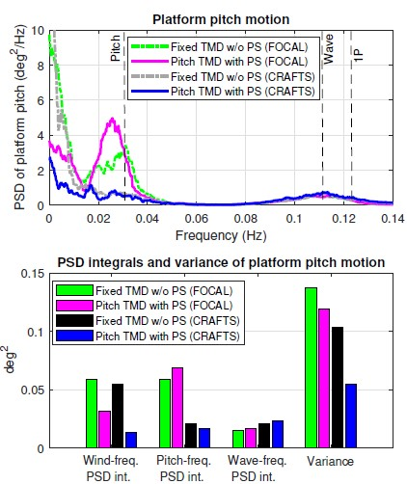
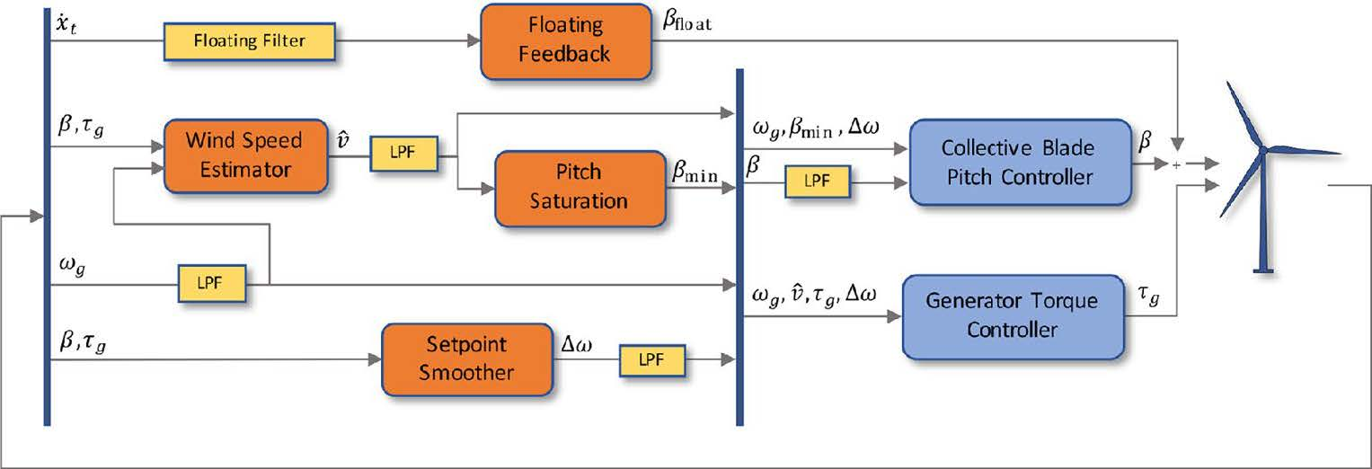
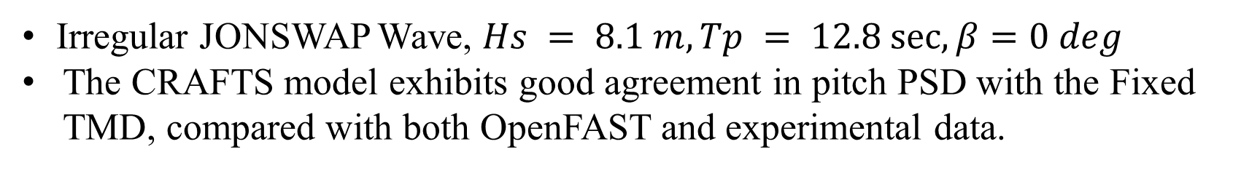
Modeling, Validation, and Control of the IEA-15MW Reference Wind Turbine and VolturnUS-S Platform
Doyal Sarker, Dung Tran, Kazi Mohsin, Mohammad Odeh, Tri Ngo, Tuhin Das
University of Central Florida, Orlando, FL 32816, USA
Introduction
Static Equilibrium & Free Decay Tests
Control-oriented, Reconfigurable and Acausal Floating Turbine Simulator (CRAFTS):
The static test was conducted under the influence of gravitational load, hydrostatic restoring moments, and the restoring forces from mooring lines. The natural periods and damping ratios were extracted from free decay tests performed on each DOF of floating platform.
Acausal plug-and-play features in Modelica language
Integrable with causal platforms such as MATLAB
Modular library structure with physics-based models (aero/hydro/structure)
validated against experimental data or recognized models
Model-based Control Co-Design for improved energy efficiency,
load attenuation
Causality-free modeling to facilitate structural innovations in FOWTs.
CRAFTS simulator developed to integrate aero-hydro-structural dynamics with control systems for better FOWT optimization.
DOF | Experiment | OpenFAST | CRAFTS
Surge(m) | 0.310 | -0.198 | -0.182
Sway(m) | 0.570 | -0.525 | -0.597
Heave(m) | -1.760 | -0.009 | -0.023
Roll(deg) | 0.310 | 2.330 | 2.595
Pitch(deg) | 0.000 | 1.020 | 1.1125
Yaw(deg) | -1.890 | -0.413 | -0.3881
Wave Only Validation Results
Irregular JONSWAP Wave, $Hs = 8.1 m, Tp = 12.8 sec, β=0 deg$
The CRAFTS model exhibits good agreement in pitch PSD with the Fixed TMD, compared with both OpenFAST and experimental data.
Hydrodynamics Module
The hydrodynamics loads modeled in CRAFTS simulator include the radiation induced added mass, wave excitation and non-linear viscous drag using Morison equation in relative form [1].
PSD integrals are calculated over the frequency bands: pitch frequency (0.012−0.05 Hz), wave frequency (0.055−0.25 Hz). Pitch resonance frequency was found by 47% and 23% for OpenFAST and CRAFTS, respectively.
Wind and Wave Inputs
In this case, both step and near rated wind with wave was simulated activating the Pitch TMD and ROSCO controller.
Control Module
ROSCO controller for regulating rotor speed, maximizing power, and damping platform motion.
Step Wind & Irregular wave
Near Rated Wind & Irregular wave
Conclusions
This study has successfully developed a control-oriented model of the wind turbine with semisubmersible platform within CRAFTS. Through the implementation of ROSCO controller with different settings such as peak shaving (PS), floating feedback, and various TMD configurations (Fixed, Pitch TMDs), the impact of turbine control and load mitigation on the FOWT’s motion response under diverse wind and wave conditions has been thoroughly assessed.
ROSCO controller with Floating feedback [2]
Acknowledgements
Tuned mass dampers (TMDs) are positioned in the floating platform and only free to translate vertically with tuned frequency (platform pitch or tower) [3]
This work is supported by the U.S. Department of Energy Advanced Research Projects Agency for Energy (ARPA-E) under the grant DE-AR0001187[3].
Contact:
References
[1] Sarker, D., Hasan, T., Ngo, T., and Das, T. (2023). Causality-free modeling of a floating wind turbine semisubmersible platform with validation results. IFACPapersOnLine, 56(3), 559–564.
[2] Abbas, N., Zalkind, D., Pao, L., and Wright, A. (2021). A reference open-source controller for fixed and floating offshore wind turbines. Wind Energy Science Discussions, 2021, 1–33.
[3] Program description “Aerodynamic Turbines Lighter and Afloat with Nautical Technologies and Integrated Servo-control”, https://arpa e.energy.gov/technologies/programs/atlantis .

