Slide 1
R 기초1
x2<-c(1,4,9)
sqrt(x2)
min(x2)
max(x2)
mean(x2)
x3<-rnorm(100)랜덤값 100개의 정규분포
# head(x3)
mean(x3)
sd(x3)
min(x3)
max(x3)
hist(x3)

Slide 2
# subset of vector : delete the first element
x[-1]
# subset of vector : delete the 1st to the 3rd element
x2<-x[-c(1:3)]
x2
# sequence of 20 values
y1<-seq(0,10, length=20)
# sequence of (1 to 10) by 0.5
y2<-seq(0,10, by=0.5)
# using rep
z1<-rep(1:4, 2)
z1
z2<-rep(1:2,5)
z2

Slide 3
c1<-c(2,4,6,8,10)
c2<-cbind(x, c1)
c2
c3<-rbind(x,c1)
c3
# two row matrix with 1 to 10
m1<-matrix(1:10, nrow=2)
m1
3 5 7 9
2 4 6 8 10
# three columns matrix with 1:6
m2<-matrix(1:6, ncol=3)
m2
3 5
2 4 6
# matrix filled by rows, defalut: filled by cloumns
m3<-matrix(1:6, nrow=2, byrow=T)
m3
2 3
4 5 6

Slide 4
gender<-c(0,1)
names(gender)<-c("female", "male")
gender
length(gender)
size<-c("S", "M","L","XL")
# define size as a factor (categorical variable)범주형 변수
size_factor<-factor(size)
size_factor
is.factor(size_factor)
size_factor3 <- factor(size, ordered = TRUE,
levels = c("S", "M","L","XL"))
size_factor3

Slide 5
2-4
square<-function(x){
return(x*x)
}
square(9)
square(1:3)
for (i in 1:10) {
i<-i+1
print(i)
if (i>5){
# stop loop after i>5
break
}
}
y=0
while(y <5){ print( y<-y+1) }
dif<-function(x,y){
return(x-y)
}
dif(20,10)
rootdif<-function(x,y){
return(sqrt(x-y))
}
rootdif(20,10)
round(5.14846, 2) 소수점두번째까지

Slide 6
3-1
setwd("C:/Users/doyeo/OneDrive/Desktop/RRR")
# export csv file - write out to csv file
write.table(brainf,file="brainf.csv", row.names = FALSE, sep=",", na=" ")
write.csv(brainf,file="brainf.csv", row.names = FALSE)
# export txt file
write.table(brainm, file="brainm.txt", row.names = FALSE, na=" ")
brain<-read.csv("brain2210.csv")
head(brain)
dim(brain)
car<-read.table(file="autompg.txt", na=" ", header=TRUE)
head(car)
dim(car)
# to get frequency of male and female (brain data)
table(brain$sex)
# using the command 'attach'
attach(brain)
# get frequency of male and female
table(sex)

Slide 7
3-2
brainf<-subset(brain, sex=='f')
mean(brainf$wt)
sd(brainf$wt)
brainm<-subset(brain, sex=='m')
mean(brainm$wt)
sd(brainm$wt)
# 'aggregate'for statistics by group
aggregate(wt~sex, data=brain, FUN=mean)
aggregate(wt~sex, data=brain, FUN=sd)

Slide 8
3-2
par(mfrow=c(2,2))
brainf<-subset(brain,brain$sex=='f')
hist(brainf$wt, breaks = 12,col = "green",cex=0.7, main="Histogram (Female)" ,xlab="brain weight")
# subset with male
brainm<-subset(brain,brain$sex=='m')
hist(brainm$wt, breaks = 12,col = "orange", main="Histogram with (Male)" , xlab="brain weight")
# histogram with same scale
hist(brainf$wt, breaks = 12,col = "green",cex=0.7, main="Histogram with Normal Curve (Female)" , xlim=c(900,1700),ylim=c(0,25), xlab="brain weight")
hist(brainm$wt, breaks = 12,col = "orange", main="Histogram with Normal Curve (Male)" , xlim=c(900,1700), ylim=c(0,25),xlab="brain weight")

Slide 9
3-3
# mean of some variables
apply (car[, 1:6], 2, mean)
# barplot using frequency
freq_cyl<-table(cyl)
names(freq_cyl) <- c ("3cyl", "4cyl", "5cyl", "6cyl", "8cyl")
barplot(freq_cyl)
barplot(freq_cyl, main="Cylinders Distribution")
a1<-lapply (car[, 1:6], mean)
a2<-lapply (car[, 1:6], sd)
a3<-lapply (car[, 1:6], min)
a4<-lapply (car[, 1:6], max)
table1<-cbind(a1,a2,a3,a4)
colnames(table1) <- c("mean", "sd", "min", "max")
table1

Slide 10
3-4
# 1. several sheets in Excel file엑셀안에 sheet여러개일때
install.packages("readxl")
library(readxl)
mtcars1 <- read_excel("D:/tempstore/moocr/mtcarsb.xlsx",
sheet = "mtcars")
mtcars1 <- read_excel("D:/tempstore/moocr/mtcarsb.xlsx",
sheet = 1)
head(mtcars1)
brain1<-read_excel("D:/tempstore/moocr/mtcarsb.xlsx",
sheet = "brain")
head(brain1)
brainm<-read_excel("D:/tempstore/moocr/mtcarsb.xlsx",
sheet = 2)
head(brainm)
# reading data from SQL databse
install.packages("RODBC")
library(RODBC)

Slide 11
4-1histogram
hist(wt, breaks = 10, col = "lightblue", main="Histogram of Brain weight" , xlab="brain weight")
# see rgb values for 657 colors, choose what you like
colors()
# select colors including "blue"
grep("blue", colors(), value=TRUE)
grep("violet", colors(), value =TRUE)
par(mfrow=c(2,1))
brainf<-subset(brain,brain$sex=='f')
hist(brainf$wt, breaks = 12,col = "green", xlim=c(900,1700),ylim=c(0,20),cex=0.7, main="Histogram with Normal Curve (Female)", xlab="brain weight")
brainm<-subset(brain,brain$sex=='m')
hist(brainm$wt, breaks = 12,col = "orange",xlim=c(900,1700),ylim=c(0,20), main="Histogram with Normal Curve (Male)", xlab="brain weight")
# 1-3. fit function (find density function)
par(mfrow=c(1,1))
d <- density(brain$wt)
plot(d)

Slide 12
4-2 boxplot
par(mfrow=c(1,2))
# 2-1 boxplot for all data
boxplot(brain$wt, col=c("coral"))
# 2-2 boxplot by group variable (female, male)
boxplot(brain$wt~brain$sex, col = c("green", "orange"))
# 2-3 horizontal boxplot
par(mfrow=c(1,1))
boxplot(brain$wt~brain$sex, boxwex=0.5, horizontal=TRUE, col = c("grey", "red"))
# 2-4 box width boxwex (width of box)
par(mfrow=c(1,2))
boxplot(brain$wt, boxwex = 0.25, col=c("coral"), main="Boxplot for all data")
boxplot(brain$wt, boxwex = 0.5, col=c("coral"), main="Boxplot for all data")
# 2-5 add text (n) over a boxplot
par(mfrow=c(1,2))
a<-boxplot(brain$wt~brain$sex, col = c("green", "orange"))
text(c(1:nlevels(brain$sex)), a$stats[nrow(a$stats),]+30, paste("n = ",table(brain$sex),sep=""))

Slide 13
4-2 barplot
# 3. bar plot with cyliner count (lec3_3.R)
# par(mfrow=c(1,1))
table(car$cyl)
freq_cyl<-table(cyl)
names(freq_cyl) <- c ("3cyl", "4cyl", "5cyl", "6cyl",
"8cyl")
barplot(freq_cyl, col = c("lightblue", "mistyrose", "lightcyan",
"lavender", "cornsilk"))

Slide 14
4-2 piechart
# 4. pie chart
# You can also custom the labels:
freq_cyl<-table(cyl)
names(freq_cyl) <- c ("3cyl", "4cyl", "5cyl", "6cyl", "8cyl")
# 4-1 pie chart
pie(freq_cyl)
# 4-2 pie chart clockwise
pie(freq_cyl, labels = c("3cyl", "4cyl", "5cyl", "6cyl","8cyl"),
clockwise = TRUE)
# 4-3 pie chart of subset
# subset with cylinder (4,6,8) - refresh creating subset data lec3_2.R
car1<-subset(car, cyl==4 | cyl==6 | cyl==8)
table(car1$cyl)
freq_cyl1<-table(car1$cyl)
pie(freq_cyl1, labels = c("4cyl","6cyl","8cyl"),
clockwise = TRUE)

Slide 15
4-3 scatterplot
(2차원)
par(mfrow=c(1,1))
x2<-c(1,4,9)
y2<-2+x2
plot(x2, y2)
# 5-4 scatterplot coloring group variable
par(mfrow=c(2,1), mar=c(4,4,2,2))
plot(disp, mpg, col=as.integer(car$cyl))
plot(wt, mpg, col=as.integer(car$cyl))
# 5-5 Conditioning plot : seperating scatterplot by factor(group) variable
car1<-subset(car, cyl==4 | cyl==6 | cyl==8)
coplot(car1$mpg ~ car1$disp | as.factor(car1$cyl), data = car1,
panel = panel.smooth, rows = 1)

Slide 16
4-3 scatterplot
(2차원)
# 5-6 cross-tab Plot to see how explanatory variables are related each othe
pairs(car1[,1:6], col=as.integer(car1$cyl), main = "autompg")
# 5-7 scatterplot with best fit lines
par(mfrow=c(1,1))
plot(wt, mpg, col=as.integer(car$cyl), pch=19색채운동그라미)
# best fit linear line
abline(lm(mpg~wt), col="red", lwd=2, lty=1실선)
# lowess : smoothed line, nonparmetric fit line (locally weighted polynomial regression)
lines(lowess(wt, mpg), col="red", lwd=3, lty=2점선)

Slide 17
4-4Graphics and layout
# 6. scatterplot of wt and mpg
par(mfrow=c(1,1))
plot(wt, mpg, main = "abline on the scatterplot")
# horizontal
abline(h = 20)
abline(h = 30)
# vertical
abline(v = 3000, col="blue")
# y = a + bx
abline(a = 40, b = -0.0076, col="red")
# linear model coefficients, lty (line type), lwd (line with)
# linear model (mpg=f(wp))
z <- lm(mpg ~ wt, data = car)
z
abline(z, lty = 2, lwd = 2, col="green")

Slide 18
4-4Graphics and layout
par(mfrow=c(2,2), mar=c(4,4,2,2)) mar(아래,왼,위,오른)
plot(wt, mpg)
plot(disp, mpg)
plot(hp, mpg)
plot(accler, mpg)
# top 1 plot, bottom 2 plot
(m <- matrix(c(1, 1, 2, 3), ncol = 2, byrow = T))
layout(mat = m)
plot(car$wt, car$mpg, main = "scatter plot of autompg", pch = 19, col = 4)
hist(car$wt)
hist(car$mpg)
# legend
# scatterplot coloring group variable (lec4_3.R)
par(mfrow=c(1,1), mar=c(4,4,4,4))
plot(wt, mpg, col=as.integer(car$cyl))
labels = c("3cyl", "4cyl", "5cyl", "6cyl","8cyl")
legend(4000, 45, legend = labels, pch = 1, col =c(3,4,5,6,8), lty =1)

Slide 19
5-1lattice-직교형태의 멀티패널툴 다변량데이터의 변수간 관계혹은 특징을 파악하는데 유용
install.packages('lattice')
library(lattice)
# basic xyplot
xyplot(NOx ~ E , data = ethanol, main = "Single Panel by xyplot")
# multi panel graph
xyplot(NOx ~ E | C , data = ethanol, main = "NOx ~ E | C ")
# multi panel graph for subset
xyplot(NOx ~ E | C , data = ethanol, subset = C > 8,
main = "NOx ~ E | C , data = ethanol, subset = C > 8")

Slide 20
5-2ggplot2-그래픽 시스템 그래프 이상의 그림을 그리고싶다면!
install.packages('ggplot2')
library(ggplot2)
car1$cyl<-as.factor(car1$cyl)
# Now, you can draw one of plot using ggplot
par(mfrow = c(1, 1))
ggplot(car1, aes(x=wt, y=disp, color=cyl, shape=cyl)) +
geom_point(size=3, alpha=0.6)
https://rstudio.com/wp-content/uploads/2015/03/ggplot2-cheatsheet.pdf

Slide 21
5-2ggplot2-그래픽 시스템 그래프 이상의 그림을 그리고싶다면!
# 5-2-1 : geom_bar : asethetic mapping (4,6,8 cyl)
ggplot(car1, aes(factor(cyl), fill=factor(cyl)))+ geom_bar(width=.5)+ facet_grid(. ~ origin)
# by default includes 95% confidence region 회귀선
ggplot(car1, aes(x=wt, y=mpg)) + geom_point(shape=1) + geom_smooth(method=lm)
# excluding 95% confidence region 신뢰구간표시 안하고싶을떄
ggplot(car1, aes(x=wt, y=mpg)) +
geom_point(shape=1) + geom_smooth(method=lm, se=FALSE)
# step3: Add a loess smoothed fit curve with confidence region
# geom_smooth() use loess 비선형회귀선
ggplot(car1, aes(x=wt, y=mpg)) + geom_point(shape=1) + geom_smooth(method="loess")

Slide 22
5-3 scatterplot3d,Heatmap
s3d <- scatterplot3d(trees, type="h", highlight.3d=TRUE,
angle=55, scale.y=0.7, pch=16, main="scatterplot3d - 5")
my.lm <- lm(Volume ~ Girth + Height) 회귀면추가
s3d$plane3d(my.lm, lty.box = "solid")
히트맵: 통계치를 구한후 크기에 비례하여 그라데이션 색상으로 표현한 시각화기법. Matrix(행렬)형태로 집어넣어야함.
par(mfrow=c(1, 1))
cor.x<-cor(car[,1:6])
heatmap(cor.x, symm=TRUE)
x <- as.matrix(USArrests[, -3])
result <- heatmap(x, scale="column", Colv=NA, cexCol=1,
main="Violent Crime Rates by US State (1973)")

Slide 23
5-4 공간지도
install.packages("maps") 세계의 지도 데이터베이스
install.packages("mapdata") maps보다 정교한 지도
install.packages("mapproj") 위도와 경도
# Korea using map package
par(mfrow = c(1, 2), mar=c(2,2,2,2))
map(database = 'world', region = c('South Korea', 'North Korea'))
title("Korea : maps packages")
# Korea using mapdata package
map(database = 'worldHires', region = c('South Korea', 'North Korea'))
title("Korea : mapdata packages")

Slide 24
par(mfrow = c(1, 1), mar=c(2,2,2,2))
map('worldHires', region=c('South Korea', 'North Korea', 'Japan', 'China'))
map('worldHires', region=c('South Korea'), col = 'blue', add = TRUE, fill = TRUE)
map('worldHires', region=c('North Korea'), col = 'coral', add = TRUE, fill = TRUE)
map('worldHires', region=c('Japan'), col = 'grey',add = TRUE, fill = TRUE)
map('worldHires', region=c('China'), col = 'yellow',add = TRUE, fill = TRUE)
map('worldHires', proj = 'azequalarea', orient = c(37.24223, 131.8643, 0))
map.grid(col = 2)
points(mapproject(list(y = 37.24223, x = 131.8643)), col = "blue", pch = "x", cex = 2)
title("독도")

Slide 25
6-1 데이터다루기
# practice data
dat1<-read.csv(file="data1.csv")
dat2<-read.csv(file="data2.csv")
# data merging 데이터 결합
dat12<-merge(dat1, dat2, by="ID")
# excluding variables 데이터 제거
exdat<-dat12[!names(dat12) %in% c("age","gender")]
exdat
# data sorting 데이터 정렬
dats1<-dat12[order(dat12$age),]
dats1
dats2<-dat12[order(dat12$gender, dat12$age), ]
dats2
# data subset (selecting data) 데이터 추출
#newdat<-dat12[which(dat12$gender=="F" & dat12$age>15),]
newdat<-subset(dat12, dat12$gender=="F" & dat12$age>15)
newdat

Slide 26
비교검정(t.test)
# to test whether or not mean of G3 is same between Urban and Rural 양측검정
t.test(G3~address, data=stud)
boxplot(G3~address, boxwex = 0.5, col = c("yellow", "coral"))
# alternative H : mu(Rural)< mu(Urban) 단측검정
t.test(G3~address, data=stud, alternative = c("less"))
P-value의 유의수준=0.05
0.05보다 크면 검정통계량의 값이 기각역에 있지않다=유의한 영향이없다
0.05보다 작으면 유의한 영향이 있다.
신뢰구간사이에 0이있다는것은 변수끼리 차이가 없다는것을 의미
wilcox.test(G3~address)—비모수적 비교검정
보통 타겟변수가 등간척도(통증정도,만족도…)일떄 사용

Slide 27
비교검정(paired t.test)
보통 전후과정을 비교검정할때
t.test(bp_pre, bp_post, mu=0귀무가설, paired=T)
P-value값이 유의수준0.05와 차이가 많을수록 귀무가설 기각
=>투약전과 투약후의 혈압에 유의한 차이가 있다고 볼수있다.

Slide 28
분산분석ANOVA-전체분산을 분할하여 어떤요인의 영향이 유의한지 검정하는방법
a1 <- aov(G3~address)
summary(a1)
이원분산분석-factor가 두개
상호작용그래프
interaction.plot(drug[x축], age[y축], value)
interaction.plot(age, drug, value)
# two-way ANOVA,
a6 <- aov(value ~ drug + age)
summary(a6)
# two-way ANOVA with interaction
a7 <- aov(value ~ drug + age+ drug*age)
summary(a7)

Slide 29
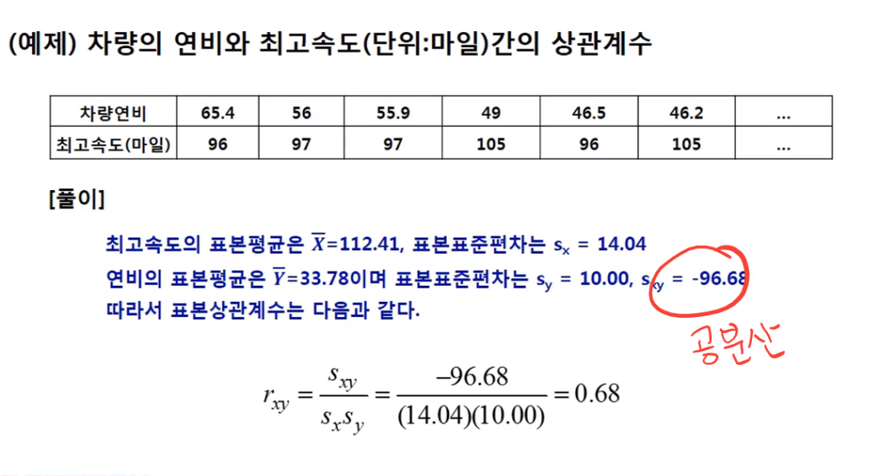
상관분석-상관계수
#correlation
cor(wt, mpg)
cor(disp, mpg)
cor(accler, mpg)
상관계수는 절대값0-1사이의값!
절대값이0에 가까울수록 상관관계가없다.
절대값이1에 가까울수록 강한 상관관계가있다.

Slide 30
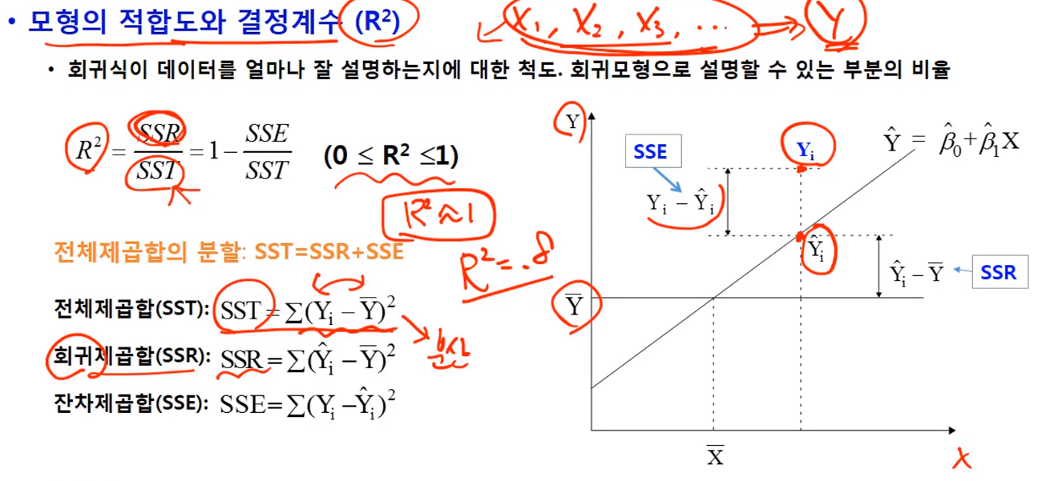
결정계수
Multiple R-squared: 0.709=결정계수
x값으로y값을 몇프로나예측가능한지.

Slide 31
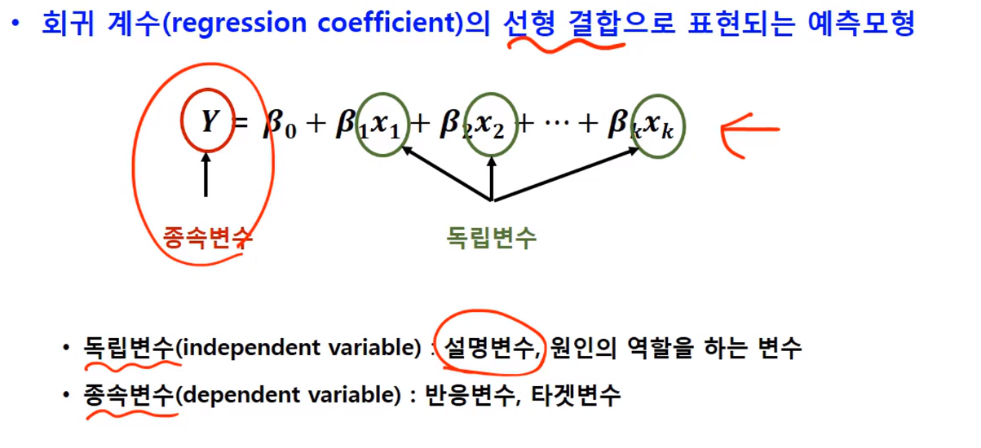
회귀분석 목적:예측과 추정
단순회귀분석=하나의독립변수로 종속변수를 설명하기.

Slide 32
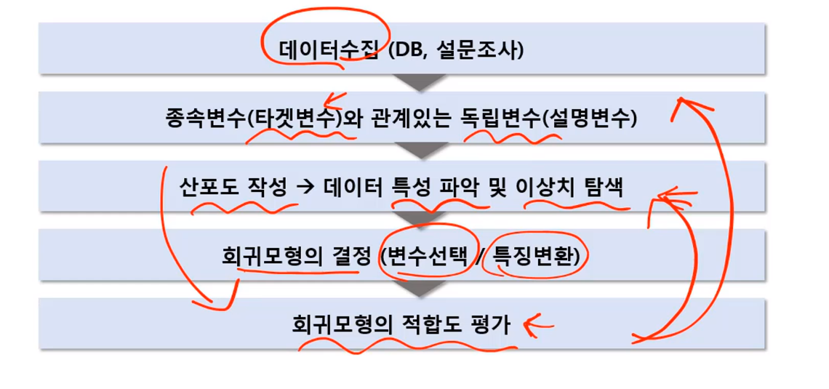
예측모형만드는 과정

