Slide 1
CSE 482: Big Data Analysis
Lecture 10 (Predictive Modeling)

Slide 2
Review
Last lecture
What is predictive modeling?
Decision tree method
Model evaluation
Today’s lecture
Model selection and overfitting
Alternative methods

Slide 3
Model Overfitting
Goal of predictive modeling:
To build a model with low training and test errors
But this is a challenge because a model with low training error does not guarantee it will have low test error
This is due to an artifact known as model overfitting problem

Slide 4
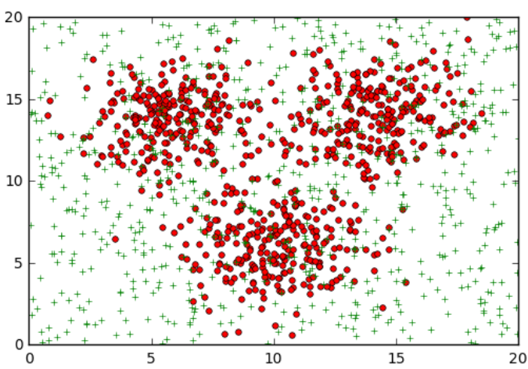
Model Overfitting (Example)
Two class problem:
+, o
1500 data points (20% for training, 80% for testing)
Data set for + class is generated from a uniform distribution
Data set for o class is generated from a mixture of 3 gaussian distributions, centered at (6,14), (10,6), and (14,14), with variances equal to 3.5.
Our goal is to train a classifier to distinguish the two classes

Slide 5
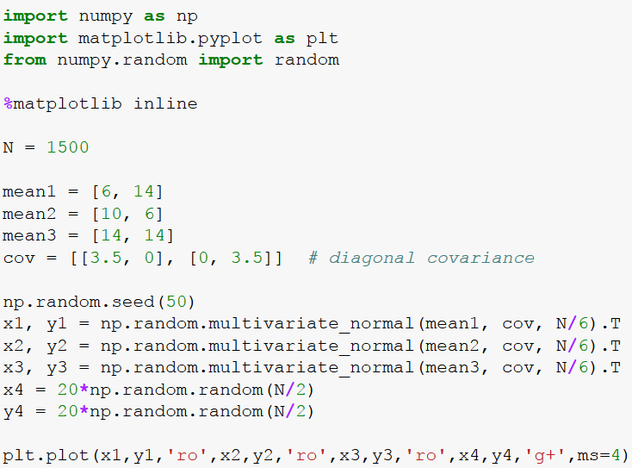
Data Generation (in Python)

Slide 6
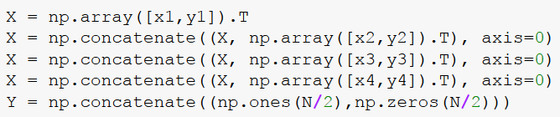
Data Generation (in Python)
Creating the predictor (X) and target (Y) variables
Creating the training and test sets
o
+

Slide 7
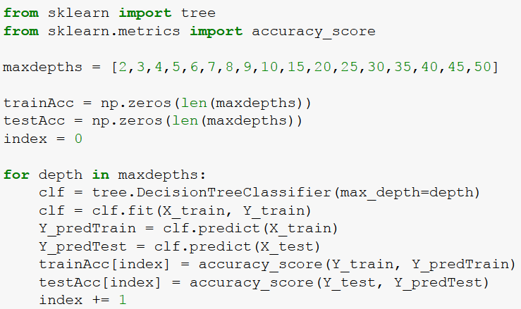
Building Trees of Different Sizes

Slide 8
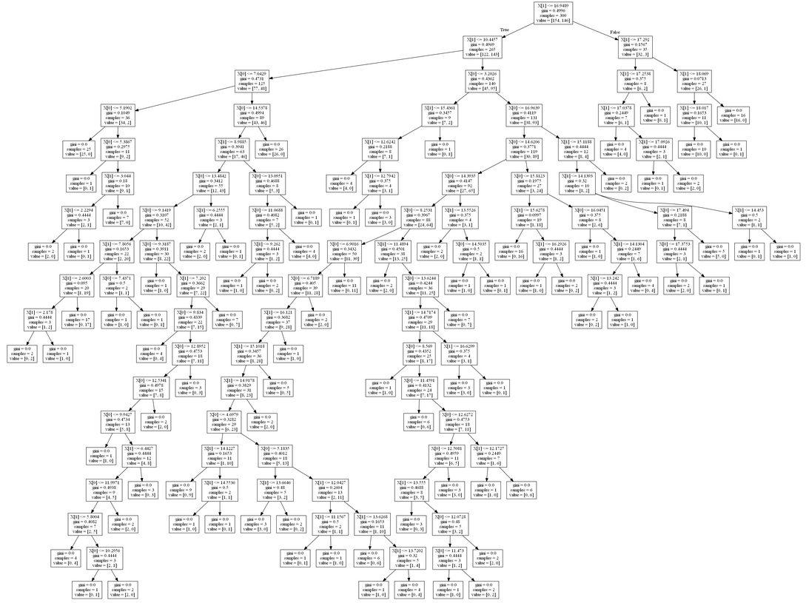
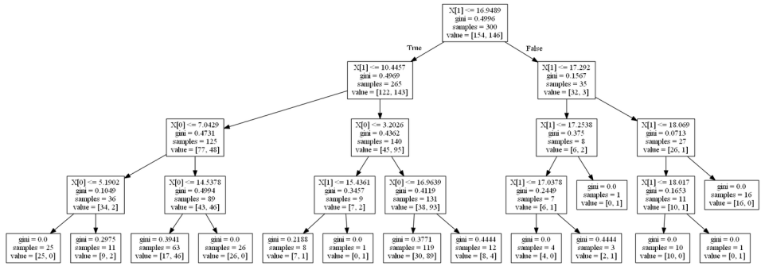
Building Trees of Different Sizes
Decision Tree with maxdepth = 4
Training accuracy ~ 81.7%
Decision Tree with maxdepth = 20
Training accuracy ~ 100%
Which tree is better?

Slide 9
Building Trees of Different Sizes
Decision Tree with maxdepth = 4
Training accuracy ~ 81.7%
Test accuracy ~ 73.2%
Decision Tree with maxdepth = 20
Training accuracy ~ 100%
Test accuracy ~ 65.9%

Slide 10
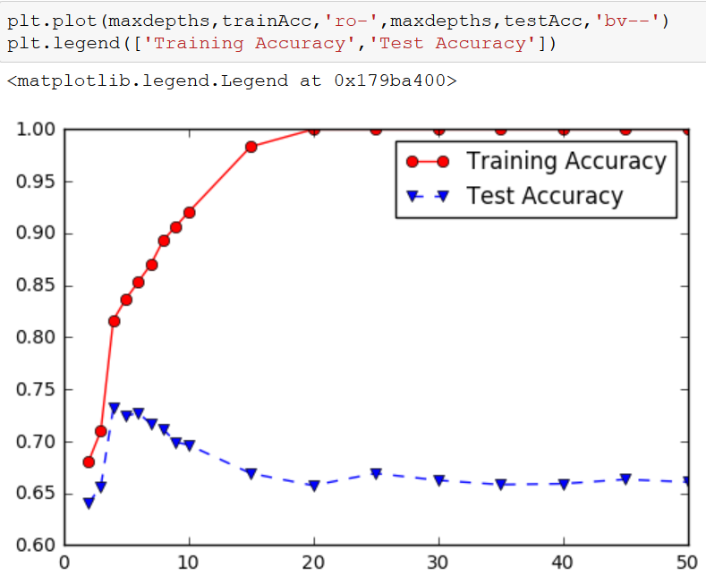
Building Trees of Different Sizes
Training accuracy keeps improving as size of the tree increases
Test accuracy improves with increasing tree size up to maxdepth=4, after which it decreases with increasing tree size

Slide 11
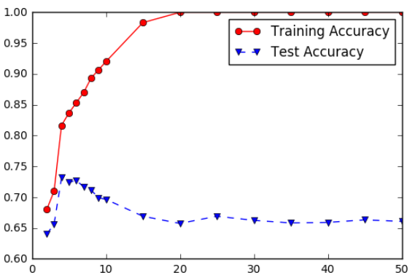
Model Overfitting and Underfitting
Underfitting: when model is too simple, both training and test accuracies are poor
Overfitting: when model is too complex, training accuracy is high but test accuracy is low

Slide 12
Overfitting
An overfitted model is undesirable because
The model may fit noise (mislabeled examples) in the training data
The model may fit exceptional cases (rather than the norm) in the training data

Slide 13
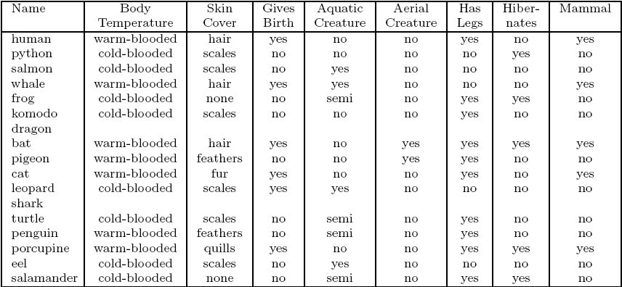
Mammal Classification Problem
Training Set
Decision Tree Model
training error = 0%

Slide 14
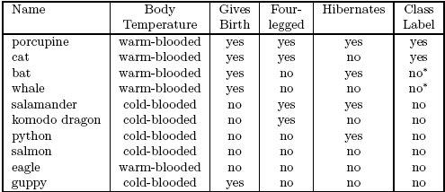
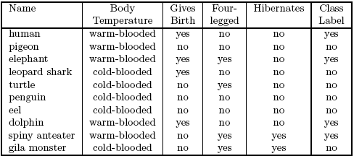
Effect of Noise (Mislabeled Examples)
Example: Mammal Classification problem
Model M1:
train err = 0%,
test err = 30%
Training Set:
Test Set:
Model M2:
train err = 20%,
test err = 10%

Slide 15
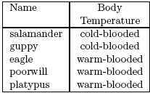


Lack of Representative Samples
Training Set:
Test Set:
Model M3:
train err = 0%,
test err = 30%
As tree grows larger, there are fewer training examples available at the leaf node to make reliable classification decision (e.g., the node may fit exceptional cases)

Slide 16
Lessons on Overfitting
Training error does not truly reflect how well the classifier performs on previously unknown data instances
Overfitting results in models that are more complex (larger) than necessary
Complexity can be measured in terms of size of tree, number of model parameters, etc.
Need a way to control complexity of the model during training
This is known as the model selection problem

Slide 17




Model Selection for Decision Tree
Depends on the decision tree software you use

Slide 18
Model Selection Using Validation Set
A general model selection approach that does not depend on the predictive modeling technique used
Divide the training data into two parts:
“Training” set: for model building
Validation set: for estimating generalization error; choose the model parameter that gives the lowest error on validation set
Drawback:
Less data would be available for training

Slide 19
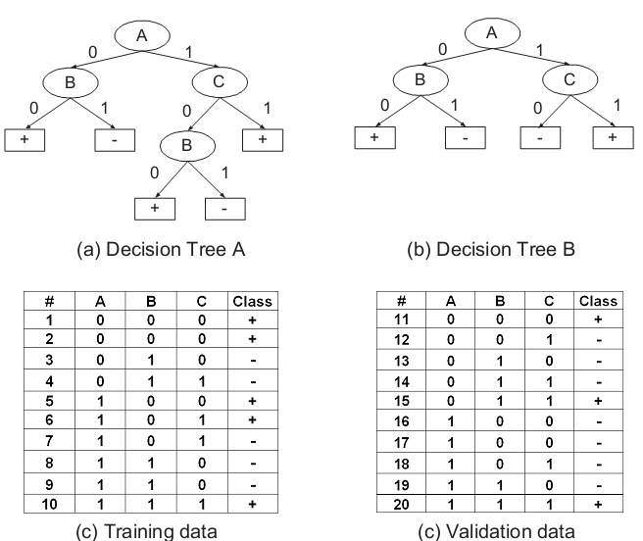
Example
Training errors:
Tree A: 10%
Tree B: 20%
Validation errors:
Tree A: 50%
Tree B: 30%
So, tree B is preferred over A

Slide 20
Predictive Modeling Techniques
Single Models
Decision Tree based Methods
Rule-based Methods
Nearest-neighbor Methods
Artificial Neural Networks
Probabilistic Methods
Support Vector Machines/Regression
Ensemble Models
Boosting, Bagging, Random Forests

Slide 21
Nearest-Neighbor Method
Given a test example:
Compute its distance to all the training examples
Identify its k nearest neighbors
Use the target values of the k nearest neighbors to predict the target value of test example
For classification, take majority vote
For regression, take the average value

Slide 22
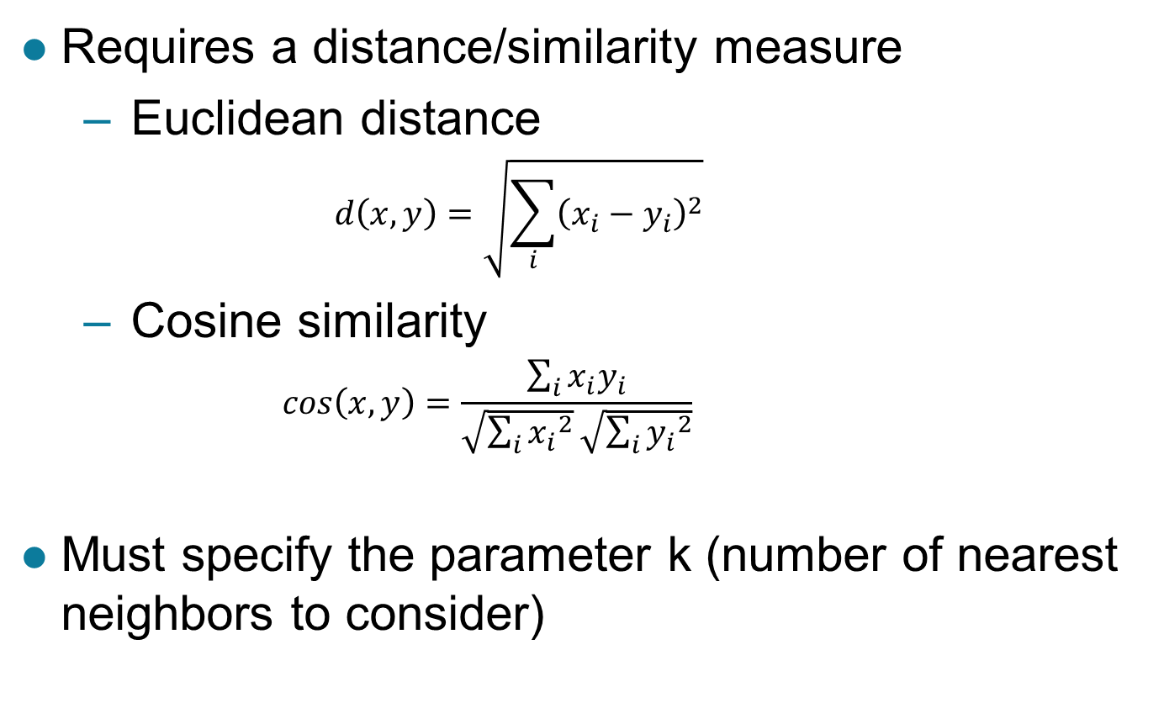
Nearest Neighbor Method
Requires a distance/similarity measure
Euclidean distance
$$d\left(x,y\right)=\sqrt{\sum_{i}{{\left(x_{i}−y_{i}\right)}^{2}}}$$
Cosine similarity
$$cos\left(x,y\right)=\frac{\sum_{i}{x_{i}y_{i}}}{\sqrt{\sum_{i}{{x_{i}}^{2}}}\sqrt{\sum_{i}{{y_{i}}^{2}}}}$$
Must specify the parameter k (number of nearest neighbors to consider)

Slide 23
Nearest Neighbor Method
Choosing the value of k:
If k is too small, sensitive to noise points
If k is too large, neighborhood may include points from other classes

Slide 24
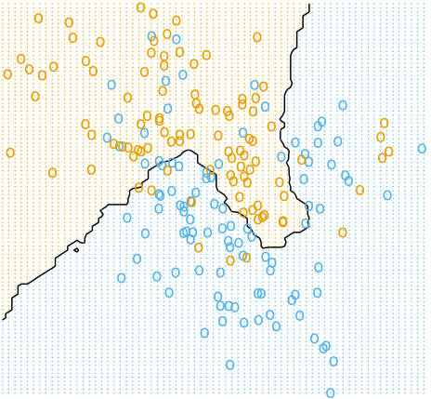
Nearest-Neighbor Method
Decision boundary using k=15
From: Elements of Statistical L1earning (Hastie, Tibshirani, Friedman)

Slide 25
Linear Method
Construct a linear decision boundary to separate training examples from different classes
+

Slide 26
Linear Method
General form of a linear model:
w’s are the model parameters
Many learning algorithms available to find the best linear model that fits w to the training data
Perceptron (single-layer neural network)
Support vector machine
Logistic regression

Slide 27
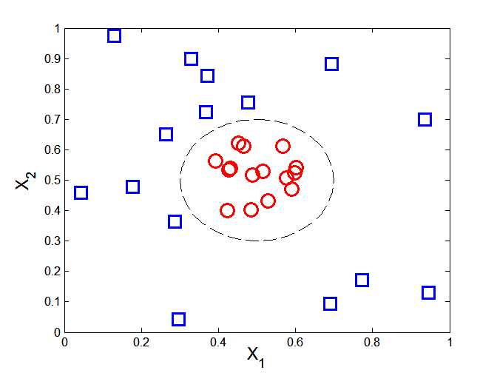
Nonlinear Method
Designed for more complicated decision boundaries
Examples: nonlinear support vector machines, artificial neural networks, etc

Slide 28
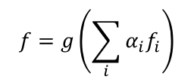
Ensemble Methods

Slide 29
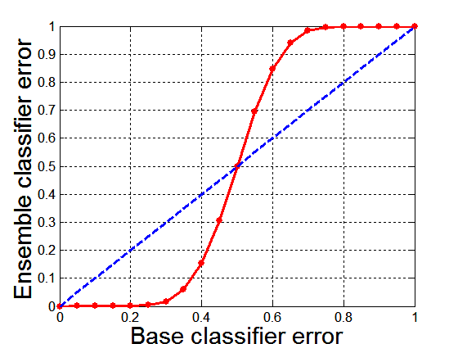
Why Ensemble Methods work?
Suppose there are 25 base classifiers
Each classifier has error rate, ε = 0.35
Assume the errors made by the classifiers are uncorrelated
Probability that the ensemble classifier makes a wrong prediction:
X: number of classifiers that made a wrong prediction
< 0.35

Slide 30
Ensemble Methods
Bagging
Build multiple classifiers by resampling the data with replacement
Boosting
Build multiple classifiers by resampling the (weighted) data with replacement
Random Forests
Train multiple decision tree classifiers and combine their predictions
Each tree is generated from a random subset of features

Slide 31
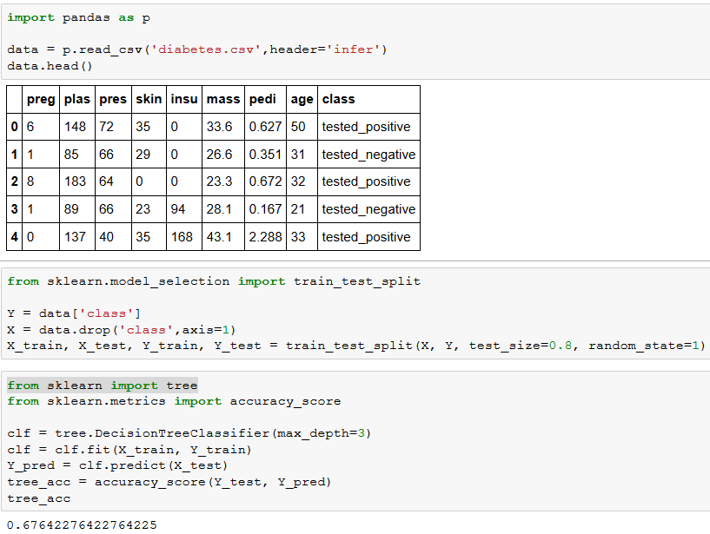
Python Example

Slide 32
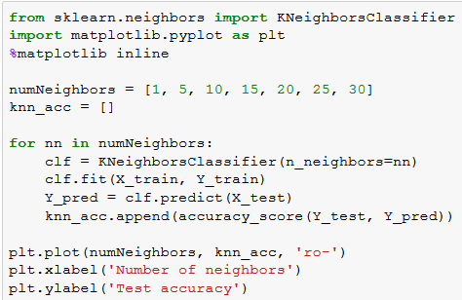
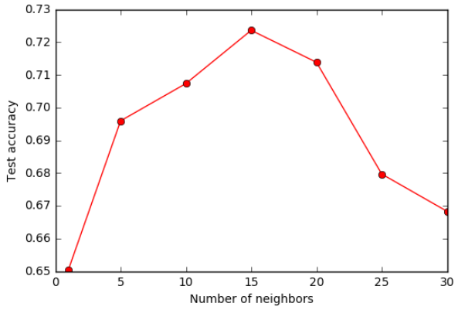
Python Example

Slide 33
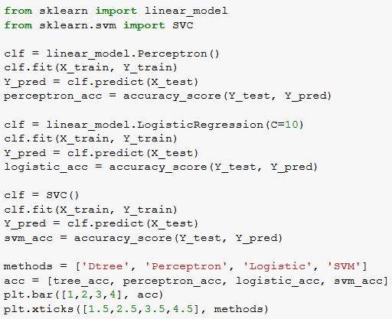
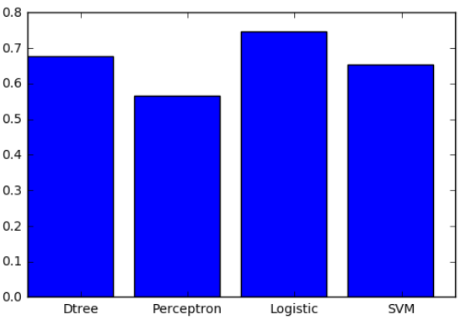
Python Example

Slide 34
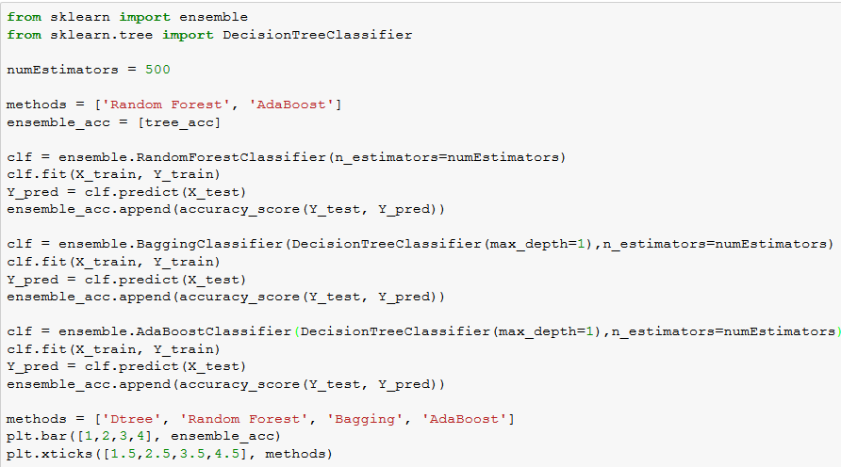
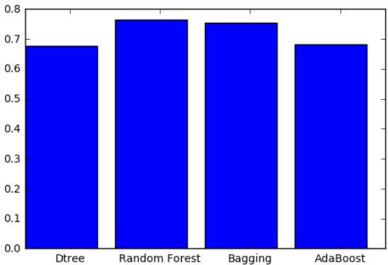
Python Example

Slide 35
Other Practical Issues in Classification
Handling imbalanced class distribution
If 99% belongs to negative class and 1% belongs to positive class, your classifier will likely predict every instances to be negative class
Stratification
Undersample the larger class
Oversample the smaller classes
Other approaches
Assign higher penalty if your classifier predicts the smaller class as the larger class
Generate more data by perturbing instances from the smaller class

Slide 36
Other Practical Issues in Classification
Use a learning curve to make sure your training set size is sufficiently large
Classification accuracy
# training examples

Slide 37
Other Practical Issues in Classification
A good model must be better than random guess
Example:
2 classes (100 positive and 400 negative examples)
Random guessing (e.g., flip a coin, if you get a head, classify as positive; otherwise classify as negative)
Another baseline: classify everything as negative
Accuracy = 400/500 = 80%
 | PREDICTED CLASS
ACTUAL CLASS |  | Class = + | Class = -
 | Class = + | 50 | 50
 | Class = - | 200 | 200
Accuracy = 50%
TPR = 50%

Slide 38
Final Words
There are many predictive modeling methods
You need to understand their strengths and limitations of each method
You need to understand some of the practical issues (overfitting/underfitting, class imbalanced, etc)
Features used are the most important aspect of predictive modeling
Often times, you can get significant performance gain by creating better features instead of applying more sophisticated classification techniques

