Slide 1
CSE 482: Big Data Analysis
Lecture 9 (Predictive Modeling)

Slide 2
Predictive Modeling
The task of predicting the value of a target variable (y) as a function of the predictor variables (X)
y = f(X)
Task | Target variable | Example Applications
Regression | Quantitative (ratio/interval) | Stock market prediction, revenue/sales forecast, temperature prediction, calorie prediction, power consumption prediction
Classification | Qualitative (nominal) | Disease prediction, image classification, spam detection, twitter mood prediction, link prediction in social networks

Slide 3
Predictive Modeling Framework
Classification or Regression technique

Slide 4
Terminology
Training set is used for model building
Contains a set of labeled examples, whose target variable values are known
Test set is used either
To predict the target values of unknown data
To evaluate the performance of the model
If it is for evaluation, then the target values of the test examples must also be known
Predictive model:
an abstract representation of the relationship between the predictor and target variables

Slide 5
Predictive Modeling Techniques
Single Models
Decision Tree Methods
Rule-based Methods
Nearest-neighbor Methods
Artificial Neural Networks
Probabilistic Methods
Support Vector Machine/Regression
Ensemble Models
Boosting, Bagging, Random Forests

Slide 6
Example: Decision Tree Classifier
categorical
categorical
continuous
class
Splitting Attributes
Home Owner
Yes
No
NO
MarSt
Single, Divorced
Married
Income
NO
< 80K
> 80K
NO
YES
Training Data
Model: Decision Tree

Slide 7
Application of Decision Tree Classifier
Decision Tree

Slide 8
Apply Model to Test Data
Test Data
Start from the root of tree.
Home Owner
Yes
No
NO
MarSt
Single, Divorced
Married
Income
NO
< 80K
> 80K
NO
YES

Slide 9
Apply Model to Test Data
Test Data
Home Owner
Yes
No
NO
MarSt
Single, Divorced
Married
Income
NO
< 80K
> 80K
NO
YES

Slide 10
Apply Model to Test Data
Test Data
Home Owner
Yes
No
NO
MarSt
Single, Divorced
Married
Income
NO
< 80K
> 80K
NO
YES

Slide 11
Apply Model to Test Data
Test Data
Home Owner
Yes
No
NO
MarSt
Single, Divorced
Married
Income
NO
< 80K
> 80K
NO
YES

Slide 12
Apply Model to Test Data
Test Data
Home Owner
Yes
No
NO
MarSt
Single, Divorced
Married
Income
NO
< 80K
> 80K
NO
YES

Slide 13
Apply Model to Test Data
Test Data
Home Owner
Yes
No
NO
MarSt
Single, Divorced
Married
Assign Defaulted to “No”
Income
NO
< 80K
> 80K
NO
YES

Slide 14
Decision Tree Classifier: Model Building
Decision Tree

Slide 15
Decision Tree Induction Algorithm
1. Start with an initial node (let D₀ be the training instances)
2. Check whether a leaf node needs to be expanded (based on stopping criteria)
If not needed, then assign a class to the node based on the majority class of training instances in D₀.
D₀
D₀
Class=No
?
Home Owner
Yes
No
D₁
D₂
b. Else
i. Find the best attribute split condition
Ii, Distribute the training instances to their corresponding child nodes based on the outcome of the split condition.
3. Repeat Step 2 for each leaf node that has not been tested

Slide 16
Design Issues for Decision Tree Classifier
Which attribute to use when expanding a node?
Need a measure to evaluate how good is the attribute split
What is the stopping condition?
Stop splitting if all the instances belong to the same class or have identical attribute values
Early termination (to avoid overfitting the training data, see next lecture)

Slide 17
How to determine the Best Split
Greedy approach:
Nodes that have purer class distribution after splitting are preferred
D₀
D₀
X
Y
Yes
No
Yes
No
D₁
D₂
D₁
D₂
Y is preferred over X to split the data D₀

Slide 18
Finding the Best Split
For each candidate attribute
Compute impurity measure of each child node
Compute the weighted average impurity measure of the children
Choose the attribute split condition that produces the lowest weighted impurity measure
I₁
I₂
…..
I_{p}

Slide 19
Measures of Node Impurity
Consider a k-class problem where the class label is either {1, 2, 3, …, k}
Let p(j) be the proportion of training instances of class j
2 popular measures for node impurity:

Slide 20
Example: Gini Index of a Single Node
P(C1) = 0/6 = 0 P(C2) = 6/6 = 1
Gini = 1 – P(C1)² – P(C2)² = 1 – 0 – 1 = 0
P(C1) = 1/6 P(C2) = 5/6
Gini = 1 – (1/6)² – (5/6)² = 0.278
P(C1) = 2/6 P(C2) = 4/6
Gini = 1 – (2/6)² – (4/6)² = 0.444

Slide 21
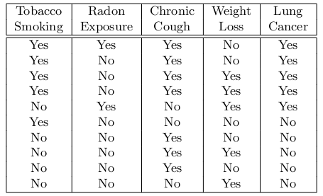
Example: Diagnosing Lung Cancer
Training instances:
Initial Tree:
?
Yes: 5 No: 5
Node is impure; so we need to expand it

Slide 22
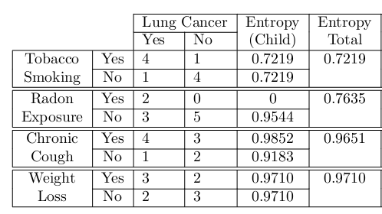
Example
Best split condition
Yes: 5 No: 5
Current Tree:
Tobacco Smoking
Yes
No
Yes: 4 No: 1
Yes: 1 No: 4

Slide 23
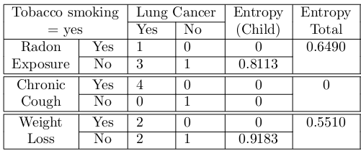
Example
Best split condition
Yes: 5 No: 5
Current Tree:
Tobacco Smoking
Yes
No
Chronic Cough
Yes: 1 No: 4
Yes
No
Yes: 4 No: 0
Yes: 0 No: 1

Slide 24
Example
Best split condition
Current Tree:
Tobacco Smoking
Yes
No
Chronic Cough
Yes: 1 No: 4
Yes
No
Yes
No

Slide 25
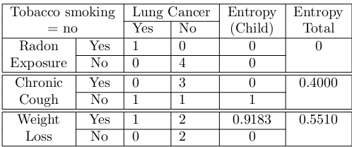
Example
Best split condition
Current Tree:
Tobacco Smoking
Yes
No
Chronic Cough
Radon Exposure
Yes
No
Yes
Yes
No
Yes: 1 No: 0
Yes: 0 No: 4

Slide 26
Example
Best split condition
Final Tree:
Tobacco Smoking
Yes
No
Chronic Cough
Radon Exposure
Yes
No
Yes
Yes
No
Yes
No

Slide 27
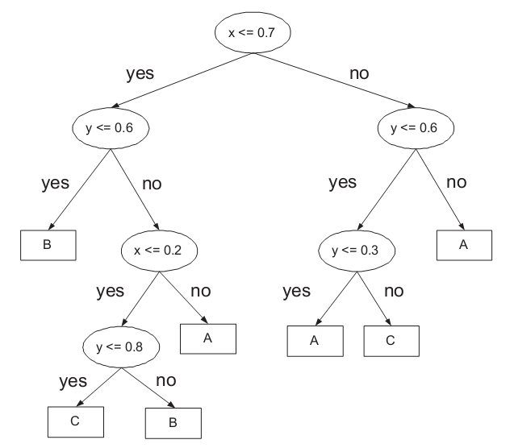
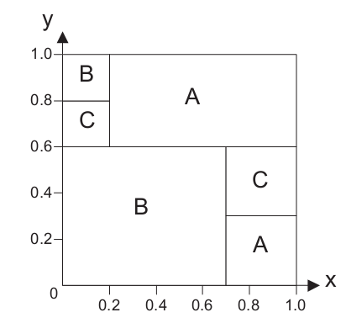
Example for 2D Numeric Data

Slide 28
Predictive Modeling in Python
Scikit-learn library provides various tools and techniques for predictive modeling
conda list (check if scikit-learn has been installed)
conda install scikit-learn
Other useful tools
Graphviz (http://www.graphviz.org/)
If you’re on windows, make sure you set the path variable to include c:\Program Files(x86)\GraphViz2.38\bin\ (or wherever graphviz is installed on the machine, make sure to add \ at the end and remove any quotes from the path)
pydotplus (after graphviz has been installed)
pip install pydotplus

Slide 29
Steps
Load the labeled data
Extract the predictor (X) and target (y) variables
Divide the data into training and test sets
Build predictive model from training set
Apply predictive model to the test set to evaluate its performance

Slide 30
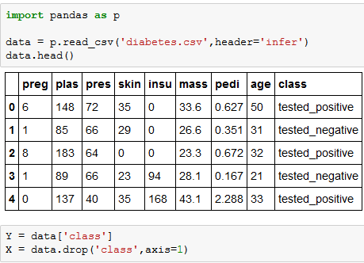
Example: Decision Tree Classification
Load the data
Extract the predictor and target variables

Slide 31
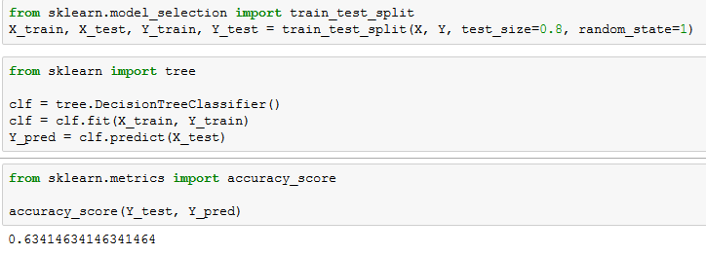
Example: Decision Tree Classification
Split the data into 20% training and 80% testing
Build the decision tree model and apply it to the test data
Evaluate accuracy of the model on the test data

Slide 32
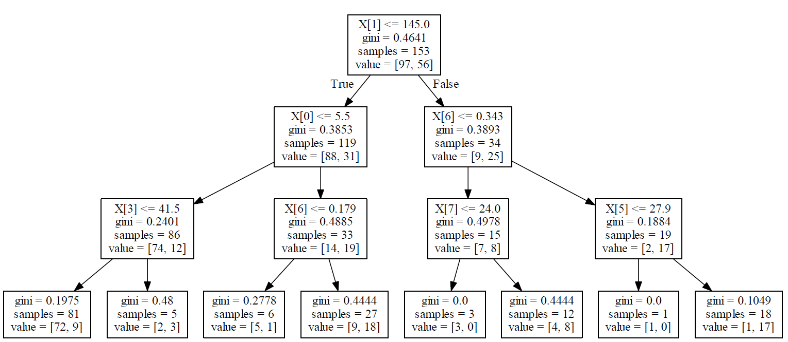
Example: Decision Tree Classification

Slide 33
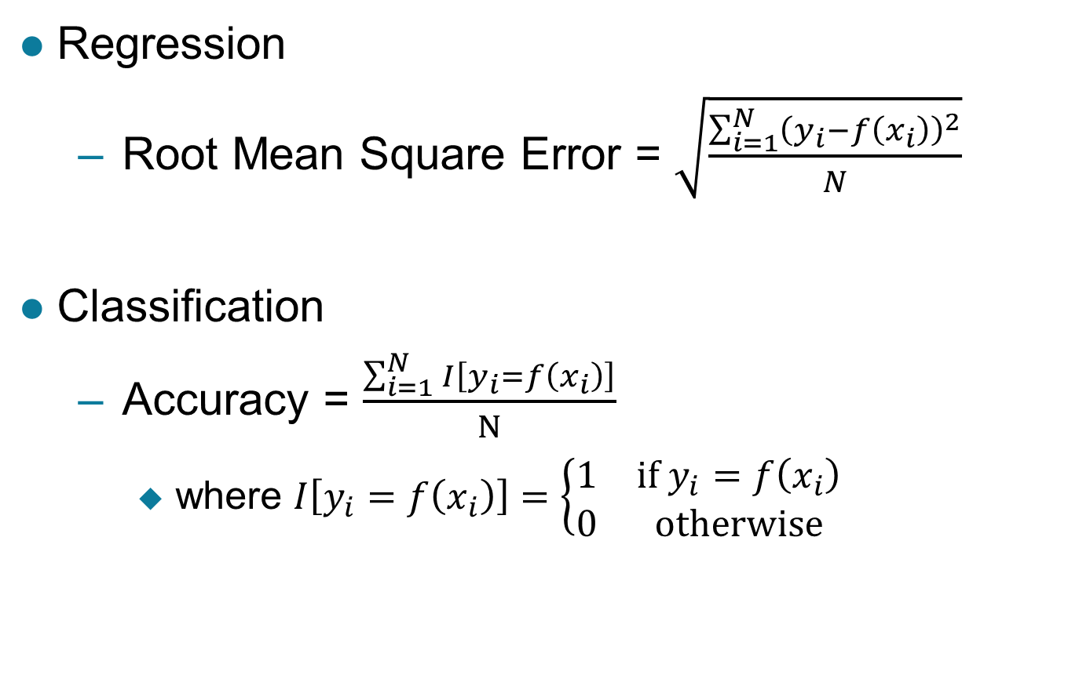
Model Evaluation
Regression
Root Mean Square Error = $\sqrt{\frac{\sum_{i=1}^{N}{{\left(y_{i}−f\left(x_{i}\right)\right)}^{2}}}{N}}$
Classification
Accuracy = $\frac{\sum_{i=1}^{N}{I\left[y_{i}=f\left(x_{i}\right)\right]}}{N}$
where $I\left[y_{i}=f\left(x_{i}\right)\right]=\left\{\begin{matrix}1 & if y_{i}=f\left(x_{i}\right) \\ 0 & otherwise\end{matrix}\right.$
Indicator function

Slide 34
Model Evaluation
Accuracy is not suitable for imbalanced classes
If 90% of the data belongs to only 1 class, then a classifier that predicts every example to be in the majority class will be 90% accurate even if we’re more interested in predicting the rare class
Examples: intrusion/cyberthreat detection, disease prediction, fraud detection, earthquake prediction, etc
Alternative measures are needed
F-measure
Area under ROC curve

Slide 35
Alternative Measures for Classification
Confusion matrix:
 | PREDICTED CLASS
ACTUAL CLASS |  | Class = + | Class = -
 | Class = + | 0 | 10
 | Class = - | 90 | 900
Accuracy = 90% (but you misclassify all the positive classes)
Assume minority class as positive class (i.e., the class you’re more interested in predicting correctly):

Slide 36
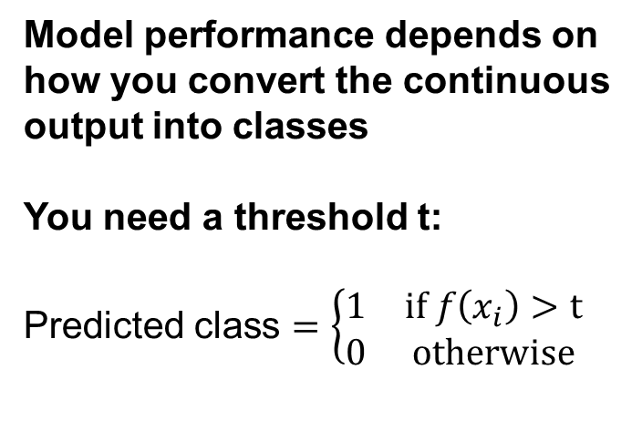
ROC Curve
Many classifiers produce continuous-valued output predictions (e.g., linear and probabilistic classifiers)
y | f(x)
1 | 2.1
1 | 1.5
0 | 0.4
0 | 0.9
0 | 0.7
1 | 0.3
0 | -2.3
Model performance depends on how you convert the continuous output into classes
You need a threshold t:
Predicted class $=\left\{\begin{matrix}1 & if f\left(x_{i}\right)>t \\ 0 & otherwise\end{matrix}\right.$

Slide 37
ROC Curve
Many classifiers produce continuous-valued output predictions (e.g., linear and probabilistic classifiers)
y | f(x)
1 | 2.1
1 | 1.5
0 | 0.4
0 | 0.9
0 | 0.7
1 | 0.3
0 | -2.3
If t = 0:
 | PREDICTED CLASS
ACTUAL CLASS |  | Class = 1 | Class = 0
 | Class = 1 | 3 | 0
 | Class = 0 | 3 | 1
Accuracy = 4/7
TPR = 3/3 = 1
FPR = 3/4 = 0.75

Slide 38
ROC Curve
Many classifiers produce continuous-valued output predictions (e.g., linear and probabilistic classifiers)
y | f(x)
1 | 2.1
1 | 1.5
0 | 0.4
0 | 0.9
0 | 0.7
1 | 0.3
0 | -2.3
If t = 0.5:
 | PREDICTED CLASS
ACTUAL CLASS |  | Class = 1 | Class = 0
 | Class = 1 | 2 | 1
 | Class = 0 | 2 | 2
Accuracy = 4/7
TPR = 2/3 = 0.67
FPR = 2/4 = 0.5

Slide 39
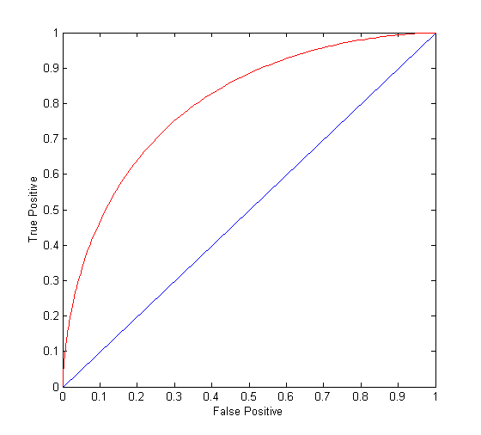
ROC Curve
(TPR,FPR):
(0,0): predict everything to be negative class
(1,1): predict everything to be positive class
(1,0): ideal
Diagonal line:
Random guessing
Below diagonal line:
prediction is opposite of the true class
Area Under ROC curve (AUC)

Slide 40
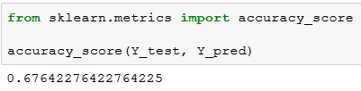
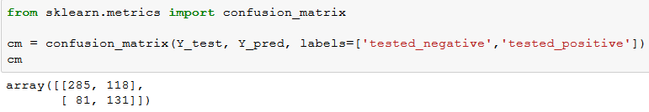
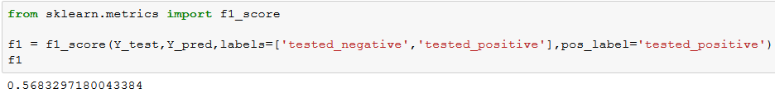
Python Example (sklearn.metrics)

Slide 41
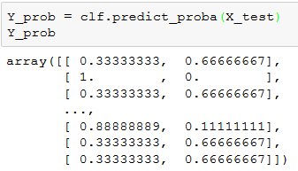
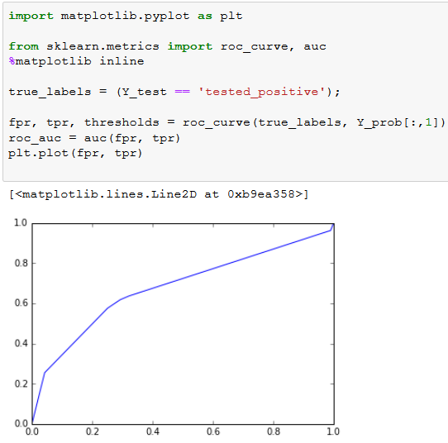
Python Example (sklearn.metrics)

Slide 42
Training and Test Set Creation
Holdout Method
Reserve k% for training and (100-k)% for testing
Limitation: evaluation result may vary depending on how you split the data into training/test sets
Data
Training
k%
Testing
100% - k%

Slide 43
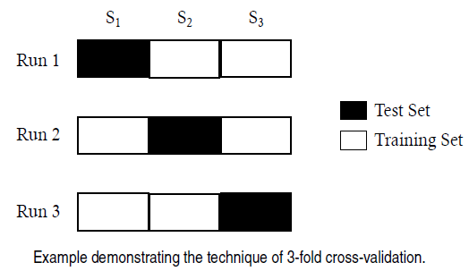
Training and Test Set Creation
Cross validation
Partition the data into k disjoint subsets
k-fold: train on k-1 partitions, test on remaining one
Leave-one-out: k=n

Slide 44
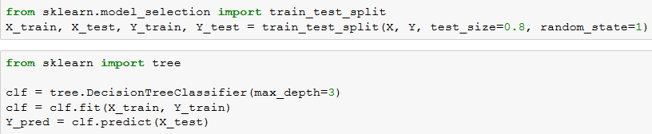
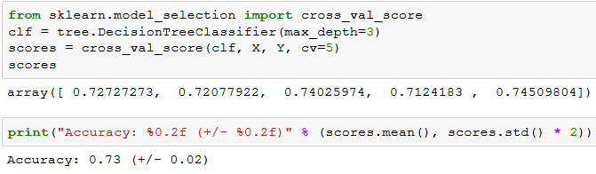
Example (sklearn.model_selection)
Holdout method:
5-fold cross validation method:

