Slide 1
How AI is Transforming the U.S. Public Accounting Industry
Sean Doyle, AI in Economics, 12/4/2025
Study done on the Public Accounting Industry and AI’s Impact on Worker’s.

Slide 2
Personal Motivation
I am looking to pursue a career in the public accounting industry. I plan on getting my CPA license in the future. With the developments in AI recently, I was curious how AI will impact the public accounting industry in the future.

Slide 3
Industry Overview (NAICS 5412)
The U.S. public accounting industry encompasses audit, tax preparation, consulting, and general assurance and advisory services.
Major players include the Big 4 Accounting Firms: (Deloitte, EY, PwC, KPMG).
  Hold dominant share of audit revenue and large presence in advisory + tech-related service lines
This industry employs over 1.3 million workers in the US, annual GDP of $1.316 (2024).

Slide 4
Stage of Industry: Mature + Disrupted
Mature Industry: Stable but low-growth audit market; inelastic demand due to regulation.
Disruptive Elements: stable demand, constrained labor supply, and increasing reliance on innovation.
AI pressures have resulted in increased investments to offset structural pressures

Slide 5
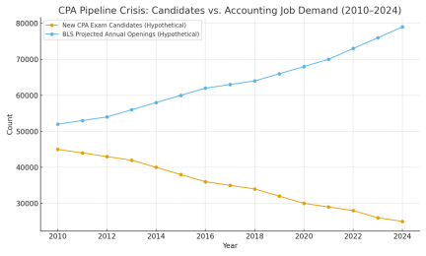
Labor Supply Visualization
Demand estimates for CPA’s continues to rise while new CPA Candidates continues to fall.

Slide 6
GenAI Effects on Workers
Routine audit tasks automated: reconciliation, vouching, document review.
AI increases demand for analytics, advisory, and system-integration skills.
Entry-level and early-career jobs now face different tasks and skills.

Slide 7
GenAI Effects on Firms
Automation leads to lower marginal costs and speeds testing.
Large firms benefit from high costs of AI -> widens the gap between large firms from everyone else.
Risks: audit opacity, bias, cybersecurity, compliance challenges.

Slide 8
Opportunities & New Frontiers
Productivity gains shift human labor toward analytical and judgment-intensive tasks.
Advisory and analytics service lines expanding.
AI-first accounting startups entering the market.

Slide 9
Personal Path & Upskilling Plan
Target roles: audit associate, financial analyst, controller roles.
Skills: Excel, SQL, Python, GAAP knowledge, AI-assisted audit platforms.
Steps: courses, certifications, portfolio projects, networking.

Slide 10
Reflection & Takeaways
AI's effects are uneven but transformative across workers and firms.
Learned how labor shortages and tech adoption interact in mature industries.
Research expanded my sense of possible career paths in AI + accounting.

