Slide 1
Data Driven Automated Algorithmic Trading
A Bachelor Thesis Presentation on
Submitted to the Malta College of Arts, Science, and Technology
By Gabriel Gauci Maistre

Slide 2
Introduction
The market has become highly efficient
Investors are forced to look for other alternatives
High profile firms are investing in data scientists
In theory it is impossible to beat the market

Slide 3
Rational of the Study
Disproving Random Walk Hypothesis (RWH) and Efficient Market Hypothesis (EMH)

Slide 4
Objective of the Study
Testing three forecasting techniques
Time series analysis
Machine learning
Bayesian inference
Building an algorithm to trade stocks using machine learning

Slide 5
Hypothesis
The market does not follow the Random Walk Hypothesis (RWH)
The market is inefficient

Slide 6
Research Methodology
The universe selected for the study is the US market
The target population for this study is a data set of 3000 equities

Slide 7
Data Analysis & Interpretation
The pairwise correlation coefficient was calculated
Only stocks which were neutrally correlated were used in the study

Slide 8
Hypothesis Testing
“The market does not follow a random walk”

Slide 9
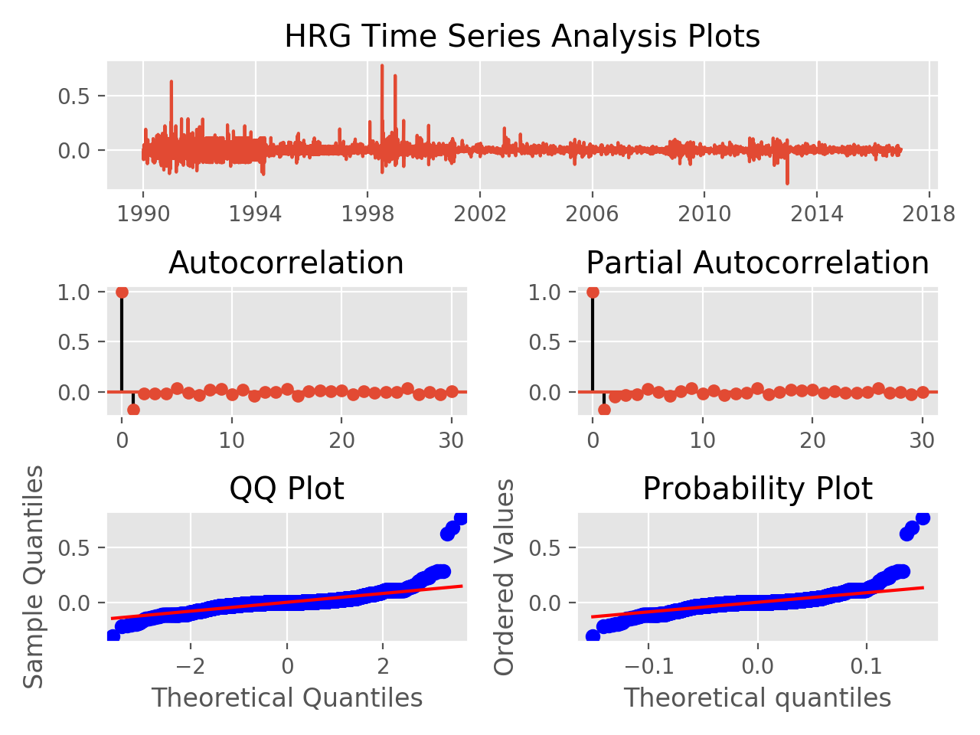
Result of Correlation Test
Since significant auto and partial correlation can be found, the hypothesis “the market does not follow a random walk” was supported.

Slide 10
Hypothesis Testing
“The markets are not efficient”

Slide 11
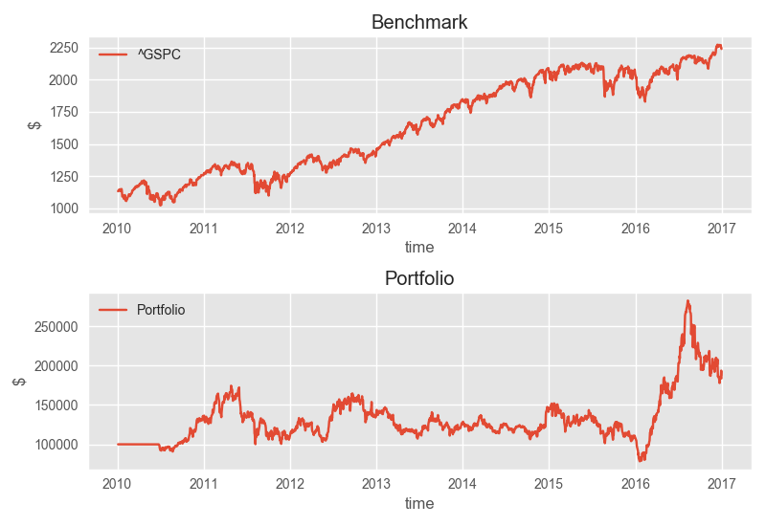
Result of Algorithmic Trading
Since the algorithm did not manage to beat the market, the hypothesis “the markets are not efficient” was not supported.

Slide 12
Findings
Time series analysis is a weak factor in forecasting financial stocks
Bayesian statistics is a strong contender as a fore- casting method
Machine learning was found to be the best method of forecasting using both classification and regression methods
Regression methods of machine learning to fair better than classification methods when implemented and backtested

Slide 13
Conclusion
Machine learning methods were successful in forecasting future prices
Regression faired better over classification
Algorithm failed in forecasting price falls
Stop losses were successful in ensuring

Slide 14
Suggestions
Fundamental analysis could be incorporated into the study
Deep learning methods could be explored
Higher frequency data could be tested
Sentiment analysis could make a significant difference

Slide 15
Thank you!

