Slide 1
Data Driven Automated Algorithmic Trading
A Bachelor Thesis Presentation on
Submitted to the Malta College of Arts,
Science, and Technology
By Gabriel Gauci Maistre

Slide 2
Introduction
The market has become highly efficient
Investors are forced to look for other alternatives
High profile firms are investing in data scientists
In theory it is impossible to beat the market

Slide 3
Rational of the Study
Using data science and algorithmic trading to invest in stocks
Beating the market by making a larger profit

Slide 4
Objective of the Study
Testing three forecasting techniques
Time series analysis
Machine learning
Bayesian inference
Building an algorithm to trade stocks using the best technique

Slide 5
Hypothesis
The market does not follow the Random Walk Hypothesis (RWH)
The market is inefficient

Slide 6
Previous Work
Radha et al. used ARMA and ARIMA models to forecast short-term interest rates
Darrat et al. used time series analysis to test the random walk hypothesis
Kumar et al. used classification models to predict market movement
Creamer et al. developed a trading algorithm using machine learning
Hoffman et al. introduced the NUTS model, an improvement to the HMC model

Slide 7
Research Methodology
The universe selected for the study is the US market
The target population for this study is a data set of 3000 equities
Stock data ranged from 1990-2017
Trading algorithm was backested over the period 2010-2017

Slide 8
Data Analysis & Interpretation
The pairwise correlation coefficient was calculated
Only stocks which were neutrally correlated were used in the study
Logarithmic returns were calculated for time series analysis and Bayesian inference
15 and 50 day simple moving averages were calculated for forecasting

Slide 9
Hypothesis Testing
“The market does not follow a random walk”

Slide 10
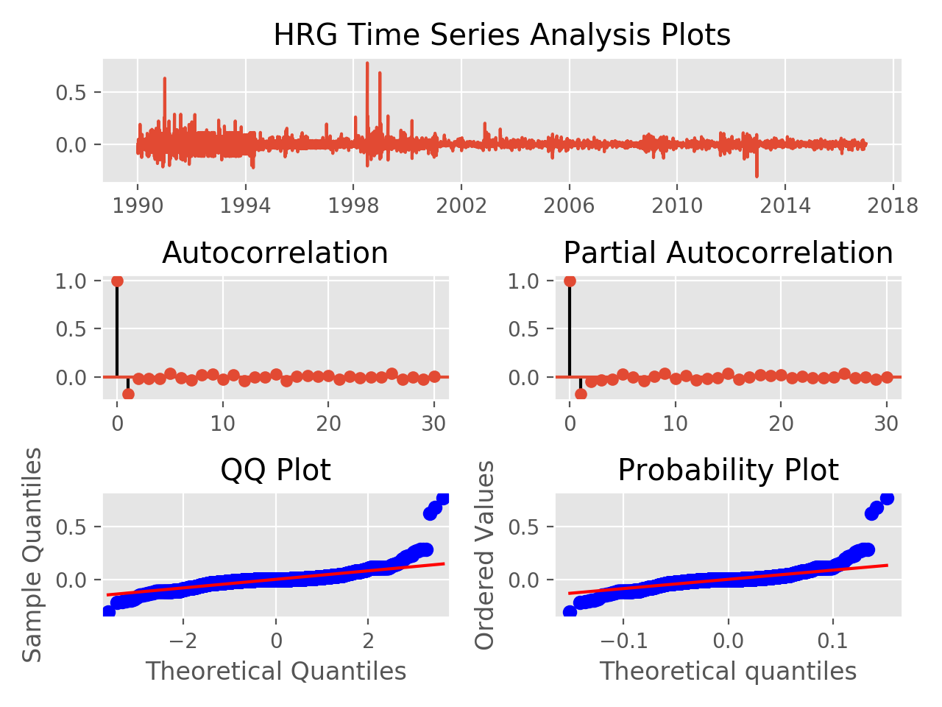
Result of Correlation Test
Since significant auto and partial correlation can be found, the hypothesis “the market does not follow a random walk” was supported.

Slide 11
Hypothesis Testing
“The market is not efficient”

Slide 12
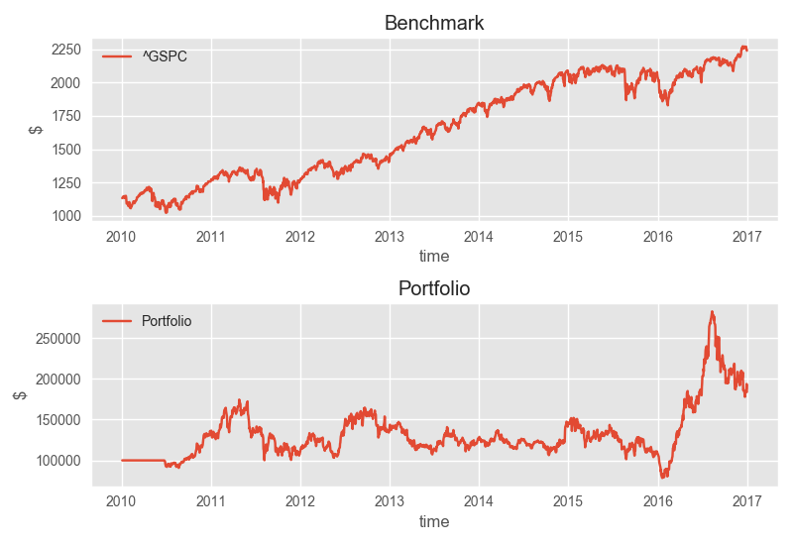
Result of Algorithmic Trading
Since the algorithm did not manage to beat the market, the hypothesis “the markets are not efficient” was not supported.

Slide 13
Findings
Time series analysis is a weak factor in forecasting financial stocks
Bayesian inference is a strong contender as a forecasting method
Machine learning is the best method of forecasting using both classification and regression methods
Regression methods of machine learning fair better than classification methods when implemented and backtested

Slide 14
Conclusion
Machine learning methods were successful in forecasting future prices
Regression faired better over classification
Algorithm failed in forecasting price falls
Stop losses were successful in limiting downfalls

Slide 15
Suggestions
Fundamental analysis could be incorporated into the study
Deep learning methods could be explored
Higher frequency data could be tested
Sentiment analysis could make a significant difference

Slide 16
Thank you!

