Slide 1
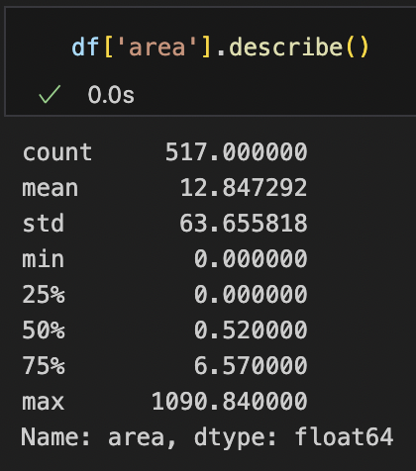
Dataset
517 instances
Area is continuous
Model of choice: linear regression
Notes:
Linear regression: limited data instances; continuous

Slide 2
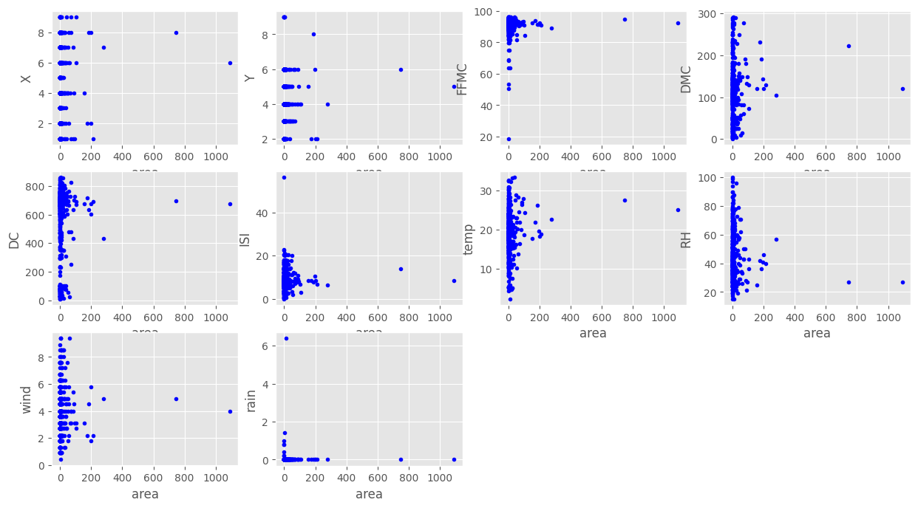
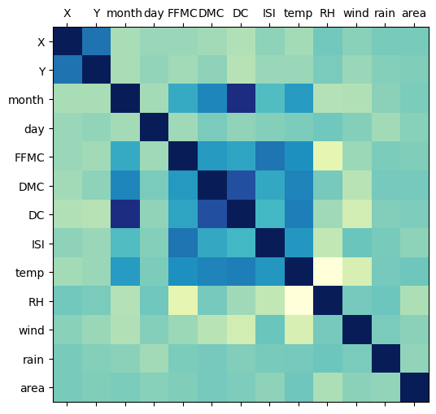
Data Preprocessing
Notes:
Observations: weak correlation between features; sparse values

Slide 3
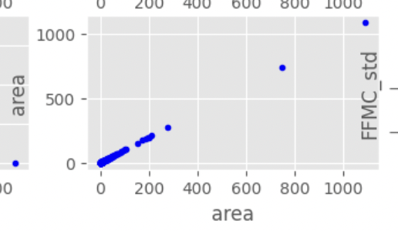
Data Preprocessing
Normalising ISI, FFMC, rain:
Set upper/lower limit to sparse values
Z-normalisation
Normalising area:
area = log(area + 1)
271 instances have area=0

Slide 4
Model
Logistic regression
Area > 0
sklearn RidgeRegression
Linear kernel
Ridge regression
Data
Area = 0
Evaluation
Notes:
271 out of 517 instances have area == 0

Slide 5
Model
Logistic regression
Area > 0
sklearn RidgeRegression
R²: 0.0204
MSE: 2.1577
R² w/kernel: 0.0238
MSE w/kernel: 2.1511
Linear kernel
Ridge regression
Data
Area = 0
Evaluation

Slide 6
Model
Logistic regression
Area > 0
sklearn RidgeRegression
Accuracy: 0.5384
R²: 0.4748
MSE: 1.2545
Linear kernel
Ridge regression
Data
Area = 0
Evaluation
R²: 0.2367
MSE: 1.6905
Notes:
271 out of 517 instances have area == 0

