Slide 1
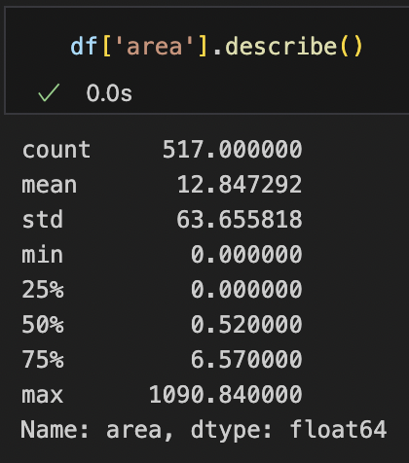
Dataset
517 instances
Area is continuous
Model of choice: linear regression
Notes:
Linear regression: limited data instances; continuous

Slide 2
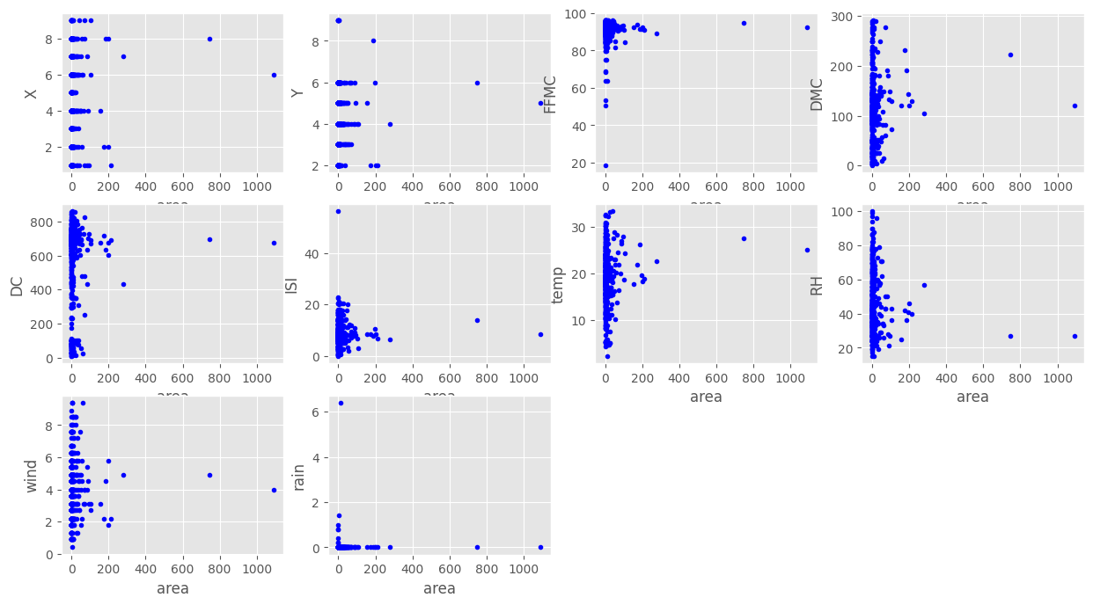
Data Preprocessing

Slide 3
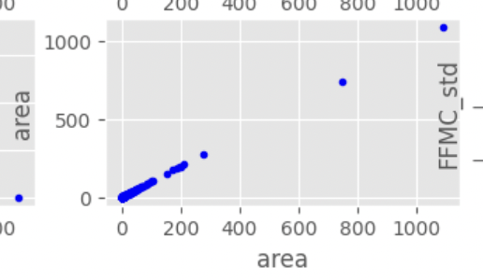
Data Preprocessing
Normalising ISI, FFMC, rain:
Set upper/lower limit to sparse values
Z-normalisation
Normalising area:
area = log(area + 1)
0: 271 instances

Slide 4
Model
Logistic regression
Area > 0
sklearn RidgeRegression
Linear kernel
Ridge regression
Data
Area = 0
Evaluation
Notes:
271 out of 517 instances have area == 0

Slide 5
Model
Logistic regression
Area > 0
sklearn RidgeRegression
R^2: 0.0183
R^2 w/kernel: 0.0213
Linear kernel
Ridge regression
Data
Area = 0
Evaluation

Slide 6
Model
Logistic regression
Area > 0
sklearn RidgeRegression
Accuracy: 0.5673
R^2: 0.4470
Linear kernel
Ridge regression
Data
Area = 0
Evaluation
R^2: 0.1570
Notes:
271 out of 517 instances have area == 0

