Slide 1
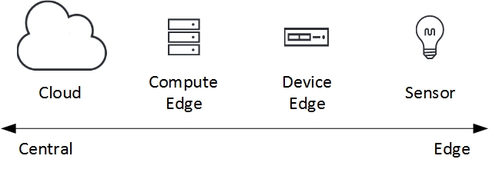

What's TinyML & Why? (1/2)
Edge computing is trying to solve:
Privacy
Bandwidth
Latency
Reliability
Power consumption
Traditionally, ML training is happening on Cloud.
Recently, ML inference is happening on Edge.
Today, ML is emerging on Sensor device.
more than 90% of IoT sensor data is not efficiently used.
Running ML inference on sensor devices at the deepest IoT edge
Notes:
2/19/2020

Slide 2
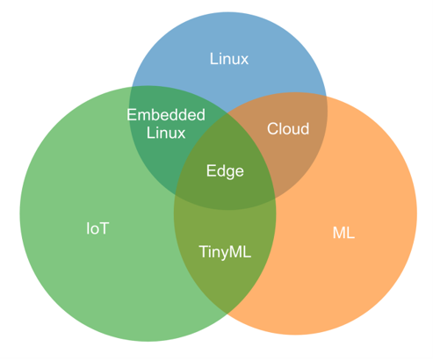
What's TinyML & Why? (2/2)
TinyML is intersection of
IoT && ML && constrained devices.
  Real Time OSes on microcontrollers.
  Heterogeneous IoT devices against homogeneous Cloud / Edge environment.
  DNN cannot fit easily at all.
TinyML
TinyML can solve Edge problems with​
run ML inference on sensor​
process raw sensor data locally​
send processed metadata, instead​
TX consumes more energy than computation.

Slide 3
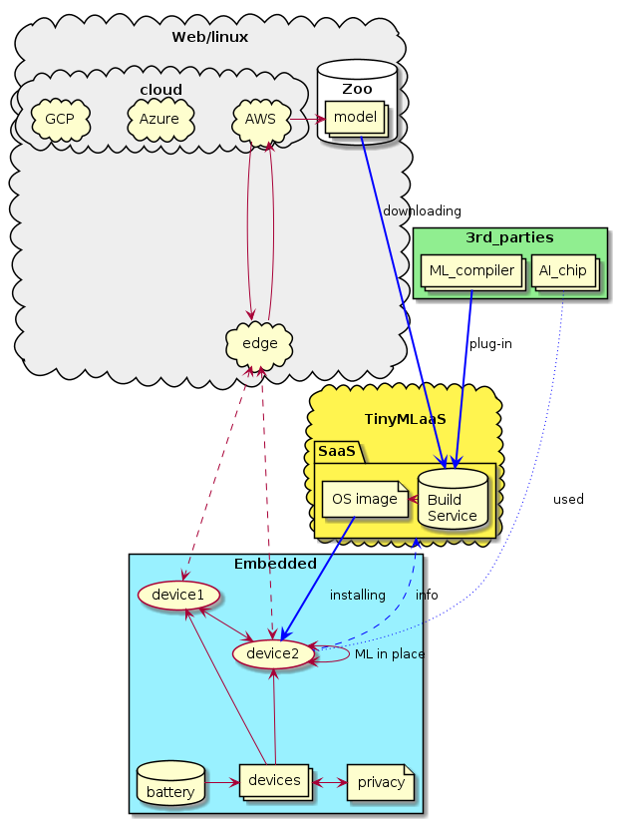
What's TinyML as-a-Service?
"Enable end customers to manage lifecycle of fleet of TinyML enabled devices"
Steps:
  Build TinyML models with various ML compilers
  Orchestrate TinyML onto heterogeneous devices
Benefits:
  Make use of E/// IoT infra (e.g. connectivity / LwM2M)
Ecosystem with partners:
  AI chip vendors
  ML compiler vendors
  Device manufactures
  Service providers / CSP
Notes:
2/19/2020

Slide 4
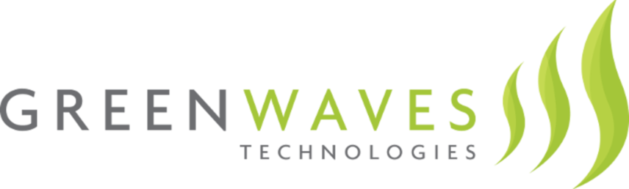





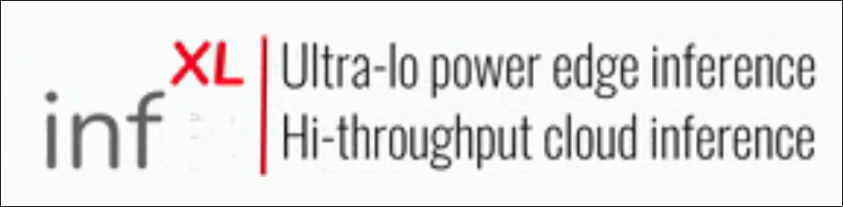



Partners for TinyMLaaS ecosystem
Collaborating for research demo with:
Potential partners (wishlist)
IoT AI chip vendor. They sell ultra-low-power AI microcontrollers. Demo collaboration.
ML compiler vendor. They support any hardware accelerators. Demo collaboration.
ML compiler vendor. They supports mainly low end MCUs. Evaluating.
AI FPGA / ASIC vendor, ultra-low-bit quantization on FPGA. Evaluating.
Notes:
2/19/2020

Slide 5
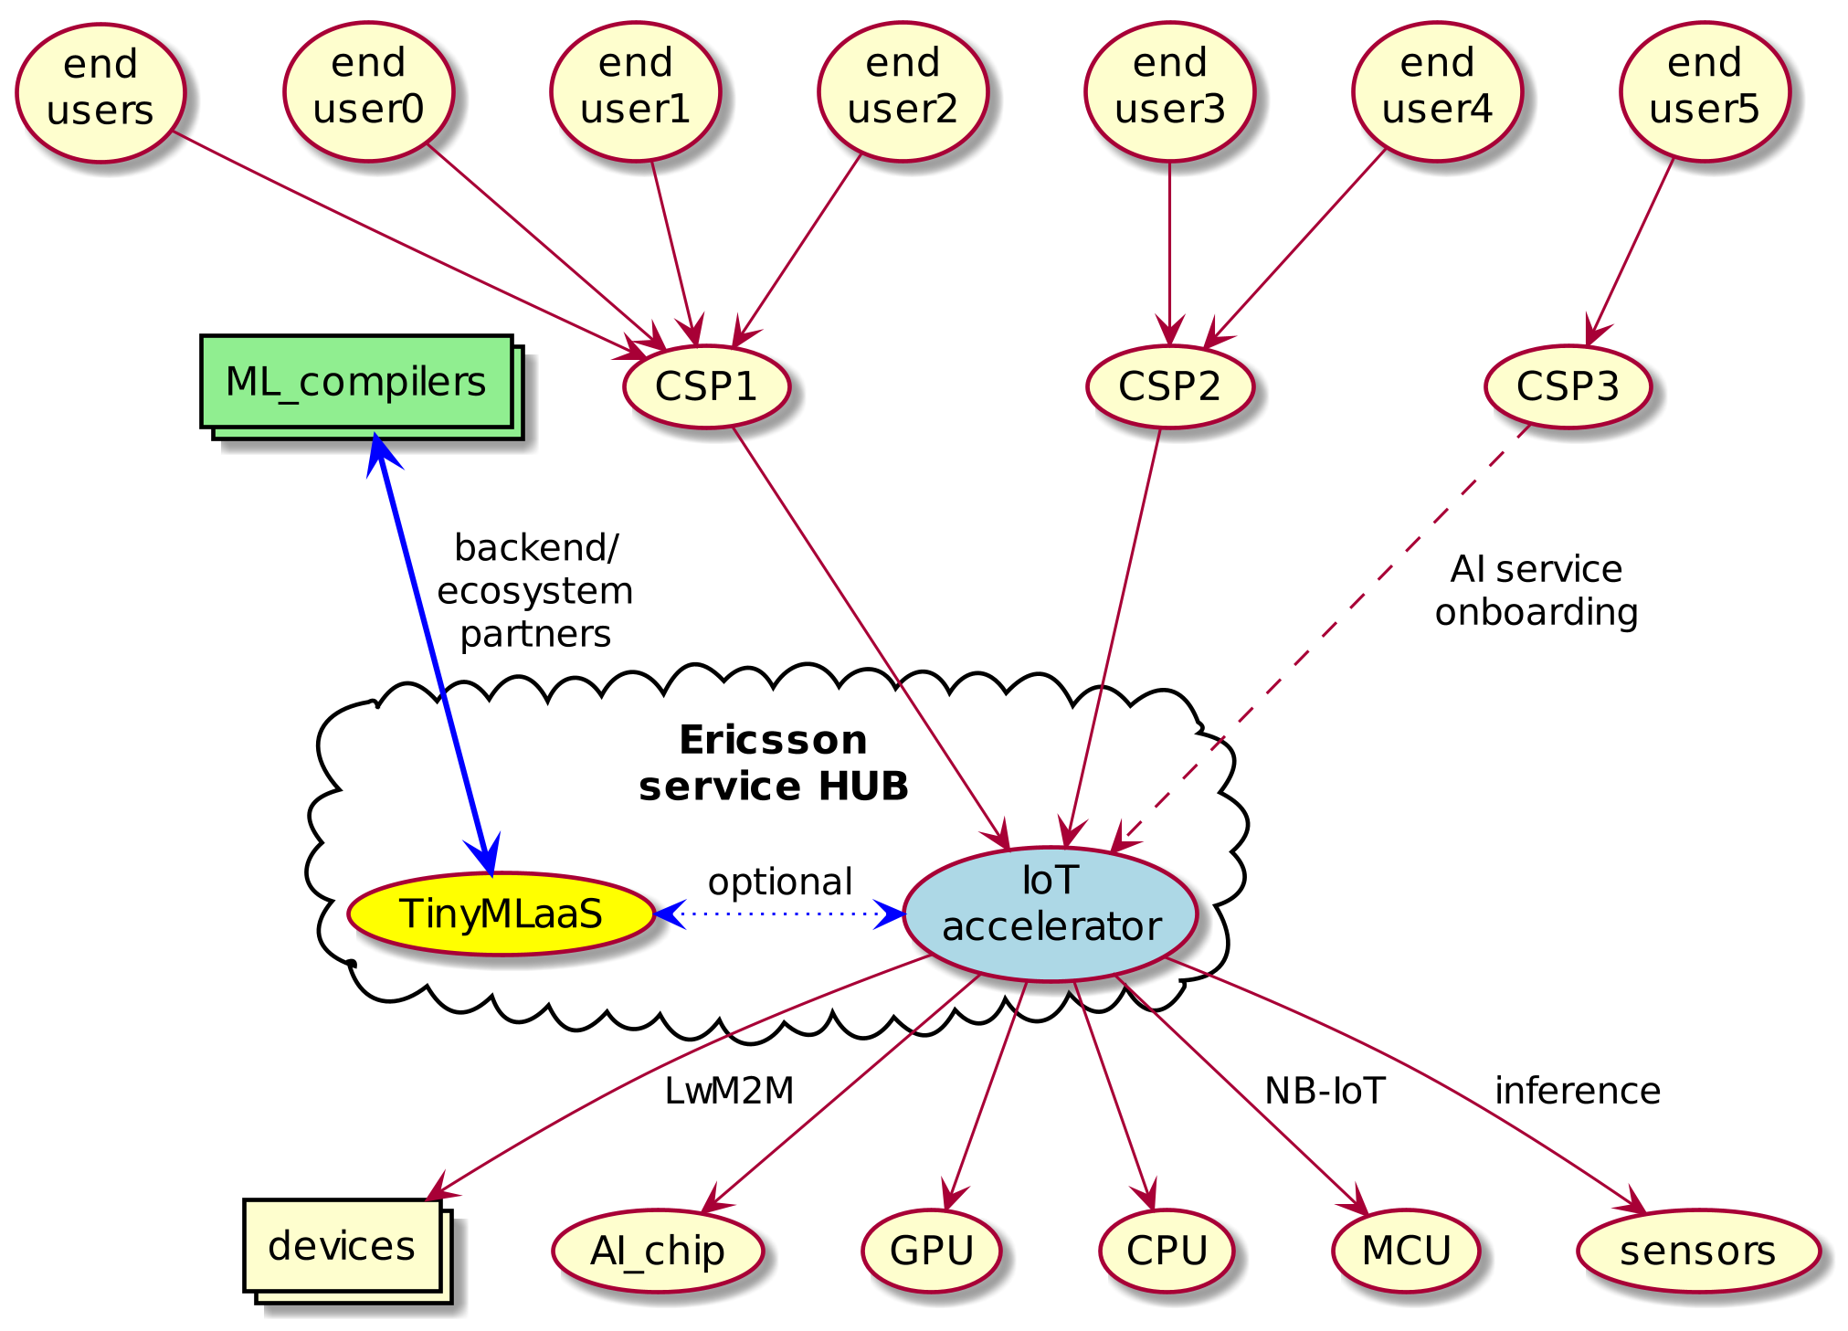
Our Goal
HW heterogeneity
E/// can help AI service providers with heterogeneous IoT devices.
Notes:
2/19/2020
CSP == AI service provides

