Slide 1
Network Intrusion detection
B411001 강도연

Slide 2
Introduction
02
Data & Preprocessing
01
Explanation on the subject
Dataset explanation
Preprocess
Model
04
Results
03
Brief model explanation
Accuracy
Evaluation
05
Implementation
CONTENTS

Slide 3
Introduction

Slide 4
Introduction
Problem:
- Big data becoming popular
- As data amount increases, the traffic will increase
- Networks are still Vulnerable
Solution:
- Make the alert system to notice the DNS intrusion

Slide 5
Data & Preprocessing

Slide 6
Dataset
1. Data with Intrusion
2. Data with DNS network traffic
Class: 2
- Normal
- Anomalous
Data: 25192
- Train data: 17634
- Test data: 7558
Features: 41
Class: 4
- Benign traffic
- Malicious DoH traffic sent using dns2tcp
- Malicious DoH traffic sent using dnscat2.
- Malicious DoH traffic sent using iodine.
Data: 540216
- Train data: 17634
- Test data: 7558
Features: 35

Slide 7
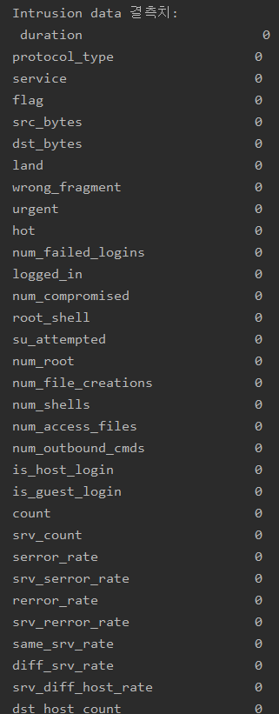
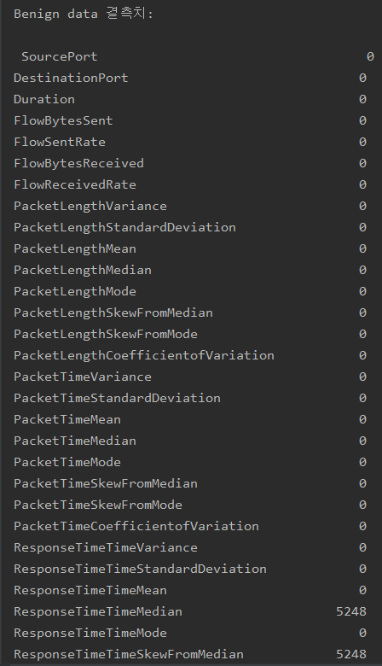




Preprocessing (Missing values)
Intrusion data
Traffic data

Slide 8
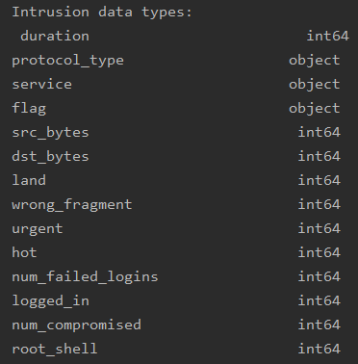
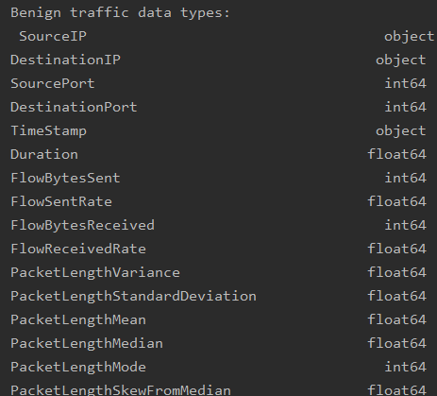
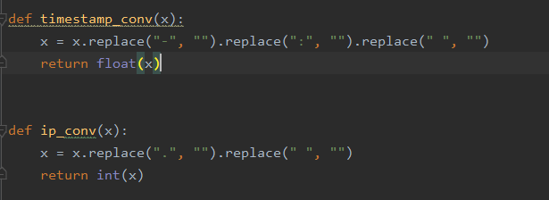
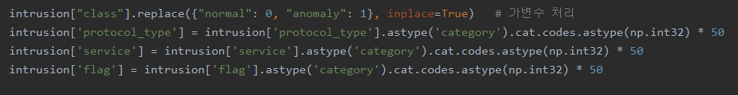
Preprocessing (Dummy variable)
Intrusion data
Traffic data
Class:
- Normal: 0
- Anomalous: 1
Protocol type:
- categorization
Service:
- categorization
Flag:
- categorization
Class:
- Benign traffic: 0
- Malicious DoH traffic sent using dns2tcp: 1
- Malicious DoH traffic sent using dnscat2: 2
- Malicious DoH traffic sent using iodine: 3
Time Stamp:
- remove all non numerical symbols
Destination IP:
- remove all non numerical symbols
Source IP:
- remove all non numerical symbols

Slide 9
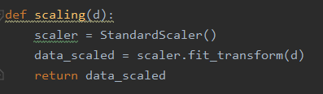
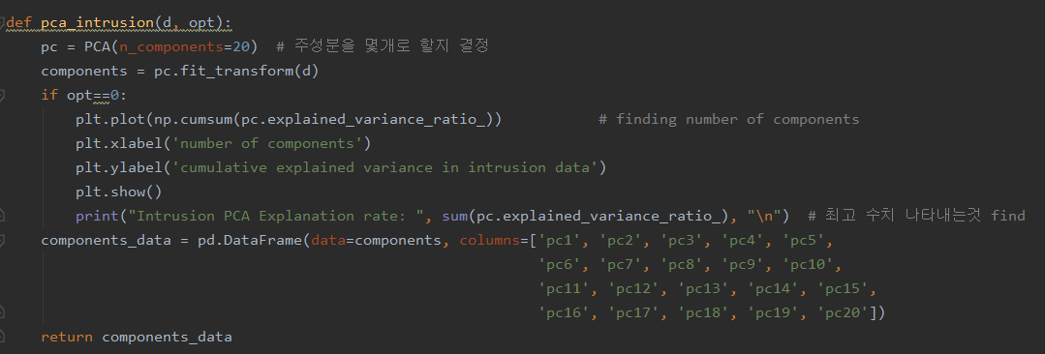
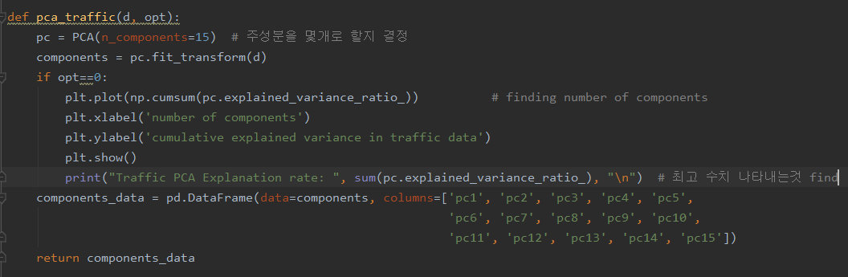
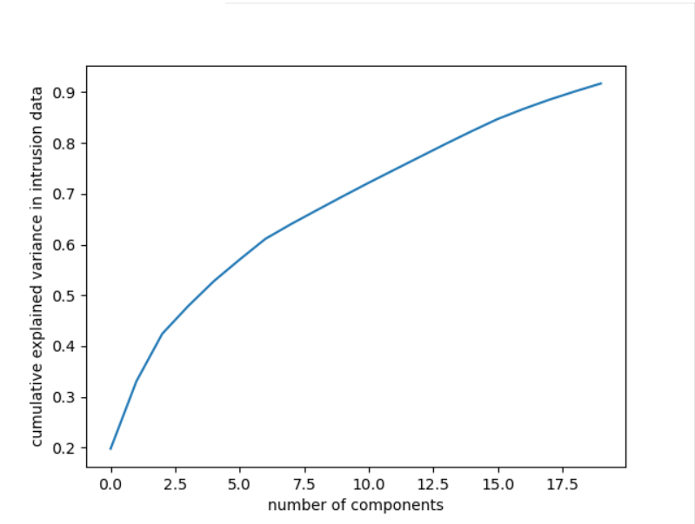
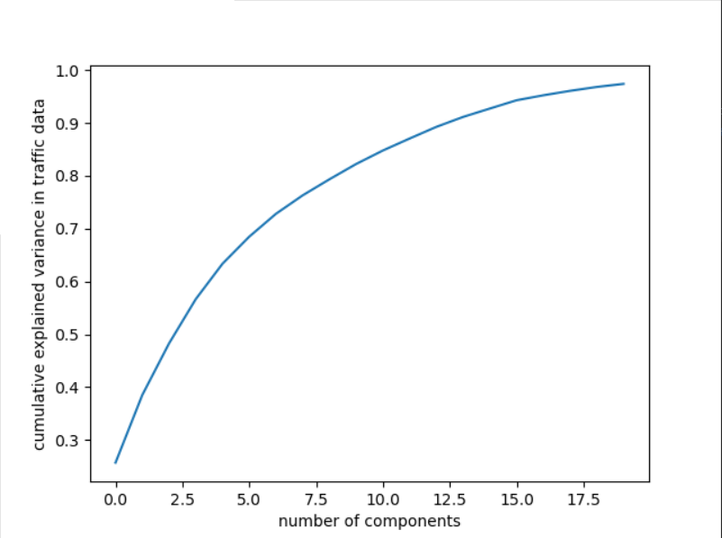
Preprocessing (Feature scaling & PCA)
Intrusion data
Traffic data

Slide 10
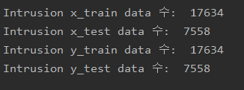
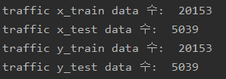
Preprocessing (Train & Test data split)
Intrusion data
Traffic data

Slide 11
Model

Slide 12
Model (Experiment flow)
Aim for diversity
- Random Forest
- Logistic Regression
- XGBoosting
- SVM
2. Comparison between two ensemble models
- Voting(soft)
- Stacking

Slide 13
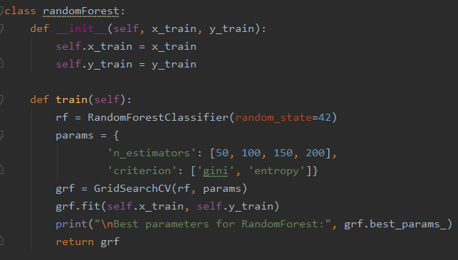
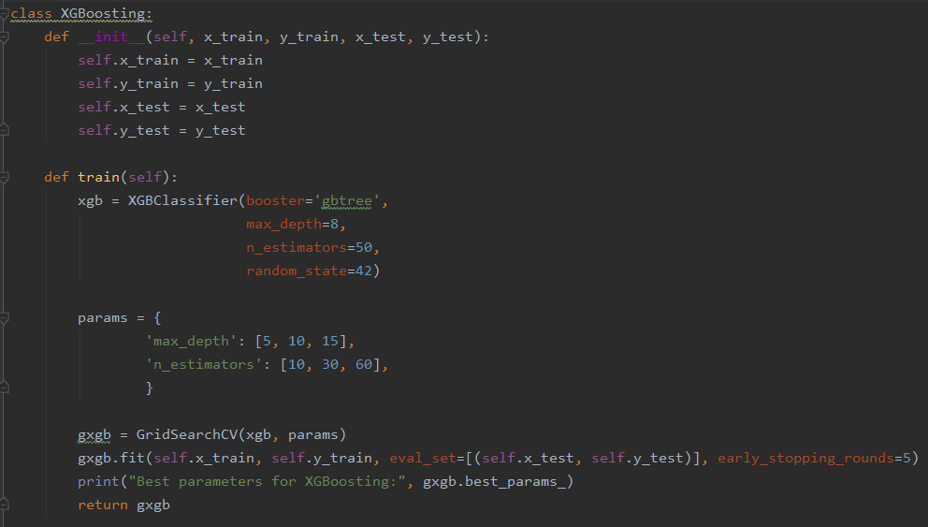
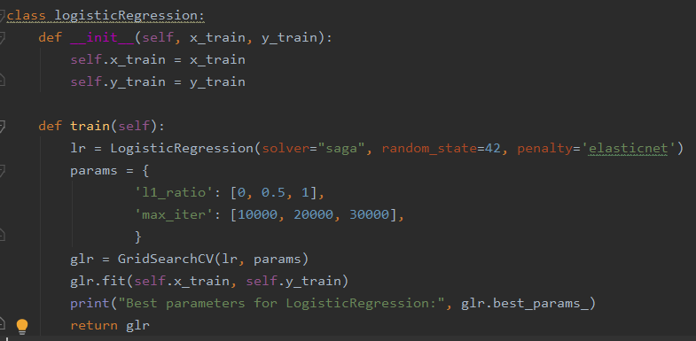
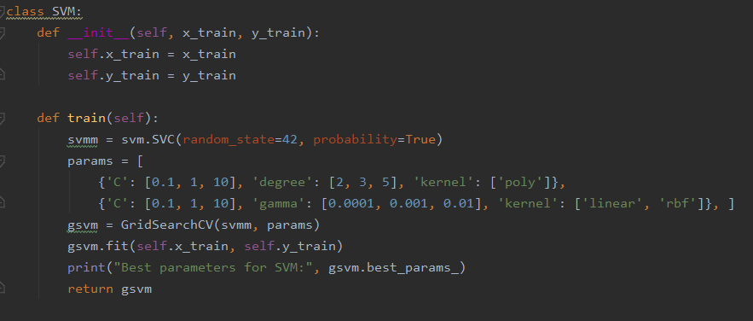
Model (Base models with GridSearch)
Base Models
Random Forest
- parameter controlled:
i) n_estimators
ii) criterion
2) Logistic Regression
- parameter controlled:
i) L1, L2, elasticnet
ii) max_iter
3) XGBoosting
- parameter controlled:
i) max_depth
ii) n_estomators
4) SVM
- parameter controlled:
i) C
ii) degree
iii) gamma
iiii) kernel

Slide 14
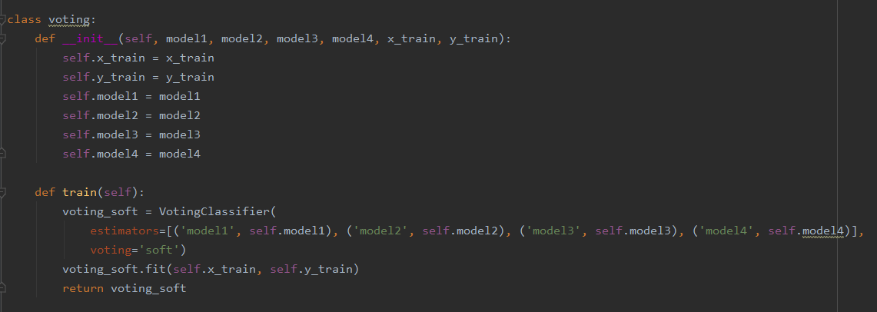
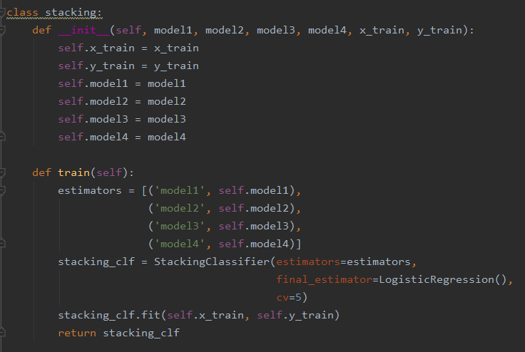
Model (Two ensemble models to compare)
Voting(soft)
Stacking(cv)
- Final estimator: Logistic regression
- CV: 5

Slide 15
Results

Slide 16
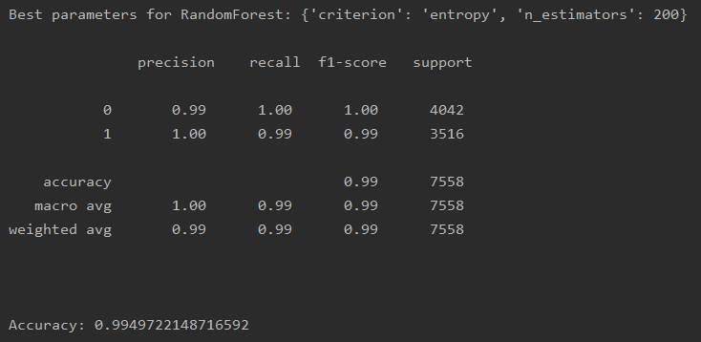
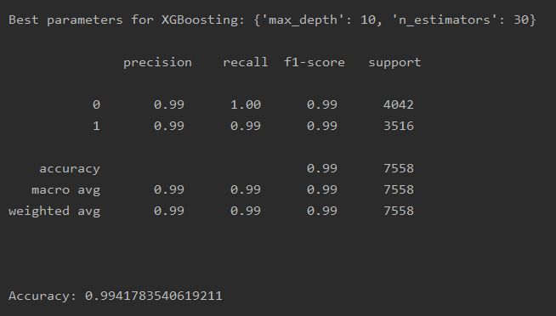
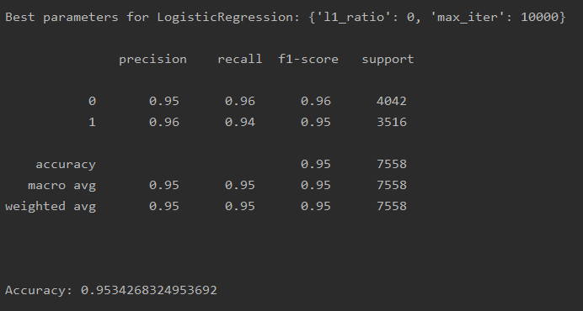
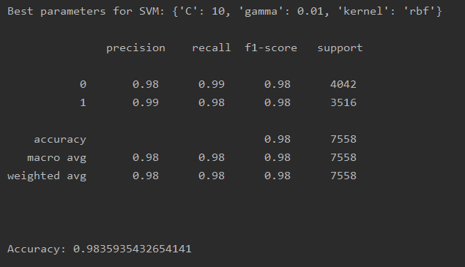
Accuracy (Base models)
1. Random Forest
3. XGBoosting
2. Logistic Regression
4. SVM

Slide 17
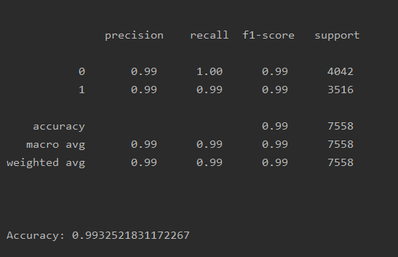
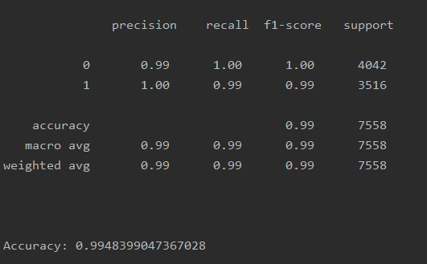
Accuracy (Two ensemble models to compare)
1. Voting(soft)
2. Stacking(cv)
* Stacking gained slightly higher accuracy than the Voting

Slide 18
Implementation

Slide 19
Implementation (Test data)
Test data
- Concatenate the two separate data for overall prediction
Predicted class(5)
1) Network Normal state
2) Network Intrusion state but not with DNS
3) Network Intrusion state, malicious DoH traffic sent using dns2tcp
4) Network Intrusion state, malicious DoH traffic sent using dnscat2
5) Network Intrusion state, malicious DoH traffic sent using iodine

Slide 20
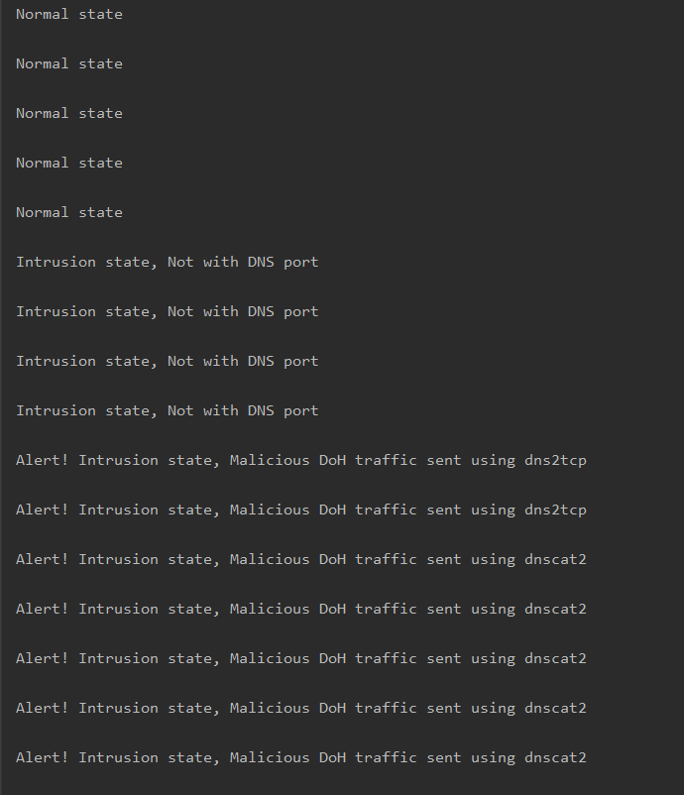
Implementation (Results)

Slide 21
Inference
Dataset:
https://www.kaggle.com/sampadab17/network-intrusion-detection
https://www.kaggle.com/peterfriedrich1/dns-test-traffic-dohbrw2020?select=malic-csvs
Sklearn, Stacking:
https://scikit-learn.org/stable/modules/generated/sklearn.ensemble.StackingClassifier.html
Dummy variable:
https://devuna.tistory.com/67

Slide 22
THANK YOU

