Slide 1
Gender shades
Intersectional Accuracy Disparities in Commercial Gender Classification
Authors of the article: Joy Buolamwini, Timnit Gebru

Slide 2
Overview
Commercial algorithms discriminate based on gender and race
Benchmark datasets overwhelmingly polarised
Relabelling of datasets using Fitzpatrick Skin Type Classification System
An additional dataset – more representative
Evaluate three commercial systems
Inspect error rates and discover large intersectional error rates
Notes:
First, we give a short overview of what the article is about, and also what we will be taking a closer look at:
That is, the fact that commercial algorithms discriminate based on ones persons gender and race, as well as that the benchmark datasets used by these algorithms, and many others, are hardly balanced at all. They show this by relabelling the datasets according to the Fitzpatrick system, which showcases this imbalance, and introduce a new dataset which is more representative. Further, they evaluate a set of three commercial face recognition algorithms, and discover that the error rate is much larger for woman of colour.

Slide 3
Current state of affairs
Commercial facial recognition: IBM, Microsoft, Face++, Google
Clients: government
Other research:
identifying emotions,
helping people with autism
determining sexuality of Caucasian males from photos from Facebook and dating sites
determining individuals characteristics( IQ, terrorism, prone to criminal actions)
Notes:
As of now, the most common commercial software in use when it comes to facial recognition are from IBM, Microsoft, Face++, which is a computer vision company headquartered in China, and Google.
These solutions are used in both electronical devices, like your phone as everyone knows, but also in other situations related to more serious aspects of ones life, like credit evaluation, or as group 7 mentioned last Monday, for evaluating someones risk of becoming a criminal, or whether they should be released from prison and such and such.
The problem arises when there are issues with accuracy when it comes to gender, race and age groups.
To properly train the algorithms we need datasets that are properly labelled and have proper representation of ethnical/racial groups.
An example that was considered was that of the report from the National institute of standards and technology, who explored the impact of ethnicity on gender classification. They used country of origin as a proxy, the issue however was that none of the the 10 countries were from Carribean or Africa – where the majority of the population are of darker skin color. Whether an oversight or a product of the lack of representative data sets, it is nonetheless problematic, considering the goal of the study, even though the point is conveyed, and improper classification and the lack of representation is identified, although one can argue on what basis.
Continuing along this line, another one of the papers referred to had concluded ethnicity does not have impact on gender classification, on the basis of using binary ethnic categorization 0 and 1. And ethnicity and race are, as we know, quite a bit more nuanced than just being Caucasian and non-Caucasian.
Other research has also gone into (read slide). Note that this is still image analysis.

Slide 4
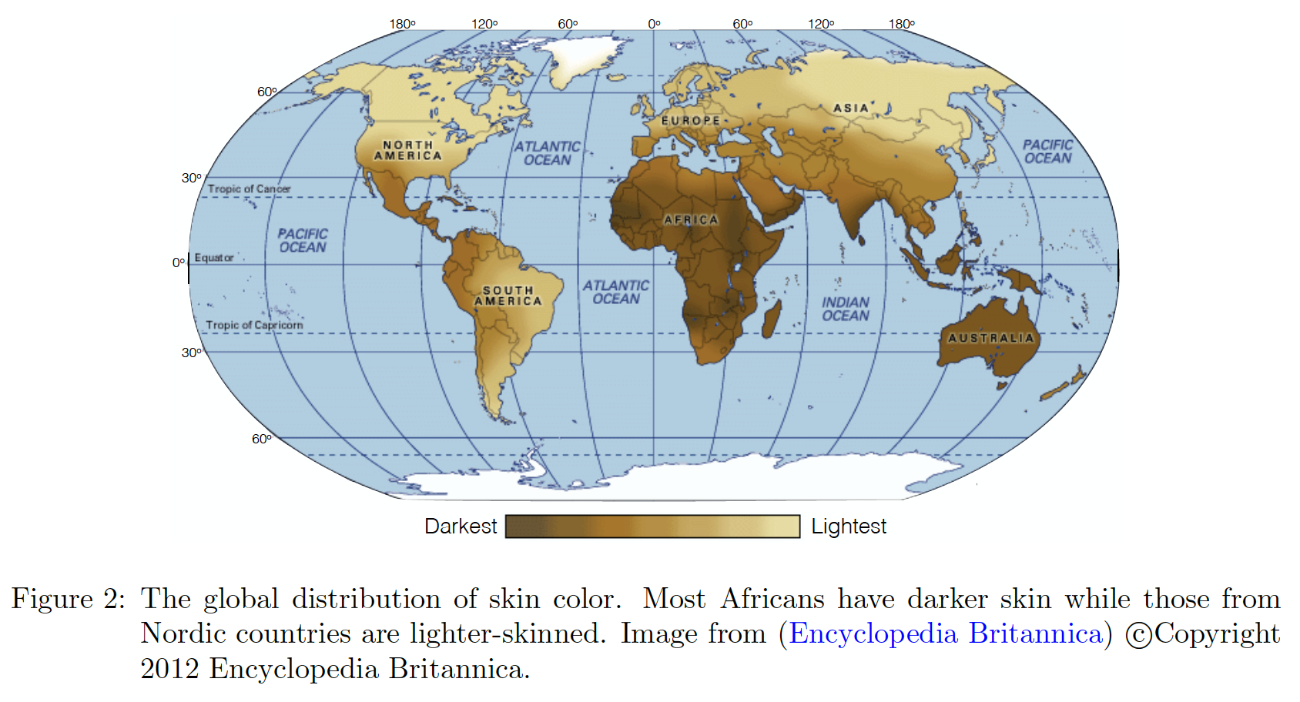
Current state of affairs
Issue with skewed results provided from different systems not provided per gender or per racial/ethnical group
Benchmark datasets highly skewed
“LFW, a dataset composed of celebrity faces which has served as a gold standard benchmark for face recognition, was estimated to be 77.5% male and 83.5% White (Han and Jain, 2014).”
Notes:
Harking back to the problematic Caucasian non-Caucasian case, one of the main issues has been that results provided from different systems have not been per gender or per racial/ethnical group.
Researchers report xx % accuracy on a data set as a whole, without mentioning how well the algorithm does on a particular ethnical group, or on females exclusively. So, when the gold standard benchmark consists of almost 80% white male faces, are you really doing facial recognition or are you doing white male recognition?
Also, since many algorithms are pretrained on data sets similar to this, it is hard to imagine them generalizing to a more diverse, real world application, where not everyone is a white male.

Slide 5
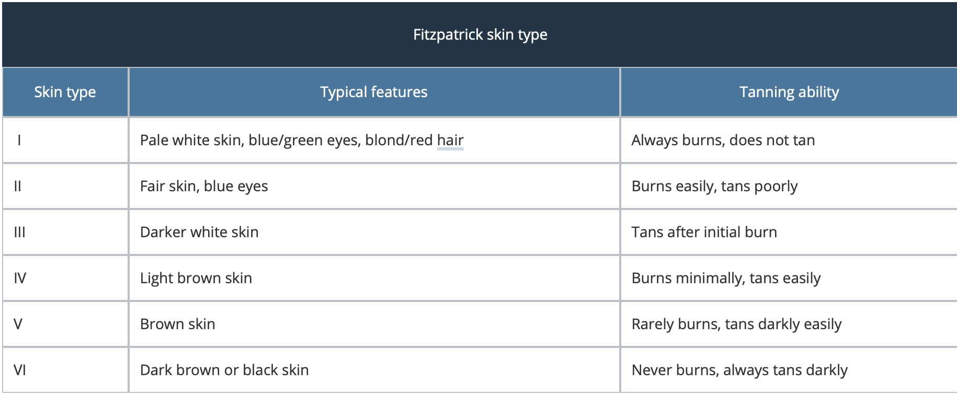
Fitzpatrick skin type
Source: Dermnet.nz
Notes:
So how do you discretise peoples ethnicity in an acceptable fashion?
There are quite a few charts describing skin types both with respect to appearance but also when it comes to ethnical origin. This scale, the Fitzpatrick skin type, is used for skin classification and determining risk of skin cancer. And since race and ethnicity can be rather unstable labels, the authors of this article opted for using skin types instead.
One can argue, as authors point out, that even this scale is biased towards lighter skin tones, since it basically has 4 different stages for what one can consider white, and 1 for black. But it is still a scientific starting point.

Slide 6
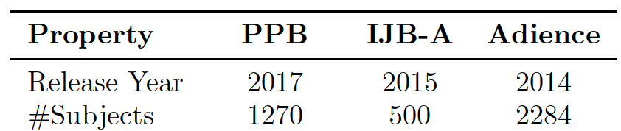
Benchmarks
Notes:
In this paper, gender division is done by separation into two classes, those perceived as male and those perceived as female, as two previous benchmarks, IJB-A and Adiance, have already used this labelling system.
All three datasets have been labelled according to Fitzpatrick skin type system, IJB-A and Adience by one of the authors, and PPB has been labelled by both authors. A dermatologist provided final labels.

Slide 7
IJB-A Adience
Released by US National Institute of Standards and Technology
The dataset consisted of 500 unique subjects who are public figures
Vary in pose and illumination
The Adience benchmark contains 2,284 unique individual subjects.
2,194 possible to be labelled by gender and skin type
Vary in pose and illumination
Notes:
A bit about the two existing datasets used in the evaluation.
*Read the slide*
*first 2 points on both*
The pictures in both of the sets vary in pose and illumination, and are both unconstrained.

Slide 8
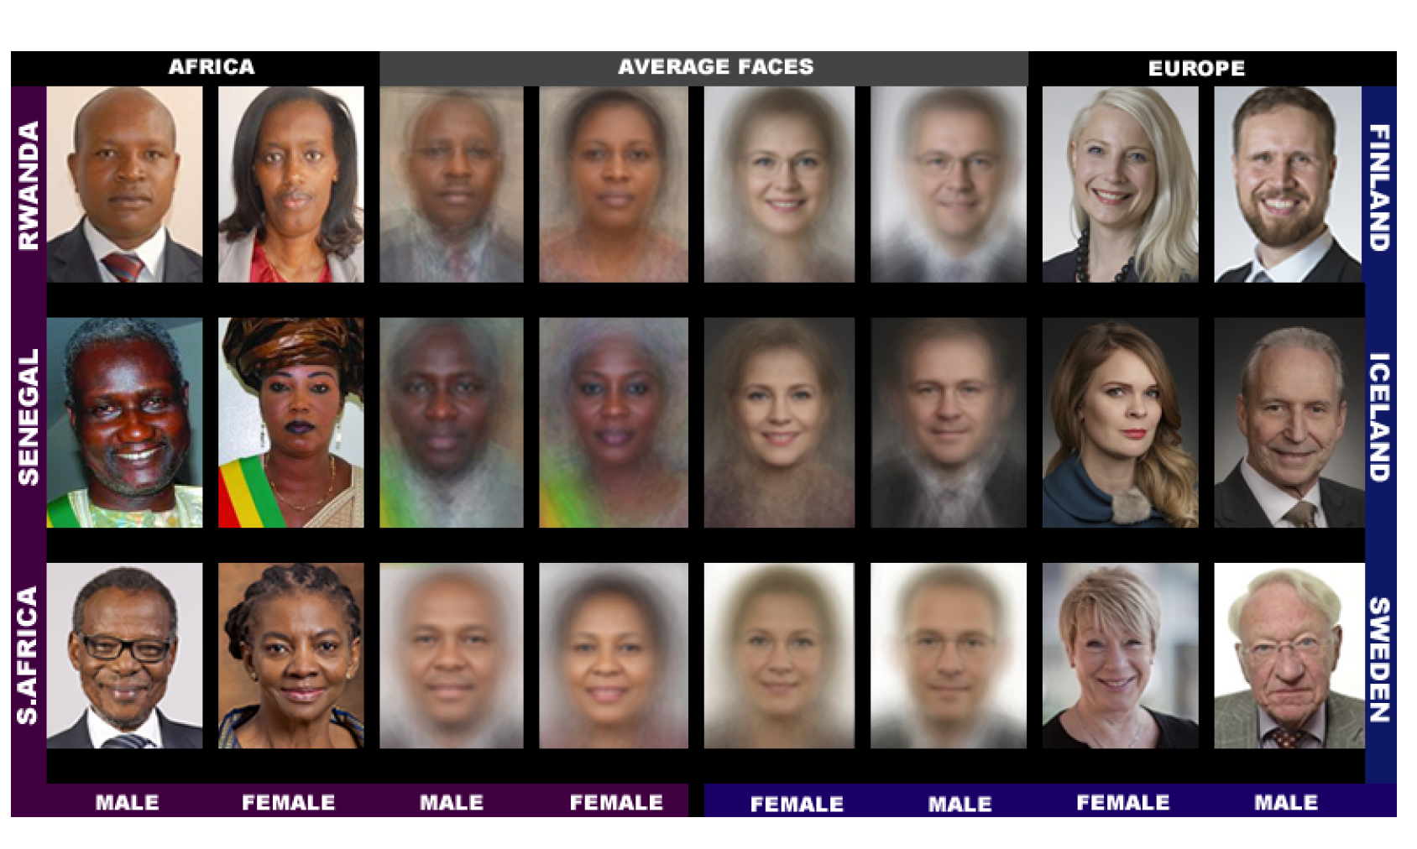
Pilot Parliaments Benchmark (PPB)
Notes:
Now, the third benchmark, the Pilot Parliament Benchmark, was made for this article, with goal to provide better intersectional representation on the basis of gender and skin type.

Slide 9
PPB
better intersectional representation on the basis of gender and skin type
Members of national parliaments
Rwanda, Senegal and South Africa
Finland, Iceland and Sweden
Constrained, fixed conditions
Notes:
The data set consists of images from national parliament members, three African and three European countries, who have been selected due to their gender parity in their respective parliaments. Rwanda is the number one in the WORLD when it comes to the proportion of female representatives. Senegal and South Africa are then next highest ranking ones. Finland, Iceland and Sweden are all among top ten when it comes to gender representation in the national parliament.
It is worth noting that the author stay critical towards their own data set and point out the lacking sides of constructing it based on parliament photos, as the photos have been taken under certain conditions, with fixed illumination and constrained poses. In addition, expressions are either neutral or smiling, which are in contrast to the previous two benchmarks.

Slide 10
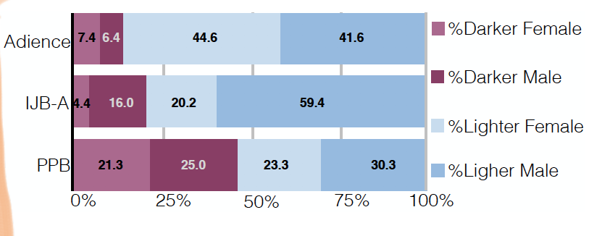
Distribution of different groups
Here light group is types I-III, and dark IV-VI.
Notes:
The authers present the distribution of dark and light coloured males and females in both their own and the two previous benchmarks, to address the obvious elephant in the room. The over-representation of lighter coloured persons in both the Adience and IJB-A datasets, as well as a general under-representation of females in IJB-A. The distribution is more even for the PPB set.

Slide 11
Commercial Gender Classification Selection
IBM
Microsoft
Face++
Goggle’s classifier was not publicly available
Notes:
The commercial software that are evaluated are the IBM, Microsoft and the Face++. Googles classifier was not publicly available at the time.
The reason Face++, a Chinese computer vision company, has been chosen is due to previous studies showing that the facial recognition systems developed in Western nations and those developed in Asian nations tend to perform better on their respective populations.

Slide 12
“None of the commercial gender classifiers chosen for this analysis reported performance metrics on existing gender estimation benchmarks in their provided documentation.”
Notes:
When choosing the commercial systems it seemed none of them have reported performance metrics on existing gender estimation benchmarks in their provided documentation.
Face++ terms of use explicitly disclaim any warranties of accuracy .
Only IBM provided confidence scores between 0 and 1 for face-based gender classification, but still no false positive or true positive rates.

Slide 13
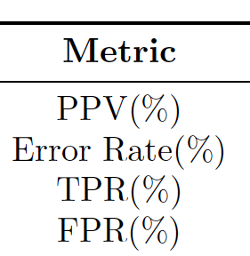
Commercial Gender ClassIfication - Evaluation Criteria
PPV– Positive predictive value
TP/(TP + FP)
Error rate – (1-PPV)
True Positive Rate – TPR
False Positive Rate - FPR
Notes:
The evaluation criteria chosen for this study are PPV- the positive predictive value, error rate which is 1-PPV, true positive rate and false positive rate.

Slide 14
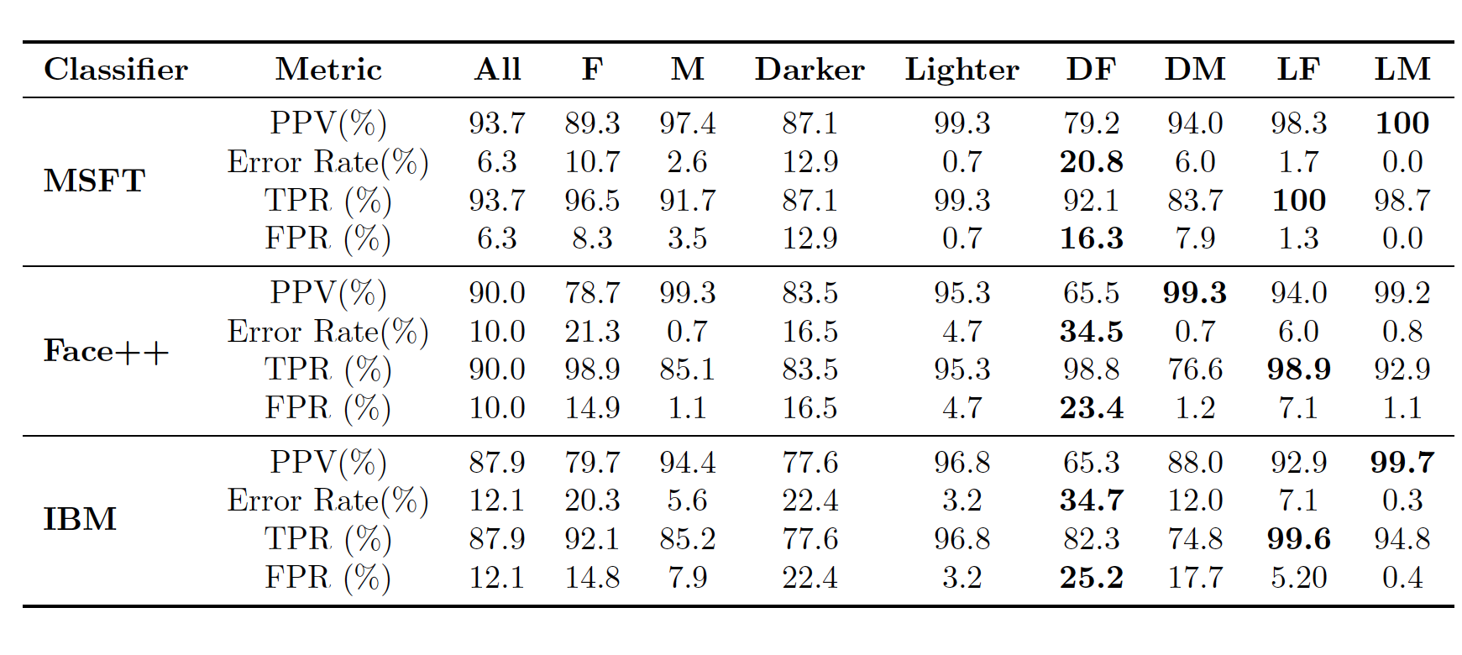
Commercial Gender Classification - Audit Results
Male and female error rates
Darker and lighter error rates
Intersectional error rates
Notes:
we see some error when it comes to classification between females and males, and looking closer at darker and lighter skinned individuals, the error increases. The false positive rate for darker skinned varies between 12.9- 22.4.
But not until we look at the intersectional error rates, namely darker females, darker males and lighter females and lighter males, that the error rates really spike up for the different groups. Namely the error rates of darker females. We see that the algorithms are mostly impeccably correct when it comes to lighter males and even lighter females.
So here we can see that an algorithm could be considered extremely successful, depending how we divide up the classification, what we choose to classify. Something to have in mind.

Slide 15
Commercial Gender Classification - Audit Results
All classifiers perform better on male faces than female faces (8.1% - 20.6% difference in error rate)
All classifiers perform better on lighter faces than darker faces (11.8% - 19.2% difference in error rate)
All classifiers perform worst on darker female faces (20.8% - 34.7% error rate)
Microsoft and IBM classifiers perform best on lighter male faces (error rates of 0.0% and 0.3% respectively)
Face++ classifiers perform best on darker male faces (0.7% error rate)
The maximum difference in error rate between the best and worst classified groups is 34.4%
Notes:
Now a concrete summary of the numbers from the table: *read the slide*
*Comment on first point*:The relatively high true positive rates for females indicate that when a face is predicted to be female the estimation
is more likely to be correct than when a face is predicted to be male.
*After all the points*: The authors point out that the presence of more darker individuals is a better explanation for error rates than a deviation in how images of parliamentarians are composed and produced. However, darker skin alone may not be fully responsible for misclassification. Instead, darker skin may be highly correlated with facial geometries or gender display norms that were less represented in the training data of the evaluated classifiers
Another thing to keep in mind is that the companies have not disclosed how the classification threshold has been picked, or what it is, hence it could be that
It has been chosen in such manner that it provides highest TPR and perhaps positive predictive value too for some groups, but this is just a speculation from our side.

Slide 16
Conclusion
Further work
do similar errors persist in other human-based computer vision tasks?
Explore intersectional error analysis of facial detection, identification and verification
Inclusive datasets
Increase transparency and accountability in artificial intelligence
Notes:
For further work, authors list research on whether similar intersectional errors persists in other human-based computer vision tasks
Further explore intersectional error analysis of facial detection, identification and verification
Produce more inclusive benchmarks
And most of all try to increase the transparency and the accountability in the artificial intelligence
I wish to also add a conclusive comment from our side, which is that It is important to be very careful when reporting overly positive results of these kind of algorithms, especially when it comes to algorithms whose clients is the government, because it is not just an arbitrary computer program anymore it is something that decides on peoples lives. Which is very scary, and cannot be accentuated enough. “ – my comment

Slide 17
“Because algorithmic fairness is based on different contextual assumptions and optimizations for accuracy, this work aimed to show why we need rigorous reporting on the performance metrics on which algorithmic fairness debates centre.”
Notes:
For the end, a concluding quote from the paper: saying

Slide 18
Thank you!

