Slide 1

DASHBOARD DESIGN
Data Analyst Internship – Task 4
Deepan Prakash | 5th June 2025

Slide 2
Objective:
Design an interactive dashboard to analyze agent performance based on call metrics and product sales.
Dataset Source:
Financial data.xlsx (contains Agent ID, Call ID, Duration, Pickup status, Products Sold)
Tool Used: Tableau Public
Key Metrics Tracked: Total Calls, Picked Calls, Pickup Rate, Avg Duration, Products Sold

Slide 3

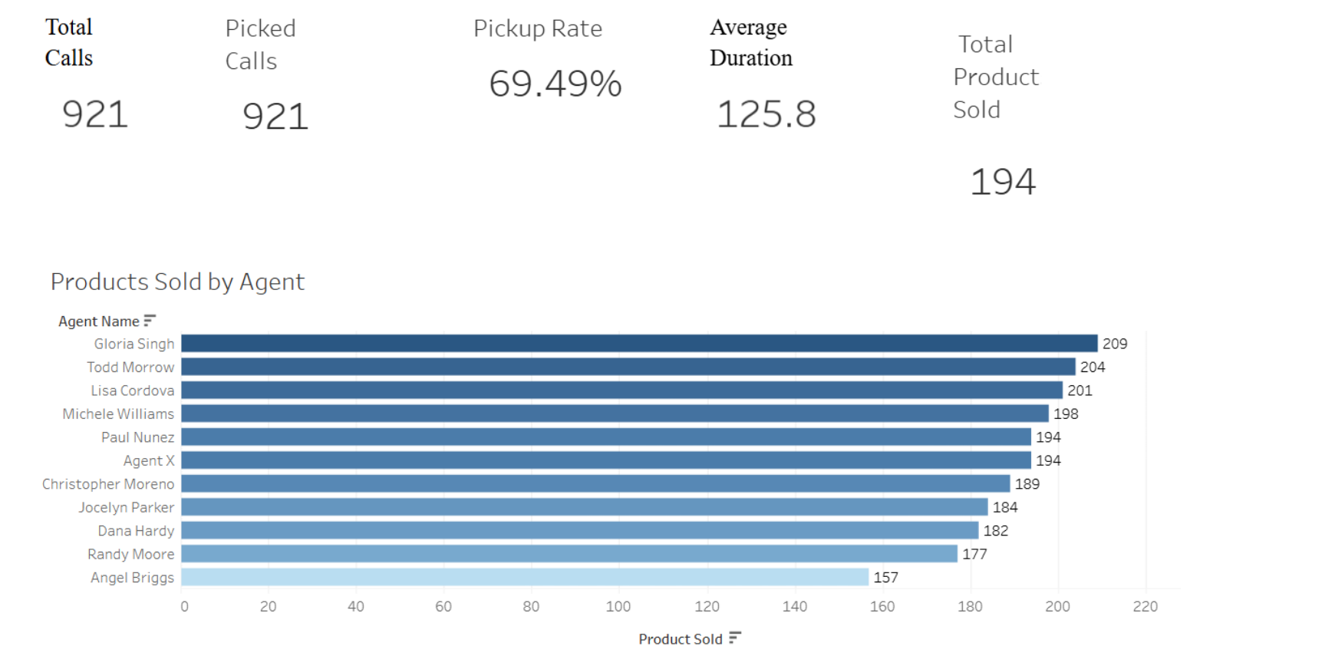
📊 KPIs and Visual Charts
KPIs Displayed:
Total Calls
Picked Calls
Pickup Rate (%)
Average Duration
Products Sold
Visuals:
Bar Chart: Products Sold by Agent
Bar Chart: Pickup Rate by Agent
Histogram: Call Duration Distribution

Slide 4
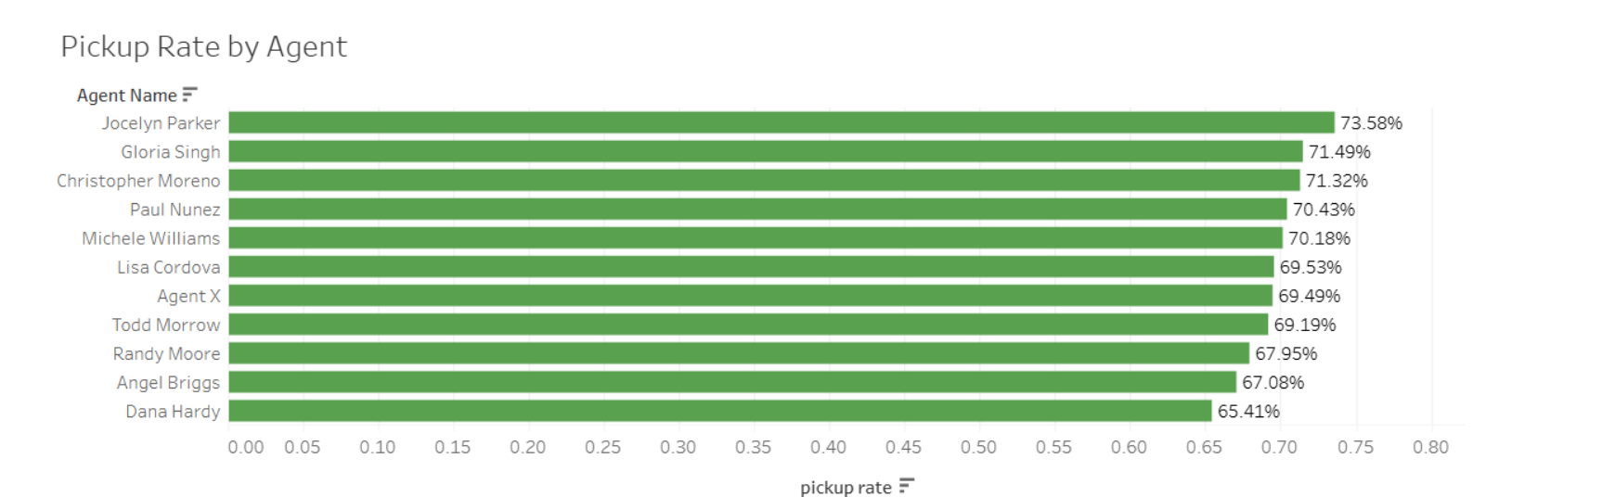

Slide 5

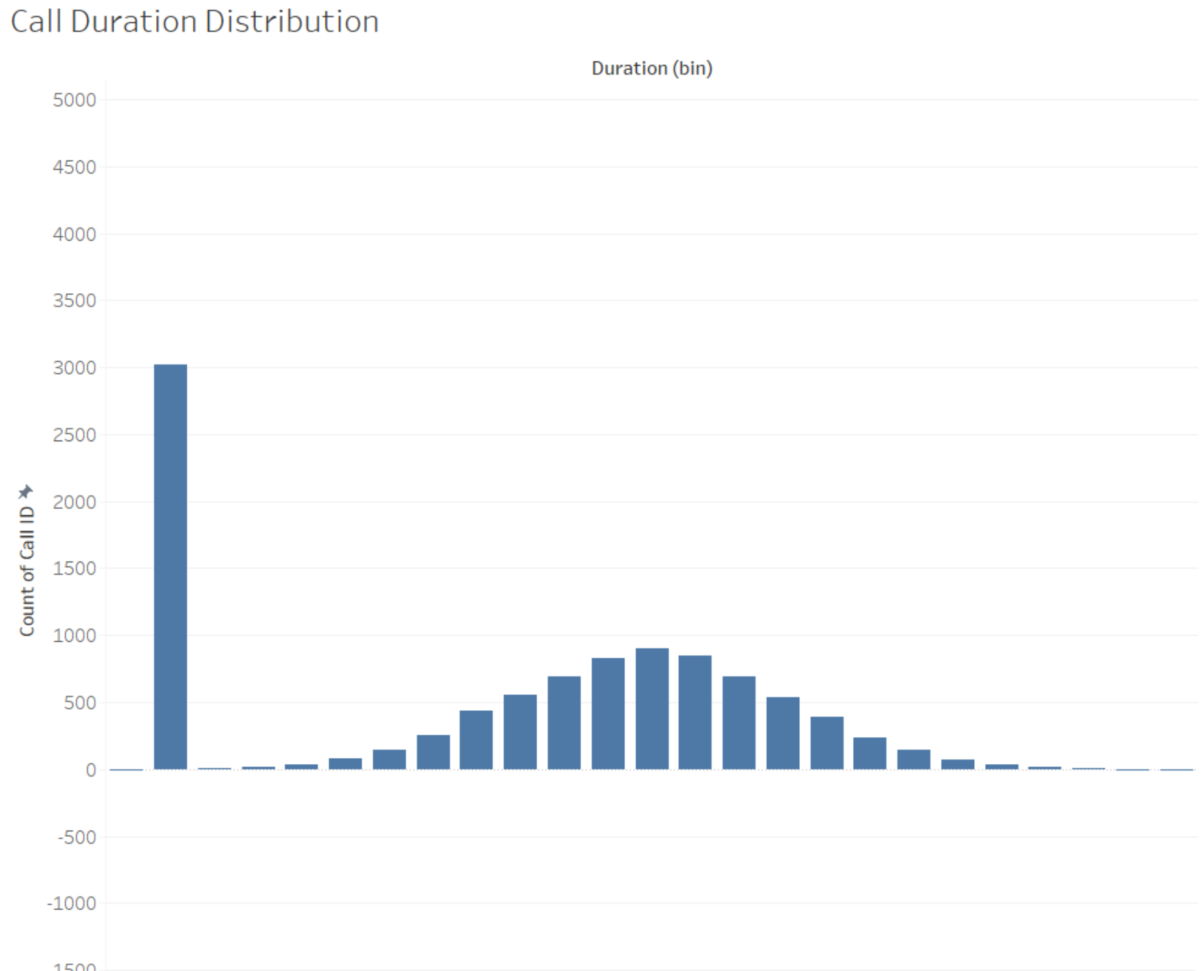

Slide 6
🔗 Dashboard Link & Submission
https://public.tableau.com/app/profile/deepan.prakash/viz/aninteractivedashboardforbusinessstakeholders/Dashboard1?publish=yes
github repo:
https://github.com/dp07-hub/Dashboard-Design
Submitted By: Deepan Prakash
Program: Data Analyst Internship

