Slide 1

Iris Flower Classification
Dev Patel (200556354)
Pawanpreet (200558464)

Slide 2
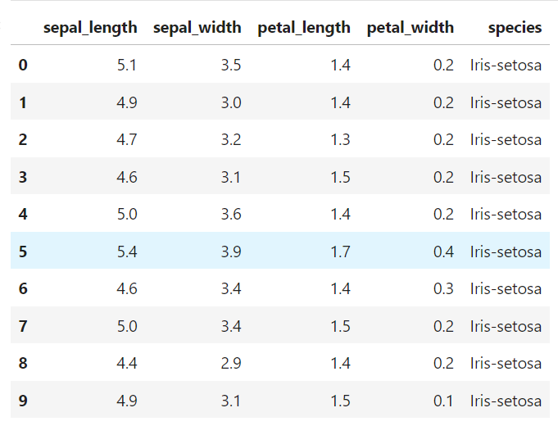
Dataset
The Iris dataset comprises measurements of four distinct features—sepal length, sepal width, petal length, and petal width
Measurements of morphological features are derived from a sample of 150 iris flowers.
Each flower is assigned to one of three distinct species: Iris-setosa, Iris-versicolor, or Iris-virginica.

Slide 3
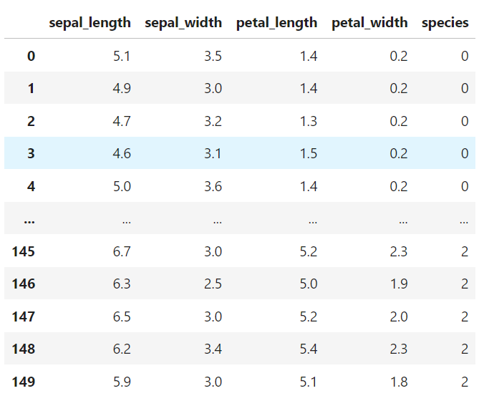
Encoding
The Label Encoder proves to be an invaluable tool, transforming categorical data into numerical formats for efficient processing by algorithms.
In our dataset preparation, we utilized this technique to convert categorical labels like Iris-setosa, Iris-versicolor, and Iris-virginica into numerical representations, optimizing our data for improved model compatibility.
Embracing Label Encoding offers numerous benefits, simplifying the integration of categorical data into machine learning models and fostering a smooth analytical process.

Slide 4
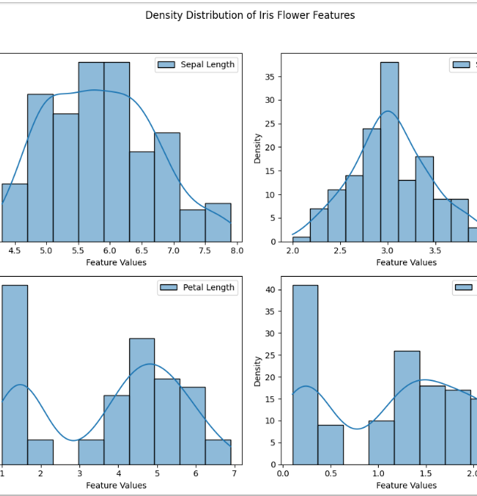
Data Exploration
In our exploration of the Iris dataset, we delved into the density distributions of features—sepal length, sepal width, petal length, and petal width.
Analyzing density distributions unveils distinct peaks, indicating certain features as potential differentiators between iris species, while insights into normality, symmetry, and identification of spikes or tails reveal outliers crucial for robust statistical analyses; the spread and concentration of values across features emphasize the importance of those with wider ranges or greater variability in distinguishing iris species.

Slide 5
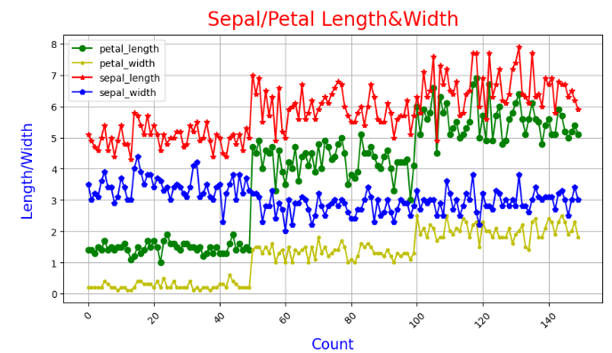
Exploration of Data
The line graph reveals a consistent pattern across all flowers, indicating that the length consistently surpasses the width for each feature. Additionally, in the case of width, both the sepal's width and length consistently exceed those of the petal. This consistent trend emphasizes the prominent distinction between the length and width aspects within each flower, underscoring the inherent morphological differences in sepal and petal dimensions.

Slide 6
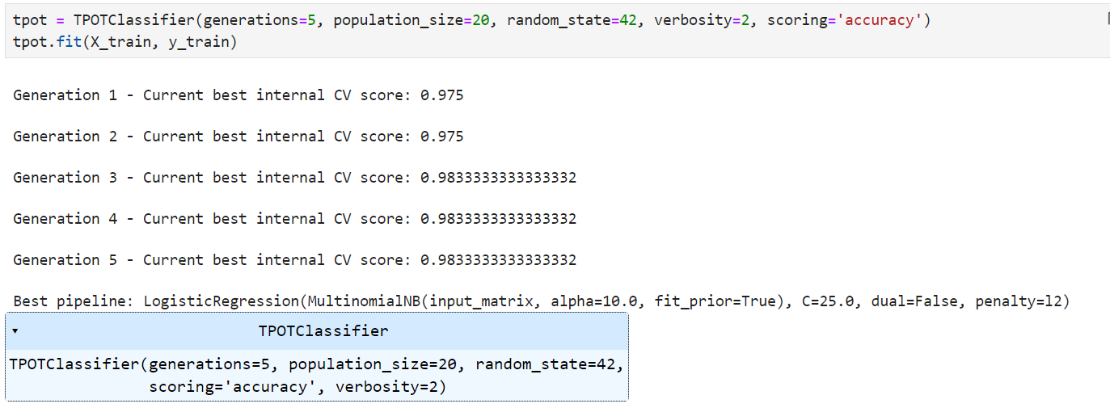
Classification
In pursuit of identifying the most effective machine learning model for iris classification, I employed TPOT, a powerful automated machine learning tool.
The optimization process spanned five generations, progressively refining model configurations. The internal cross-validation scores steadily improved across generations, reaching a peak accuracy score of 98.33% in the later stages.
The ultimately recommended pipeline, an ensemble of Multinomial Naive Bayes and Logistic Regression, showcased superior predictive performance, underlining TPOT's efficacy in automating the selection of optimal machine learning architectures for iris classification

Slide 7
Thank You…!

