Slide 1
Predicting Drive Failure
A Predictive-Maintenance System Built on Real Backblaze Drive Stats
IT Capstone Project

Slide 2
THE PROBLEM
Unplanned Drive Failure Is an Operational Cost
▪ Reactive maintenance (replace only after failure) risks data loss and unplanned downtime
▪ Blanket proactive replacement wastes budget on drives that would have run fine
▪ The real industrial answer: predict early, estimate remaining useful life, and pick a threshold suited to your own cost structure
Predicting Drive Failure — IT Capstone

Slide 3
POSITIONING
Not Just Another "Predict Drive Failure" Notebook
▪ Early-warning labeling, not same-day diagnosis
Same-day features already look like a failure — trivial and non-predictive; excluded from training
▪ Remaining useful life, not just yes/no
A Cox Proportional Hazards survival model, the standard real-world framing
▪ Per-prediction explainability
SHAP explains THIS drive's score, not just global feature importance
▪ A genuine decision-support result
The right cost threshold depends on your own cost structure — no universal answer
Predicting Drive Failure — IT Capstone

Slide 4
DATA
Real Backblaze Drive Stats, One Quarter
DRIVE MODEL
ST16000NM001G
highest-volume model with full SMART coverage
QUARTER
2026-01
2026-01-01 to 2026-03-31
REAL FAILURES
267
early-warning-positive rows
▪ A real vendor-reporting discovery during model selection: the highest-volume drive model reported ZERO values for 2 of the 7 SMART attributes this project relies on — a genuine WD/Toshiba-vs-Seagate reporting difference, confirmed while picking a model
Predicting Drive Failure — IT Capstone

Slide 5
METHODOLOGY
Classifier: RandomForest, Grouped Split
▪ RandomForestClassifier
300 trees, max depth 8, class_weight='balanced', on 7 SMART features
▪ Split grouped by drive, not by row
StratifiedGroupKFold on serial_number — no drive's rows appear on both sides of train/test
▪ Why this matters
A failing drive contributes several rows to the positive class; a naive row-level split let the same physical drive leak across train and test, inflating early metrics — caught and fixed
Predicting Drive Failure — IT Capstone

Slide 6
RESULTS
Classifier Performance (Real Held-Out Test Fold)
PRECISION
94%
failure class
RECALL
100%
failure class
F1
97%
harmonic mean
ROC-AUC
0.998
test set
▪ 230 train / 77 test drives
zero drive overlap between the two sets
Predicting Drive Failure — IT Capstone

Slide 7
STATISTICAL HONESTY
Report the Range, Not Just One Split
▪ Only ~43 real failing drives underlie every classifier metric
genuinely few for a held-out evaluation — which fold you land in matters a lot
▪ Precision stable across folds: 0.98 ± 0.02
▪ Recall unstable across folds: 0.90 ± 0.16 (range ~0.62–1.00)
depends heavily on which specific failing drives land in the test fold
▪ All 4 folds evaluated and disclosed in model/metrics.json, not just the deployed one
Predicting Drive Failure — IT Capstone

Slide 8
METHODOLOGY
Survival Analysis: Remaining Useful Life
CONCORDANCE
0.945
0.5=random, 1.0=perfect
DRIVES MODELED
34,729
FAILURE EVENTS
43
genuinely few — disclosed
▪ Cox Proportional Hazards model (lifelines, penalizer=0.1)
estimates days remaining per drive, not just a risk label
▪ Kaplan-Meier baseline
fleet-wide reference survival curve shown alongside each drive's own curve
Predicting Drive Failure — IT Capstone

Slide 9
PRODUCT
Three Dashboards, Three Audiences
▪ Fleet Overview — leadership/budget
3D rack, event feed, live-feel replay, cost-avoidance estimate
▪ Operator Lookup — technician
per-drive SHAP explanation, not just a global importance chart
▪ Optimization Lab — decision-maker
remaining useful life + 3D cost-optimized threshold surface
Predicting Drive Failure — IT Capstone

Slide 10
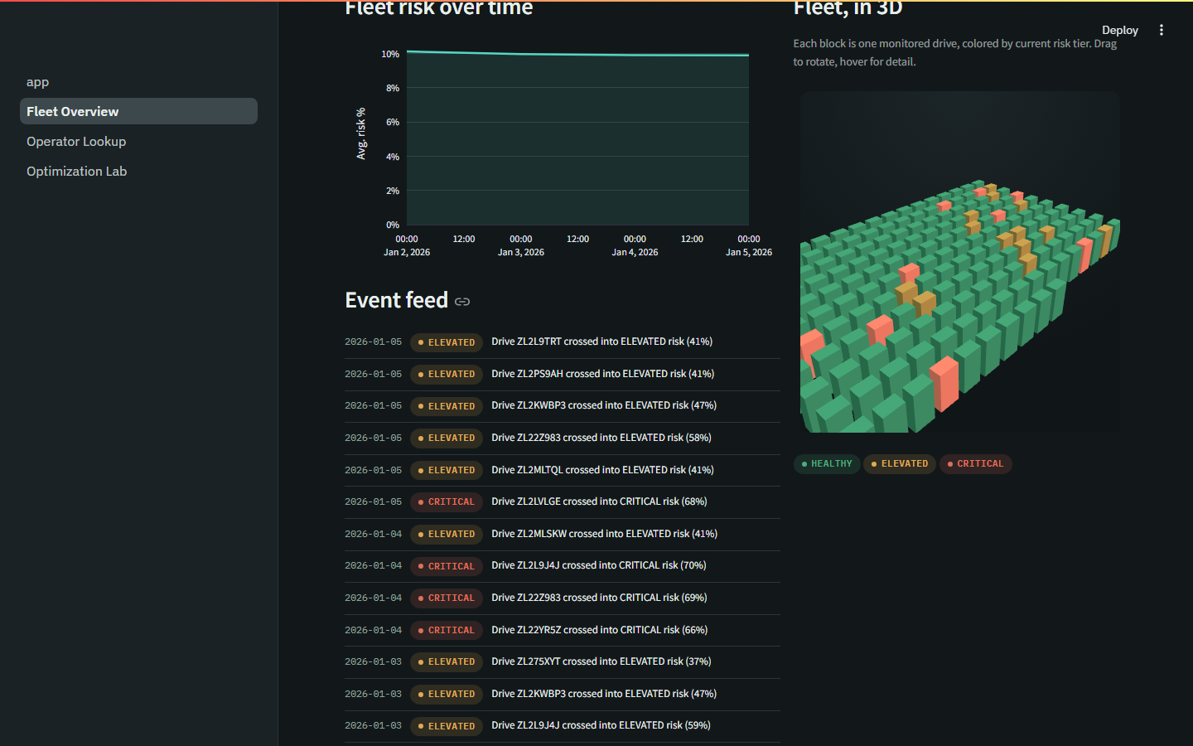
DASHBOARD
Fleet Overview
3D rack colored by risk tier, real trend line, event feed with both elevated and critical events
Predicting Drive Failure — IT Capstone

Slide 11
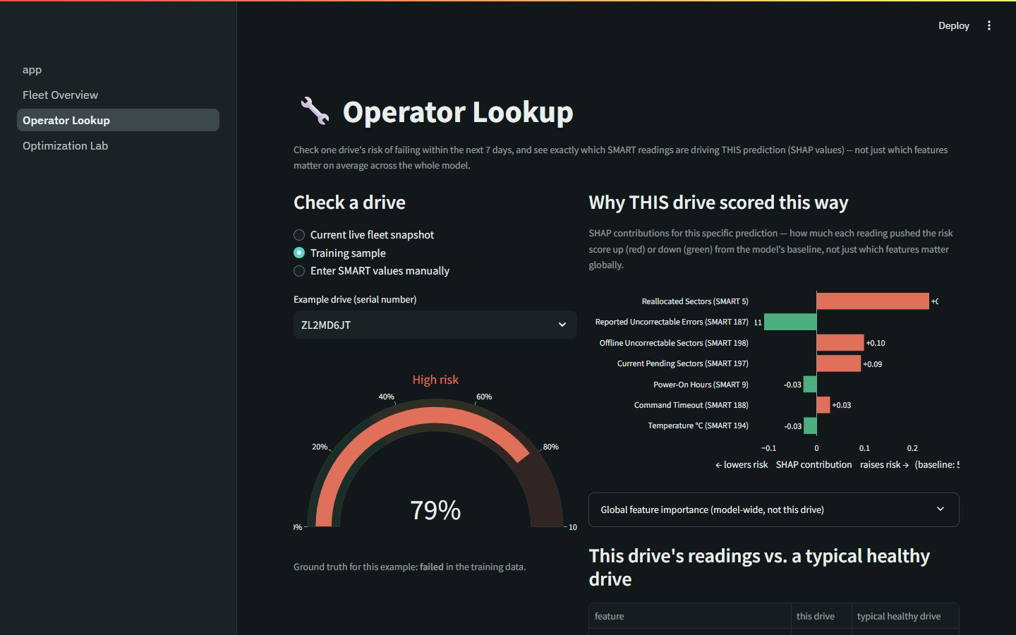
DASHBOARD
Operator Lookup
A real high-risk drive (79%) with its SHAP explanation — which readings actually drove this score
Predicting Drive Failure — IT Capstone

Slide 12
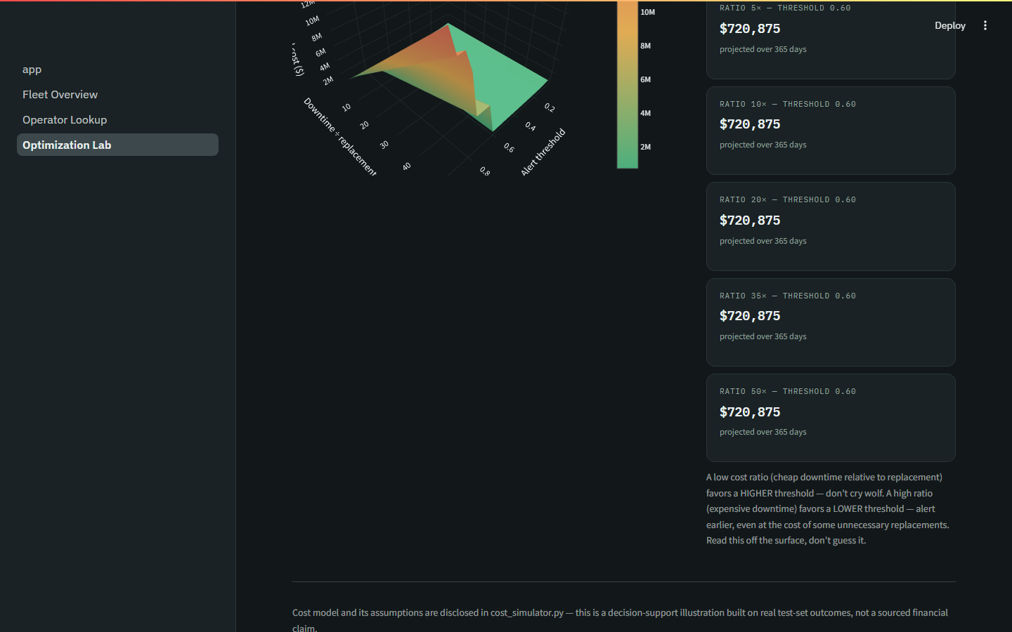
DASHBOARD
Optimization Lab
3D cost surface: the optimal alert threshold moves with the organization's cost ratio
Predicting Drive Failure — IT Capstone

Slide 13
AUTOMATION
Two-Tier Alerting, One Layer Genuinely Unattended
▪ ⚠️ Early warning
fires the moment a drive crosses into ELEVATED risk — real lead time
▪ 🚨 Critical
fires when a drive crosses into CRITICAL risk — act now
▪ In-browser alert
instant, while someone is actively using Fleet Overview
▪ Scheduled GitHub Actions check
runs hourly, independent of the app or anyone watching — free and unlimited on a public repo, the genuinely unattended piece
Predicting Drive Failure — IT Capstone

Slide 14
HONESTY
Known Limitations
▪ Rare-event target (~1.36% real annual failure rate) — report precision/recall/F1, not accuracy
▪ Only ~43 real failing drives — cross-fold range reported, not a single flattering split
▪ One vendor's fleet — a demonstrated method, not a drop-in production tool
▪ “Live” is a labeled replay of real historical data, not a live sensor feed
▪ Cost-avoidance figures are adjustable planning assumptions, not sourced statistics
▪ Static, last-observed covariates in the survival model, not full time-varying history
Predicting Drive Failure — IT Capstone

Slide 15
ROADMAP
Future Work
▪ Validate the Cox proportional-hazards assumption
▪ Calibration curve / Brier score for predicted probabilities
▪ Extend GitHub Actions automation to periodic model retraining
▪ Data drift detection between training and live data
▪ A pytest test suite and CI workflow
Predicting Drive Failure — IT Capstone

Slide 16
Thank You
Questions?
https://hdd-failure-predictor.onrender.com
https://github.com/dp2426-NAU/hdd-failure-predictor

