Slide 1
Prompt Crash-Test Lab
LLM Robustness Benchmark Framework
CS 599 Contemporary Developments
Applications of Large Language Models

Slide 2
Motivation: Background
Large Language Models (LLMs) power critical applications
Medical diagnosis, legal analysis, financial decisions
Challenge: Output inconsistency from minor prompt changes
Same question, different phrasing = different answers
Formatting variations cause unpredictable behavior
Impact on business and users:
Loss of trust in AI systems
Compliance and regulatory risks
Increased operational costs

Slide 3
Motivation: The Critical Gap
Current state of LLM testing:
No standardized robustness benchmarks
Manual testing is time-consuming and incomplete
Limited understanding of failure patterns
Industry needs:
Systematic approach to measure reliability
Automated testing frameworks
Data-driven model selection criteria
This project addresses the gap between LLM capabilities and production-grade reliability requirements

Slide 4
Project Objectives and Goals
Primary Objectives:
1. Develop reproducible robustness benchmark
Standardized test suite for LLM consistency evaluation
2. Automate prompt variant generation and testing
Systematic exploration of prompt space
3. Identify and categorize failure patterns
Understand what causes inconsistent outputs
4. Establish best practices for robust prompting
Actionable guidelines for practitioners
5. Enable data-driven model selection
Quantitative comparison across LLM providers

Slide 5
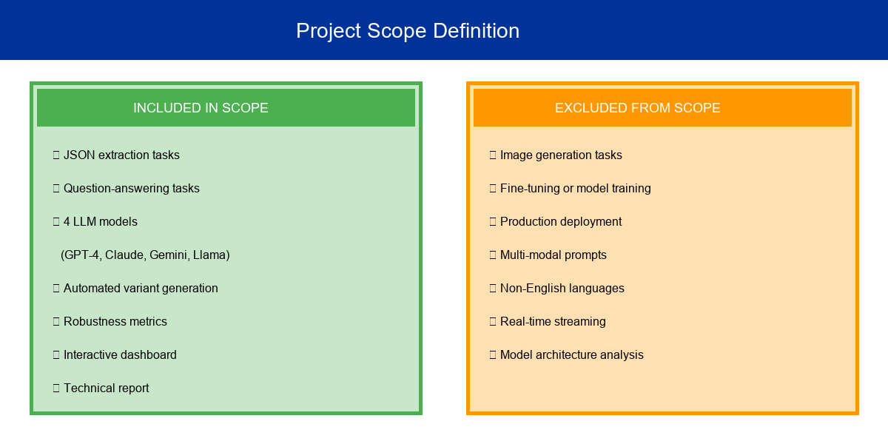
Project Scope
Clear boundaries for focused execution within timeline and budget

Slide 6
Tools, Techniques, and Frameworks
Core Technologies
Programming Language: Python 3.11+
LLM Framework: LangChain for orchestration
Semantic Analysis: sentence-transformers
Storage: SQLite for caching and reproducibility
LLMs and Infrastructure
Model APIs: OpenAI (GPT-4), Anthropic (Claude 3.5)
Google (Gemini 1.5 Pro), Together AI (Llama 3.1 70B)
Visualization: Streamlit dashboard
Development: Git version control, Jupyter notebooks

Slide 7
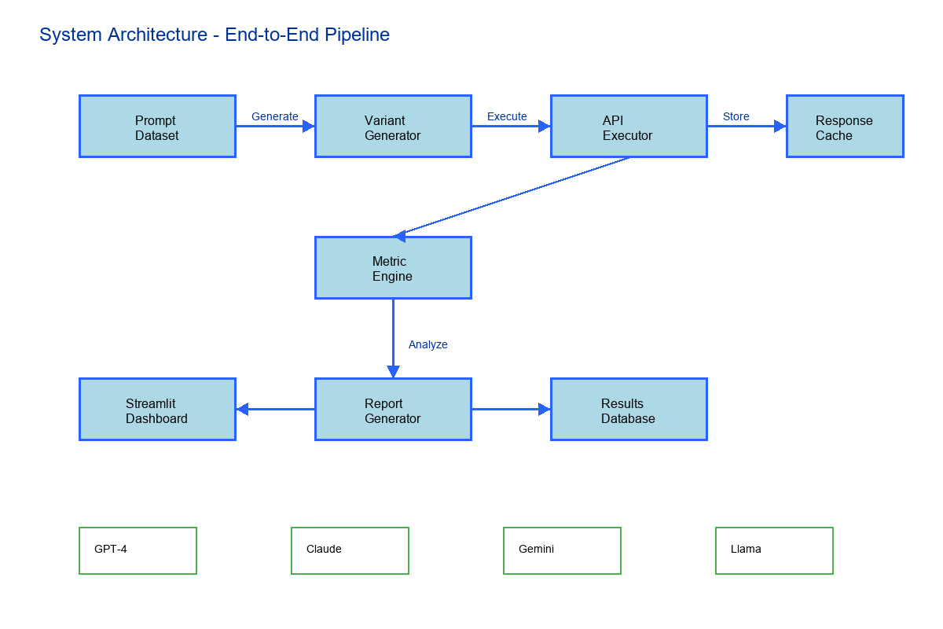
System Architecture
End-to-end pipeline from variant generation to reporting

Slide 8
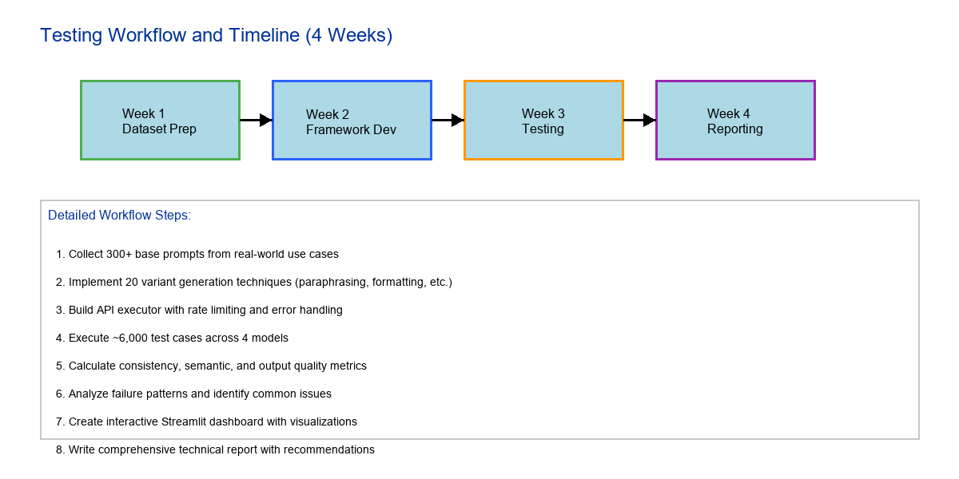
Testing Workflow and Timeline

Slide 9
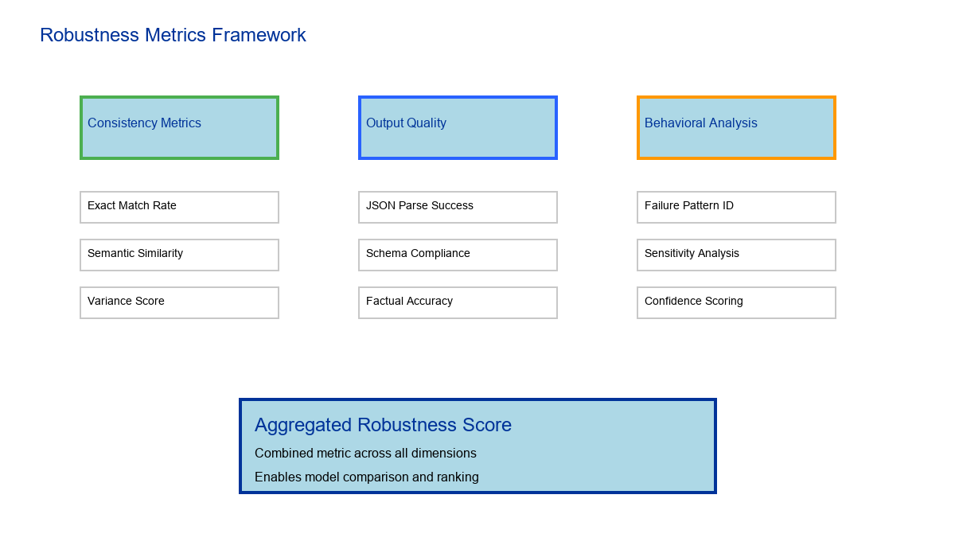
Robustness Metrics Framework
Comprehensive evaluation across multiple dimensions

Slide 10
Expected Outcomes and Deliverables
Deliverables:
1. Benchmark Dataset: 300+ prompts, 6,000 test cases
2. Testing Framework: Python package with automation
3. Interactive Dashboard: Streamlit visualization
4. Technical Report: Comprehensive findings and best practices
Timeline: 4 weeks total with weekly milestones
Budget: Estimated $50 for API usage fees
Optimized with caching and free tier utilization

Slide 11
Key Milestones and Phases
Phase 1: Dataset Preparation (Week 1)
Collect and curate base prompts
Implement variant generation logic
Phase 2: Framework Development (Week 2)
Build API executor with rate limiting
Implement metric calculation engine
Phase 3: Testing and Evaluation (Week 3)
Execute full test suite across 4 models
Collect and analyze results
Phase 4: Reporting and Visualization (Week 4)
Develop Streamlit dashboard
Write technical report with recommendations

Slide 12
Team Structure and Communication
Team Composition:
Clear role definition and responsibilities
Communication Plan:
Daily: Slack for quick updates and questions
Weekly: 30-minute sync meeting for progress review
Documentation: Shared Google Drive for artifacts
Collaboration Tools:
GitHub for code repository and version control
Notion for project planning and task tracking
Google Colab for shared experimentation
Risk Management:
API rate limits: Implement exponential backoff
Budget overrun: Leverage free tiers and caching

Slide 13
Discussion
Key questions for discussion:
Q: Why focus on JSON extraction and Q&A tasks?
A: Structured output and factual accuracy are production priorities
Q: Why these four specific models?
A: Balanced commercial vs open-source comparison
Q: How do you ensure reproducibility?
A: Fixed random seeds, comprehensive caching, version control
Q: What if API costs exceed budget?
A: Free tier utilization, aggressive caching, phased execution
Q: How will success be measured?
A: Variance metrics, benchmark completion, actionable insights

Slide 14
Thank You! Any Questions???

