Slide 1
Linux Update Manager
Devon Peel

Slide 2
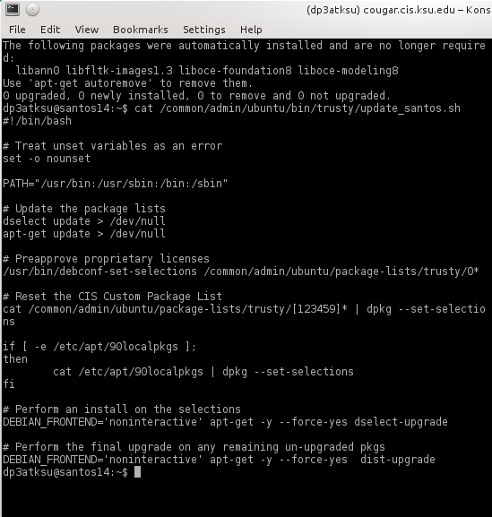
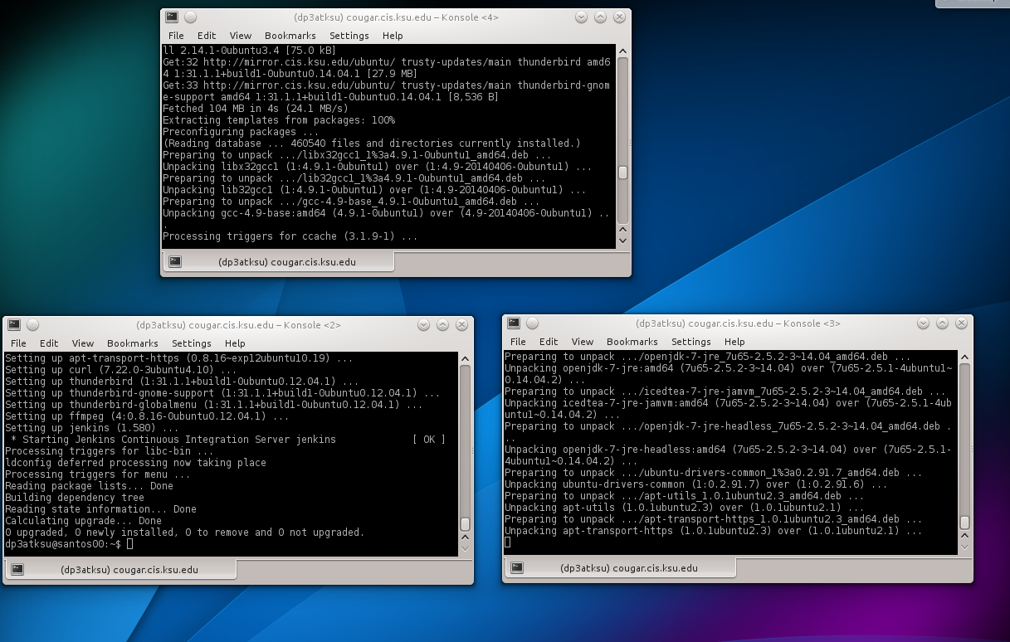
Current Set Up

Slide 3
Terms
KVM - Kernel Virtual Machine
Configuration Management - Cfengine, Puppet
Package Manager - Apt-get, Yum, Ports

Slide 4
Apache
Print Server
AD Mirror
DNS
DHCP
KVM/Ganeti

Slide 5
Goals
Allow Administrator to verify certain updates, and ignore others
Warn the Administrator of necessary daemon restarts and system restarts
Integrate with configuration manager, Puppet, Chef, Cfengine
Alert administrator that update failed and automatically reinstall the working version

Slide 6




Tools
Vim
Cfengine
Python
Bash
Apt-get

