Slide 1
Linux Update Manager
Devon Peel

Slide 2
In Process of Developing
Web layout
Controller backend of discovering updates and permitting the updates

Slide 3
To Do
Ldap login
Database to keep track of updates install history
Rollback install failed updates

Slide 4
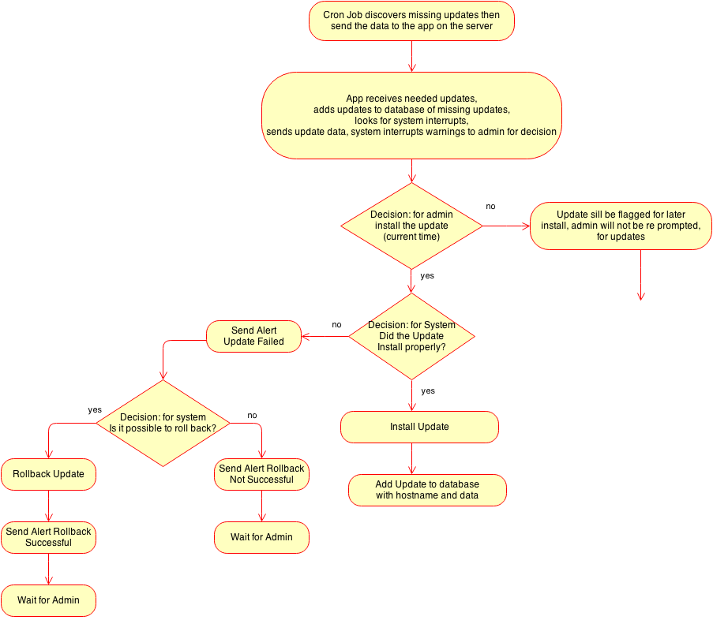

Slide 7
