Slide 1
Cosine Similarity based TopoMap
Angle dependent Data Reduction Algorithm
Devarsh Patel (dp3324) : 5th May, 2022

Slide 2
Modifications
Cosine Similarity and Tree based hull alignment
Uses Cosine Similarity Matrix instead of conventional Euclidian Distance Matrix.
Implements tree based hull alignment method (custom) instead of Convex Hull Alignment.
Encompasses the contact point in the component with linear placement along the y-axis.

Slide 3
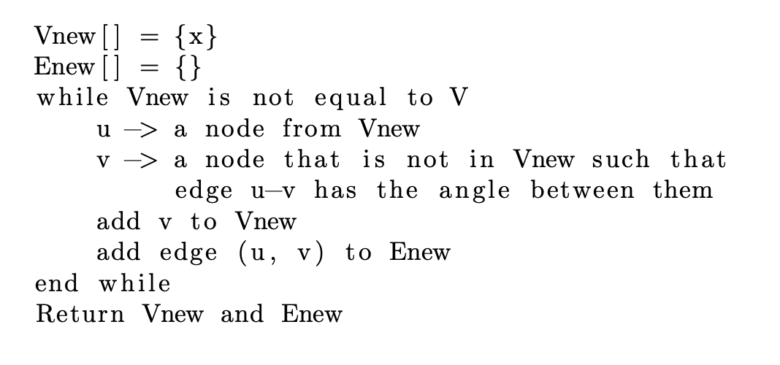
Spanning Tree Algorithm
Based on Cosine Similarity

Slide 4
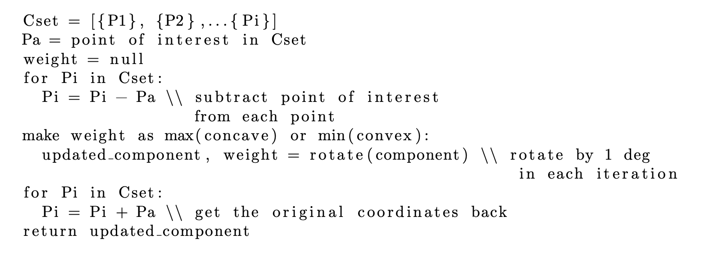
Hull Alignment Algorithm
Uses Custom tree-based Algorithm

Slide 5
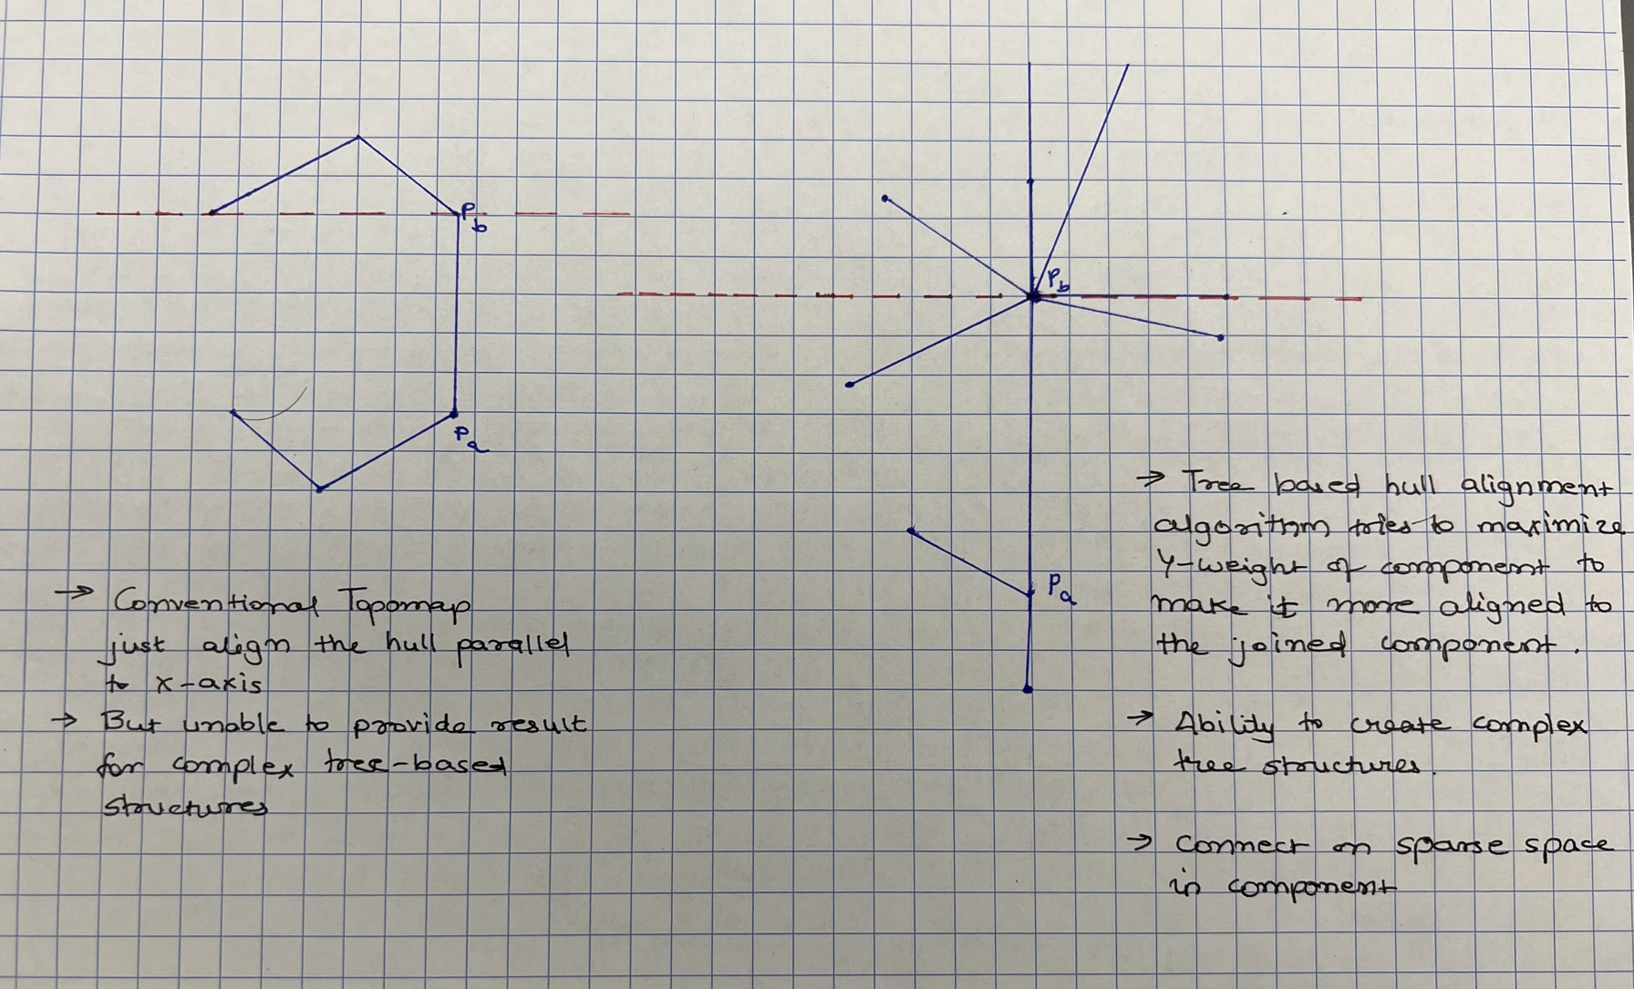
Hull Alignment Algorithm
Comparison

Slide 6
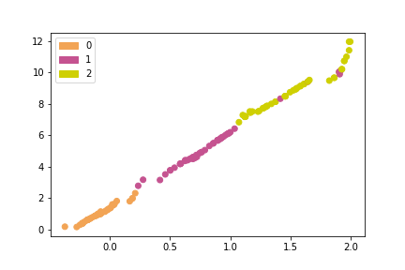
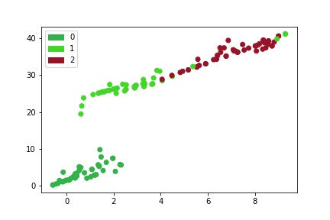
Result Comparison (Iris)
Comparison between Euclidian and Cosine Similarity
Euclidian Distance Matrix based Result
Cosine Similarity Matrix based Result

Slide 7
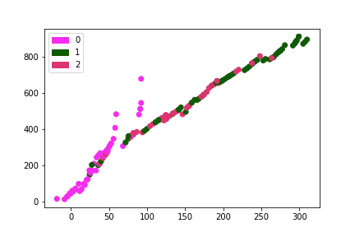
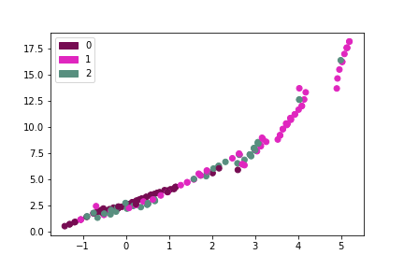
Result Comparison (Wine)
Comparison between Euclidian and Cosine Similarity
Euclidian Distance Matrix based Result
Cosine Similarity Matrix based Result

Slide 8
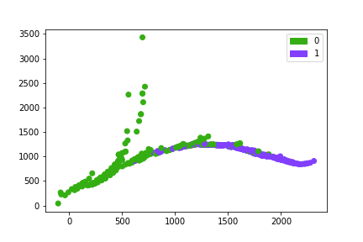
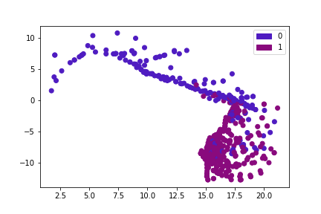
Result Comparison (Breast Cancer)
Comparison between Euclidian and Cosine Similarity
Euclidian Distance Matrix based Result
Cosine Similarity Matrix based Result

Slide 9
Conclusion
Based on Results
TopoMap using Cosine Similarity was able to preserve the relation between points more clearly than euclidian distance matrixes.
The hull alignment algorithm was clearly able to provide the relation of a points with its complete cluster.
More clear separation between the points and their respective clusters.
Increase time efficiency with increase computation complexity and minimized computation processing time.

